Slide 1
Property law and practice
Lara Hopkinson
Senior Lecturer

Slide 2
Topic for this week
Latent Defects Insurance
  Definition of latent defect insurance
  Brief history
  Application of LDI
  Advantages and disadvantages
  Comparison to collateral warranties
  Case study example

Slide 3
Questions for you
Are you already aware of Latent Defects Insurance?
What are your personal experiences (if any)?
What do you think this relates to?

Slide 4
Definition
“Provides cover for the cost of rectifying or repairing structural damage cased by a fault in the design, construction or materials of a new build, conversion or completed build project that may not be apparent at the time of practical completion”
Isurv, 2006
Typically for a 10-12 year period post completion

Slide 5
Brief history
First proposed in 1988
Construction Industry Sector Group of the National Economic Development Council
  Building Users’ Insurance Against Latent Defects (BUILD)
Protect for 10 years
Non-cancellable material damage policy
Initially limited to structure, weather shield, envelope
Taken by developer but transferable

Slide 6
How defects can arise
Design errors
Poor workmanship (in accordance with good practice)
Wrong or poor quality materials

Slide 7
Examples of common latent defects
Defective basement tanking allowing water penetration.
Inadequate wind-posts or wall ties causing movement damage to walls.
Under-strength concrete or misplaced reinforcement allowing movement damage to the structure.
Inadequate foundations causing subsidence of the building.
Source: Designing Buildings Wiki

Slide 8
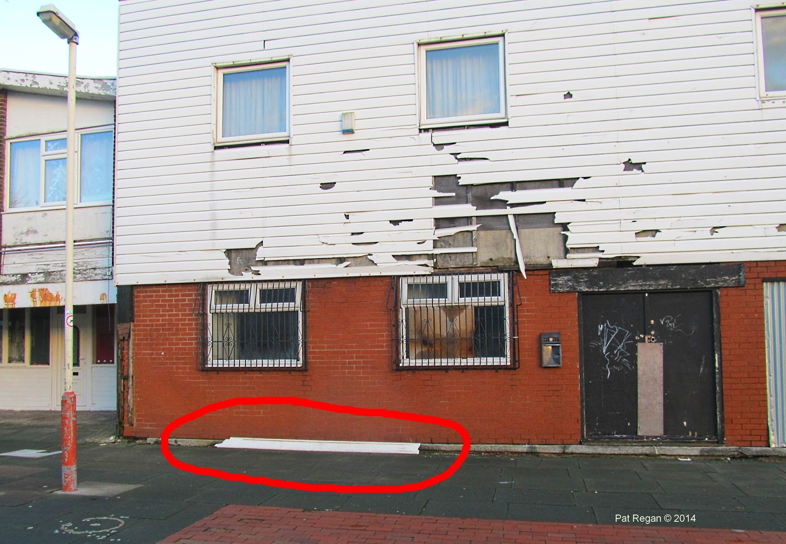
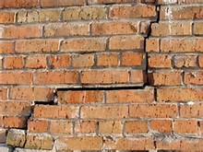
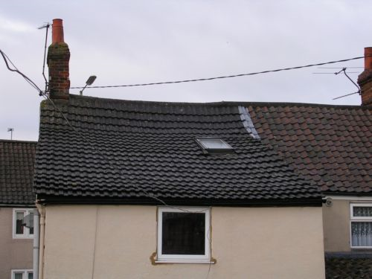

Slide 9
Application
Generally taken out at the start of a project
Will not need to be renewed
Normally by the developer (transferable)
Covers any party with an interest in a project
Basic cover structure & weatherproofing
  Can extend to M&E services, loss of rent
Compulsory in some EU countries (e.g. France)
Largely for new build; can be purchased for completed buildings in some cases

Slide 10
Structural parts
Foundations, columns, beams
External walls & cladding
External doors & windows
Stairs & floors
Roof structures
Other external & internal load bearing elements

Slide 11
Weatherproofing & waterproofing cover
Weatherproofing will normally cover:
  Roof coverings
  Skylights
  External walls & cladding
  External windows & doors
  Ground floor slab
Waterproofing will normally cover:
  Elements that prevent entry of water below ground level

Slide 12
Exclusions
Non structural parts:
  Generally NOT included in cover
  Can be provided for M&E services OR for damage from defects in non-structural parts (limited)
Also:
  Work outstanding at practical completion
  Alternative use of the property
  Inherent defects discovered during defects liability / maintenance period
  Wear & tear / general deterioration

Slide 13
Advantages
No need to prove negligence
Protects against developer / contractor insolvency
Allows for easier future sale
Cover is freely assignable
No restrictions of number of assignments
Cuts out time delays & costs of legal proceedings
Enables repairs to be carried out immediately
Can be amended to suit specific requirements

Slide 14
Disadvantages
Adds to construction costs (1-3%)
Defects not resulting in physical damage are not covered
Often total exclusion for consequential / economic losses
Policy limited to maximum sum insured
Claims will be subject to an excess
Penalise for under-insurance
Available largely for new build

Slide 15
Technical auditor
Technical audits required as part of cover
Monitors progress during design & construction phases for insurer
Report to insurer
Aim: to ensure project adheres to building standards
Can identify issues early
Therefore resolve these quickly without excessive cost

Slide 16
Replacement for Collateral Warranties?

Slide 17
LDI vs Collateral Warranties
Contract which includes third parties not necessarily in the main project contract
Provides for duty of care to a third party involved within the project
E.g. an architect owing a duty of care to the occupier of a new office development should a defect arise
  Right to recover damages from the professional responsible

Slide 18
Drawbacks of collateral warranties
Contain limitations / exclusions of liability
Proof of breach of obligations needed
One project could have large number of documents
Insolvency = lack of ability to claim
Are LDI policies therefore better?

Slide 19
Case study
Contractor suing a piling specialist for major defects on a wine warehouse in South West England
Warehouse built in 2008, 860,000 sq ft facility
March 2009 – cracks identified in concrete floor slab
January 2010 – differences in floor level of 48mm
Investigation found that number of piles had not been driven deep enough
~120 weeks to undertake significant remedial work
Contractors spend to investigate ~£2m
Occupier may need to relocate from warehouse
Costs for rectifying could be more than £40m
http://www.pi-propertyinsurance.co.uk/NewsDetails.aspx?hid=6&nid=111

Slide 20
Useful information
Lexology (www.lexology.com)
Designing Buildings Wiki (www.designingbuildings.co.uk)
Building Magazine online (www.building.co.uk)
Out-Law (www.out-law.com)
Isurv (www.isurv.com)

Slide 21
NHBC warranties
Lara Hopkinson

Slide 22
Aims
Background
Details on Buildmark
  Relating to the first 2 years
  Relating to years 3 onwards
Minimum claim values
Shared ownership schemes
Extra requirements for Building Regulations
Extra requirements for contamination
Limits of payments
CML Certificate

Slide 23
Are you already aware of Buildmark?
If so, what do you know?
What are your personal experiences?

Slide 24
Background
Buildmark – 10-yr warranty for new dwellings / commercial premises
Around 80% of new homes built are covered
NHBC also provide building control services
Builders & developers must adhere to NHBC technical standards as well as building regulations
NHBC inspectors will visit building works at key stages to check compliance
  Foundations, drainage, superstructure, pre-plaster, pre-handover

Slide 25
Buildmark
Split into 2 parts:
  First 2 years
  Year 3 – 10
Pre-completion insolvency cover
Build standards
Resolution service

Slide 26
During the first 2 years
Builder warranty & NHBC guarantee
Builder is responsible for correcting any damage
  Within a reasonable time at their own expense
  Cover any relevant costs for removal, storage or alternative accommodation
The builder is NOT liable for:
  Wear & tear, neglect, failure to maintain
  Damp, condensation & shrinkage
  Storms, severe weather conditions, flooding
  Fire & smoke
  Anything done to the home after completion date

Slide 27
Years 3 onwards
NHBC provide insurance to cover costs of rectifying physical damage:
  Foundations, walls, external cladding, curtain walling, external render & external vertical tile hanging, roofs, ceilings, balconies, load-bearing parts of floors, flues, chimneys and access steps to the main structure
  Staircases, floor decking and screeds inside the main structure
  Retaining walls (if necessary)
  Double- or triple-glazing panes for outside windows & doors
  Below-ground drainage

Slide 28
Minimum claim values
Up to 2 years:
  No excess or minimum claim value
3 years and over:
  Minimum claim value rather than excess
  Policy will pay if costs are over the minimum value
  Minimum values depend on year of build

Slide 29
Shared ownership schemes
Buildmark Choice
  Cover is similar for standard domestic properties
  I.e. first 2 years – builder / contractor responsible for fixing damage that occurs
  Years 3 onwards – insurance to put right physical damage in specified parts
  Can be for 10 or 12 years
  Excess may be payable on this part of the policy

Slide 30
Extra insurance for Building Regulations
Covers the following aspects of Building Regulations:
  Part A – Structure
  Part B – Fire safety
  Part C – Site preparation & resistance to contaminants & moisture
  Part J – Combustion appliances & fuel storage systems
  Part K – Protection from falling, collision & impact
  Part N – Glazing (Wales only)

Slide 31
Extra insurance for contamination
Protects if a statutory notice is received / could be issued due to condition of the land
NHBC will take responsibility for:
  Work to treat, isolate or remove contamination
  Prevents the issue of a statutory notice
  Or will provide payment
  Will also cover costs of removal, storage & alternative accommodation

Slide 32
Limits of payments

Slide 33
In comparison:
CML certificate
Council of Mortgage Lenders (CML) Professional Consultant’s Certificate
Not an insurance policy
Provides cover for the professional in relation to certification
Applies where builders are not registered under a scheme OR it is considered unsuitable by a warranty provider
The owner can recover costs for defects, consequential losses, damages (personal injury & to 3rd party property)

Slide 34
Useful information
NHBC (www.nhbc.co.uk)
Find Law (www.findlaw.co.uk)
Construction Industry Council (www.cic.org.uk)

