Slide 1

MSc Public Health and Social Care in Practice
Quality Assurance and Service Improvements
LCHS7006
Quality Assurance and Patient Safety Failures in the Lucy Letby Case: Leadership, Governance and Organisational Change
Student Name: Adnankhan Firojkhan Sindhi
Student ID:2528923
Notes:
Good morning everyone, and thank you for attending my presentation. I will now examine the root cause analysis of the case of Lucy Letby at the Countess of Chester Hospital within a systems based approach to safety. So I will include a discussion of some of the important models, discuss some policy issues that led to the failures, discuss how these failed to influence healthcare service delivery, and provide a brief summary of the text that follows.

Slide 2
Introduction
01
02
The case highlighted significant issues of clinical governance, leadership, quality assurance, and patient safety.
Warnings issued by clinicians regarding deaths and collapses among babies were ignored.
03
04
Poor communication, escalation, staffing, and whistleblowing procedures raised threats to the safety of infants.
This presentation reviews the causative factors, policies, leadership, and improvement strategies in healthcare.
Notes:
The Letby case led to significant clinical governance, leadership and quality assurance failings at Countess of Chester Hospital. In 2015-16, concerns relating to deaths and collapses in the neonatal unit were not acted upon quickly enough and were repeatedly raised by senior clinicians. It illustrates the negative effects of poor incident reporting, poor escalation processes, inadequate staffing, and a poor whistle-blowing culture on patient safety. This presentation reviews the underlying causes, policy failures and leadership problems. It assesses suitable change-management and quality-improvement models to reinforce accountability, staff preparedness and more secure health care provision.

Slide 3

Case Background
Unusual neonatal deaths and collapses occurred between June 2015 and June 2016.
Senior clinicians raised concerns, yet hospital leaders delayed police involvement and external investigation.
Letby received convictions for seven murders and seven attempted murders by July 2024.
The Inquiry examined governance, staff conduct, hospital responses, and NHS safety arrangements (Lawrence, Conn, 2024).
Notes:
Unusual deaths and collapses had occurred with babies in the neonatal unit at Countess of Chester Hospital from June 2015 to June 2016. Senior clinicians voiced concerns about Lucy Letby, but hospital leaders delayed any action to involve the police and make an effective investigation by an outside party. Letby was convicted of killing seven babies and trying to kill six in August 2023, and was added with a seventh attempted-murder conviction in July 2024. The public hearings of the Thirlwall Inquiry started on 10 September 2024 and concluded with oral evidence in March 2025. It looked at how the hospital responded, clinical governance, staff behaviour and broader arrangements for safety in the NHS (Lawrence and Conn, 2024).

Slide 4
Outline the problem
The neonatal unit failed to recognise, escalate, and respond systematically to patient-safety concerns.
Consultants identified unusual events, but investigation and safeguarding escalation remained significantly delayed.
NHS England demanded stronger oversight, speaking-up systems, and responsive organisational cultures (NHS England, 2023).
The Inquiry examines leadership, governance, culture, and responses affecting baby protection (Thirlwall Inquiry, 2026).
Notes:
The main issue identified was that patient safety issues were not recognised, escalated and responded to systemically in the neonatal unit. There were concerns from consultants about unusual deaths and collapses; however, these were deferred until further investigation and escalation was carried out. The Thirlwall Inquiry is looking at the impact of the Trust's leadership, governance, culture and response to concerns from clinicians on the protection of babies (Thirlwall Inquiry, 2026). NHS England then highlighted the need for better board oversight, robust speaking up systems and culture where staff concerns are listened to and addressed (NHS England, 2023). These failures led to reduced accountability, organisational learning and prompt risk control, highlighting how ineffective governance creates opportunities for threats to patient safety to persist.

Slide 5
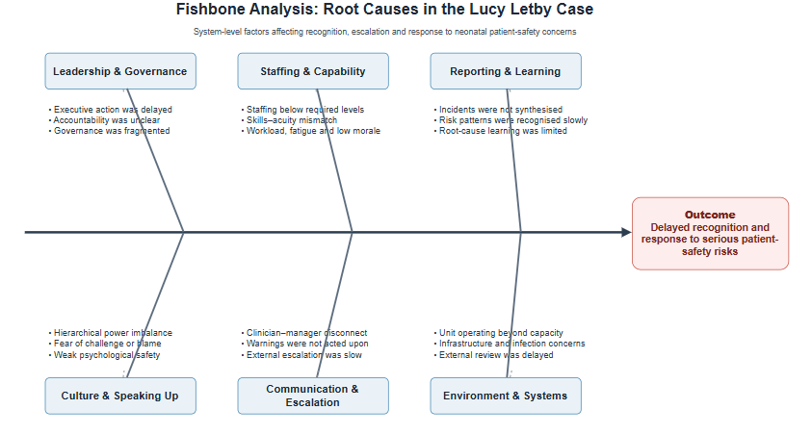
Outline the root causes of the problem
1
Fishbone analysis groups failures across leadership, staffing, reporting, culture, communication, and systems.
2
Interconnected organisational weaknesses prevented timely recognition, escalation, investigation, and effective organisational learning.
3
Nursing numbers remained one-fifth below required standards, weakening care capacity (Lawrence and Conn, 2024).
4
Power hierarchies and weak psychological safety discouraged staff from challenging decisions (Capper et al., 2024).
Notes:
The Fishbone Diagram highlights the major organisational causes of the inadequate response to patient-safety concerns. It classifies the causes into five categories: leadership and governance, staffing, reporting, workplace culture and communication and wider system pressures. The diagram depicts that the problem is not a single failure, but a series of interconnected failures, which enabled healthcare leaders to focus on what areas to improve, including accountability, escalation, staffing and the learning system.
Organisational, as opposed to individual, failures have been identified through root cause analysis. Leadership acted too slowly in responding to the consultants' concerns, and there was no clear accountability and governance for escalation and for external scrutiny. The neonatal unit had not reached its full capacity, was under-resourced and was not as highly trained as required, with the number of nurses being one-fifth lower than the minimum (Lawrence and Conn, 2024). Staffing levels may have reduced the effectiveness of the surveillance, communication and consistent care. Shortages, burnout and retention challenges are also threats to safe neonatal care found by Chant et al. (2024). Deaths and collapses were not related to an urgent risk pattern through incident-reporting and review. Furthermore, Capper et al. (2024) demonstrate that a hierarchy of power, fear and psychological safety may suppress the calling out of concerns and lead to them not being addressed sufficiently.

Slide 6
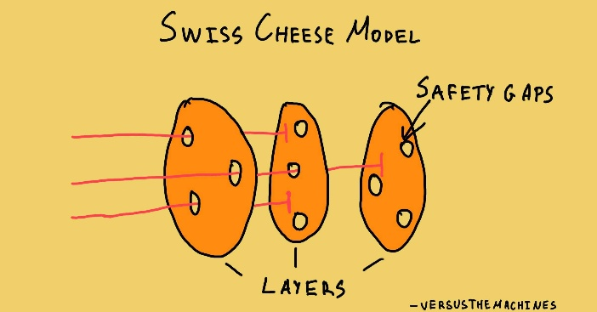
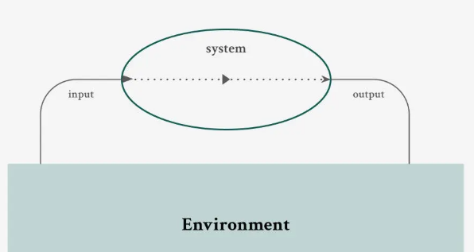
Application of Relevant Theories
The Swiss Cheese Model explains harm through aligned weaknesses across multiple protective layers.
Reporting, oversight, staffing, escalation, and speaking-up failures collectively removed vital organisational safeguards (Wiegmann et al., 2022).
Systems Theory examines interactions among clinicians, managers, resources, governance processes, and regulators.
Systems analysis supports sustainable improvement while preserving individual accountability (Weaver et al., 2021).
Notes:
The Swiss Cheese Model and Systems Theory can offer complementary explanations of the Lucy Letby case. The Swiss Cheese Model suggests that harm can only happen when there are gaps in several protective layers. A lack of reporting of incidents, leadership oversight, staffing, escalation and speaking-up procedures all stripped away safeguards. The model, however, may be reducing the complexity of the causal relationships, as it does not represent the dynamic relationship between people and processes. Thus, Wiegmann et al. (2022) would caution against applying it superficially.
The Systems Theory offers a more holistic organisational analysis, with a focus on interaction between clinicians, managers, governance processes, resources and regulators. It shifts the focus away from any individual wrongdoing and towards factors that could have influenced the decision to dismiss warnings. In states of individual fault-finding, systems-based investigations lead to more sustainable improvements, as argued by Weaver et al. (2021). However, the accountability of individuals should not be watered down in a system, and effective reform will demand redesigned protection and clearly defined accountability.

Slide 7
Policy and Governance Issues
The case revealed inadequate policy implementation rather than a complete absence of regulation (Care Quality Commission, 2025).
Duty of Candour and Freedom to Speak Up arrangements were insufficiently applied.
PSIRF promotes proportionate investigation, systems learning, and staff-family involvement (NHS England, 2022).
Speaking-up policies require psychological safety and credible leadership responses (Delpino, Lees-Deutsch, and Solanki, 2023).
Notes:
This case uncovered a policy–practice gap, not a lack of legislation. There was a lack of openness in the Duty of Candour following serious harm and an absence of arrangements for Freedom to Speak Up (FTSU) which could have facilitated raising concerns by clinicians. Policies were ineffective as leaders failed to take action on warnings to investigate (where needed), safeguarding (where needed) and challenge the situation at board level (Care Quality Commission, 2025). The Patient Safety Incident Response Framework, published by NHS England (2022), strongly advocates for systems-based learning, the investigation of incidents proportionately and engaging families and staff. However, reporting can have little value if there is a culture of non-challenge within the organisation. Similarly, Delpino, Lees-Deutsch, and Solanki (2023) propose that speaking-up mechanisms need to be accompanied by psychological safety and leadership actions that are credible.

Slide 8
Impact on Service Delivery
Delayed escalation compromised neonatal safety, care quality, and parental confidence in hospital governance.
Weak speaking-up cultures reduce monitoring, staff wellbeing, and service capacity (Seo et al., 2024).
Repeated incidents increased investigation, litigation, workforce disruption, reputational damage, and recovery costs (Kim et al., 2023).
Governance failures threatened equity because vulnerable babies required consistent safeguards across services.
Notes:
These failures impacted delivery of services in terms of quality, efficiency and equity. Parents were less confident in clinicians and hospital governance, and preventable risk was left unabated through delayed escalation, compromising neonatal safety. The negative speaking up culture also impacts situation monitoring and care quality, as well as stress, staff burnout, and turnover, which limits capacity (Seo et al., 2024; Kim et al., 2023). Inefficient situations grew as a result of repeated incidents, investigations, litigation, disruption of the workforce, and reputational recovery. Equity was put under pressure as vulnerable babies relied on regular protection, and the evidence suggests that neonatal care can differ according to ethnicity and deprivation; therefore, governance is key to this protection.

Slide 9
Leadership Strategies for Change
Transformational leadership should rebuild trust, establish safety priorities, and empower clinical challenge.
Safety improvements require inspirational leadership combined with clear accountability (Ystaas et al., 2023).
Distributed leadership broadens responsibility, but unclear ownership may delay action (Carstensen et al., 2024).
Transactional leadership should define escalation standards, audit duties, and consequences for ignored warnings.
Notes:
Transformational leadership should set up a vision for patient safety, restore some trust and enable clinicians to challenge unsafe decisions. There are links between this style and an improvement in safety culture and nursing safety practices, but with no accountability, there is no inspiration (Ystaas et al., 2023; Hamdan et al., 2024). But transactional leadership needs to be complemented by transactional escalation standards, audit responsibilities and consequences of not following warning escalations. A just culture approach requires that we differentiate between human error, risky behaviours and reckless conduct, and promote reporting while not absolving accountability. The consultants, nurses, safety specialists and non-executive directors must have joint responsibility for raising concerns, both clinically and in a distributed way. This decreases the reliance on senior leaders, but the allocation of responsibilities cannot be lost and distributed leadership can otherwise result in a loss of ownership and delay of action (Carstensen, Kjeldsen and Nielsen, 2024).

Slide 10
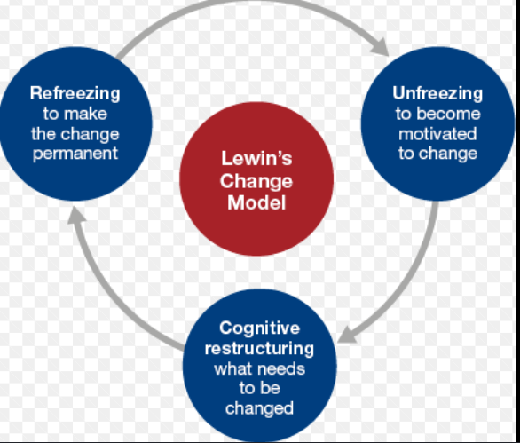
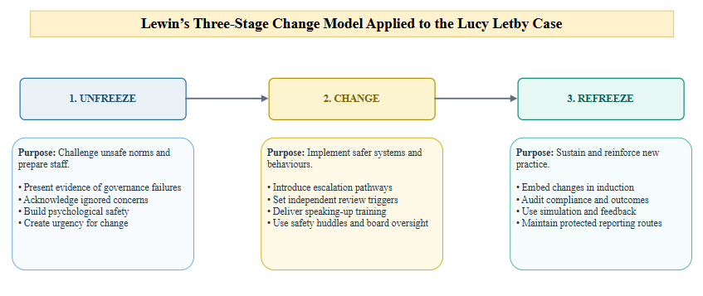
Workforce Preparation for Change
Lewin’s unfreezing stage exposes governance failures and challenges deeply normalised organisational silence.
The change stage introduces escalation pathways, independent reviews, training, and multidisciplinary safety huddles.
Refreezing embeds improvements through audits, induction, simulation, feedback, and protected reporting routes (Silvola et al., 2024).
Sustainable redesign requires participation, communication, training, and continuing evaluation (Adelman-Mullally et al., 2023).
Notes:
According to Lewin's model, the workforce would be prepared for the changes that were to come in three phases. In unfreezing, leaders need to demonstrate evidence of governance failures, show staff that concerns have been ignored and provide a safe space for them to question decisions. This creates a sense of urgency and breaks the silence. Change — The Trust should implement escalation plans, independent review triggers, speaking up training, safety huddles and board accountability. If change is to be imposed, participation is a key element – if hierarchy is to be reproduced. Practices should be introduced during refreezing activities using audits, induction, practising in a simulation environment and protected reporting and feedback. While Lewin provides clarity, change in healthcare is not a stable process, so refreezing should not be a rigid process, but rather an ongoing one. Stakeholder participation, communication, training and review are highlighted as factors for successful, transformative healthcare redesign that is sustainable (Silvola et al., 2024; Adelman-Mullally et al., 2023).

Slide 11
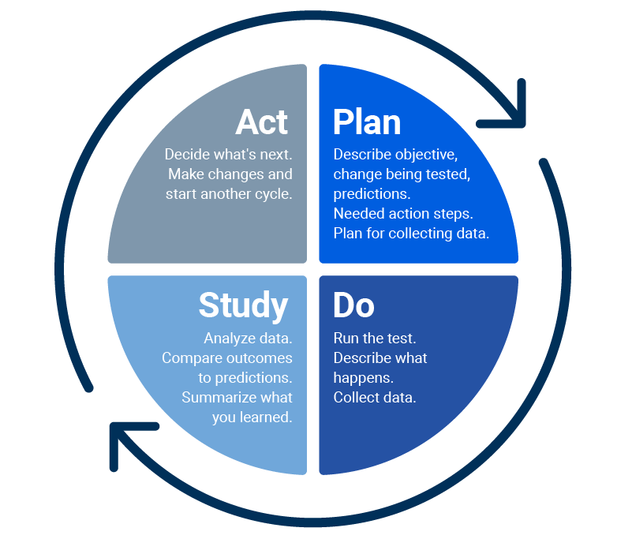
Change Framework: PDSA
1
A controlled, evidence-based testing system by the Plan–Do–Study–Act (PDSA) framework would enhance the safety of newborns (Abuzied et al., 2023).
3
Doing pilots revised procedures within one neonatal team, supported by training and huddles.
5
Acting standardises successful changes and repeats cycles for weaker interventions (Endalamaw et al., 2024).
Leaders would refer to baseline data in Study, check staff and family feedback and look for any unintended consequences (NHS England, 2023). Studying compares baseline outcomes, staff feedback, family experiences, and potential unintended consequences.
2
Planning defines escalation criteria, independent review triggers, responsibilities, and measurable safety indicators.
4
Notes:
A controlled, evidence-based testing system by the Plan–Do–Study–Act (PDSA) framework would enhance the safety of newborns. In Plan, the Trust will review and refresh escalation criteria, identify escalation triggers, and review measures including response time, incident-report completion and staff speaking up confidence (Abuzied et al., 2023). In Do, the updated process would be to work with one neonatal team for piloting, with training and huddles for safety. Leaders would refer to baseline data in Study, check staff and family feedback and look for any unintended consequences (NHS England, 2023). In Act, the successful changes would be 'improved, standardised and replicated' throughout the Trust and the ineffective ones would be taken through another 'cycle'. Rapid learning and Staff participation are important with PDSA, but measures may be poorly defined, or the cycle may be incomplete and result in superficial improvements. Good governance and access to trustworthy data and repeated testing are hence crucial (Endalamaw et al., 2024).

Slide 12
Strengths and Weaknesses of PDSA
01
02
03
04
PDSA enables small-scale testing, rapid learning, frontline participation, and systematic evidence-based refinement.
Its iterative approach reduces risks before wider implementation across complex healthcare services.
Incomplete cycles and weak documentation reduce improvement quality (Manandi et al., 2023).
Reliable data, leadership accountability, protected staff time, and repeated evaluation remain essential (Barr and Brannan, 2024).
Notes:
The key strength of PDSA is that it is an iterative process that enables teams to test small changes, learn rapidly, and make adjustments to interventions before implementing them more broadly. It also fosters frontline engagement and ties decisions for improvement to tangible evidence. But all of the above is only effective if each step is carefully executed. When teams were under time constraints, lacked skills or documented their PDSA steps inconsistently, the quality of PDSA was different, according to Manandi et al. (2023). Oversimplification and under-resourced scientific processes, combined with poor leadership, also can lead to a lack of scientific rigour, warn Barr and Brannan (2024). In this instance, PDSA may be used to enhance neonatal escalation procedures – but only if there's reliable data, executive accountability, protected staff time, repeated cycles and evaluation.

Slide 13
Potential Barriers and Responses
01
02
Barriers include resistance, blame fears, hierarchy, workload, inadequate training, and weak follow-through.
Kotter’s first phase creates urgency, acknowledges failures, and develops a guiding coalition (George et al., 2026).
04
03
The final phase sustains change through audits, monitoring, induction, and board oversight.
The second phase enables staff through training, safety huddles, and protected speaking-up channels.
Notes:
The potential barriers and responses for each of the four categories are shown below: Staff resistance, fear of blame, hierarchical decision-making, lack of psychological safety, workload pressure and training and weak leadership follow-through are some of the potential barriers. Kotter's three big steps outline the process leaders can follow to prepare for change: communicate the patient-safety threat, recognise failures, and establish a guiding coalition (George et al., 2026). Second, they should engage and enable staff to speak up through dedicated speaking-up mechanisms, training, multi-disciplinary safety huddles and well-defined escalation processes. Thirdly, they need to put in place and maintain change, track reporting times, audit compliance, report early success and incorporate new practices into induction, appraisals and board oversight. This will help minimise resistance and increase accountability.

Slide 14
Report Structure and Conclusion
Component Two introduces the case, quality-assurance problem, and wider healthcare governance context.
It analyses root causes, leadership weaknesses, policy failures, and resulting service-delivery consequences.
Kotter-based recommendations strengthen governance, speaking-up culture, accountability, and neonatal patient safety.
The report applies systems theories and PDSA, evaluating strengths, limitations, and barriers.
Notes:
Component 2 will start with an introduction to the Lucy Letby case and the quality-assurance problem. It will then examine the underlying causes, pertinent leadership shortcomings and policy matters impacting service delivery. The report will include theories of systems and the PDSA model, assess strengths and weaknesses, and discuss barriers to change. It will end with recommendations based on Kotter's findings on how to enhance governance, speaking-up culture, accountability and neonatal patient safety.

Slide 15
References
Abuzied, Y., Alshammary, S.A., Alhalahlah, T. and Somduth, S., 2023. Using FOCUS-PDSA quality improvement methodology model in healthcare: process and outcomes. Global Journal on Quality and Safety in Healthcare, 6(2), pp.70-72. https://pmc.ncbi.nlm.nih.gov/articles/PMC10275632/pdf/i2589-9449-6-2-70.pdf
Adelman-Mullally, T., Nielsen, S. and Chung, S.Y., 2023. Planned change in modern hierarchical organizations: A three-step model. Journal of Professional Nursing, 46, pp.1-6.
Barr, E. and Brannan, G.D., 2024. Quality improvement methods (lean, PDSA, Six Sigma). In StatPearls [Internet]. StatPearls Publishing. https://www.ncbi.nlm.nih.gov/books/NBK599556/
Capper, T., Ferguson, B. and Muurlink, O., 2024. Health professionals' experiences of whistleblowing in maternal and newborn healthcare settings: A scoping review and thematic analysis. Women and Birth, 37(3), p.101593. https://www.sciencedirect.com/science/article/pii/S1871519224000416
Care Quality Commission (2025). Regulation 20: Duty of Candour - Care Quality Commission. [online] Cqc.org.uk. Available at: https://www.cqc.org.uk/guidance-regulation/providers/regulations-service-providers-and-managers/health-social-care-act/regulation-20 [Accessed 13 July 2026].
Carstensen, K., Kjeldsen, A.M. and Nielsen, C.P., 2024. Distributed leadership in health quality improvement collaboratives. Health care management review, 49(1), pp.46-58. https://journals.lww.com/hcmrjournal/_layouts/15/oaks.journals/downloadpdf.aspx?an=00004010-202401000-00006
Chant, K., Latour, J.M., Booth, N., Viola, L., Crofts, K., Nishimura, Y. and Gallagher, K., 2024. Job satisfaction and intent to stay in neonatal nursing in England and Wales: a study protocol. BMC Health Services Research, 24(1), p.913. https://link.springer.com/content/pdf/10.1186/s12913-024-11379-0.pdf
Delpino, R., Lees-Deutsch, L. and Solanki, B., 2023. ‘Speaking Up’for patient safety and staff well-being: a qualitative study. BMJ Open Quality, 12(2). https://bmjopenquality.bmj.com/content/bmjqir/12/2/e002047.full.pdf
Endalamaw, A., Khatri, R.B., Mengistu, T.S., Erku, D., Wolka, E., Zewdie, A. and Assefa, Y., 2024. A scoping review of continuous quality improvement in healthcare system: conceptualization, models and tools, barriers and facilitators, and impact. BMC health services research, 24(1), p.487. https://link.springer.com/content/pdf/10.1186/s12913-024-10828-0.pdf
George, K.L., Fowler, M., Ojha, V., Fong, M.M., Isenegger, K., Perdriau, C., Saffar Perez, M., Gertner, Y. and Lewis, C., 2026. Using Kotter’s Eight-Stage Model to Understand Departmental Efforts to Broaden Participation in Computing. ACM Transactions on Computing Education, 26(4), pp.1-27. https://dl.acm.org/doi/pdf/10.1145/3800570
Hamdan, M., Jaaffar, A.H., Khraisat, O., Issa, M.R. and Jarrar, M.T., 2024. The association of transformational leadership on safety practices among nurses: the mediating role of patient safety culture. Risk Management and Healthcare Policy, pp.1687-1700. https://www.tandfonline.com/doi/pdf/10.2147/RMHP.S458505
Kim, S., Kitzmiller, R., Baernholdt, M., Lynn, M.R. and Jones, C.B., 2023. Patient safety culture: the impact on workplace violence and health worker burnout. Workplace health & safety, 71(2), pp.78-88. https://journals.sagepub.com/doi/pdf/10.1177/21650799221126364
Manandi, D., Tu, Q., Hafiz, N., Raeside, R., Redfern, J. and Hyun, K., 2023. The evaluation of the Plan–Do–Study–Act cycles for a healthcare quality improvement intervention in primary care. Australian Journal of primary health, 30(1), p.PY23123. https://connectsci.au/py/article-pdf/doi/10.1071/PY23123/586598/py23123.pdf
NHS England (2022). NHS England » Freedom to speak up national policy, guidance and planning tool. [online] Www.england.nhs.uk. Available at: https://www.england.nhs.uk/ourwork/freedom-to-speak-up/developing-freedom-to-speak-up-arrangements-in-the-nhs/ [Accessed 13 July 2026].
NHS England (2023). NHS England » Verdict in the trial of Lucy Letby. [online] Www.england.nhs.uk. Available at: https://www.england.nhs.uk/long-read/verdict-in-the-trial-of-lucy-letby/ [Accessed 13 July 2026].
NHS England (2023). Plan, Do, Study, Act (PDSA) Cycles and the Model for Improvement. [online] Available at: https://aqua.nhs.uk/wp-content/uploads/2023/07/qsir-pdsa-cycles-model-for-improvement.pdf [Accessed 13 July 2026].
Seo, J.K. and Lee, S.E., 2024. Improving patient safety and care quality through a “speaking-up” climate: the mediating role of situation monitoring. Risk Management and Healthcare Policy, pp.2035-2043. https://www.tandfonline.com/doi/pdf/10.2147/RMHP.S471043
Silvola, S., Restelli, U., Croce, D. and Basu, D., 2024. Change management for services redesign in healthcare: a conceptual framework. Journal of preventive medicine and hygiene, 65(3), p.E410. https://pmc.ncbi.nlm.nih.gov/articles/PMC11698107/
Thirlwall Inquiry (2026). Terms of reference | The Thirlwall Inquiry. [online] Available at: https://thirlwall.public-inquiry.uk/about/terms-of-reference/ [Accessed 13 July 2026].
Weaver, S., Stewart, K. and Kay, L., 2021. Systems-based investigation of patient safety incidents. Future healthcare journal, 8(3), pp.e593-e597. https://www.sciencedirect.com/science/article/pii/S2514664524001103
Wiegmann, D.A., Wood, L.J., Cohen, T.N. and Shappell, S.A., 2022. Understanding the “Swiss Cheese Model” and its application to patient safety. Journal of patient safety, 18(2), pp.119-123. https://pmc.ncbi.nlm.nih.gov/articles/PMC8514562/pdf/nihms-1651282.pdf
Ystaas, L.M.K., Nikitara, M., Ghobrial, S., Latzourakis, E., Polychronis, G. and Constantinou, C.S., 2023. The impact of transformational leadership in the nursing work environment and patients’ outcomes: a systematic review. Nursing Reports, 13(3), pp.1271-1290. https://www.mdpi.com/2039-4403/13/3/108

