Slide 1
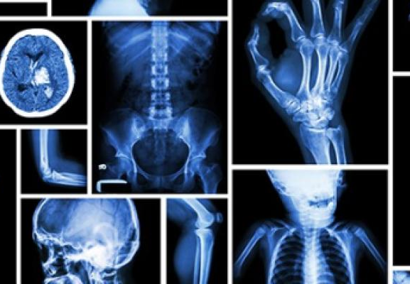
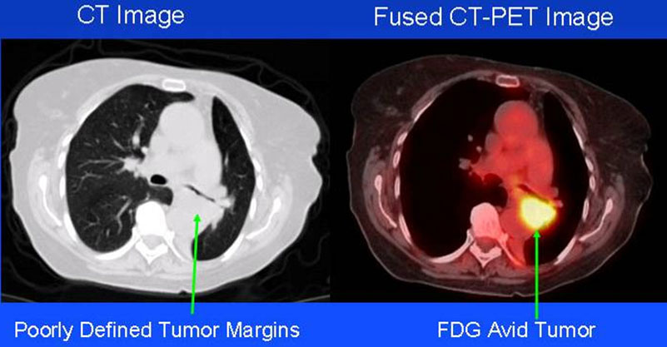
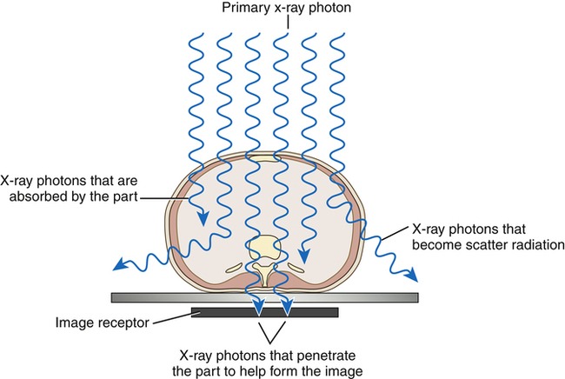

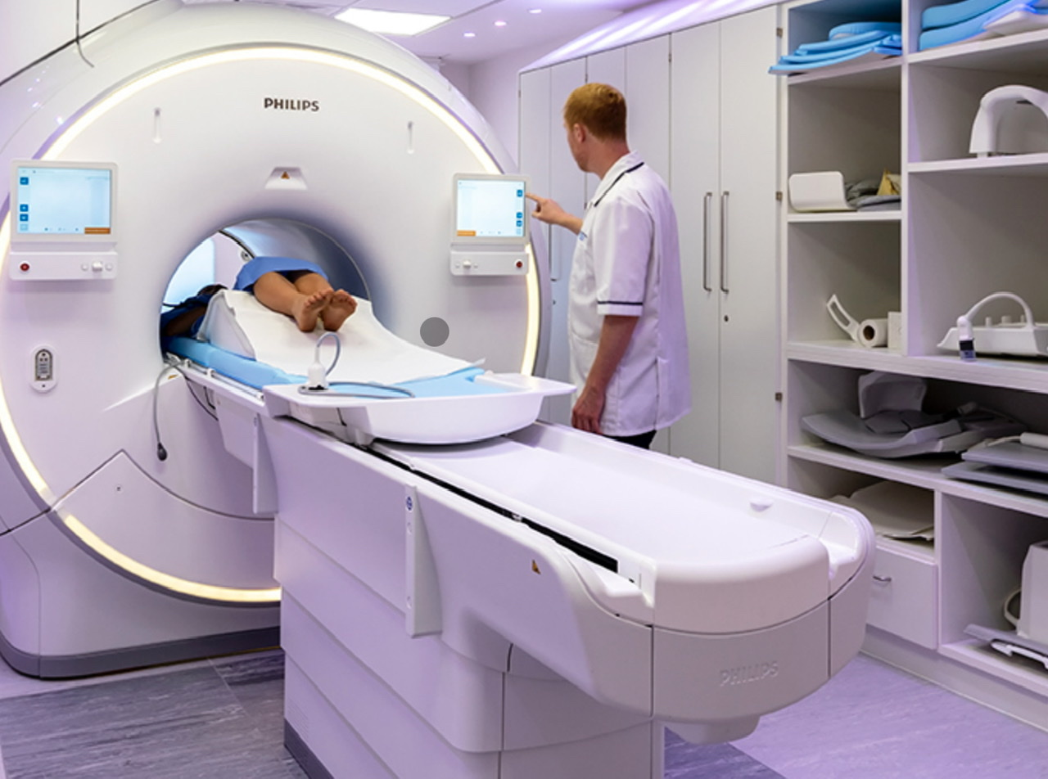
Diagnostic
Therapeutic
Two types:
NHS England (no date)
and Adler and Carlton (2019)
Sciences underpinning profession:
Medical Physics
Chemistry
Human Biology
Nuclear medicine
National School of Healthcare Science (no date)
and Wininger (2022)
National Institute of Biomedical Imaging and Bioengineering (2016) and Herring (2020)
2. Understanding of anatomy examined
1. Use of radioactive tracers
PET scan
3. Understanding chemistry/physics within the body
NHS UK (2022) and Holmes et al. (2021)
X-ray
1. Anatomy
3. Chemistry if contrast needed
2.Understanding Medical Physics
Radiographer

Slide 2
References
Adler, A. and Carlton, R. (2019) Radiologic and Imaging Sciences and Patient Care. 7th Edition.
Herring, W. (2020) Learning Radiology. Recognizing the Basics. 4th edition. Elsevier.
Holmes, K., Elkington, M. and Harris, P. (2021) Clark’s Essential Physics in Imaging for Radiographers. 2nd Edition. CRC Press.
National Institute of Biomedical Imaging and Bioengineering (2016) Nuclear Medicine. Available at: https://www.nibib.nih.gov/science-education/science-topics/nuclear-medicine#:~:text=Single%20Photon%20Emission%20Computed%20Tomography%20or%20SPECT%20and%20Positron%20Emission,imaging%20modalities%20in%20nuclear%20medicine. (Accessed: 16th June 2023).
National School of Healthcare Science (no date) Healthcare science specialities explained: Physical Sciences. Available at: https://nshcs.hee.nhs.uk/healthcare-science/healthcare-science-specialisms-explained/physical-sciences/ (Accessed: 9th June 2023).
NHS England (no date) The 14 allied health professional. Available at: https://www.england.nhs.uk/ahp/role/#radiographer (Accessed: 9th June 2023).
NHS UK (2022) X-ray. Available at: https://www.nhs.uk/conditions/x-ray/ (Accessed: 16th June 2023).
Wininger, K. L. (2022) Chemistry in the Radiologic Sciences. Radiologic Technology, 93, pp.303-328.

