Slide 1
BA International Hotel Management
Organisational Consultancy
BMIH6005
Week Two

Slide 2
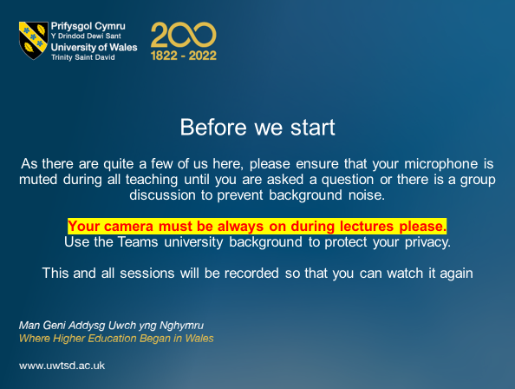

Slide 3
Today’s Learning Objectives
- Understand the purpose and approach to organisational diagnosis
- Data collection methods and data analysis
- Identify key diagnostic models and tools
- Understand symptom versus root cause

Slide 4
Let’s Recap…
What are the 4 steps of effective consultancy:
  Diagnosis, planning, implementation and evaluation
What are the future trends for consultancy in hospitality:
  Technology, sustainability and employee wellbeing
What are the advantages of an external consultant over an internal consultant:
  Fresh perspective
  Objectivity
  Specialism

Slide 5
Next 4 Lectures:
  Diagnosis – Today: Diagnosing Organisational Issues
  Planning – Strategic Planning & Stakeholder Communication
  Implementation – Implementing Change & Change Management
  Evaluation – Evaluation & 360 Monitoring
  Followed by ‘Ethics and other considerations’

Slide 6
Model / Tool / Framework | Primary Topic / Purpose | Key Use
5 Whys | Diagnosis | Root cause analysis of simple or isolated issues
McKinsey 7S | Diagnosis & Strategic Planning | Internal alignment across structure, systems, etc.
Star Model | Diagnosis & Strategic Planning | Organisational design & interdependent levers
SWOT | Strategic Planning | Assessing internal strengths/weaknesses + context
TOWS | Strategic Planning | Strategy formulation from SWOT output
PESTLE / STEEPLED | Strategic Planning | Analysing external macro-environment
Six Sigma (DMAIC) | Diagnosis / Implementation | Process improvement and efficiency
Force Field Analysis | Change Management | Mapping driving and restraining forces
Stakeholder Mapping | Communication / Implementation | Identifying and analysing key stakeholders
Kotter’s 8 Steps | Change Management | Structured model for leading change
Lewin’s Change Model | Change Management | Unfreeze–Change–Refreeze model
Balanced Scorecard | Monitoring & Evaluation | Measuring performance across multiple dimensions
360 Feedback | Evaluation / Ethics | Multi-source performance appraisal
Ethical Decision Models | Ethics | Guiding ethical choices during consultancy

Slide 7

Types of Organisational Problems
Structural: e.g. unclear roles, siloed teams
Cultural: e.g. toxic leadership, low trust
Process: e.g. inefficient workflows, duplication
People: e.g. low engagement, skills gaps
External: e.g. regulation, market disruption

Slide 8
GROUP ACTIVITY (20 mins):-
List as many organisational problems as you can.
Try and be specific, for example not just poor sales, but poor sales due to weak/ineffective sales training.
Categorise each of your issues into one of the following if you can:
- Structural
- Cultural
- Process
- People
- External

Slide 9
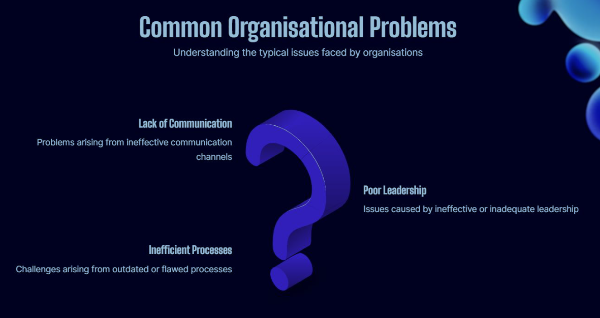
Notes:
As a Team work together in breakout rooms and complete this activity. You have 30 minutes to complete and present a presentation.
Name 2x SWOT and 2 x TOWS points
Post the different hotels in the announcements on teams, or into each group individually
SWOT and TOWS Possible answers:
Strengths
Strong brand recognition
Excellent location
High-quality customer service
Wide range of amenities and services
Weaknesses
High employee turnover
Limited online presence
Lack of diversity in the customer base
Inefficient operational processes
Opportunities
Growing demand for eco-friendly hotels
Increasing number of business travelers
Expansion of the tourism industry
Technological advancements in hotel operations
Threats
Intense competition from other hotels
Economic downturns
Changes in customer preferences
Natural disasters and pandemics
TOWS
SO Strategies
Leverage strong brand recognition and high-quality customer service to attract a diverse customer base
Use the hotel's excellent location to target business travelers
Expand online presence to attract a wider audience and increase bookings
WO Strategies
Address employee turnover issues by offering competitive compensation packages, training programs, and career development opportunities
Use technological advancements to improve operational efficiency and enhance customer experiences
Introduce eco-friendly initiatives to cater to the growing demand for sustainable hotels
ST Strategies
Use strong brand recognition and high-quality customer service to differentiate from competitors
Focus on providing a wide range of amenities and services to maintain a competitive edge
Develop contingency plans to address economic downturns and natural disasters
WT Strategies
Diversify the customer base to reduce the impact of changes in customer preferences
Implement cost-cutting measures to mitigate the impact of economic downturns
Develop crisis management plans to address natural disasters and pandemics

Slide 10
Why Diagnose?
Distinguishes symptom vs root cause
Ensures solutions match the real problem
Builds credibility and insight before change is proposed
"Prescription without diagnosis is malpractice."

Slide 11
The Diagnostic Process (Overview)
1. Entry & Contracting
2. Data Collection
3. Data Analysis
4. Feedback & Recommendations
5. Planning Change (covered in next session)

Slide 12
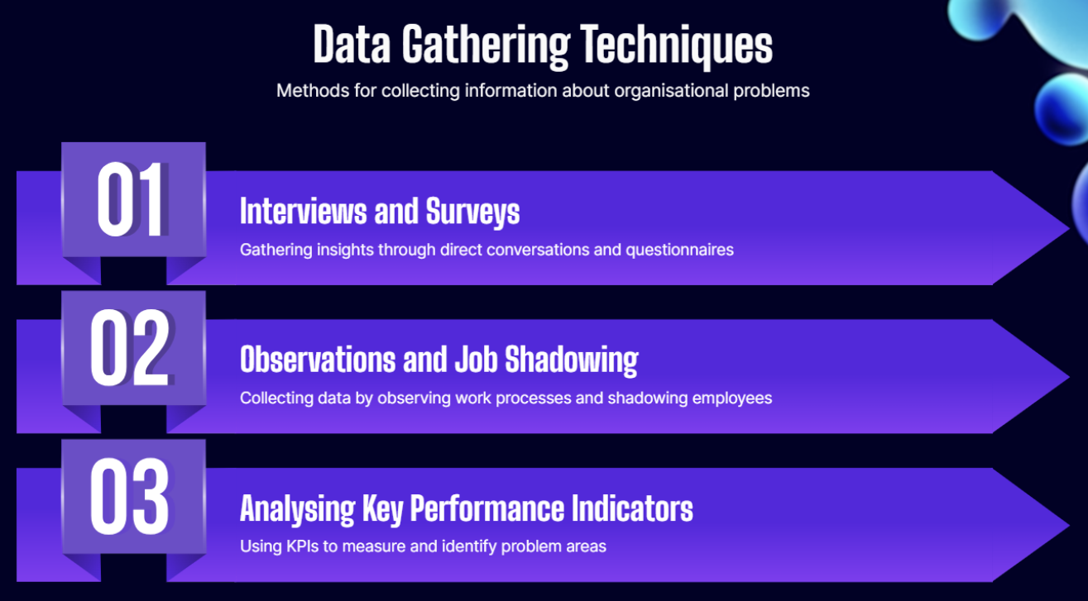
… and don’t forget secondary data: docs, reports, news, previous consultancy, etc.
Notes:
As a Team work together in breakout rooms and complete this activity. You have 30 minutes to complete and present a presentation.
Name 2x SWOT and 2 x TOWS points
Post the different hotels in the announcements on teams, or into each group individually
SWOT and TOWS Possible answers:
Strengths
Strong brand recognition
Excellent location
High-quality customer service
Wide range of amenities and services
Weaknesses
High employee turnover
Limited online presence
Lack of diversity in the customer base
Inefficient operational processes
Opportunities
Growing demand for eco-friendly hotels
Increasing number of business travelers
Expansion of the tourism industry
Technological advancements in hotel operations
Threats
Intense competition from other hotels
Economic downturns
Changes in customer preferences
Natural disasters and pandemics
TOWS
SO Strategies
Leverage strong brand recognition and high-quality customer service to attract a diverse customer base
Use the hotel's excellent location to target business travelers
Expand online presence to attract a wider audience and increase bookings
WO Strategies
Address employee turnover issues by offering competitive compensation packages, training programs, and career development opportunities
Use technological advancements to improve operational efficiency and enhance customer experiences
Introduce eco-friendly initiatives to cater to the growing demand for sustainable hotels
ST Strategies
Use strong brand recognition and high-quality customer service to differentiate from competitors
Focus on providing a wide range of amenities and services to maintain a competitive edge
Develop contingency plans to address economic downturns and natural disasters
WT Strategies
Diversify the customer base to reduce the impact of changes in customer preferences
Implement cost-cutting measures to mitigate the impact of economic downturns
Develop crisis management plans to address natural disasters and pandemics

Slide 13
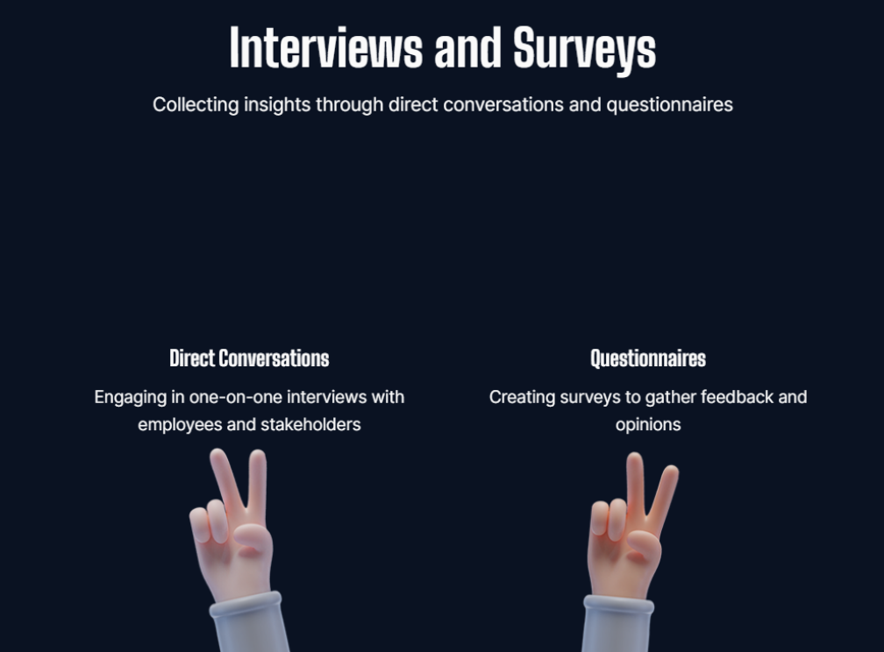
Notes:
As a Team work together in breakout rooms and complete this activity. You have 30 minutes to complete and present a presentation.
Name 2x SWOT and 2 x TOWS points
Post the different hotels in the announcements on teams, or into each group individually
SWOT and TOWS Possible answers:
Strengths
Strong brand recognition
Excellent location
High-quality customer service
Wide range of amenities and services
Weaknesses
High employee turnover
Limited online presence
Lack of diversity in the customer base
Inefficient operational processes
Opportunities
Growing demand for eco-friendly hotels
Increasing number of business travelers
Expansion of the tourism industry
Technological advancements in hotel operations
Threats
Intense competition from other hotels
Economic downturns
Changes in customer preferences
Natural disasters and pandemics
TOWS
SO Strategies
Leverage strong brand recognition and high-quality customer service to attract a diverse customer base
Use the hotel's excellent location to target business travelers
Expand online presence to attract a wider audience and increase bookings
WO Strategies
Address employee turnover issues by offering competitive compensation packages, training programs, and career development opportunities
Use technological advancements to improve operational efficiency and enhance customer experiences
Introduce eco-friendly initiatives to cater to the growing demand for sustainable hotels
ST Strategies
Use strong brand recognition and high-quality customer service to differentiate from competitors
Focus on providing a wide range of amenities and services to maintain a competitive edge
Develop contingency plans to address economic downturns and natural disasters
WT Strategies
Diversify the customer base to reduce the impact of changes in customer preferences
Implement cost-cutting measures to mitigate the impact of economic downturns
Develop crisis management plans to address natural disasters and pandemics

Slide 14
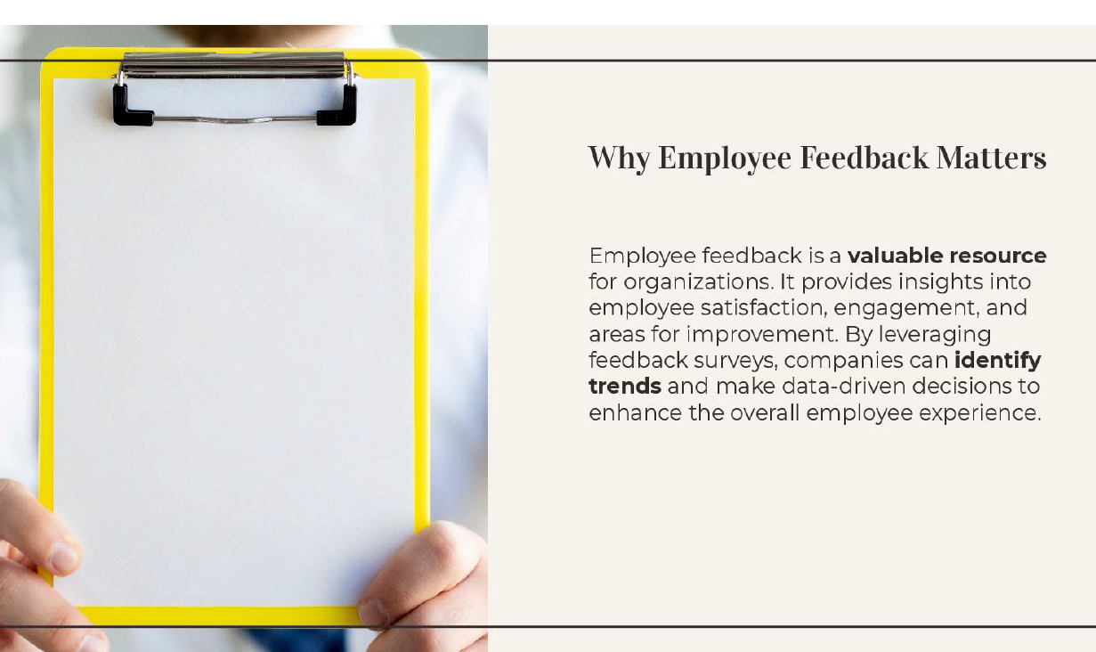
Notes:
As a Team work together in breakout rooms and complete this activity. You have 30 minutes to complete and present a presentation.
Name 2x SWOT and 2 x TOWS points
Post the different hotels in the announcements on teams, or into each group individually
SWOT and TOWS Possible answers:
Strengths
Strong brand recognition
Excellent location
High-quality customer service
Wide range of amenities and services
Weaknesses
High employee turnover
Limited online presence
Lack of diversity in the customer base
Inefficient operational processes
Opportunities
Growing demand for eco-friendly hotels
Increasing number of business travelers
Expansion of the tourism industry
Technological advancements in hotel operations
Threats
Intense competition from other hotels
Economic downturns
Changes in customer preferences
Natural disasters and pandemics
TOWS
SO Strategies
Leverage strong brand recognition and high-quality customer service to attract a diverse customer base
Use the hotel's excellent location to target business travelers
Expand online presence to attract a wider audience and increase bookings
WO Strategies
Address employee turnover issues by offering competitive compensation packages, training programs, and career development opportunities
Use technological advancements to improve operational efficiency and enhance customer experiences
Introduce eco-friendly initiatives to cater to the growing demand for sustainable hotels
ST Strategies
Use strong brand recognition and high-quality customer service to differentiate from competitors
Focus on providing a wide range of amenities and services to maintain a competitive edge
Develop contingency plans to address economic downturns and natural disasters
WT Strategies
Diversify the customer base to reduce the impact of changes in customer preferences
Implement cost-cutting measures to mitigate the impact of economic downturns
Develop crisis management plans to address natural disasters and pandemics

Slide 15
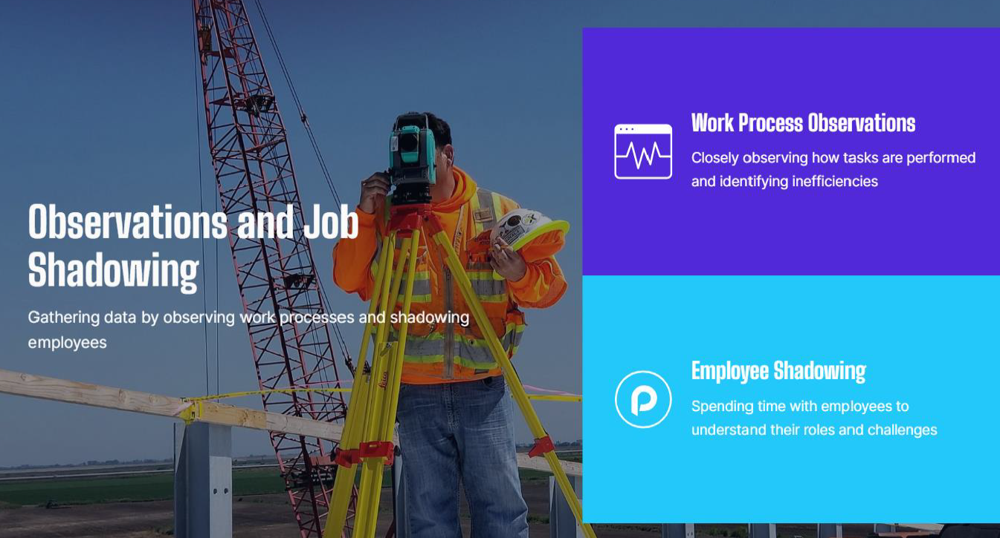
Notes:
As a Team work together in breakout rooms and complete this activity. You have 30 minutes to complete and present a presentation.
Name 2x SWOT and 2 x TOWS points
Post the different hotels in the announcements on teams, or into each group individually
SWOT and TOWS Possible answers:
Strengths
Strong brand recognition
Excellent location
High-quality customer service
Wide range of amenities and services
Weaknesses
High employee turnover
Limited online presence
Lack of diversity in the customer base
Inefficient operational processes
Opportunities
Growing demand for eco-friendly hotels
Increasing number of business travelers
Expansion of the tourism industry
Technological advancements in hotel operations
Threats
Intense competition from other hotels
Economic downturns
Changes in customer preferences
Natural disasters and pandemics
TOWS
SO Strategies
Leverage strong brand recognition and high-quality customer service to attract a diverse customer base
Use the hotel's excellent location to target business travelers
Expand online presence to attract a wider audience and increase bookings
WO Strategies
Address employee turnover issues by offering competitive compensation packages, training programs, and career development opportunities
Use technological advancements to improve operational efficiency and enhance customer experiences
Introduce eco-friendly initiatives to cater to the growing demand for sustainable hotels
ST Strategies
Use strong brand recognition and high-quality customer service to differentiate from competitors
Focus on providing a wide range of amenities and services to maintain a competitive edge
Develop contingency plans to address economic downturns and natural disasters
WT Strategies
Diversify the customer base to reduce the impact of changes in customer preferences
Implement cost-cutting measures to mitigate the impact of economic downturns
Develop crisis management plans to address natural disasters and pandemics

Slide 16
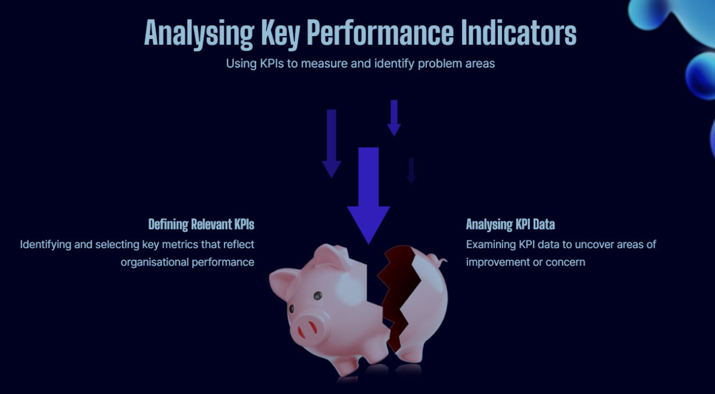
Notes:
As a Team work together in breakout rooms and complete this activity. You have 30 minutes to complete and present a presentation.
Name 2x SWOT and 2 x TOWS points
Post the different hotels in the announcements on teams, or into each group individually
SWOT and TOWS Possible answers:
Strengths
Strong brand recognition
Excellent location
High-quality customer service
Wide range of amenities and services
Weaknesses
High employee turnover
Limited online presence
Lack of diversity in the customer base
Inefficient operational processes
Opportunities
Growing demand for eco-friendly hotels
Increasing number of business travelers
Expansion of the tourism industry
Technological advancements in hotel operations
Threats
Intense competition from other hotels
Economic downturns
Changes in customer preferences
Natural disasters and pandemics
TOWS
SO Strategies
Leverage strong brand recognition and high-quality customer service to attract a diverse customer base
Use the hotel's excellent location to target business travelers
Expand online presence to attract a wider audience and increase bookings
WO Strategies
Address employee turnover issues by offering competitive compensation packages, training programs, and career development opportunities
Use technological advancements to improve operational efficiency and enhance customer experiences
Introduce eco-friendly initiatives to cater to the growing demand for sustainable hotels
ST Strategies
Use strong brand recognition and high-quality customer service to differentiate from competitors
Focus on providing a wide range of amenities and services to maintain a competitive edge
Develop contingency plans to address economic downturns and natural disasters
WT Strategies
Diversify the customer base to reduce the impact of changes in customer preferences
Implement cost-cutting measures to mitigate the impact of economic downturns
Develop crisis management plans to address natural disasters and pandemics

Slide 17
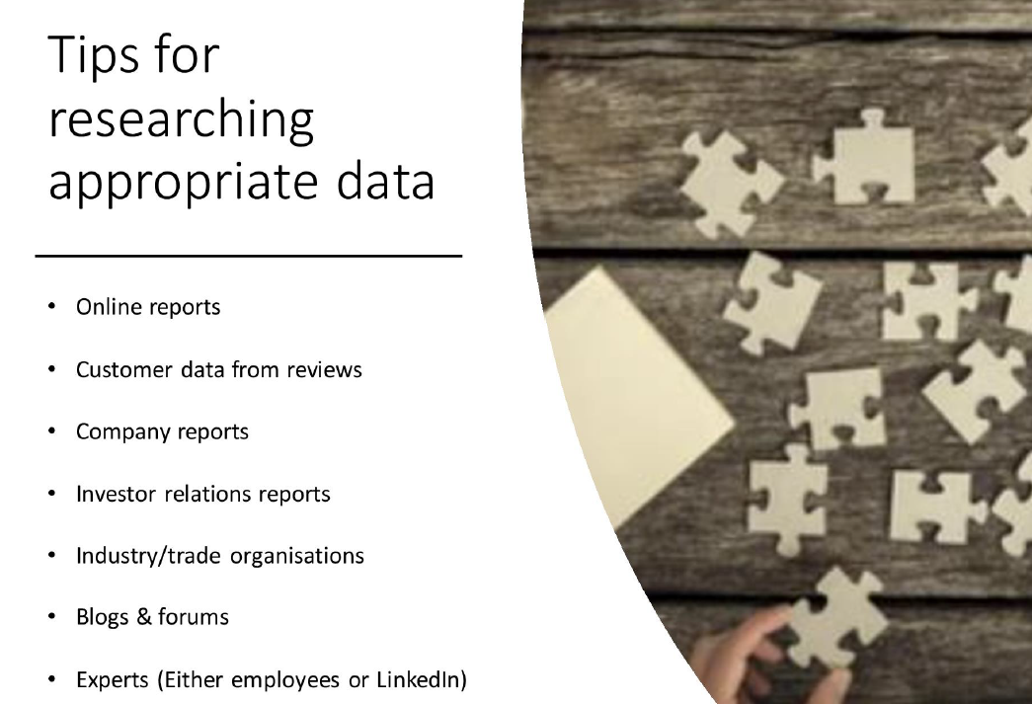
Secondary Sources:
Notes:
As a Team work together in breakout rooms and complete this activity. You have 30 minutes to complete and present a presentation.
Name 2x SWOT and 2 x TOWS points
Post the different hotels in the announcements on teams, or into each group individually
SWOT and TOWS Possible answers:
Strengths
Strong brand recognition
Excellent location
High-quality customer service
Wide range of amenities and services
Weaknesses
High employee turnover
Limited online presence
Lack of diversity in the customer base
Inefficient operational processes
Opportunities
Growing demand for eco-friendly hotels
Increasing number of business travelers
Expansion of the tourism industry
Technological advancements in hotel operations
Threats
Intense competition from other hotels
Economic downturns
Changes in customer preferences
Natural disasters and pandemics
TOWS
SO Strategies
Leverage strong brand recognition and high-quality customer service to attract a diverse customer base
Use the hotel's excellent location to target business travelers
Expand online presence to attract a wider audience and increase bookings
WO Strategies
Address employee turnover issues by offering competitive compensation packages, training programs, and career development opportunities
Use technological advancements to improve operational efficiency and enhance customer experiences
Introduce eco-friendly initiatives to cater to the growing demand for sustainable hotels
ST Strategies
Use strong brand recognition and high-quality customer service to differentiate from competitors
Focus on providing a wide range of amenities and services to maintain a competitive edge
Develop contingency plans to address economic downturns and natural disasters
WT Strategies
Diversify the customer base to reduce the impact of changes in customer preferences
Implement cost-cutting measures to mitigate the impact of economic downturns
Develop crisis management plans to address natural disasters and pandemics

Slide 18
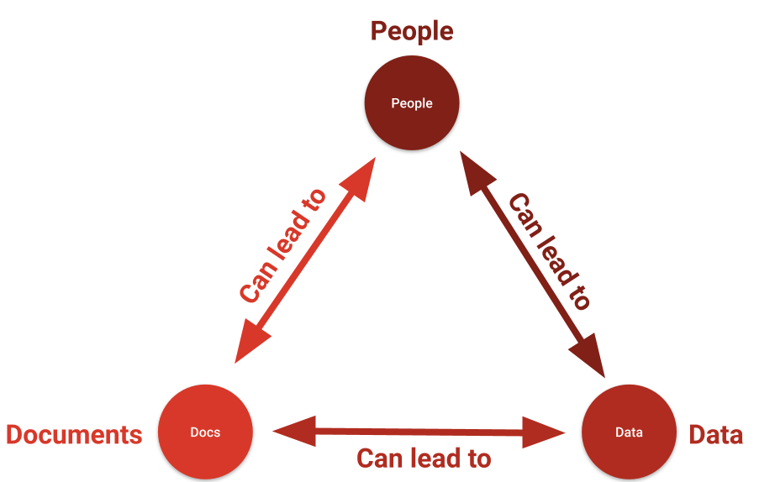
Information Collection
Triangulation: multiple methods increase depth and validity
REMEMBER: Ethics: Consent, confidentiality, transparency
This Photo by Unknown Author is licensed under CC BY-ND

Slide 19
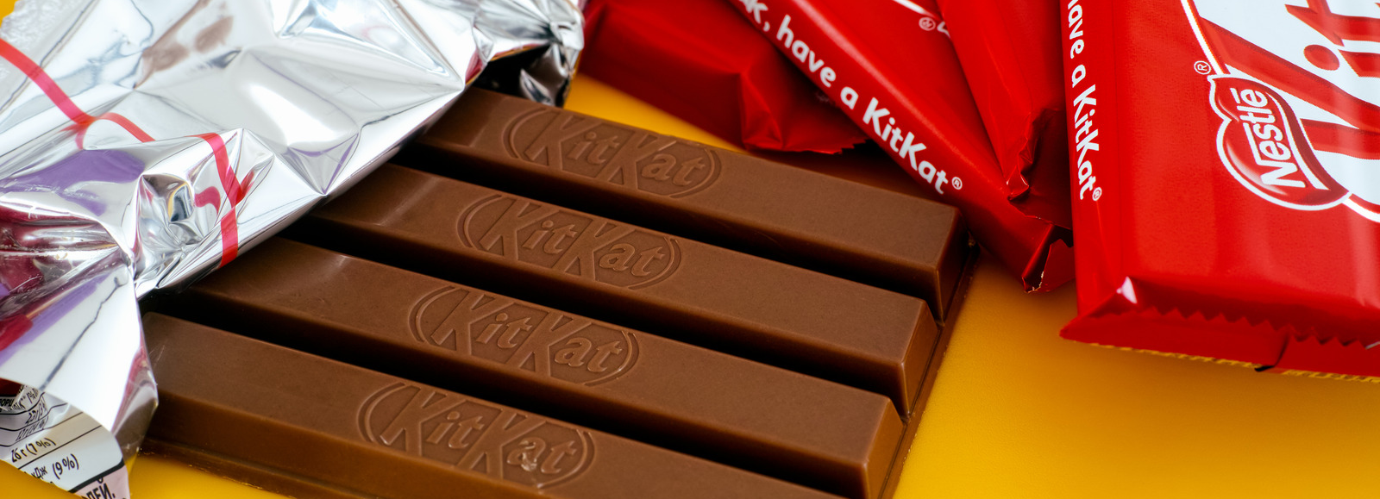
Take a break…

Slide 20
Diagnostic Models (Overview)
7S: Alignment across organisational elements
Star Model: Design focus – strategy, structure, people
5 Whys: Simple root cause tool
Six Sigma DMAIC (Define/Measure): Process improvement
These are internal diagnosis tools which are more commonly the starting point to consultancy. However, external tools can be used at this stage to gather a wider view (e.g. PESTLE)

Slide 21
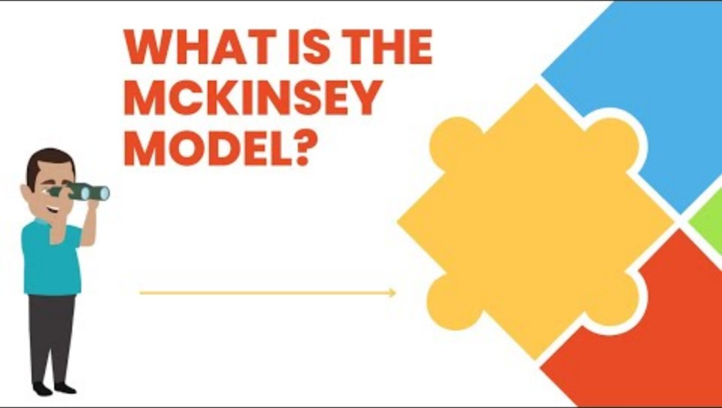
Focus on McKinsey 7S

Slide 22
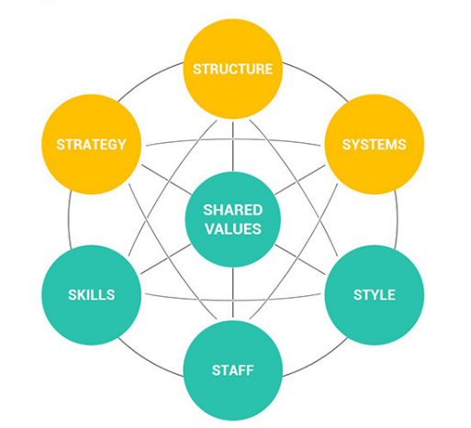
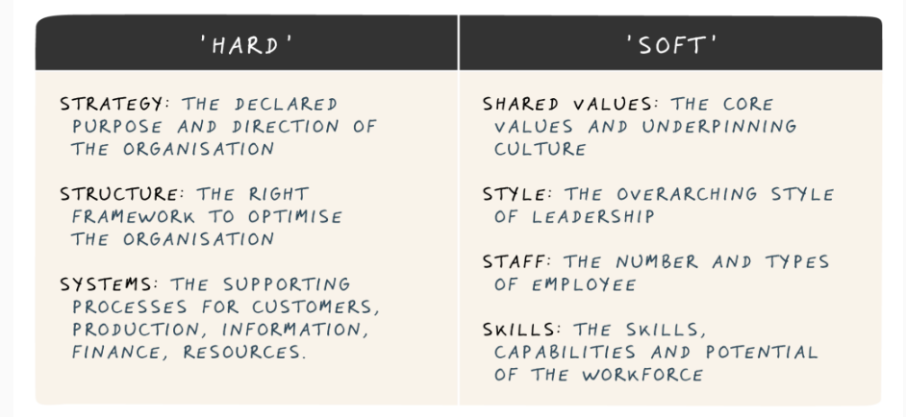
Focus on McKinsey 7S

Slide 23
ACTIVITY – On the chat board:
Pick one of the 7S elements. Write a one-sentence example of how it could impact a hotel’s performance — either positively or negatively.
E.g: Structure – “If there’s no clear chain of command, guest complaints may not be handled quickly.”

Slide 24
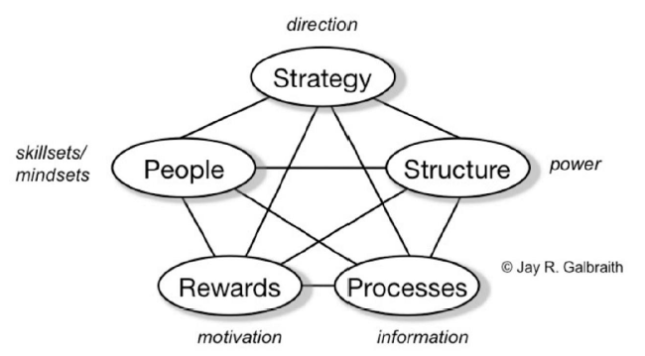
Focus on the Star Model
The Star Model of organisational design is a framework developed by Jay Galbraith. It helps organisations align their structure and strategy effectively. It
focuses on five
key elements, all
of which must
work together
for optimal
performance:

Slide 25
Focus on the Star Model
Strategy – Defines the direction and goals of the organisation. It drives the choices in the other four areas.
Structure – Refers to how the organization is arranged (e.g., departments, reporting lines, hierarchies).
Processes – Includes the flow of information and decision-making (e.g., how work gets done, collaboration methods).
Rewards – How performance is measured and compensated (e.g., pay, recognition, promotion).
People – The skills, mindset, and capabilities of employees (e.g., recruitment, development, culture).
The idea is that all five areas must be aligned with the strategy for the organisation to function effectively — like points of a star all connected to the centre.

Slide 26
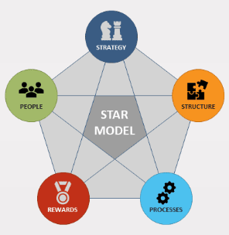
ACTIVITY – On the chat board:
Pick one of the Star Model elements. In the chat, give a one-sentence example of how it could affect a hotel’s success.
E.g: Rewards – “If front desk staff are recognised for excellent service, guest satisfaction is likely to improve.”

Slide 27

‘Getting to the root of the problem’
All diagnosis tools should endeavour to get the root cause of a problem or issue – referred to as root cause analysis.
Effective consultancy should distinguish between surface level symptoms and root causes. Failing to do so risks reoccurrence of the problem in the future.

Slide 28
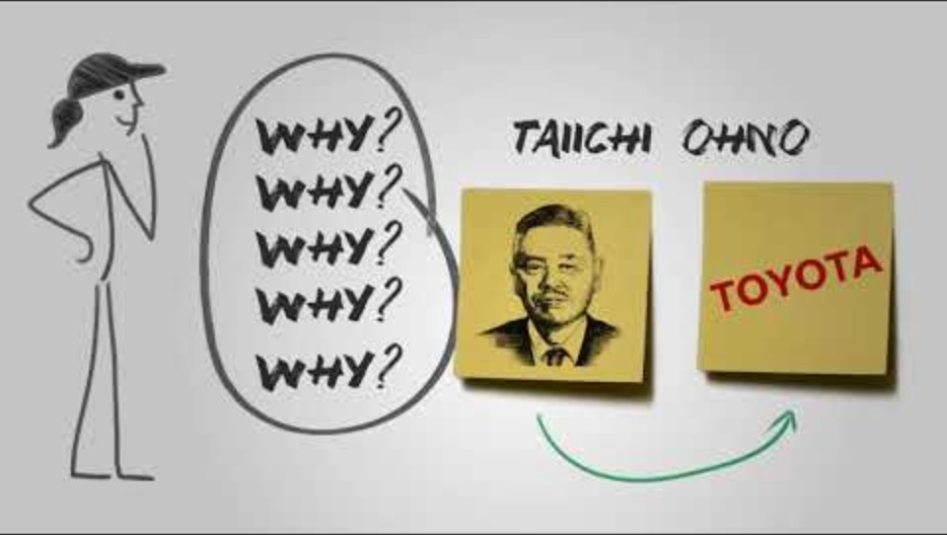
Focus on 5 Whys

Slide 29
Focus on 5 Whys
A focussed ‘Root Cause' analysis tool. A simple process of asking "Why?" repeatedly until the core issue emerges.
Example:
Why are guests complaining about slow check-in?→ Because the front desk takes too long to process each guest.
Why does it take too long to process each guest?→ Because staff need to manually enter information and look up booking details.
Why do they need to enter details manually?→ Because the booking system doesn’t sync properly with the front desk system.
Why doesn’t the system sync properly?→ Because the hotel is using outdated software that isn't integrated.
Why is the hotel using outdated software?→ Because management delayed the IT upgrade to save on costs.

Slide 30
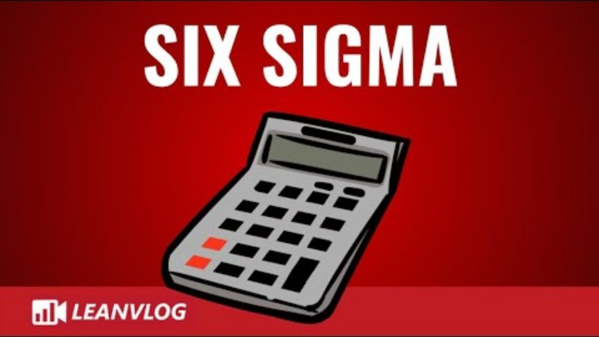
Focus on Six Sigma

Slide 31
Focus on Six Sigma
Six Sigma is a data-driven methodology used to improve processes by reducing errors, defects, and variation. Its goal is to make processes more efficient, consistent, and customer-focused.
Origin: Developed by Motorola in the 1980s; popularized by companies like GE.
Goal: Achieve near-perfect quality — no more than 3.4 defects per million opportunities.

Slide 32
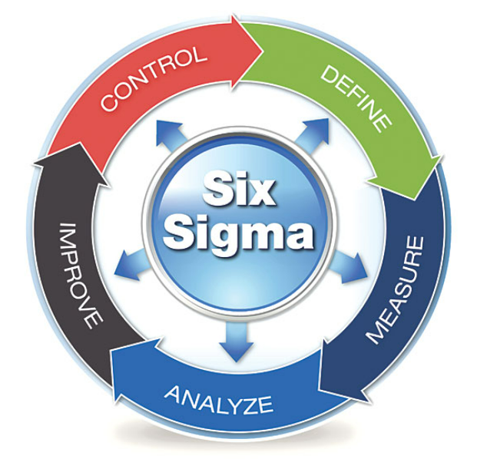
Focus on Six Sigma
The DMAIC cycle:
Define – the problem and requirements
Measure – current performance
Analyse – root causes of defects or issues
Improve – the process with targeted solutions
Control – maintain improvements over time
Tools: Statistical analysis, control charts, process mapping, root cause analysis, etc.

Slide 33
Focus on Six Sigma
The DMAIC cycle:
Define – the problem and customer requirements
Measure – current performance
Analyse – root causes of defects or issues
Improve – the process with targeted solutions
Control – maintain improvements over time
Tools: Includes statistical analysis, control charts, process mapping, root cause analysis, etc.
Only ‘Define & Measure’ at diagnosis stage!

Slide 34
Focus on Six Sigma
Example:-
Define: Problem is high number of guest complaints about room cleanliness. Goal is to reduce complaints by 50% in 3 months.
Measure: Collect data on number of complaints per day, time spent cleaning each room and housekeeping checklist completion rates
Analyse: Find patterns in certain staff members or shifts that have higher complaint rates, checklist items often missed (e.g., under beds, bathrooms)
Improve: Provide targeted training, implement mobile checklists, add random room inspections
Control: Weekly audits, track trends in complaints, maintain training refreshers every quarter.
DESIRED OUTCOME = Complaints drop significantly, and guest satisfaction scores rise.

Slide 35
Model / Tool / Framework | Primary Topic / Purpose | Key Use
5 Whys | Diagnosis | Root cause analysis of simple or isolated issues
McKinsey 7S | Diagnosis & Strategic Planning | Internal alignment across structure, systems, etc.
Star Model | Diagnosis & Strategic Planning | Organisational design & interdependent levers
SWOT | Strategic Planning | Assessing internal strengths/weaknesses + context
TOWS | Strategic Planning | Strategy formulation from SWOT output
PESTLE / STEEPLED | Strategic Planning | Analysing external macro-environment
Six Sigma (DMAIC) | Diagnosis / Implementation | Process improvement and efficiency
Force Field Analysis | Change Management | Mapping driving and restraining forces
Stakeholder Mapping | Communication / Implementation | Identifying and analysing key stakeholders
Kotter’s 8 Steps | Change Management | Structured model for leading change
Lewin’s Change Model | Change Management | Unfreeze–Change–Refreeze model
Balanced Scorecard | Monitoring & Evaluation | Measuring performance across multiple dimensions
360 Feedback | Evaluation / Ethics | Multi-source performance appraisal
Ethical Decision Models | Ethics | Guiding ethical choices during consultancy

Slide 36
Diagnostic Scenario Group Activity:
Harmony Hotels is a mid-sized hotel chain aiming to offer a “seamless luxury experience” across all its properties. However, customer feedback shows inconsistencies in service quality between locations. Some teams upsell premium services actively; others don’t mention them. Staff turnover is high, and internal communication varies between branches.
TASK:
Choose McKinsey 7S or Star Model.
Identify 2–3 elements in the model that may be misaligned (e.g., strategy vs. systems, structure vs. people).
Suggest one data source you would use to confirm your thinking (e.g., exit interviews, customer reviews).
Prepare a 1–2 minute summary to share with the class.

Slide 37
SUMMARY:
Diagnosis is critical to effective change
Structured tools ensure thorough analysis
Always dig deeper: symptoms may mask deeper causes

Slide 38

Any Questions?

Slide 39
I look forward to seeing you next week.
If you have any questions in the meantime, please send an email from your student account n.dyer@uwtsd.ac.uk

