Slide 1


Psychology in Healthy and Social Care
Module Number: LCHS 4010_LON
Assignment No: Assignment 1
Student Name: Cheila Tavares
Student ID: 2430825
Lecturer’s name: Christopher Mafuva
Submitted: 17th November 2025

Slide 2
Acknowledge use of AI
I have not used AI for this presentation.
I did all the researches by self.

Slide 3
Overview
Case Study
Development Psychology
PIES
Background about Theory
Application of theory to case study
Nature and Nurture
Strengths and Weaknesses
Conclusion
References

Slide 4
Case Study
Amira is a 3 years old child who recently started nursery. Showing signs of anxiety when left by her carers, limited verbal communication, and difficulty engaging in group play.

Slide 5
Development Psychology
Developmental psychology can be defined as the discipline that attempts to describe and explain the changes that occur over time in the thought, behaviour, reasoning and functioning of a person due to biological, individual and environmental influences (Slater and Bremner, 2017).

Slide 6

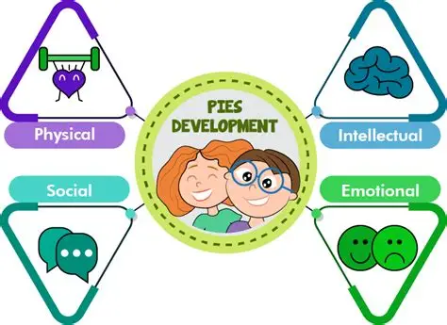

PIES
The PIES framework can be applied in numerous settings, from early childhood education to professional development. In early childhood education, the focus is on creating a nurturing environment that supports all aspects of a child’s development. This might involve physical activities, cognitive challenges, emotional support, and opportunities for social interaction (NeuroLaunch Editoral Team, 2024).

Slide 7
PIES Analysis of Amira ( 3 years old)
Amira displays separation anxiety, which is closely linked to attachment. Bowlby (1988) explains that young children rely on secure attachment figures to feel safe. Consistent, sensitive responses from adults help children regulate emotions (Ainsworth 1979).
Amira’s limited verbal communication impacts her ability to express.
Difficulty engaging in group play may indicate that Amira feels overwhelmed in social settings.

Slide 8
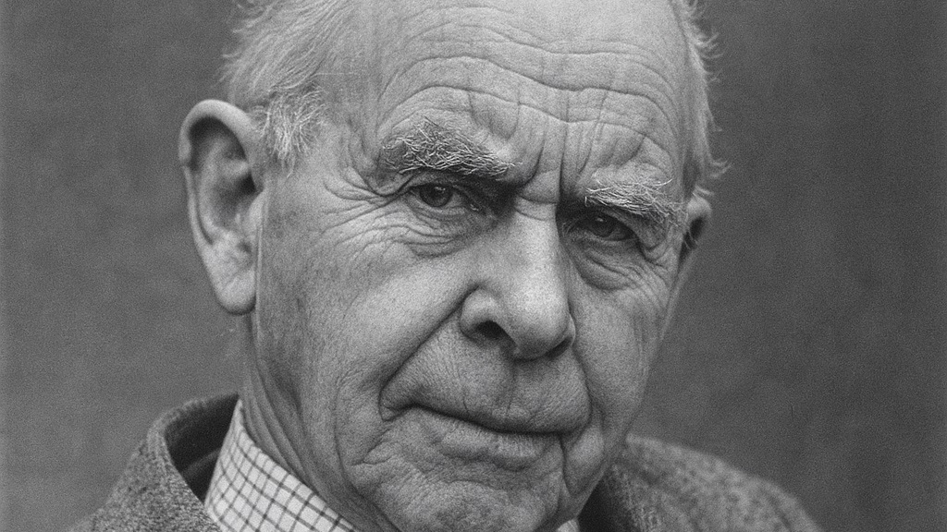
John Bowlby’s
John Bowlby (1907-1990), Born in London, England.
Studied psychology and pre-clinical sciences at Cambridge University.
Trained in psychiatry at the Maudsley Hospital in London.
Also Trained in Psychoanalysis with the British Psycoanalystic Society.
Died 2 September 1990 (aged 83) leaving a legacy that continues to influence psychology and early childhood care worldwide.
John Bowlby’s Attachment Theory is a psychological theory that revolutionised our understanding of child development. Created by British psychoanalyst John Bowlby in the mid-20th century, this theory emphasises the importance of early relationships in shaping a child’s emotional and social development.

Slide 9
Bowlby’s Attachment Theory
Birth to 6 weeks):
Infants display innate signal behaviours
6 weeks to 6-8 months):
Babies begin to show preference for familiar caregivers
6-8 months to 18 months-2 years):
Children actively seek proximity to specific attachment figures
18 months-2 years onwards):
Children develop more complex relationships with caregivers

Slide 10
Applying Bowlby’s Attachment Theory to Amira
Children need a close and continuous caregiving relationship called for a theoretical explanation.
Maintain consistent communication with parents to ensure continuity of care.
Use simple language, repetition, gestures and visual aids.

Slide 11
Nature and Nurture
Nature refers largely to our genetics. It includes the genes we are born with and other hereditary factors that can impact how our personality is formed and influence the way that we develop from childhood through adulthood (Cherry, 2025).
According to the American Psychological Association (2018), Nurture refers to the environmental factors that influence development and behavior of a person.
Both Nature and Nurture helps to understanding Amira:
Nature: Natural shy, sensitive traits
Nurture: Transition to a new environment, communication

Slide 12
Strenghts and Weaknesses
Simplistic Attachment Styles:
The categorization of attachment styles (secure, anxious, avoidant) may be too simplistic and not fully capture the complexity of human relationships and emotional responses. The Strange Situation Procedure developed by Ainsworth, which categorizes attachment types, has been critiqued for not accounting for the full range of attachment behaviors observed in different cultural settings.
Limited Scope of Attachment:
Bowlby’s theory primarily addresses emotional bonds and may not encompass other forms of attachment, such as those formed in later life or in different contexts. The concept of monotropy, which emphasizes a primary bond, has been challenged by findings that children can form multiple attachments, including strong bonds with fathers and other caregivers.
Biological Foundation:
Bowlby's theory is rooted in biological psychology, suggesting that attachment behaviors are innate and evolved through natural selection. This perspective aligns with the idea that infants are biologically primed to form emotional bonds with caregivers.
Empirical Support:
Numerous studies have confirmed the existence of attachment styles and their impact on later relationships and mental health, providing empirical support for Bowlby's theory.

Slide 13
Conclusion
Amira requires a nurturing, consistent, and developmentally informed approach. By applying the PIES framework and following the outlined support plan, practitioners can promote her emotional security, social engagement, cognitive growth, and physical confidence. Collaboration with parents and regular monitoring will ensure that Amira continues to progress and feel safe within the nursery environment.

Slide 14
Reference List
Ainsworth, M. (1979) 'Infant–mother attachment
American Psychological Association (2018). Nurture. APA Dictionary of Psychology. https://dictionary.apa.org/nurture
Bowlby, J., Ainsworth, M., & Bretherton, I. (1992). The origins of attachment theory. Developmental Psychology, 28(5), 759-775.
Bowlby, J. (1988) A Secure Base: Parent‑Child Attachment and Healthy Human Development. New York: Basic Books.
Cherry, K. (2025, January 27). How nature vs. nurture shapes who we become. Verywell Mind. https://www.verywellmind.com/what-is-nature-versus-nurture-2795392
Early Years TV (2024) John Bowlby’s Attachment Theory and Developmental Phases. Available at: https://www.earlyyears.tv/john-bowlbys-attachment-theory-and-developmental-phases/ (Accessed: 15 November 2025).
Slater, A., & Bremner, J. G. (Eds.). (2017). An introduction to developmental psychology. John Wiley & Sons.
NeuroLaunch Editorial Team (2024) ‘PIES Framework: Nurturing Physical, Intellectual, Emotional, and Social Development’, NeuroLaunch, 30 September. Available at:https://neurolaunch.com/pies-physical-intellectual-emotional-social/ ( Accessed:15 November 2025).

