Slide 1
Digital Skills &
Personal Branding
Task 2
The Cloud
CertHE Skills for the Workplace
BMSK4007
Notes:
This session examines the most popular 21st Century technologies that are used in the modern workplace.
Students may have other examples to share with the class.
The final few slides offer a few opinion pieces for class discussion and to examine possibilities of bias etc.

Slide 2
The 21st Century
Workplace
Mobile
Cloud
WiFi
Notes:
Discussion on how all new technologies used in the workplace are based on the framework of these 3 areas.
Mobile devices can be taken anywhere, but need internet connectivity to be able to access work related files and data.
This can only be done if the documentation is stored offsite (in the cloud)

Slide 3
Cloud based Software
Cloud-based applications can be used at any time on almost any device with an Internet connection, a benefit that leads to greater collaboration, particularly for businesses with remote employees.
Using Cloud-based software, teams in different locations can collaborate on documents without needing to email attachments and share calendars and task lists from wherever they are.
Participants just sign up for the service and access the application over the Internet, without downloading or installing software.
American Express Open (2011) ‘6 ways cloud computing helps businesses save time and money, [online] accessed Mar 2018

Slide 4
Cloud based Software
Employees also can connect through instant messaging and even hold impromptu meetings with robust audio, video and web conferencing capabilities.
This improved sharing of information has the potential to enable companies to react more quickly to business opportunities.
American Express Open (2011) ‘6 ways cloud computing helps businesses save time and money, [online] accessed Mar 2018

Slide 5
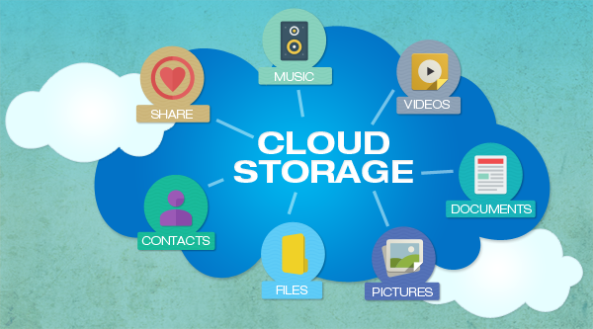
Cloud File Storage

Slide 6
Cloud File Storage
Cloud storage simply means a hard drive on the internet, a place to store your files and easily access them from any device, anywhere in the world as long as you have internet access.
You can also use cloud storage as a backup, but you must be careful about this as many services will delete files in the cloud when they are deleted from your computer to keep everything in sync. Some will keep deleted files for you though.

Slide 7
Cloud File Storage
An article on Tech Advisor (2020) reviewed 10 (of the best, in their view) cloud storage services.
Please read this and then see what you think
Have you used any?
Does your workplace use any?
Which ones do you/they use and why?
You could also examine some of the least well-known to see what they have to offer.
*Make Notes for your assignment*
Casserly, M. (2020) Best Cloud Storage 2020, [online] available at https://www.techadvisor.co.uk/test-centre/internet/best-cloud-storage-services-3614269/ accessed Dec 2020

Slide 8
Cloud File Storage
Biggest isn’t necessarily best of course, although an argument can be made that bigger companies may have more robust processes to keep your files safe AND it could be less likely that their business model will fail; leaving you with the annoyance of uploading your files yet again to a new provider.
Click on the images in the next few slides to explore further.
See what you think and make notes!
Casserly, M. (2020) Best Cloud Storage 2020, [online] available at https://www.techadvisor.co.uk/test-centre/internet/best-cloud-storage-services-3614269/ accessed Dec 2020

Slide 9
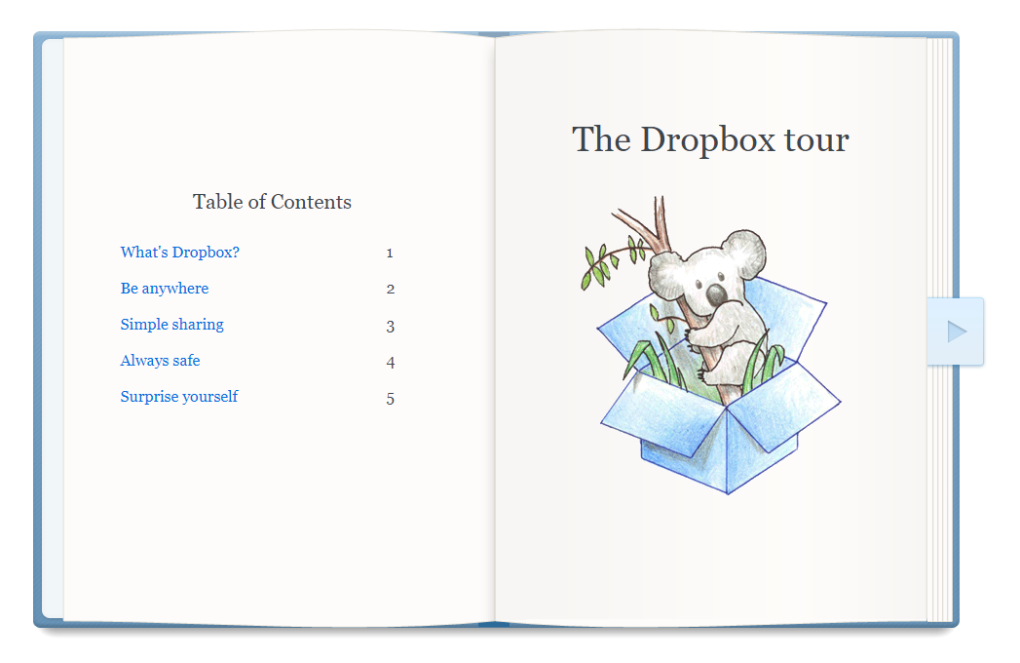
Cloud File Storage

Slide 10
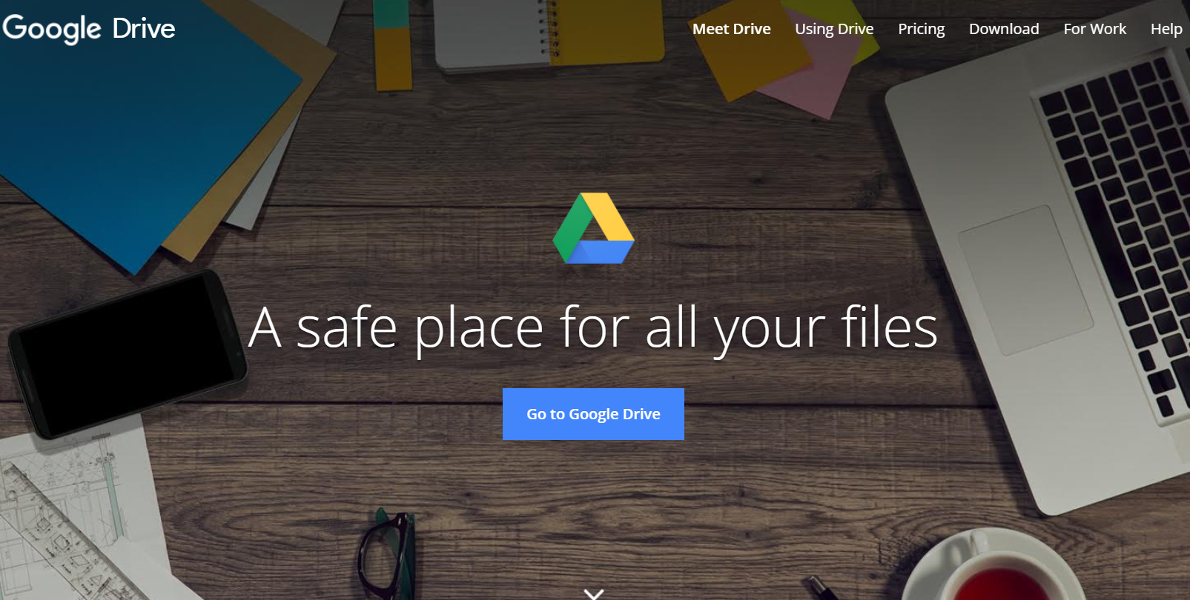
Cloud File Storage

Slide 11
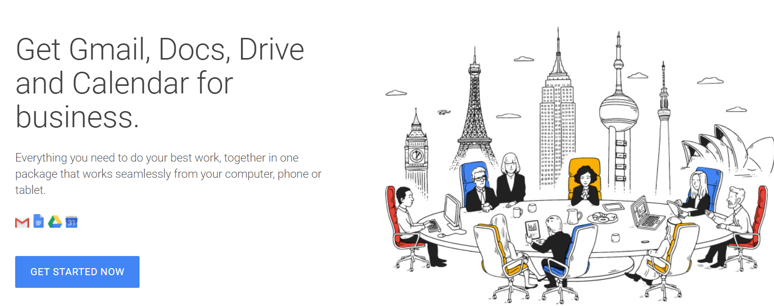
Cloud File Storage

Slide 12
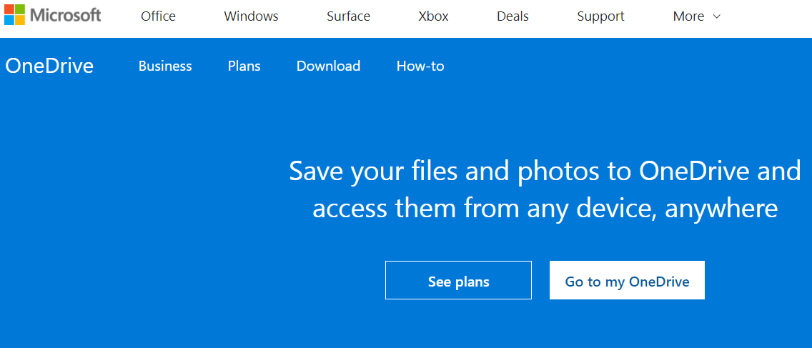
Cloud File Storage

Slide 13
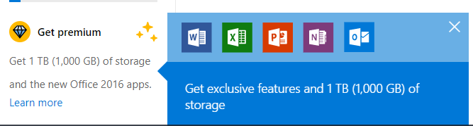
Cloud File Storage
The Premium (paid for version) of OneDrive offers additional storage and features

