Slide 1
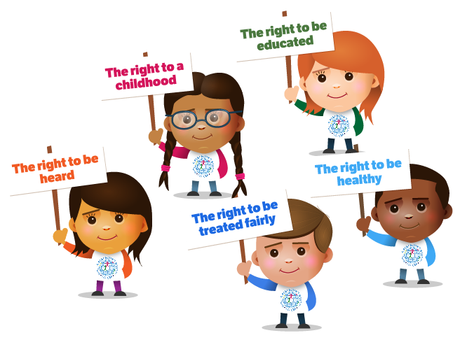
United Nations Convention on the Rights of the Child
(UNCRC)

Slide 2
Aims of the lesson
To understand the terms ‘rights’ and ‘needs’
To become familiar with and appreciate the UNCRC
To become familiar with Wales’ seven core aims
To identify the role of the Children’s Commissioner

Slide 3
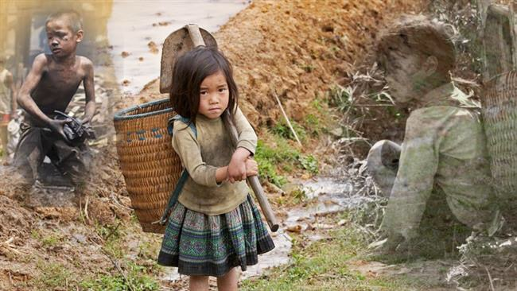
Basic Facts
Children’s rights are violated throughout the world every day…
Between 15 and 20 million children are working as slaves at this moment.
An estimated 2 million children worldwide are sexually exploited every year.
300,000 children around the world are actively participating in more than 20 armed conflicts.

Slide 4
Basic Facts
An estimated 25 million children and adolescents are currently uprooted from their homes; they make up nearly half of the refugee population worldwide.
There are an estimated 100 million children living on the streets today.
The UN Convention on the Rights of the Child (UNCRC)
Recognizes each one of these practices as a violation of human
rights, and obliges each government to work toward eliminating
these practices within their own nation and throughout the world.

Slide 5

What are the Needs of Children and Young People?

Slide 6
When was the UNCRC introduced?
The UN General Assembly adopted the Convention and opened it for signature on 20 November 1989 (the 30th anniversary of its Declaration of the Rights of the Child). It came into force on 2 September 1990, after it was ratified by the required number of nations.
What are the aims/purpose of the UNCRC?
The United Nation's Convention on the Rights of the Child (UNCRC) is an international rights treaty which applies to all children and young people under 18. The aim of the UNCRC is to recognise children's rights and ensure that children grow up in the spirit of peace, dignity, tolerance, freedom, equality and solidarity.
Have all countries ratified the UNCRC?
The UNCRC was adopted by the General Assembly on 20 November 1989 and has been ratified by 196 countries, including Somalia, making it the most widely ratified international human rights treaty in history. As of today, only one country has yet to ratify the landmark treaty – United States of America.
(Save the Children, 2021)
https://treaties.un.org/Pages/ViewDetails.aspx?src=IND&mtdsg_no=IV-11&chapter=4&lang=en

Slide 7
When did the UK sign up, and when did the UNCRC become Law in the UK?
The UK signed it in 1990, ratified it in 1991 and it came into UK law in 1992
How many Articles are included in the UNCRC?
54, all of which are linked, and no right is more important than another
What are the Articles?
Articles 1-42 are all about children’s rights. Articles 43-54 are about how governments and international organisations will work to give children their rights
What is the organisation working for children recognised by the UNCRC?
United Nations International Children’s Emergency Fund (UNICEF)
(Unicef, 2019)

Slide 8
What is the UNCRC?
The UNCRC is a treaty that lays out the rights of children and the standards to which all governments must aspire to promote these rights.
Children and Young People need special rights because they are relatively more vulnerable to abuse, and exploitation compared to adults.
The UNCRC brings together children’s human rights into one international convention.
(UNICEF, 2019)

Slide 9
What is the UNCRC?
The United Nations Convention on the Rights of the Child (UNCRC) is a legally-binding international agreement setting out the civil, political, economic, social and cultural rights of every child, regardless of their race, religion or abilities.
In 1989, governments worldwide promised all children the same rights by adopting the UNCRC.
The Convention changed the way children are viewed and treated – in other words, as human beings with a distinct set of rights instead of as passive objects of care and charity.

Slide 10
What is the UNCRC?

Slide 11
Task 1 – What is a right?
Discuss what is meant by this term.
Feedback your definitions

Slide 12
Rights
A Right is a power or liberty to which you are entitled. Rights serve as rules.
Rights are something everyone has because of being born.
No one has the power to give them to you or take them away from you.
Rights are what you are entitled to, needs are what you require.
)

Slide 13
Rights
Human rights are the basic things that all human beings are entitled to survive and to develop. Every single person regardless of their age has human rights, and the Government has a responsibility to make sure that people’s rights can be accessed, are respected and can be enjoyed.
Children and young people need special rights because they are relatively more vulnerable compared to adults. The UNCRC brings together children’s human rights into one international convention.
The Government has a responsibility to ensure that all people understand and respect Children’s Rights - this includes children and young people, parents, families, carers, teachers.

Slide 14
Task 2 - The Difference Between Needs and Rights?

Slide 15
Needs and Rights (OU, 2019)
All children have needs
Children are entitled to have their needs met
Needs can only be met if adults take responsibility for meeting them
Recognition of responsibility leads to recognition that children have rights
Fulfilment of rights means children’s needs are met

Slide 16
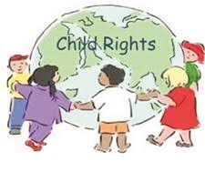
Why are Children’s Rights Important?

Slide 17
What makes the UNCRC so special?
Every child has rights, whatever their ethnicity, gender, religion, language, abilities or any other status.
United Nations International Children’s Emergency Fund (UNICEF) are the only organisation working for children recognised by the Convention.
There are four articles in the convention that are seen as special. They are known as the “General Principles”, and they help to interpret all the other articles and play a fundamental role in realising all the rights in the Convention for all children. They are:
Non-discrimination (article 2)
Best interest of the child (article 3)
Right to life survival and development (article 6)
Right to be heard (article 12)
(Unicef, 2019)

Slide 18
The UNCRC and the USA
Why hasn’t the USA ratified the UNCRC?
The US is not in compliance with the treaty.
Fear of infringement on USA’s rights.
Fear of interference in family life and parental child rearing.

Slide 19
The UNCRC and the USA
What has happened?
  In 1995 Madeline Albright, then the US ambassador of the UN, signed the UNCRC on behalf of President Clinton.
  Since the UNCRC was ratified, Bill Clinton, George Bush and Barack Obama have all failed to ratify the convention.
  USA still need to approve the UNCRC – they need State Department and Senate approval, and a presidential signature.

Slide 20
The UNCRC and the USA
What if the USA ratified the UNCRC?
  Greater priority of children’s rights in the United States and the world
  Quality education and healthcare guaranteed
  Influence the children’s rights in other countries
  Improve America’s reputation as a champion of child wellbeing

Slide 21
The UNCRC and the UK
In UK we have what is known as a Dualist State – this gives domestic legal effect to international treaties only to the extent they are provided for in UK legislation.
International law has to be national law as well, or it is no law at all.
Regardless of the UNCRC’s legal status, it does create a set of recognised standards.
Welsh Government formally adopted the UNCRC January 2004.

Slide 22
The UNCRC and Wales
The WG see children as right bearers, and in 2002 the UNCRC Committee applauded the WG for using the UNCRC in Wales’ strategy for children and young people, including information on what rights a child should have.
The Welsh Government formally adopted the United Nations Convention on the Rights of the Child as the basis for policy making for children and young people (0-25) in Wales in January 2004, and it received strong cross-party support from the National Assembly for Wales.
WG’s Seven Core Aims for children and young people were developed to summarise the UNCRC to help with national and local planning and delivery of services for children and young people.

Slide 23

Children’s Rights in Wales

Slide 24
Wales’ Seven Core Aims
Wales’ ambition is for all children to have a bright future. They want a future which is a fairer society and where every person is able to make the most of their abilities and contribute positively to the community that they live in. Wales do not want any children to be disadvantaged by poverty and inequality.
The Programme for Children and Young People incorporates the seven core aims, and has a detailed section for each, which includes an explanation and diagram to show how the Core Aims integrate with the Programme for Government, Well-being Goals, legislation, policies, programmes, outcome indicators and, of course, the articles from the UNCRC.
Additionally, all sections have been brought together in a comprehensive version of the Programme for Children and Young People.

Slide 25
Wales’ seven core aims
The seven core aims are:
To ensure that children in Wales have a flying start in life
Children have a comprehensive range of education and learning opportunities
Children enjoy the best possible health and are free from abuse, victimisation and exploitation
Children have access to play, leisure, sporting and cultural activities
Children are listened to, treated with respect, and have their race and cultural identity recognised
Children have a safe home and a community which supports physical and emotional wellbeing
Children are not disadvantaged by poverty
(National Assembly Wales 2019; Children’s Rights in Wales, 2019).

Slide 26
Wales’ Seven Core Aims
Homework Task
Use the UNCRC articles find out which one's link to each of the 7 core aims…
Example;
Core aim one: To ensure that children in Wales have a flying start in life, links to articles: 3, 6, 18, 28, 29 and 36 of the UNCRC

Slide 27

Children’s Commissioner
Wales was the first country in the UK to have a Children’s Commissioner in 2001, with England employing a Children’s Commissioner shortly after.
The key aims of a Children’s Commissioner are to safeguard and promote the rights and welfare of children, support children and young people, listen to children and young people, advise children and young people and those who care for them, influence the government and other organisations on children’s rights and to speak up for children and young people within Wales.
The Children’s Commissioner is also compelled to pay extra attention to the interest and views of those children in marginalised factions. (Williams, 2013; Children’s Commissioner Wales, 2016; Dunford, 2010)

Slide 28
Children’s Commissioner
Class questions and discussion…
Do you know the current children’s commissioner for Wales?
Rocio Cifuentes– has been in the post since April 2022. Rocio has held numerous posts within the children & young people sector. Her past roles were Chief Executive of the charity Ethnic Minorities and Youth Support Team (EYST) Wales. She has also served on the Wales Committee for Equality and Human Rights Commission and chaired the Welsh Refugee Coalition. She has also taught in a college, worked in youth homelessness and set up a charity for young people with mixed abilities including disabilities called Mixtup.
Do you know the maximum length of time a children’s commissioner can stay in their role?
7 years, discuss why you think this may be
Do you think that children’s commissioners are promoted enough?
Do you think that the children’s commissioner is doing a good job in Wales? Explain.
(Welsh Government, 2023)

Slide 29
References
Children’s Commissioner for Wales (2016) About Us: Championing the Rights for Children and Young People in Wales [online] Available at: http://www.childcomwales.org.uk/about-us/ (accessed 17/10/2016)
Children’s Rights in Wales (2019) Policy and Law Reform [online] Available at http://www.childrensrightswales.org.uk/policy-law-reform.aspx (accessed 17/10/2016)
Dunford, J. (2010) Review of the Office the Children’s Commissioner England. London: Crown Copyright
National Assembly Wales (2019) Children and Young People: Rights to Action. Cardiff: Welsh Government Available at: http://www.assembly.wales/Committee%20Documents/HSS(2)-02-04%20Paper%201%20%20Children%20and%20Young%20People%20Rights%20to%20Action-04022004-14558/n0000000000000000000000000016990-English.pdf (Accessed 12/2/19)
Open University (OU)(2019) Understanding Children’s Rights: The relationship between needs and rights. Available at: http://www.open.edu/openlearncreate/mod/oucontent/view.php?id=53766&section=3.4.1 (Accessed 12/2/19)
Save the Children (2021) UN Convention on the Rights of the Child (UNCRC) An International Agreement for Child Rights Available at: https://www.savethechildren.org.uk/what-we-do/childrens-rights/united-nations-convention-of-the-rights-of-the-child (accessed 15/02/2021)
UNICEF (2019) What is the UNCRC? Available at: https://www.unicef.org.uk/what-we-do/un-convention-child-rights/ (accessed 12/02/2019)
Welsh Government (2017) Children’s Commissioner [online] Available at: http://gov.wales/topics/people-and-communities/people/children-and-young-people/rights/commissioner/?lang=en (accessed17/02/2018)
Williams, J. (2013) The United Nations Convention on the Rights of the Child in Wales. Cardiff: University of Wales Press

