Slide 1
Which reflex points to work

Slide 2
What you can experience
Tenderness: –
Indicates and imbalance in the follow of energy and circulation with can manifest as congestion, inflammation and irritation.
Tenderness can also reflect past trauma to an area such as accident – sensitivity
Crystals - indicate congestion in tissues.
Represent areas of trauma
Pitman and Mackenzie (2002) Reflexology A practical Approach. Nelson Thornes

Slide 3
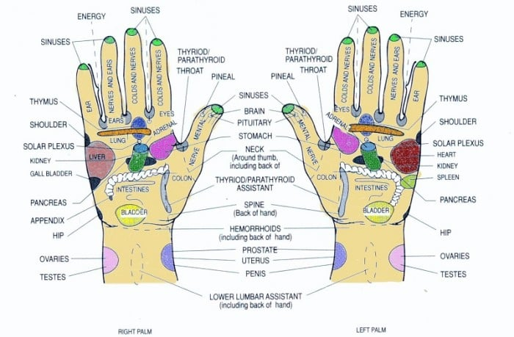
Headaches
Poor digestion/constipation- toxins.
Work the stomach and intestines and colon
reflexes
Menstrual imbalances in women – ovaries,
Liver congestion- liver reflex
Eye strain for migraine –Eye reflex
Neck, jaw, midback shoulder area tension.
Work head reflex, neck reflex and shoulder
reflex

Slide 4
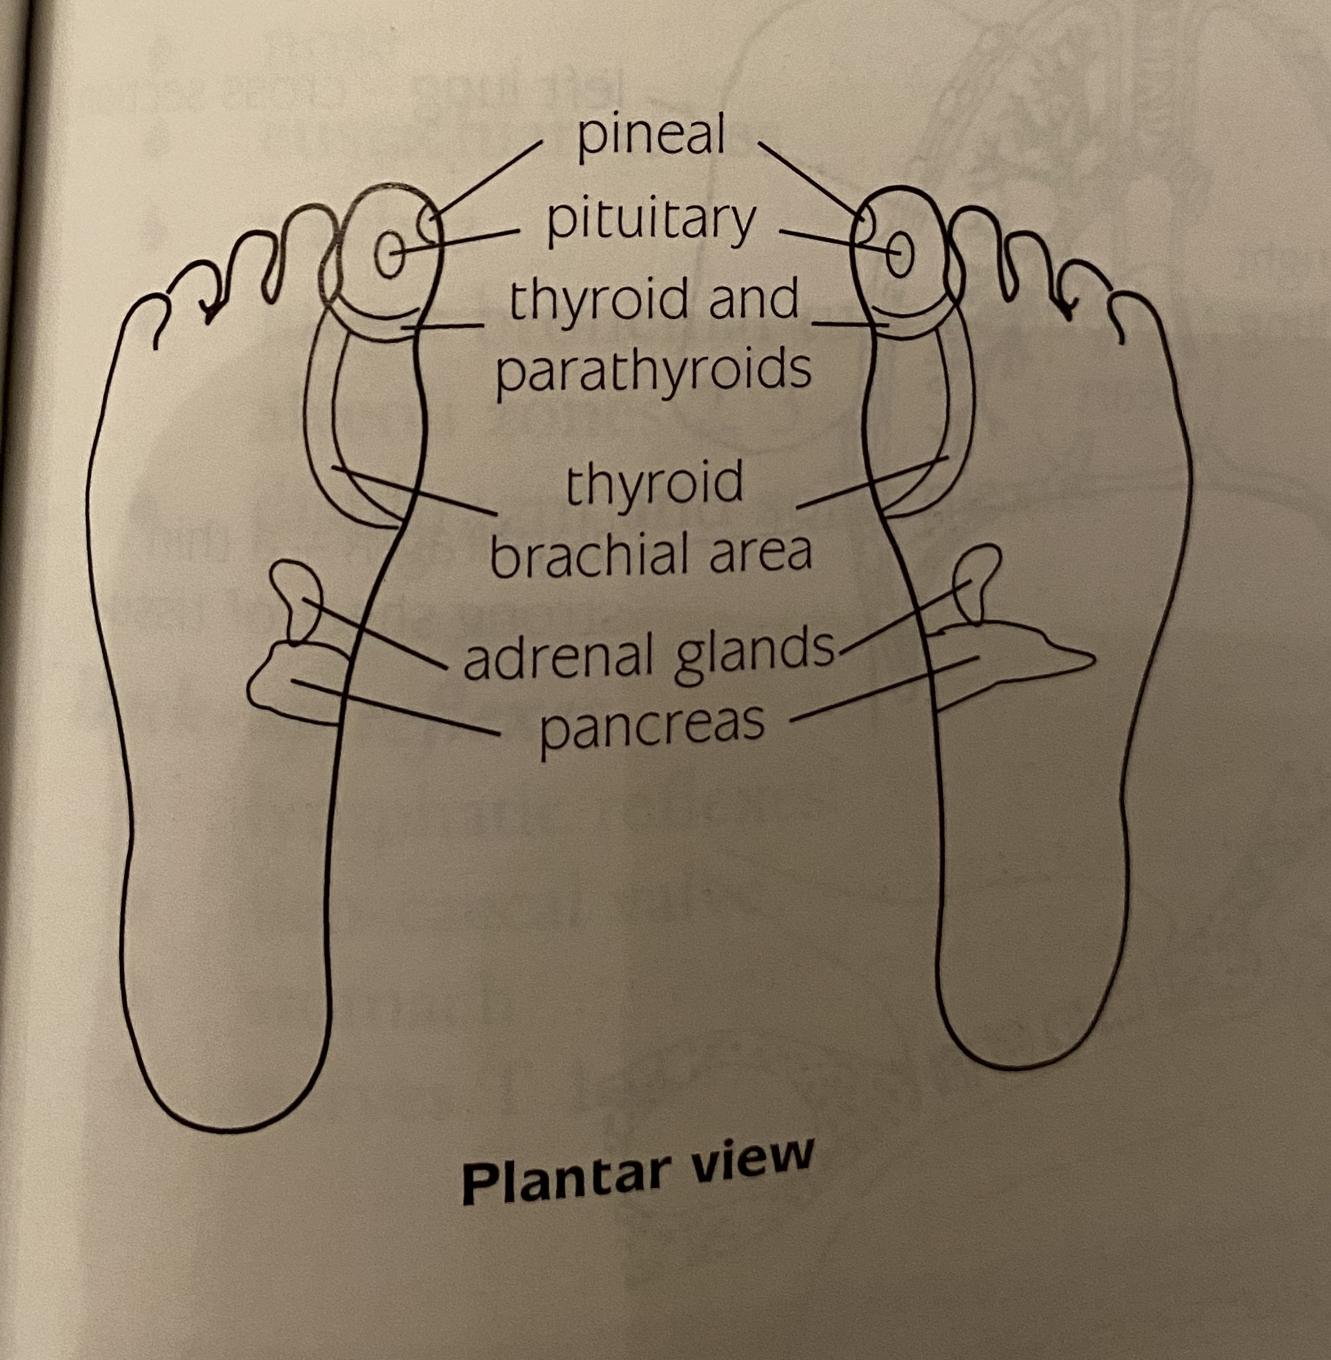
Endocrine system
Pituitary gland
Pineal gland
Thyroid
Thymus gland
Adrenal glands
Pancreas

Slide 5
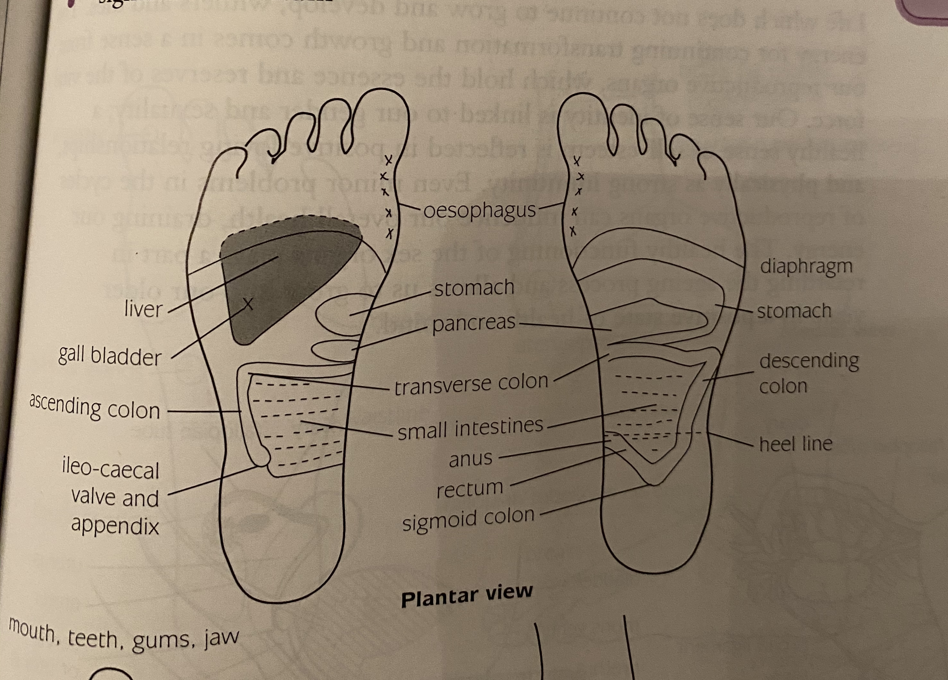
Digestion
Oesophagus
Stomach
Small intestine
Liver
Gall bladder
Pancreas
Sigmoid and rectum

Slide 6
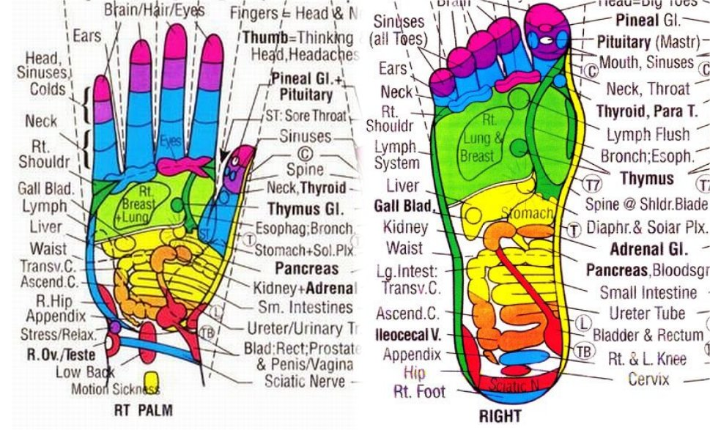

Slide 7


