Slide 1



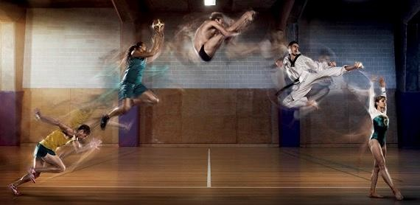


Sports Trauma Management
9. Exposure, Environment & Everything Else
c. Medical Emergencies
vi. Hypothermia
16 Royal Terrace, Glasgow, G3 7NY, T: 0845 600 2613, F: 0141 332 5335, W:www.society-of-sports-therapists.org, E: admin@society-of-sports-therapists.org

Slide 2





Hypothermia
Mild
Moderate
Severe
32-35ºC
30-32ºC
<30ºC
Core Temperature | Features
35º | Maximum shivering thermogenesis
31º | Shivering stops
30º | Atrial fibrillation & other dysrhythmias
29º | Reduced LOC, bradycardia, bradypnoea
24º | Hypotension
22º | Ventricular fibrillation
18º | Asystole

Slide 3
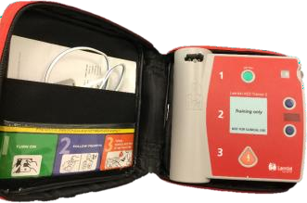
Management of Hypothermia
Remove Pt from cold and remove wet clothes
Dry skin gently
High Flow 0₂
Continuous observation
Careful handling
  Airway adjuncts may trigger VF
Withhold adrenaline until 30ºC
And then double the interval
  3rd, 7th, 11th
If in cardiac arrest
  Deliver 3 shocks as per protocol – despite temperature
  Withhold further shocks until +30ºC

