Slide 1
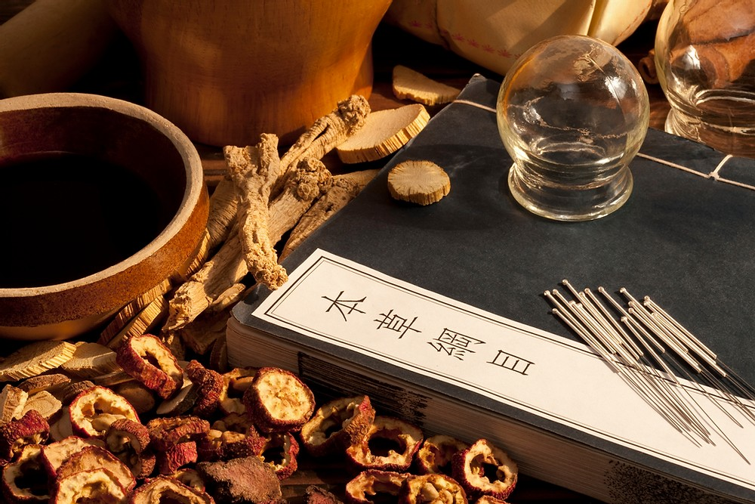
Student Name and Student Number:
Shamarlah Benjamin -1817308
Nadine Gayle -1816824
Mehrunnisa Ayub - 1814905
Awais Ali -1816831
Letitia Buyana - 1817068
Module: Complementary Therapies Group 1 Acupuncture
Module code: BMHP5001_BIRM
Lecturers Name: Dr Mark Gallagher-Read
Group 1: Acupuncture
(Vanecek ,N. 2020)

Slide 2
Order of Presentation
Letitia - Introduction to Acupuncture
Mehrunnisa -History of Acupuncture
Nadine - Benefits of Acupuncture
Shamarlah - Contraindications and Risks of Acupuncture
Awais – Conclusion

Slide 3
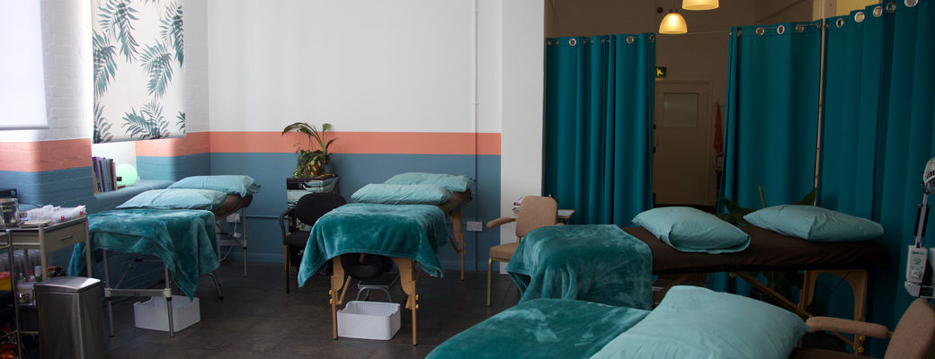
Introduction
What is acupuncture? (Napadow, V., Ahn, A, Longhurt, J., Lao, L., et al, 2008).
Why is it important to know about acupuncture?
How does acupuncture work?
Where is acupuncture practiced? (Geanty, R.2015)

Slide 4
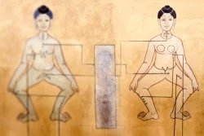
History
The theory and practice of acupuncture originated in china. It was first mentioned a few hundred years before the common era, acupuncture can de dated back to the stone ages.
Evidence can be found such as sharp tool and stones were used in practises to drain excess abscess.
Acupuncture was first recorded during the ancient Chinese era by medical text by Huang Di Nel Jing, The Yellow Emperor's Classic of Internal Medicine (White, Earnest 2014).
Modern acupuncture was established during the Ming Dynasty (1368-1644).
It was later introduced in japan and was imported to the West from the 17 century and the later recorded in Europe in the 18 century.

Slide 5
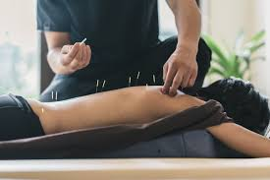
Benefits

Slide 6
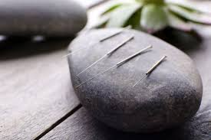
Benefits
During the follicular phase - day 5, 6, 7 or 8 of your menstrual cycle
What are some of the benefits of acupuncture (Looking at positive) ?
What can acupuncture help with?
(tccablogadmin, 2018)

Slide 7
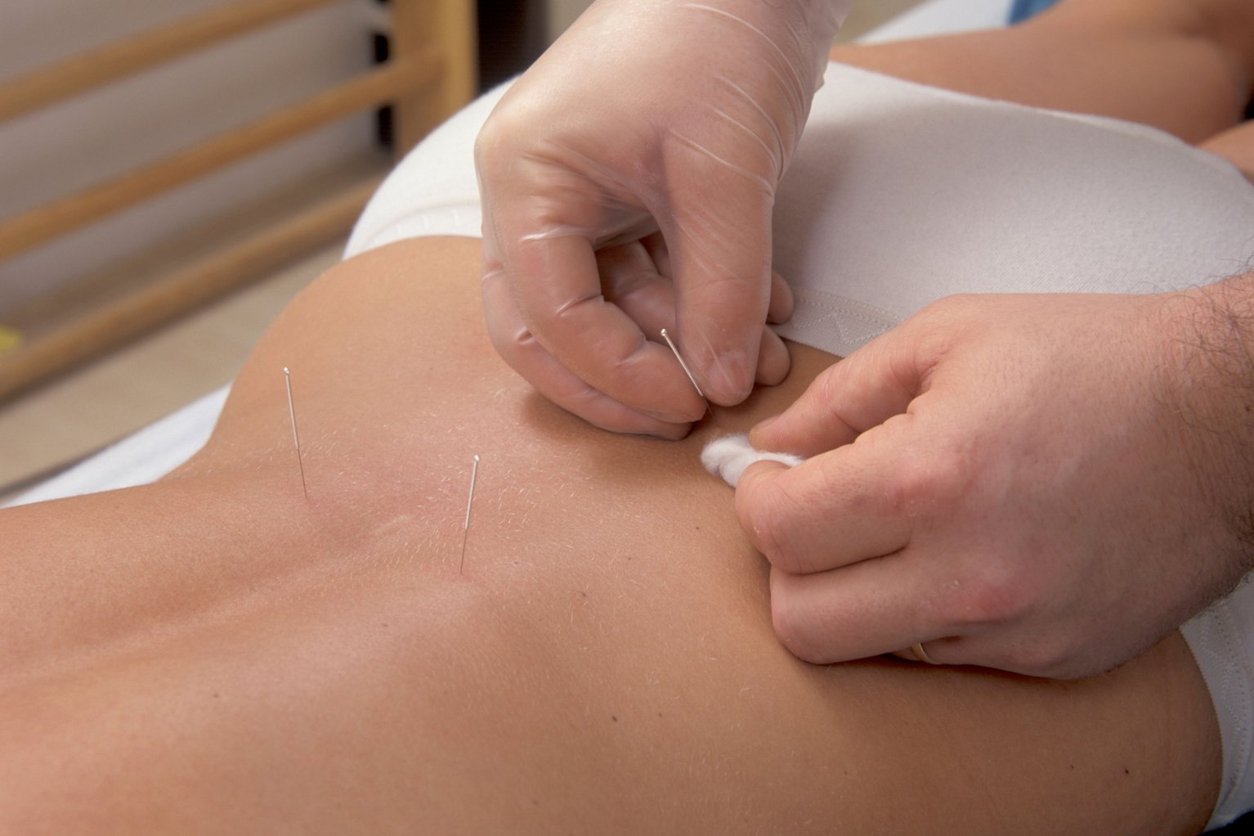
Benefits
Stress
Depression
The Needles are inserted into specific places on the body, which practitioners call acupuncture points.
Pain
Dental pain
Hypertension
Allergies
Increased Energy
Chronic pain
Anxiety
Morning sickness
Enhanced Mental Clarity
Chronic headaches
Reduced Eye Strain
White, A. (2017). Acupuncture for Back Pain: Does it Work? [online] Healthline. Available at: https://www.healthline.com/health/acupuncture-for-back-pain#benefits [Accessed 15 Feb. 2021].

Slide 8
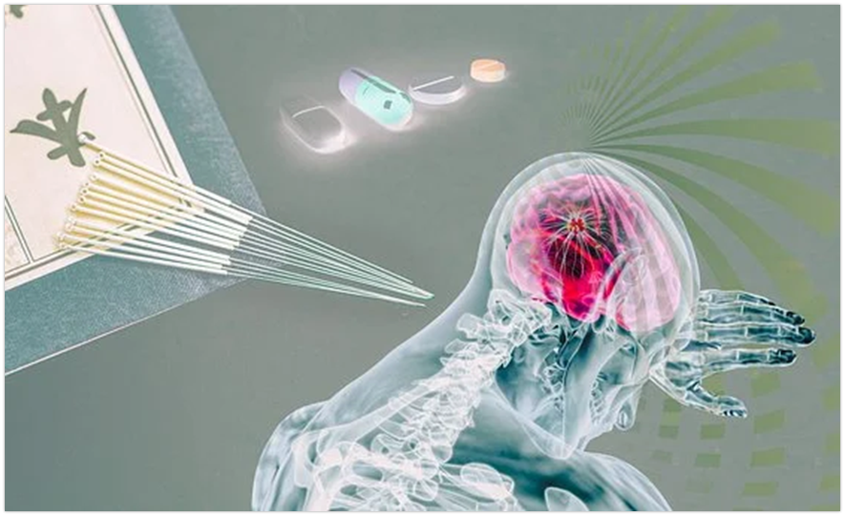
Risks and Contra-indications of Acupuncture

Slide 9
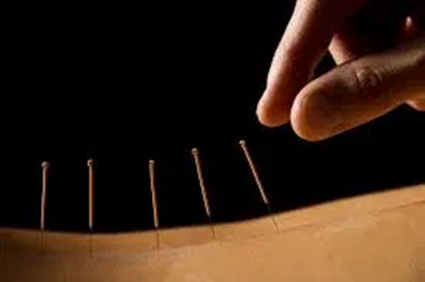
Risks and Contra-indications
Why can contra-indications take place during acupuncture?
According to (Zanardi, P. 2004) Throughout the United states of America acupuncture remains an instability field.
www.balwynnorthchiropractic.com
Like other psychiatric procedures, acupuncture treatments contain some counterindications

Slide 10
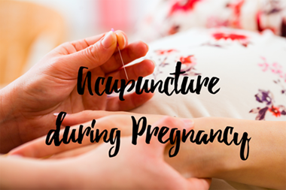
Bleeding disorder
Muscle spasms and tremors
Reliant on drugs or alcohol
Unwilling to participate
Allergies
Arthritis
Pregnancy
Injury and soreness
Electro-acupuncture
Skin disorders
Costly

Slide 11

Risks and Contra-indications
According to (Borland, S. 2012) Countless numbers of NHS patients have already had serious side effects from acupuncture.
National Patient Safety Agency
Dangerous
that the actual dangerous figures are highly probable to be even significantly greater, as their research only covered people who have acupuncture in the NHS rather than independently.
(Borland, S. 2012)
Many complications
Complementary therapy which involves needle-punching flesh is not as safe as originally believed.
(Borland, S. 2012)

Slide 12
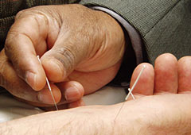
Conclusion
Is Acupuncture recognised to be a valid treatment by western health professionals and organisations?
According to (Hawkes, N. 2016) “Acupuncture from a western perspective?”
Does acupuncture really work?
(Greenfacts, 2015)

Slide 13
Quiz
How many different types of acupuncture are available?
Name two types of acupuncture?
What should you look for in a Acupuncturist?
What dynasty was acupuncture first discovered?
What is the main purpose for acupuncture?
Would you have acupuncture

Slide 14
References
balwynnorthchiropractic.com. Acupuncture. Are you looking for an acupuncturist in Balwyn or Kew? https://www.balwynnorthchiropractic.com.au/services/acupuncture-balwyn/ [Accessed on: 05 February 2021]
Borland, S. (2012). Mail online. Hidden perils of acupuncture: Lost needles, punctured lungs and fainting among NHS horror stories. https://www.dailymail.co.uk/health/article-2198441/NHS-horror-stories-Hidden-perils-acupuncture-lost-needles-punctured-lungs.html [Accessed on: 19 February 2021]
Geanty, R.(2015) Norwich acupuncture rooms. Faqs. https://www.norwichacupuncturerooms.co.uk/faqs/ [Accessed on: 26 February 2021]
GreenFact. (2015). Evaluating effectiveness and safety of acupuncture. https://www.greenfacts.org/en/acupuncture/index.htm#1
[Accessed on: 20 February 2021]
Hawkes,N. (2016). How acupuncture works- from a Western perspective. nikkihawes.com/how-acupuncture-work/
[Accessed on: 20 February 2021]
Miller, B.(2020) Green Garage. 12 Pros and Cons of Acupuncture. https://greengarageblog.org/12-pros-and-cons-of-acupuncture
[Accessed on: 05 February 2021]
Notes:
14
14
14

Slide 15
Napadow, V., Ahn, A, Longhurt, J., Lao, L., et al, (2008). The status and future of acupuncture mechanism research. J Altern Complement Med. 14 (7), 861-869.
Sullivan, D., (2021). Acupuncture: How It Works, Benefits, and Results for Pain. Healthline. https://www.healthline.com/health/acupuncture-how-does-it-work-scientifically#TOC_TITLE_HDR_1 [Accessed 7 February 2021].
Vanecek ,N. (2020). EastWest acupuncture. OK, lets talk COVID & Chinese Medicine. https://eastwest-acu.com/ok-lets-talk-covid-chinese-medicine/ [Accessed on: 05 February 2021]
White, A. (2017). Acupuncture for Back Pain: Does it Work? [online] Healthline. https://www.healthline.com/health/acupuncture-for-back-pain#benefits [Accessed 15 February 2021].
White, A, Ernest, E (2014). A Brief History of Acupuncture. https://doi.org/10.1093/rheumatology/keg005 [Accessed 18 February 2021].
Zanardi, P. (2004) Spine-health. Acupuncture considerations. https://www.spine-health.com/treatment/alternative-care/acupuncture-considerations [Accessed on: 05 February 2021]

Slide 16
Thank you
(Vanecek ,N. 2020)

