Slide 1
Understanding psychological development across the lifespan
Student Name: Graciete de Jesus Pires Estroia.
Student ID: 2008307
Module Code:BMHP4003_BIRM Psychology in Health and Social Care
Module Co-ordinator : Rebecca Kavanagh
Assignment section: Task 1 –Academic Poster.

Slide 2
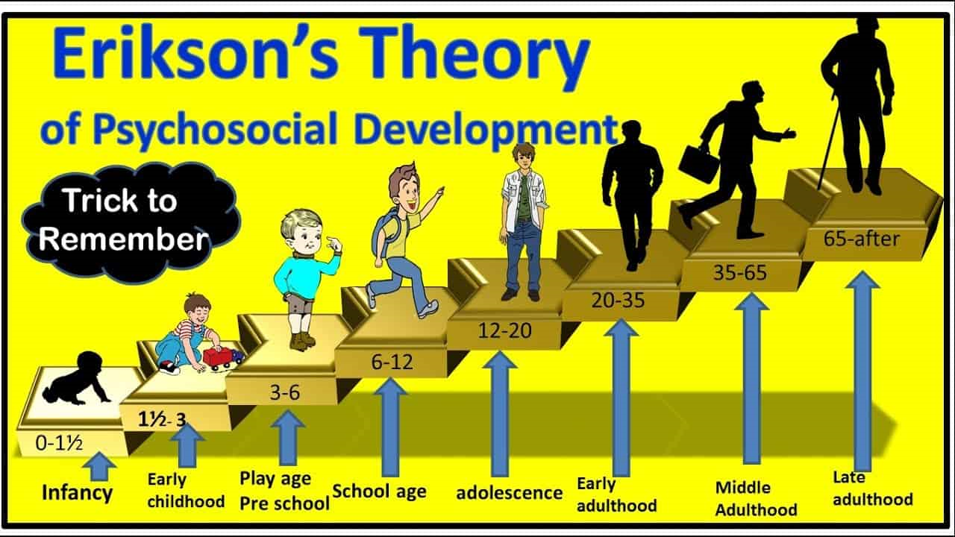
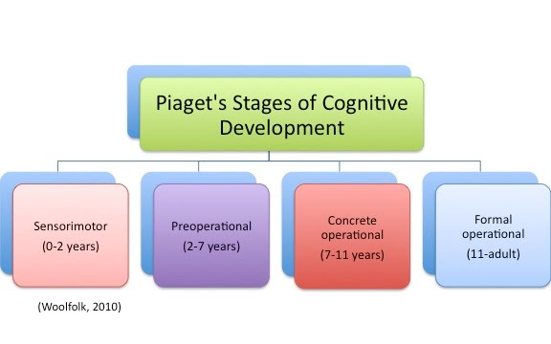
Understanding psychological development across the lifespan
Introduction: Psychology is a science who talk about 8 stages, Erickson theory, around progress and growth, through the affiliation of the individual and his wishes to culture. Each stage determined by why his call the crisis and the base of this crisis is the psychological change that because the problems that must be resolved. Observe the Piaget stages and how they develop, as well as the comparison of each scientist's focus.
According to Erikson's theory development Identity means understanding and acceptance of self and society. Identity grows from stage to stage, and the initial image of identity influences subsequent images.
Stage 1: Basic Trust vs. Mistrust: Birth to age 1 It is the basis of self-esteem or self-confidence. Belief and scepticism Affective ties are formed, resulting in a sense of bodily trust. Belief (or misbelief) in the provision of basic requirements such as food and compassion.
Stage 2: Autonomy vs. Autonomy Shame and Doubt: Ages 1-3: Main figure are the parents; the reaction of the parents plays a big role. In many undertakings, cultivate a sense of self-sufficiency.
Stage 3: Initiative vs. Guilt: Ages 3-5: Development of initiative and feeling of guilt. Take charge of some activities—you might feel guilty if you fail or if your limits are crossed.
Stage 4: 6-11 Industriousness vs. Inferiority: Ages 6-11 discovery of creativity. Property of human culture. Friends are very important. Inferiority can be a challenge. Build self in one's abilities when one is competent, or a lack of self - esteem when one is not.
Stage 5: Identity vs. Role Confusion: Ages 12-18 Groups and the search for their identity. Confrontations with the father figure. Explore with and expand your sense of self and role.
Stage 6: Intimacy vs. Isolation: Ages 18-35 (approximately) Period of love, romantic or also the isolation that can stop the person. Establish bonds and connection with people.
Stage 7: Generativity vs. Stagnation: Ages 35-55 (approximately) The main figure is family and work, biological reproduction, having children, achievement and social development. The previous stages are the resolution of what may affect this stage. Make a contribution to society while also being a part of a family.
Stage 8: Ego Integrity vs. Despair: Ages 55+ The main figure is humanity, reflecting on what its past has been like. You can see integrity if the reflection had success or despair if it has not concluded the stages positively will have to face death and guilt. Evaluate and make sense of one's life and the significance of one's contributions.
According to Jean Piaget established a cognitive development theory stage are:
Sensorimotor is stage 1: (0-2 years) young new-borns do not remember an object after it has been withdrawn from their sigh, and youngsters learn about the environment through their senses and physical action.
Preoperational is stage 2: (2-7 years) In this phase children can use symbols to show words, pictures and ideas, which is why kids presume to be playing. Piaget devised the Three-Mountain Task to assess children's egocentrism.
Concrete operational is stage 3: (7-11 years) Children at this age are able to reason logically about real (concrete) events, have a good grip on the usage of numbers, and are beginning to apply memory methods. The notion of reversibility is also understood by children in the concrete operational stage, which means that items can be changed and subsequently returned to their original form or condition.
Formal operational is stage 4: (11 to adulthood) In addition to abstract concepts and hypothetical circumstances, children in the formal operational stage may deal with them. This stage allows children to utilise abstract thinking to solve problems, consider alternate answers, and test them.
Erikson (1993
Comparation: Both Piaget and Erikson were European psychoanalysts who were schooled in the Freudian tradition; both would eventually reject Freud's mental model; and both would make significant contributions to the study of child development. However, the difference between both is Erikson focuses on the self and social orientation, while Piaget focuses on the child's abilities and senses.
Activity: Psychology and Nurses can use Erikson theory stage in healthcare when they are supporting old people, like encourage them to be independent and self-management. Also getting them involve in activities to chance they health or disabilities, this involves considerable effort or time commitment.
Conclusion: Many beliefs exist on how babies and children grow up to become happy, healthy individuals. Erikson adapted Freud's concepts and proposed a psychosocial development hypothesis. concept of self is shaped through our social interactions and the accomplishment of social tasks, argument Erikson. Jean Piaget established a cognitive development theory that describes how children reason and think as they progress through different stages according to Erikson mean axes of life is the search for identify; this term referred to the subconscious, understanding and acceptance of self and society.

Slide 3
Bibliography
Boyd, D., & Bee, H. (2019). Lifespan development, global edition. ProQuest Ebook Central. Available From : https://ebookcentral.proquest.com (pp 389- 399) ( Access on 01/06/2021)
Brown, C. and Lowis, M. J. (2003) ‘Psychosocial development in the elderly: An investigation into Erikson’s ninth stage’, JOURNAL OF AGING STUDIES, pp. 415 – 426 (Access on 08/06/21)
Brown, C. and Lowis, M. J. (2003) ‘Psychosocial development in the elderly: An investigation into Erikson’s ninth stage’, JOURNAL OF AGING STUDIES, pp. 415 – 426. Available From: doi:10.1016/S0890-4065(03)00061-6 (Access on 05/06/2021)
Clark NM, Becker MH, Janz NK, Lorig K, Rakowski W, Amderson L. Self-management of chronic disease by older adults: A review and questions for research. Journal of Aging and Health. 1991;3(1):3–27. Available From: https://deepblue.lib.umich.edu/bitstream/handle/2027.42/67628/10.1177_089826439100300101.pdf?sequence=2 ( Access on 03/06/2021)
Erikson, E. H. (1993). Childhood and society. WW Norton & Company. Available from: https://scholar.google.com/citations?user=kj8e2QMAAAAJ&hl=es&oi=sra ( Access on 11/06/21)
Erikson, E. H., Erikson, J. M., & Kivnick, H. Q. (1994). Vital involvement in old age. WW Norton & Company. Available From: https://books.google.co.uk/books?hl=es&lr=&id=LWg-AAAAQBAJ&oi=fnd&pg=PP2&ots=6cBTdIgVoz&sig=MMF35qBYqeGeCG4vZc1VgigX-wQ&redir_esc=y#v=onepage&q&f=false (Access on 10/06/2021)
Gilleard, C., & Higgs, P. (2016). Connecting Life Span Development with the Sociology of the Life Course: A New Direction. Sociology, 50(2), 301–315. Available From: https://doi.org/10.1177/0038038515577906 ( Access on 04/06/21)
Image of Erikson theory Available From : https://notester.co/study-notes/erik-eriksons-psychosocial-development-theory/ ( Access on 31/05/21)
Image of Piaget’s theory Available From : https://1c682a6f-a-b8b365a8-s-sites.googlegroups.com/a/npsd.org/new-teachers-guide-using-educational-psychology/home/the-cognitive-development-of-students/Slide1.jpg (Access 30/05/2021)
Marcia, J. E. (2002). Identity and psychosocial development in adulthood. Identity: An international journal of theory and research, 2(1), 7-28.Available From: https://www.tandfonline.com/doi/abs/10.1207/S1532706XID0201_02 ( Access on 04/06/21)
Perry, T. E., Ruggiano, N., Shtompel, N., & Hassevoort, L. (2015). Applying Erikson's wisdom to self-management practices of older adults: findings from two field studies. Research on aging, 37(3), 253–274. Available From: https://doi.org/10.1177/0164027514527974 (Access on 05/06/2021)
Piaget, J. (2003). Part I: Cognitive Development in Children--Piaget Development and Learning. Journal of research in science teaching, 40. Available From: https://eric.ed.gov/?id=EJ773455 (Access on 22/05/2021)
Plomin, R. and Daniels, D. (1987) ‘Children in the same family are very different, but why?’, Behavioral & Brain Sciences, 10(1), p. 44. Available From: https://www.cambridge.org/core/journals/behavioral-and-brain-sciences/article/abs/children-in-the-same-family-are-very-different-but-why/E25EBFF425678F5D9168DC2A2C037B6C (Access on 05/06/21)
Rosenthal, D. A., Gurney, R. M., & Moore, S. M. (1981). From trust on intimacy: A new inventory for examining Erikson's stages of psychosocial development. Journal of Youth and Adolescence, 10(6), 525-537. Available From: https://link.springer.com/article/10.1007/BF02087944 (Access on 03/06/2021)
Slavin, R. E. (2019). Educational psychology: Theory and practice. Available From: 0205351433.pdf (pearsonhighered.com) ( Access on 07/06/2021)
Sulloway, F. J. (1996) Born to rebel: Birth order, family dynamics, and creative lives. New York, NY: Pantheon Books (02/06/2021)

Slide 4
Annotation Bibliography
Boyd, D., & Bee, H. (2019). Lifespan development, global edition. ProQuest Ebook Central, pp.389 - 399.
This book is how to learn about different theories of development psychology. Agreed with Boyd & Bee (2019) suggested that Self-management as the “day-to-day efforts that individuals must perform to regulate or lessen the impact of disease on physical health status” and helps to understand that elders can be independent and make their life easy and enjoying the time with friends, family and others. This book is trustworthy since it was published in a peer-reviewed publication, and the author is a specialist in the subject of Lifespan Development Psychology. For the poster, I used between 389 and 399 pages of this book to assist me comprehend and explain Erikson's theory in the elderhood stages.
Brown, C. and Lowis, M. J. (2003) ‘Psychosocial development in the elderly: An investigation into Erikson’s ninth stage’, JOURNAL OF AGING STUDIES, pp. 415 – 426.
This article helps to understand the elderhood suggested that after stage 8 can be Stage 9 that human beings stay in a state of potential psychological and (perhaps) spiritual growth for the rest of their lives, regardless of how many years they live. Such knowledge can only bring comfort to the elderly, as well as crucial insight to friends, relatives, and caregivers who can obtain a better grasp of what lurks under their senior charges' outward behaviour.
Clark et al (1991)Self-management of chronic disease by older adults: A review and questions for research. Journal of Aging and Health. 1991;3(1):3–27.
This book is how to learn about Self-management as the “day-to-day efforts that individuals must perform to regulate or lessen the impact of disease on physical health status”. This book is credible as it is published in a reviewed journal, it is reliable as the author is an expert in this field of used page 25 of this book to help me to understand and explain Erikson’s theory in elderhood stage. It helps to understand that if you have successfully completed all of Erikson's stages, it is now time to make happy memories and share them with family, caregivers, and friends.
Erikson et al (1994). Vital involvement in old age. WW Norton & Company.
This book is how to learn about in what way individuals in their late adult years, the reflect on their lives and feel either gratified or dissatisfied. Also shows Erikson theory in 8 stages: Individuals who are proud of their accomplishments have a strong sense of identity and few sorrows in their lifetimes. People who are not successful at this point in their lives, on the other hand, may feel as if their lives have been wasted. They focus on the "might have, should have, and could have" scenarios. It can make them feels bitter, depressed, and despairing as they approach the conclusion of their life. This article is credible as it is published in review journal and it is reliable as the author is an expert in this field. I used page 44-55 of this book to help me to understand Erikson stages of psychology.

Slide 5
Annotation Bibliography
Erikson, E. H. (1993). Childhood and society. WW Norton & Company.
In this article, Erikson (1993) highlights how clinical psychoanalysis is linked with a cultural anthropological approach. It explains the social significance of childhood, as well as the links between education and culture, as well as fear and social anxiety in children. Descriptions of circumstances recorded in children's clinics, in the rehabilitation of war veterans, in the education of American Indians, and in the investigation of modern ideologies of the young of industrialised countries are used to investigate the qualities of maturity and infantilism. Modern and archaic human motivations.
Gilleard, C., & Higgs, P. (2016). Connecting Life Span Development with the Sociology of the Life Course: A New Direction. Sociology, 50(2), 301- 315. https://doi.org/10.1177/0038038515577906
This article aims to address three interconnected concerns related to the possibility of a more fruitful exchange between life course sociology and life span psychology. The first is to try to explain why these two sub-disciplines haven't been able to develop their engagement with one another, despite their long-standing desire to do so; the second is to highlight the potential for Erik Erikson's model of life span development to enrich sociology of the life course; and the third is to highlight the potential for linking Erikson theory with contemporary research. This article helps to understand and explain Erikson's theory stage, which is found between pages 301-315 of this book.
Marcia, J. E. (2002). Identity and psychosocial development in adulthood. Identity: An international journal of theory and research, 2(1), 7-28.
This article helps to comprehend adult psychosocial development that is examined from a variety of angles. In terms of status measurements, stage-specific crises in ego growth connected with different life cycle stages are handled, building on Erikson's polar alternative resolves (Erikson, 1959). This article is credible because it was published in a peer-reviewed journal, and it is reliable because the author explains Erikson's theory on the stages of human development. In the elderhood stage, I used this article to assist, explain, and comprehend Erikson's theory.
Perry et al (2015). Applying Erikson's wisdom to self-management practices of older adults: findings from two field studies. Research on aging, 37(3), 253–274.
This article helps to understands the author thesis about how older persons apply wisdom in new fields. Older persons reasserted their autonomy by initiating creative problem solving, and by applying abilities learned from productive activities earlier in life to new health-related difficulties that arose later in life. Also understand Erikson’s theory in older adults. This article is credible because it was published in a peer-reviewed journal, and it is reliable because the author explains Erikson's theory of human development stages. This article was used to locate Stage 8 of Erikson theory on pages 253-274 in order to build the poster.

Slide 6
Annotation Bibliography
Piaget, J. (2003). Part I: Cognitive Development in Children--Piaget Development and Learning. Journal of research in science teaching, 40.
As a result, this article demonstrates Piaget theory's uncertainty that this will accelerate the development of cognitive structures' talent. The operational aspect not the analysis of states, but the comprehension of transformations requires reinforcement. Bringing together minds Marcia (2002) The cyclical process that may describe identity re-formulation through the adult psychosocial stages is discussed and illustrated in relation to identity. Finally, two adult psychosocial development case studies are provided. This source is credible because it was published in a peer-reviewed journal, and it is trustworthy because the author is a subject matter expert in this field. On pages 176-186 of this article, Piaget's theory was used to understand Cognitive Development in Children—Piaget Development and Learning.
Rosenthal, et al (1981). From trust on intimacy: A new inventory for examining Erikson's stages of psychosocial development. Journal of Youth and Adolescence, 10(6), 525-537.
This article demonstrates the understanding according to Rosenthal et al (1981) says that Erikson’s psychosocial stages are examined using a new inventory. Each subscale comprises 12 items in the self-report questionnaire, which was designed in a pilot research of 97 teenagers and tested in a survey of 622 teenagers. The reliability and validity of the data is shown. The Erikson Psychosocial Stage Inventory (EPSI) has found to be a useful tool for researchers in the field of psychosocial development. The Erikson Psychosocial Stage Inventory (EPSI) is a valuable measure for researchers interested in early adolescent development and mapping changes as a consequence of life experiences, according to the findings.
Slavin (2019). Educational psychology: Theory and practice.
According to Slavin (2019), the goal of education is to captivate students' minds with compelling and useful concepts rather than simply loading information into their skulls. The goal of this is to investigate various approaches to achieving this goal. This book is credible because it was published in a peer-reviewed journal, and it is trustworthy because the author is a subject matter expert in this field. I created the poster with the help of page 257, which helped me understand the alternative ideas of teaching and learning in individuals.

