Slide 1
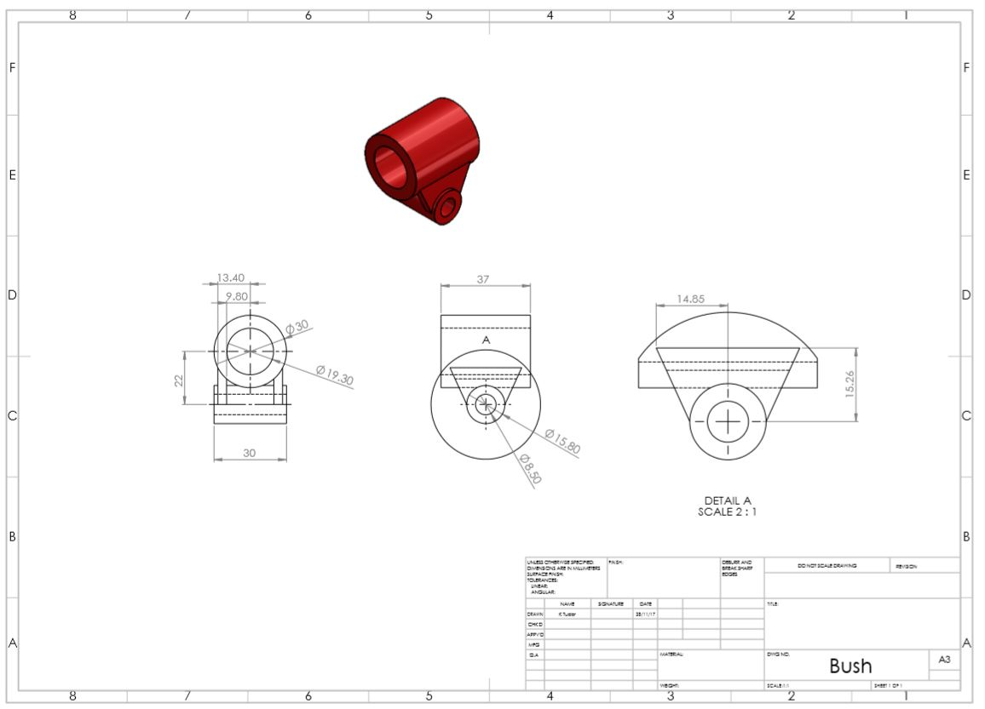

Slide 2
Isometric View
Section View
Front View
Side View
Hidden Detail
Dimension Line
8
Centre Mark
Centre Line
9
4
3
Scale
2
5
6
1
7

Slide 3
Numbers on the Technical Drawing.
Title
Name of Designer
Date
Signature/ID number
Checked by
Approved by
Material
Finish
Tolerances

