Slide 1
BMTP6016
Strategic Management
Internal Analysis of Business
Dr. Ernest Balutie Wavei

Slide 2



Slide 3
Where Are We Now?
Module: | Strategic Management
Week | Lecture Topic
1 | Module Overview, Strategic Management in business operations & Assignment
2 | Strategy and Theoretical Underpinnings
3 | Stakeholders in Tourism, Events and Leisure
4 | Internal Analysis of a Business
5 | External Analysis of a Business
6 | Strategy Formulation Tools
 | Reading Week
7 | Strategic Leadership
8-10 | Political economy, Geopolitical Dynamics, and Strategies
11-13 | Module Recap, Assignment Workshop, & Assignment Submission

Slide 4
Today’s Objectives
Recap
Exercise
Discuss the internal analysis of business
Levels of strategy and how to creating strategy
Case study-internal analysis of Events and Tourism firms

Slide 5
Recap
What did we discuss last week?

Slide 6
Recap
Stakeholder theory
Stakeholders in Events and Tourism

Slide 7
Stakeholders
What is Strategy for?
To define and express the purpose of an organisation to stakeholders.
Who are Stakeholders?
Corporate Philosophy and Strategic Framework:
Mission Statement – purpose/differentiation
Vision Statement – future achievement
Statement of Corporate Values – guiding core principles
Statement of Objectives – specific outcomes to achieve

Slide 8
Exercise 10 minutes
Case study-business stakeholders
Leisure Resort is a large hotel operating in UK. The following stakeholder groups are interested in the work of this hotel.
Owners of the hotel- want as much profit as possible
Employees- want many jobs with security of employment
Local community-want more jobs but worried about pollution
Consumers-want reasonably priced goods else they buy from competitors.
Question:
1. Categorise these stakeholders into the two main types. 2. In practice, explain the implication of the objectives of these stakeholders. 3. As the Manager, what will you do?

Slide 9
Internal Analysis of Business
Understanding the business environment is an important first step in strategic management. This can be done in two ways:
Internally
Externally
Today, we will focus on internal analysis of business.

Slide 10
Internal Analysis of Business
Internal analysis explores what drives an organisation from within - its resources, capabilities, core competencies, and challenges.
Analysing business internally provides a foundation for making effective decisions and developing business strategies.

Slide 11
Internal Analysis of Business
It’s not the market that defines you - it’s what’s inside your organisation. That’s the power of internal analysis.
To help make sense of this process, many consultants and business practitioners recommend using the SWOT analysis framework.
SWOT stand for Strengths, Weaknesses, Opportunities, and Threats.

Slide 12
Internal Analysis of Business
The SWOT analysis framework encompasses a systematic examination of an organisation’s internal strengths and weaknesses, derived from its resources and capabilities, as well as the external opportunities and threats identified through environmental analysis.
By integrating both internal and external perspectives, SWOT analysis provides a comprehensive foundation for strategic decision-making, enabling managers to leverage organisational strengths, mitigate weaknesses, capitalise on emerging opportunities, and minimise potential threats.

Slide 13

Coffee Break
30 minutes

Slide 14
SWOT
SWOT analysis require detailed investigation in order to understand their nature and implications for the business.
Class Activity (30 minutes): Carefully read the case study and answer the questions that follow to test your understanding and critical thinking.
Case Study: SWOT Analysis of Coastal Hotel.
Costal Hotel is a mid-sized hospitality company operating primarily in London. It has established a strong market position and enjoys a monopoly in its niche segment, supported by steady cash flow that enables it to maintain consistent service quality and financial stability.

Slide 15
Case Study: SWOT Analysis of Coastal Restaurant.
However, the hotel faces certain internal challenges. Management complacency has begun to limit innovation and responsiveness to changing customer preferences. Additionally, the location of its current hotel is less attractive compared to competitors, reducing its visibility and accessibility to new customers.
Despite these weaknesses, the hotel has significant opportunities for growth, particularly through expansion within London and into other high-potential regions of the UK. Such growth could diversify its portfolio and strengthen its market presence.
Nevertheless, the company must remain cautious of external threats, including rising competition from both established fine dining and emerging fast-food chains, as well as a saturated London market that may limit further expansion opportunities.

Slide 16
SWOT
Questions:
Using the SWOT framework, identify the Coastal hotel’s strengths, weaknesses, opportunities, and threads, and then indicate which quadrants are internal and external.
Which of the four SWOT elements do you think presents the biggest challenge for Coastal hotel-and why?
How can Coastal Hotel address its management complacency to become more competitive?
What strategies could the hotel use to overcome its poor location and attract more customers?
How might increasing competition and market saturation in London affect its long-term strategy?
In what ways can Coastal Hotel leverage its strong cash flow to expand across the UK?

Slide 17
Possible answers
1.
Strengths: Prime seaside location attracting tourists and locals, strong reputation for high-quality, fresh, locally sourced seafood, experienced and friendly staff providing excellent customer service.
Weaknesses: Management complacency, poor location leading to seasonal fluctuations and reduced business during off-peak months, limited online presence and weak digital marketing strategies.
Opportunities: Growing coastal tourism increasing potential customer numbers, rising consumer demand for sustainable and locally sourced food, possibility of collaborations with local hotels and travel agencies, potential to expand through online delivery or catering services.
Threats: Increasing competition from new hotels and restaurants, Unpredictable weather affecting tourist numbers, Economic downturns reducing customer spending on dining out.

Slide 18
Possible answers
1.
Summary of Quadrants
Quadrant | Type
Strengths | Internal
Weaknesses | Internal
Opportunities | External
Threats | External

Slide 19
Possible answers
2. The greatest challenge is market saturation in London, as it limits expansion opportunities and intensifies competition. Without exploring new markets or repositioning its brand, Coastal hotel may struggle to maintain profitability and growth.
3. Encourage innovation and accountability by setting clear performance goals, introducing staff training, and promoting a culture of continuous improvement. Bringing in new leadership perspectives or consultants could also revitalise management practices.
4. The hotel could improve its online presence, offer shuttle services, or partner with local attractions to enhance accessibility. Strong digital marketing campaigns and loyalty programmes could also help draw repeat customers despite the location disadvantage.

Slide 20
Possible answers
5. Rising competition may reduce market share and profit margins. To sustain growth, Coastal Hotel should differentiate its brand - for example, by offering more personalisation, or expanding into emerging UK cities with higher growth potential.
6. A strong cash flow enables Coastal Hotel to invest in property expansion, refurbish current facilities, and adopt technology to enhance guest experience. Strategic partnerships or franchising can support sustainable national growth with reduced financial risk.

Slide 21



Corporate-level strategy
Diversifying from the organisation’s original activities into other activities (e.g. Accor diversifying their brands for wider market reach.)
Marketing and product improvement strategies (e.g. Developing a lower cost accommodation increased room sales).
Business-level strategy
Functional strategies
Marco Pierre White group restaurants are geared to increasing their franchise partners
Johnson, Whittington, Scholes, Angwin, Regner (2017)

Slide 22
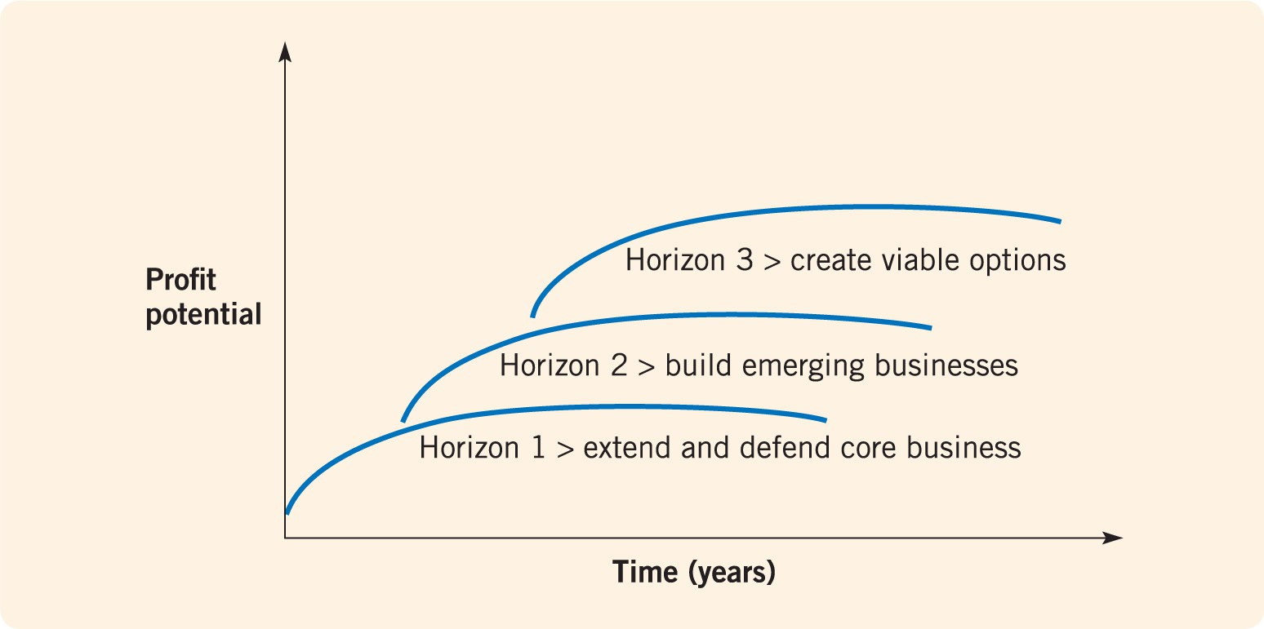
Note: ‘profit’ on the vertical axis can be replaced by non-profit objectives; ‘business’ can refer to any set of activities; ‘time’
can refer to a varying number of years.
Source: M. Baghai, S. Coley and D. White, The Alchemy of Growth, Texere Publishers, 2000. Figure 1.1, p. 5.
Johnson, Whittington, Scholes, Angwin, Regner (2017)

Slide 23
Exploring Strategy Framework
It can be applied in many contexts.
In each context the balance of strategic issues differs:
Small businesses (e.g. strategic purpose, growth issues and retaining independence).
Multinational corporations (e.g. geographical scope; cultural issues and
structure/control issues).
Public sector organisations (e.g. service/quality and managing change issues).
Johnson, Whittington, Scholes, Angwin, Regner
Not-for-profit organisations (e.g. purpose and funding issues).
(2017)

Slide 24
All managers are concerned with strategy
Top managers frequently formulate and control strategy but may also involve others in the process.
Middle and lower level managers have to meet strategic
objectives and deal with constraints.
All managers have to communicate strategy to their teams and can contribute to the formation of strategy through ideas and feedback.
Johnson, Whittington, Scholes, Angwin, Regner
(2017)

Slide 25
Organisations may also use strategy specialists
Many large organisations have in-house strategic planning or analyst roles.
Strategy consultants can be engaged from management consulting firms (e.g. Accenture, IBM Consulting, PwC).
There are a growing number of specialist strategy consulting firms (e.g. McKinsey & Co., The Boston Consulting Group).
Johnson, Whittington, Scholes, Angwin, Regner (2017)

Slide 26
Case study: (1 hour)
Answer both questions below:
Select one tourism or event business operating in the UK and conduct a comprehensive SWOT analysis of the organisation.
2. Based on your selected UK business, identify the same or a comparable tourism or event firm operating in the USA and conduct a SWOT analysis of that organisation.
Then, compare the UK and USA markets and critically evaluate which market presents greater growth potential for the business, providing clear justification for your conclusion.

Slide 27
Recap
What did we discuss today?

Slide 28
Recap
What did we discuss today?
Understanding internal analysis of a business
SWOT Framework
Levels of strategy
Business case studies-applying SWOT analysis

Slide 29
Any Questions?

Slide 30
Next Week…
External Analysis of a business

Slide 31
                Thank You
                For
                Joining
                See you next week!
Dr. Ernest Balutie Wavei
Email: e.wavei@uwtsd.ac.uk

