Slide 1

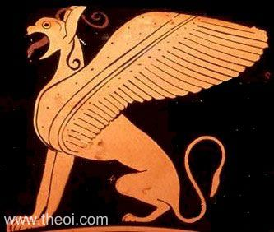
Myth and Art.
The Griffin
Isobel Griffin.

Slide 2
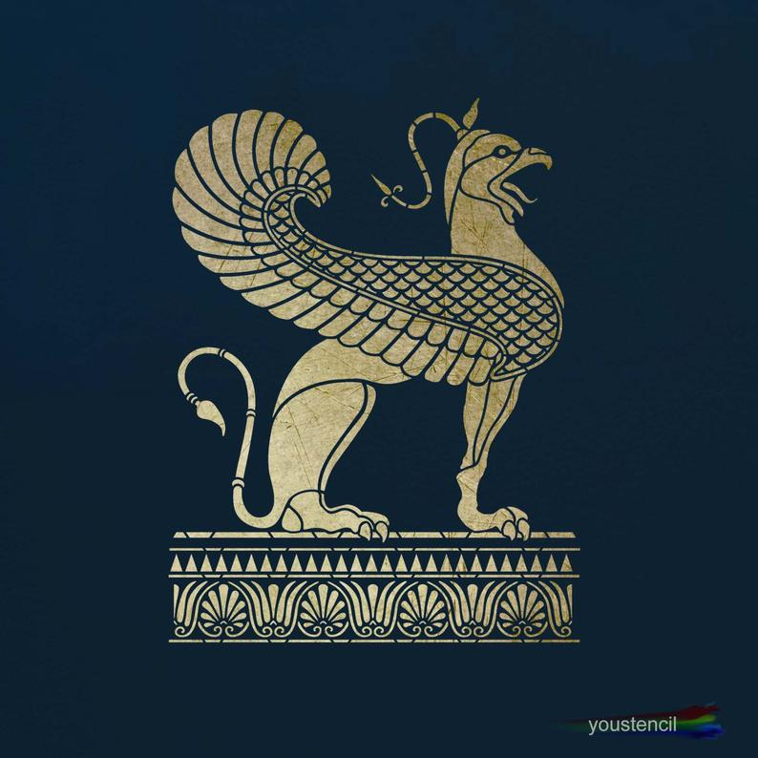
What is a Griffin?
A creature with the head and wings of an eagle and the body of a lion.
The griffin is known to be the King of beasts and birds and to be powerful and majestic.
Has incredible strength and protects against evil and witchcraft.
Guards treasures, sacred sites and royal families.
Guards the rich deposits of gold in the mountains of Skythia (Scythia). The Arimaspians battled them for the riches.
Mentioned to be one of the creatures to guard the gold of India (Philostr.vit.Apollon iii. 48).
A Greek griffin

Slide 3
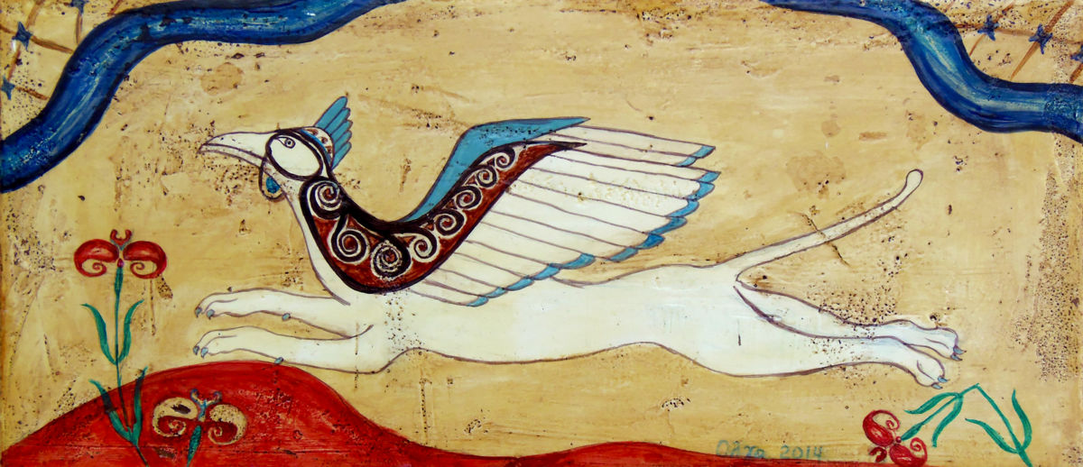
The Origins
The first griffins appeared in sculptures in Ancient Egypt and Iran at around 3000 BC.
Frescoes from 1400 BC show the creature guarding Greek Palaces.
Later, Greek natural historians and Pliny the Elder went to describe the griffins’ form, habitat and behaviour.
The Romans adopted the griffin and spread the legend throughout Europe.
Ancient Minoan fresco with a flying griffin

Slide 4
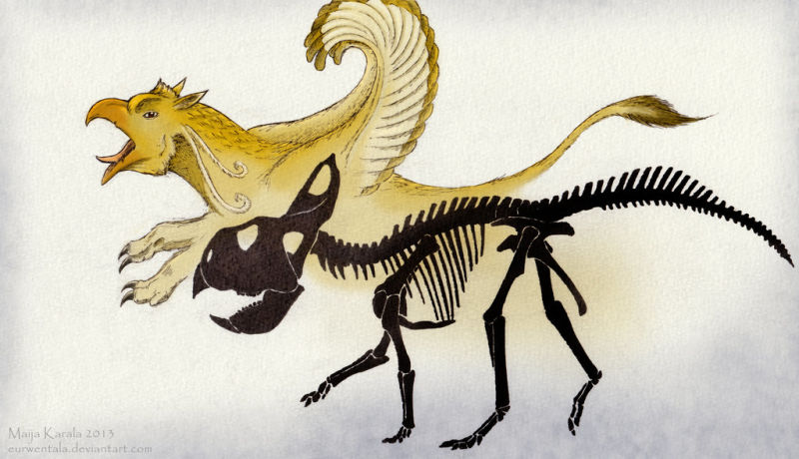
Fossil Findings
Adrienne Mayor (2014):
The pentaceratops had a beaked face with a four-legged body.
Several fossil findings of the pentaceratops were located near known gold veins.
Due to the location of the fossil remains, the ancients could misinterpret the dinosaur as being a griffin.
A pentaceratops skeleton next to a griffin drawing

Slide 5
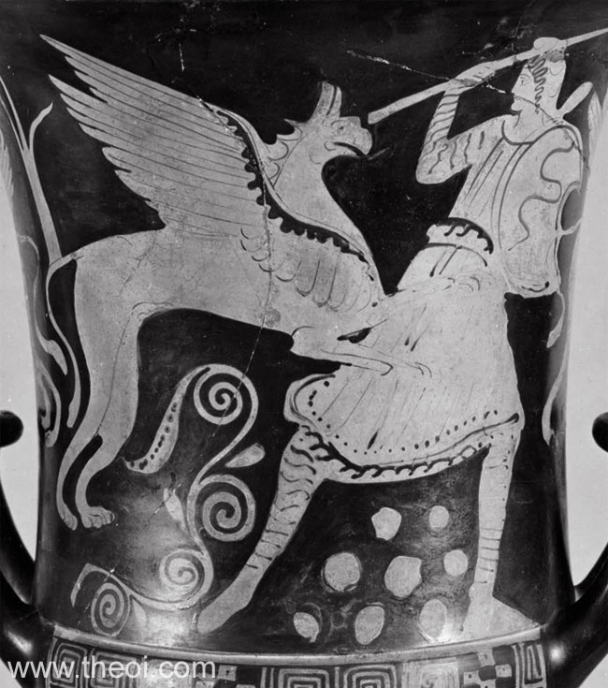
Herodotus
Herodotus, Histories 4. 27. 1 :
"Of these too, then, we have knowledge; but as for what is north of them, it is from the Issedones that the tale comes of the one-eyed men [Arimaspoi (Arimaspians)] and the Grypes (Griffins) that guard gold; this is told by the Skythians (Scythians), who have heard it from them; and we have taken it as true from the Skythians, and call these people by the Skythian name, Arimaspoi; for in the Skythian tongue arima is ‘one’, and spou is the ‘eye’."
Griffin fighting Arimaspian, Athenina
red-figure calyx krater C5th BC.

Slide 6
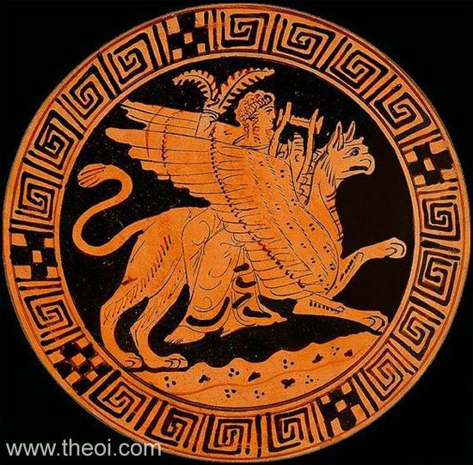
The Gods and the Griffin
Pulled the chariot of Apollo.
Apollo represents wisdom and knowledge which are also the characteristics of the griffin.
More of a symbolic creature used in legends and folklore.
Gives the griffin a sense of mystery.
The sun god Apollo riding on the griffin Athenian
red-figure kylix C4th B.C.

Slide 7
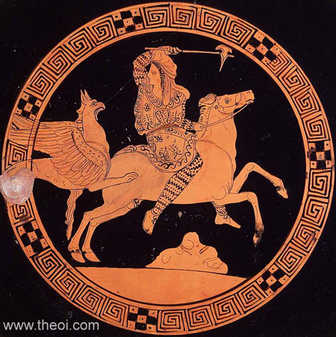
Aeschylus
Aeschylus, Prometheus Bound 802 ff (trans. Weir Smyth) (Greek tragedy C5th B.C.) :
"[Prometheus warns the wandering Io :] ‘But now listen to another and a fearsome spectacle. Beware of the sharp-beaked hounds of Zeus that do not bark, the Grypes (Griffins), and the one-eyed (monôpoi) Arimaspoi (Arimaspians), mounted on horses, who dwell about the flood of Plouton's (Pluton's) stream that flows with gold. Do not approach them.’"
Griffin and Arimaspian,
Athenian red-figure kylix C4th B.C

Slide 8
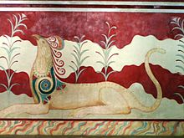
The Knossos Palace ‘Throne Room’
Minoan Palace at Knossos on Crete.
1400 BC
The ‘Throne Room’ was decorated with frescoes of elegant griffins.
A sign of protectiveness, knowledge and being blessed with supernatural powers to whoever sat there.
Unusual representation as they do not have wings.
One of the two griffins flanking the throne in the Knossos
Palace

Slide 9
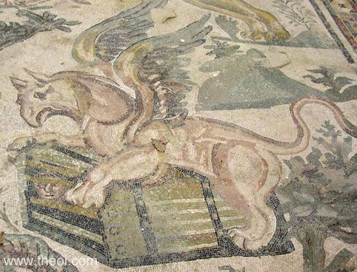
Villa Romana Del Casale
Roman period 320 AD
Located in the corridor of the ‘Great Hunt’.
Symobolises the might of the Roman Empire as it dominates all including nature because the griffin has become a spectator.
A griffin upon a chest with a man hiding inside. Located at
Villa Romana Del Casale

Slide 10
Reference
Atsma.A.J. (2017) Theoi: Gryps. Available at: https://www.theoi.com/Thaumasios/Grypes.html (Accessed on 03 June 2019)
Belmont, M. (2016) Gods – And – Monsters. Available at: http://www.gods-and-monsters.com/mythology-griffin.html (Accessed on: 03 June 2019)
Geller, P. (2017) Mythology.net. Available at: https://mythology.net/mythical-creatures/griffin/ (Accessed on: 03 June 2019).
Mayor, A. (2014) The Griffin and the Dinosaur: How Adrienne Mayor discovered a fascinating link between myth and science. National Geographic Children's Books.
Napier, D. (2012) Read Roman Mosaics: Villa Romana Del Casale. Available at: https://read-mosaics.blogspot.com/p/thevilla-romana-del-casale-as-coach.html (Accessed on: 03 June 2019)

