Slide 1
LCMB7024
Competitor Analysis and Strategy
Week 3 – Session 2

Slide 2
Content of the Session
Introduction
Marketing growth strategies
Ansoff Matrix
Ansoff Matrix: Pioneer vs follower
Porter’s Generic Strategy Model
Porter’s Generic strategy: Pioneer vs. Follower
Competitive Market Positions
and Roles

Slide 3
Introduction
Understanding how strategic frameworks guide marketing decision-making.
Exploring the relationship between innovation, competition, and market roles.
Examining how businesses grow, compete, and adapt in dynamic markets.
Comparing pioneering and follower strategies within evolving industries.

Slide 4
Marketing Growth Strategies:
Why it matters?
Markets today are highly competitive and rapidly changing.
Strategic thinking enables firms to anticipate change, seize opportunities, and mitigate threats.
Applying models like the Ansoff Matrix and Porter’s Generic Strategies helps marketers plan effective responses to competition.

Slide 5
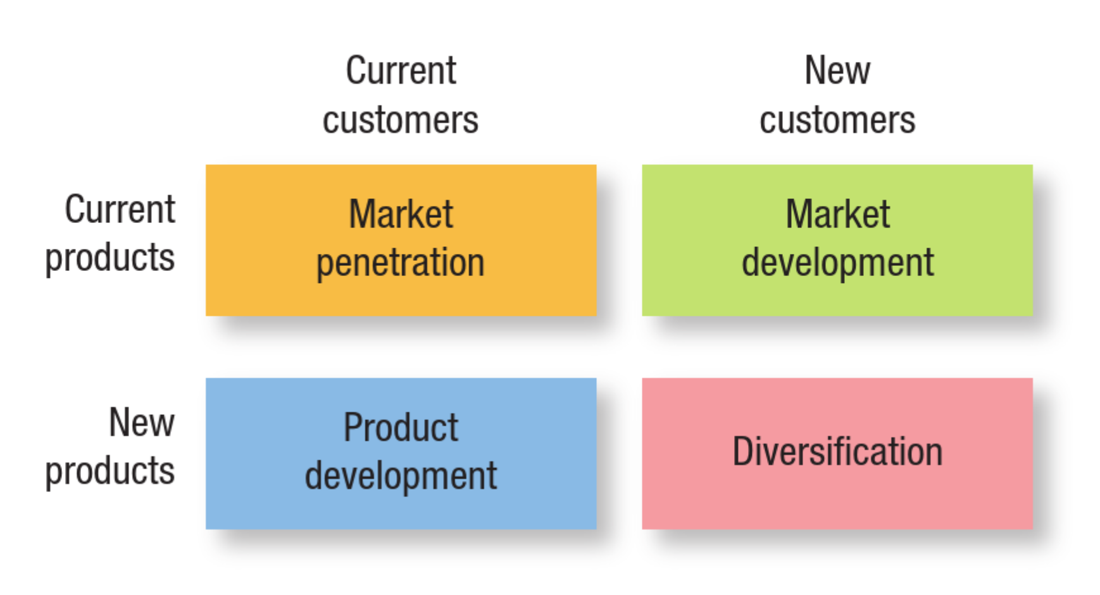
Ansoff Matrix (1 of 5)
(Hooley et al., 2020)

Slide 6

Market Penetration (2 of 5)
Market Penetration -> Increase sales of current products to existing customers.
Encourage customers to buy more, use more often, or attract competitors’ customers within the same market.
Strategies include:
  Advertising and promotions to boost usage
  Loyalty programs to retain customers
  Competitive pricing
Notes:
Coca-Cola often uses promotional campaigns like “Share a Coke” to increase sales among existing consumers by encouraging repeat purchases and brand engagement.
McDonald’s introduces limited-time deals (like “2-for-1 Big Mac”) to increase frequency of visits among current customers.
Risk level: Low – you already know the market and product well.
(Kotler, Keller, & Chernev, 2022; Hollensen, 2020).

Slide 7
Market Development (3 of 5)
Market Development -> Increase sale by selling new products to existing customers.
Expand geographically, demographically, or through new distribution channels.
Strategies include:
  Entering new countries or regions
  Targeting a new demographic group (e.g., younger or older consumers)
  Using online channels to reach new audiences
Notes:
Example:
Taco Bell launches a new plant-based taco or spicy fries targeting Gen Z.
Starbucks expanded its coffee business from the U.S. to international markets such as China and India.
Tesla introduced its cars to new global markets (like the Middle East and Asia) while keeping the same models.
Risk level: Moderate – product is proven, but the new market has uncertainties.
(Jobber & Ellis-Chadwick, 2020; Hollensen, 2020).

Slide 8

Product Development
(4 of 5)
Product Development Strategy -> Increasing sales by offering existing products to new markets.
Introduce innovation to keep loyal customers engaged and satisfied.
Strategies include:
  Launching updated or upgraded versions
  Introducing complementary products
  Leveraging R&D to innovate
Notes:
Example:
Toyota introduces its hybrid Prius model in a new emerging market like India or expands its SUV range in South America.
Apple consistently upgrades existing product lines (like iPhones, iPads, and Apple Watches) to keep current customers upgrading within the brand.
Netflix introduced gaming and interactive content to its existing subscribers to enhance engagement.
Risk level: Moderate – you know the market, but new product development can fail.
(Kotler et al., 2022; Armstrong et al., 2021).

Slide 9

Diversification (5 of 5)
Diversification -> The riskiest strategy, involving developing entirely new products for new markets, which could be related (synergistic) or unrelated diversification.
Example: Tesla expands from EVs into solar energy and energy storage (Powerwall)
Notes:
Types of Diversification:
Related diversification: New products related to existing operations.
→ Example: Disney launching Disney+ streaming (related to entertainment).
Unrelated diversification: New products in entirely different sectors.
→ Example: Virgin Group expanding from airlines to finance and mobile services.
Risk level: High – both the market and product are new, but it offers long-term growth potential.
(Lambin & Schuiling, 2022; Piercy & Cravens, 2021).

Slide 10

Ansoff Matrix –
Pioneering and follower organisations
Pioneering Organisations
  Pioneers are typically innovators that lead market change by developing new products or creating new markets.
They tend to operate in the Product Development and Diversification quadrants.
Notes:
Netflix started as a DVD rental service and pioneered online streaming — completely transforming entertainment consumption.

Slide 11

Ansoff Matrix –
Pioneering and follower organisations
Follower Organisations
  Follower refers to a company that enters a market after pioneering firms and builds its strategy by observing, learning from, and adapting the innovations or business models introduced by those pioneers.
They prioritise Market Penetration and Market Development strategies.
Notes:
Apple and Samsung built the smartphone market, but Xiaomi entered later, focusing on affordable innovation for emerging markets.

Slide 12
Ansoff Matrix –
Pioneering and follower organisations
Strategy (Ansoff) | Pioneers | Followers | References
Market Penetration | Maintain dominance through customer loyalty and branding | Compete via cost advantage or imitation | Kotler et al., 2022; Ritala & Huotari, 2019
Market Development | Enter new markets with brand-led innovation | Adapt existing products to emerging regions | Hollensen, 2020
Product Development | Lead innovation and differentiation | Adopt modified versions of pioneer products | Taneja & Toombs, 2021
Diversification | Create new industries or ecosystems | Rarely applied due to high risk | Zhang & Cantwell, 2022
Notes:
Link to Pioneering and Follower Organisations
The Ansoff Matrix helps explain how pioneering and follower organisations approach growth and competitive positioning differently in response to environmental change.
1. Pioneering Organisations
Pioneers are typically innovators that lead market change by developing new products or creating new markets. They tend to operate in the Product Development and Diversification quadrants.
Product Development:
Pioneers such as Tesla and Apple introduce breakthrough innovations to existing markets, aligning with Ansoff’s emphasis on new product creation for current customers.
As noted by Taneja & Toombs (2021, Journal of Strategic Marketing), pioneering firms leverage dynamic capabilities to innovate continuously, creating first-mover advantages.
According to Kotler et al. (2022), this proactive innovation aligns with the marketing orientation philosophy, focusing on anticipating future customer needs.
Diversification:
Pioneering firms often explore entirely new markets (e.g., Amazon’s move from retail to cloud computing).
Zhang & Cantwell (2022, Industrial Marketing Management) highlight that diversification supports strategic renewal and risk dispersion for pioneering organisations but demands high resource commitment and innovation capacity.
2. Follower Organisations
Followers, on the other hand, often prioritise Market Penetration and Market Development strategies, focusing on efficiency, adaptation, and learning from pioneers’ successes.
Market Penetration:
Followers (e.g., Samsung following Apple in smartphones) improve existing products, adopt cost leadership, and refine distribution and promotion strategies.
Ritala & Huotari (2019, Technovation) argue that followers succeed through strategic imitation and incremental innovation, reducing risks while benefiting from pioneers’ market education efforts.
Market Development:
Followers extend established products into new regions or demographics, often with local adaptations.
Hollensen (2020) and Piercy & Cravens (2021) note that market development allows followers to expand without heavy innovation costs, leveraging economies of scale and established production efficiencies.

Slide 13
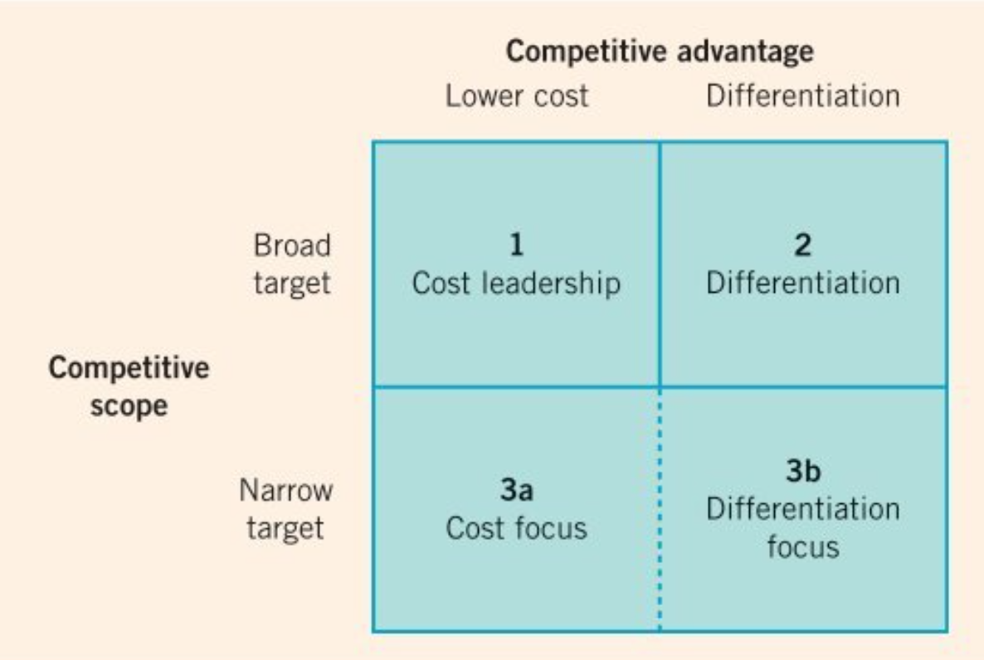
Porter’s Generic Strategy Model (1 of 6)
Porter’s Generic Strategy Model
(Johnson et al., 2017)

Slide 14
Porter’s Generic Strategy Model
(2 of 6)
Porter's Generic Strategies describe how a company can achieve a competitive advantage in its industry.
Developed by Michael Porter, these strategies outline how businesses can outperform their rivals by either offering products or services at a lower cost or by differentiating their offerings.

Slide 15


Cost Leadership
(3 of 6)
Becoming the lowest-cost producer in the industry.
Efficiency, economies of scale, tight cost controls.
Example: Walmart and Aldi’s ability to offer a wide range of products at the lowest prices.
Notes:
This strategy requires significant capital investment in efficient processes and infrastructure.

Slide 16

Differentiation
(4 of 6)
Creating unique and superior value for customers.
Innovation, brand building, customer service.
Example: Apple's focus on design, user experience, and brand image allows it to charge a premium price.
Notes:
This strategy requires strong marketing, product development, and a customer-centric approach.

Slide 17


Cost Focus
(5 of 6)
Achieving cost leadership within a narrow market segment.
Serving a specific niche better than competitors.
Example: Dollar General successfully caters to the needs of budget-conscious shoppers in smaller communities where larger retailers may not be present.
Notes:
This strategy requires a deep understanding of the target segment and efficient operations.

Slide 18

Differentiation Focus
(6 of 6)
Offering unique products or services to a narrow market segment.
Catering to specific needs of niche customers.
Example: Ferrari's focus on luxury and performance allows them to command high prices within the sports car market.
Notes:
This strategy requires specialization, high-quality products, and strong customer relationships.

Slide 19
Porter’s Generic Strategies –
Pioneering and Follower Organisations
Porter’s Strategy | Focus | Pioneers | Followers
1. Cost Leadership | Achieving the lowest operational cost to offer low prices and defend market share. | Rare at early stages; may emerge later once scale is achieved (e.g., Tesla’s efficiency drive). | Common - followers exploit process efficiencies and cost imitation to undercut pioneers (e.g., Xiaomi, Shein).
2. Differentiation | Creating unique value via innovation, quality, or brand experience. | Primary pioneer strategy - innovation and first-mover branding (e.g., Apple, Dyson). | Incremental differentiation through adaptive innovation and design refinement (e.g., Samsung, Huawei).
3a. Cost Focus | Offering low-cost solutions to a narrow or niche segment. | Occasionally used in underserved niches with cost sensitivity. | Frequently used - followers specialise in low-price niches (e.g., Aldi, Ryanair).
3b. Differentiation Focus | Delivering premium or sustainability-oriented products to a specific segment. | Favoured by pioneers in sustainability or craftsmanship niches (e.g., Patagonia, Rivian). | Used by adaptive followers replicating niche differentiation at lower cost (e.g., Everlane).

Slide 20
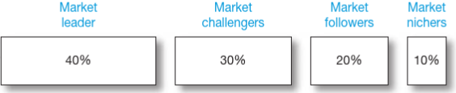
Competitive Market Positions and Roles
Firms with the largest market share. Market leaders often lead in price changes, new product introductions, distribution coverage, and promotion spending.
These firms are fighting hard to increase their market share. They aggressively try to attack the leader.
Followers are firms that want to hold their share without rocking the boat. They avoid direct competition.
These firms serve small segments that are not being pursued by other firms. “Nichers” specialise in serving specific customer groups, geographic areas, or product lines.
(Kotler et al., 2020)
Notes:
Market Leader (40%): The firm with the largest market share. Market leaders often lead in price changes, new product introductions, distribution coverage, and promotion spending. Examples include companies like Facebook, Apple, and Google. Market leaders can either expand total demand, protect their current market share, or try to expand their market share further.
Market Challenger (30%): These firms are fighting hard to increase their market share. They aggressively try to attack the leader.
Market Follower (20%): Followers are firms that want to hold their share without rocking the boat. They avoid direct competition.
Market Nicher (10%): These firms serve small segments that are not being pursued by other firms. Nichers specialize in serving specific customer groups, geographic areas, or product lines.

Slide 21
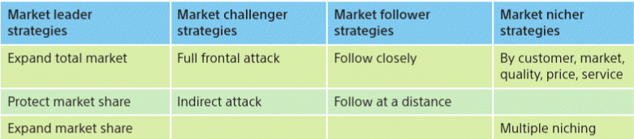
Marketing Strategies for
Competitive Market Roles
(Kotler et al., 2020)
Notes:
Market Leader Strategies
- Expand Total Market: Market leaders benefit most when the entire market grows. They typically try to attract new customers or encourage existing ones to use more of the product.
- Protect Market Share: Leaders must continuously defend their current business. They can do this by fixing weaknesses, consistently delivering value, and blocking competitive moves.
- Expand Market Share: Leaders can grow by further penetrating existing markets or taking share from competitors.
Market Challenger Strategies
- Full Frontal Attack: Challenging firms directly attack the leader's strengths with comparable resources. This is a head-on competition.
- Indirect Attack: Challengers can attack the leader's weaknesses or gaps in the market the leader has overlooked.
Market Follower Strategies
- Follow Closely: These firms try to imitate the leader's products and marketing to maintain market share.
- Follow at a Distance: These firms differentiate slightly or focus on specific segments without directly challenging the leader.
Market Nicher Strategies
- By Customer, Market, Quality, Price, Service: Nichers focus on serving specific, smaller market segments exceptionally well. They tailor their offerings to match the needs of that niche.
- Multiple Niching: Selecting two or more smaller niches at the same time that are specialized and distinct from larger market segments

Slide 22
Summary
Ansoff Matrix: Provides a framework for growth strategies, including market penetration, market development, product development, and diversification.
Porter's Generic Strategies: Identifies competitive approaches like cost leadership, differentiation, cost focus, and differentiation focus.
Competitive Market Positions and Roles: Marker Leaders, Market challengers, Market followers, Market nichers.

Slide 23
Group Activity
Choose a recent example where a follower disrupted a market pioneer (e.g., Netflix vs. Blockbuster, Tesla vs. traditional automakers, Airbnb vs. hotel chains).
Identify the unique strategies the follower used (Ansoff Matrix, Porter’s Generic Strategy).
Analyse how macro-environmental changes (technology, regulation, consumer behaviour, cultural trends) created opportunities for the follower.
Discuss whether the pioneer could have responded differently to maintain dominance.

Slide 24
References
Hague, Paul. The Business Models Handbook: Templates, Theory and Case Studies. London, United Kingdom; New York, Ny, Kogan Page Limited, 2019.
Kotler, P., Armstrong, G., Harris, L. and Piercy, N. (2020) Principles of marketing. 8th European edn. Harlow: Pearson.
Lieberman, M.B. and Montgomery, D.B. (1988) ‘First-mover advantages’, Strategic Management Journal, 9(S1), pp. 41–58. https://doi.org/10.1002/smj.4250090706
Johnson, G., Whittington, R., Scholes, K., Angwin, D., & Regnér, P. (2017) Exploring strategy : text and cases. Eleventh edition. Harlow: Pearson Education Limited.
Whittington, R. et al. (2020) Exploring strategy: text and cases. Twelfth Edition. Harlow: Pearson.

