Slide 1


Recruitment and Selection for a Project Engineer
Supporting the introduction of KUKA robotics for friction welding
Developing and Managing Individuals and Teams (LCLM5002_BIRM)
Lecturer : Dr Mudassar Hasan
Valentin Otelea
Id no. 2410975
Notes:
Recruitment and Selection for a Project Engineer
Supporting the introduction of KUKA robotics for friction welding
Developing and Managing Individuals and Teams (LCLM5002_BIRM)
Valentin Otelea
Id no. 2410975
Lecturer : Dr Mudassar Hasan

Slide 2
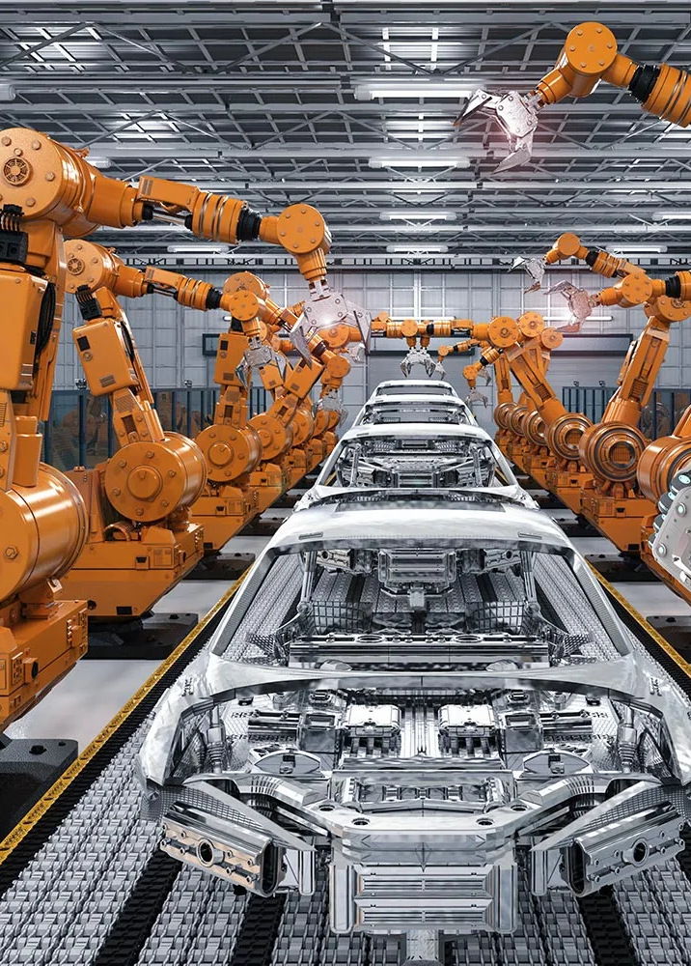
Table of Contents:
1. Introduction to JLR Castle Bromwich
2. Recruitment Process
Job Analysis
Job Description
Person Specification
3. Interview Types (3 slides)
4. Questioning Techniques
5. Face-to-Face vs. Online Interview
6. Conclusion
7. Reference list
Notes:
Table of Contents:
1. Introduction to JLR Castle Bromwich
2. Recruitment Process
Job Analysis
Job Description
Person Specification
3. Interview Types (3 slides)
4. Questioning Techniques
5. Face-to-Face vs. Online Interview
6. Conclusion
7. Reference list

Slide 3
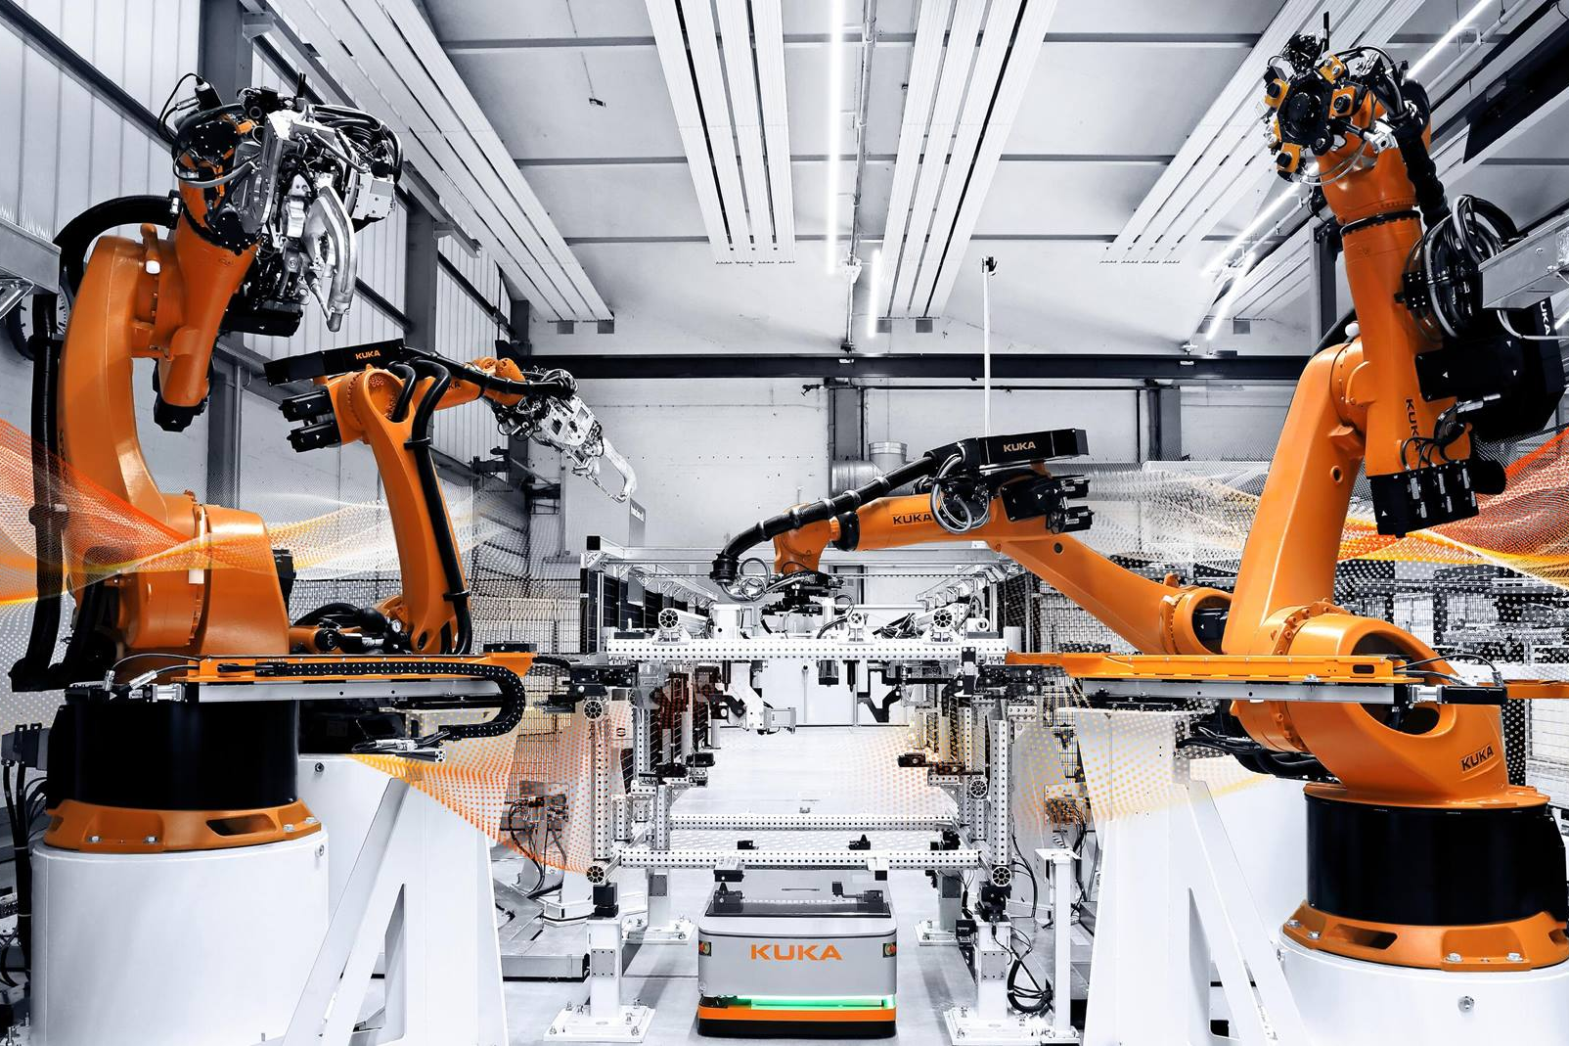

Company Introduction
Jaguar Land Rover (JLR) – UK’S largest automotive manufacturer
Castle Bromwich, Birmingham – is one of JLR’s traditional homes for Jaguar saloon and sports car manufacturing.
In recent years, the facility has been undergoing transformation, including plans to become a centre for electrification.
This was to include manufacturing of new electric and electrified Jaguars, such as a proposed electric XJ, and to support battery and electronic drive unit production in the Midlands. (JLR, 2025).
New Project – Implementation of KUKA friction welding robots for car components --- requires skilled Project Engineer
Notes:
Jaguar Land Rover (JLR) – UK’S largest automotive manufacturer
Castle Bromwich, Birmingham – is one of JLR’s traditional homes for Jaguar saloon and sports car manufacturing.
In recent years, the facility has been undergoing transformation, including plans to become a centre for electrification.
This was to include manufacturing of new electric and electrified Jaguars, such as a proposed electric XJ, and to support battery and electronic drive unit production in the Midlands. (JLR, 2025).
New Project – Implementation of KUKA friction welding robots for car components --- requires skilled Project Engineer

Slide 4

Recruitment Process Overview
Step 1 : Job Analysis – Understanding project needs
Step 2 : Job Description – defining duties (coordination, technical oversight, reporting)
Step 3 : Person Specification – essential/desired qualities
Step 4 : Attracting Candidates – job posting , LinkedIn, engineering boards
Step 5 : Shortlisting and Interviewing – competency-based, structured interviews
Step 6 : Final Selection and Onboarding
This Photo by Unknown Author is licensed under CC BY-SA-NC

Slide 5
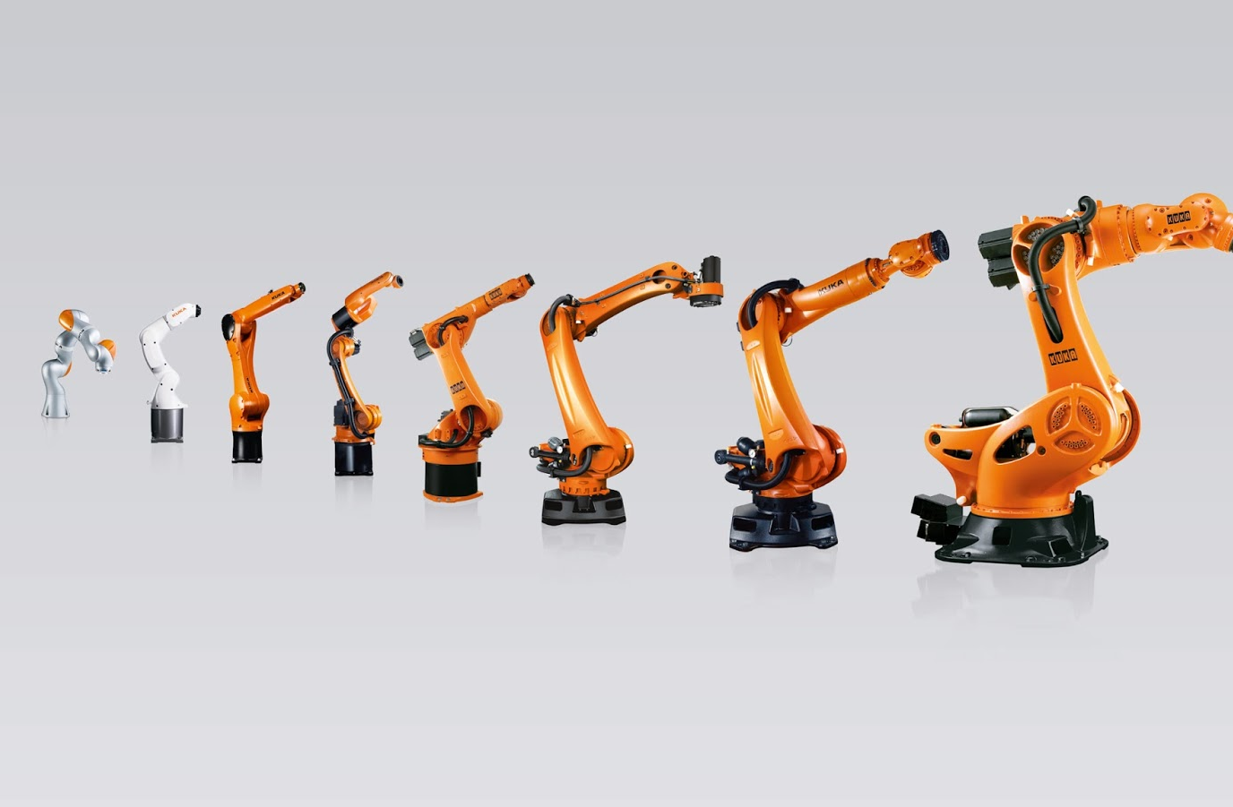
Job Analysis
“An effective job analysis forms the basis for all key human resource functions”
(Prien, Goodstein, Goodstein, and Gamble, 2009)
Role title : Project Engineer (Automation – Friction Welding)
Tasks:
- Oversee installation and commissioning of KUKA robots
- Manage suppliers and customer requirements
- Ensure compliance with safety and quality standards
Skills Needed:
- Automotive engineering background
- Knowledge of automation/robotics
- Strong project management skills
- Communication with stakeholders
This Photo by Unknown Author is licensed under CC BY-NC-ND

Slide 6

Person Specification
1. Essential:
Degree in Mechanical Industrial Engineering
With 3-5 years automotive industry experience
Project management capability
Communication and leadership skills
2. Desirable:
Experience with KUKA robots
Lean/continuous improvement knowledge
Supplier and customer – facing experience

Slide 7
Interview Type 1:
Structured Interview
“The structured interview could offer a valuable alternative to the conventional unstructured approach.” (Wright, Lichtenfels, and Puresell, 1989)
Definition:
Standardized, same questions for all candidates
Application:
Ensures fairness, checks technical knowledge (robotics, automotive processes, etc.)
Strengths:
Comparable results, reduces bias
Weaknesses:
Less flexibility, may overlook personality fit

Slide 8
Interview Type 2:
Competency-Based Interview
“Employing the wrong person can significantly impact organisational morale and increase stress levels, while also leading to substantial financial costs.” (Yv, Naboka, and Kosenko, 2025)
Definition:
Focus on past experiences to predict future performance
Application:
Test adaptability, project delivery under pressure, stakeholder management
Strengths:
Evidence-based, useful for leadership roles
Weaknesses:
DEPENDS ON CANDIDATE’S ABILITY TO ARTICULATE EXPERIENCES

Slide 9
Interview Type 3:
Panel Interview
“Despite more than 50 years of research, the panel interview continues to be a widely used tool but often debated method for personnel selection.”(Dixon, Wang, Calvin, Dineen, and Tomlinson, 2002)
Definition:
CANDIDATE INTERVIEWED BY MULTIPLE STEAKHOLDERS
Application:
SUITABLE FOR PROJECT ENGINEER ROLE WITH CROSS-FUNCTIONAL IMPACT
Strengths:
MULTIPLE PERSPECTIVES, HOLISTIC EVALUATION
Weaknesses:
Can intimidate candidates, scheduling issues

Slide 10

Questioning Techniques
Probing Questions – “Can you explain how you managed a supplier delay in a past project?”
Socratic Questions – Paul and Elder (2007) encourage critical thinking, “Why do you think robotics is key to transformation?”
Leading Questions – limited use, risk of bias but can test assumptions (Powell, Hughes‐Scholes, and Sharman, 2012)
Behavioural Questions (STAR) –STAR is an acronym for Situation, Task, Action, Results. (Sharp, 2012) Test real, world example skills
Situational Questions – “If a KUKA robot failed mid-production, how would you respond?”
Best approach it will be Probing and Behavioral/Socratic, ideal for Project Engineering role.

Slide 11

Face-to-Face vs. Online Interview
Face-to-Face
Rapport – Schober (2018) suggest that it is strong and builds trust
Observation – Body language and technical enthusiasm
Convenience – Requires travel and logistics
Technology – Minimal reliance
Best Use – Final stage

Slide 12

Face-to-Face vs. Online Interview
Online Interview
Rapport – Limited but possible (O’connor, and Madge, 2017)
Observation – Restricted to screen
Convenience – Time and cost efficient
Technology – Risk of connection issues
Best Use – Initial screening and global candidates
Hybrid model recommended – start online and finish face-to-face at Castle Bromwich

Slide 13
Conclusion
Recruitment must align skills and cultural fit
For JLR, Project Engineer needs technical expertise and stakeholder management
Structured and Competency-based interviews ensure fairness and quality
Probing and behavioural questions are most effective
Hybrid interview method ensures best outcome

Slide 14
References
JLR (2025) Global Footprint. Available at: Global Footprint | JLR Corporate Website (Accessed: 22 September 2025).
Prien, E.P., Goodstein, L.D., Goodstein, J. and Gamble Jr, L.G., (2009). A practical guide to job analysis. John Wiley & Sons.
Wright, P.M., Lichtenfels, P.A. and Pursell, E.D., (1989). The structured interview: Additional studies and a meta‐analysis. Journal of occupational psychology, 62(3), pp.191-199.
Yv, V., Naboka, L. and Kosenko, A., (2025). Use of competency-based interviews for the assessment of soft skills in public service. State Formation, 1(37), pp.580-593.
Paul, R. and Elder, L., (2007). Critical thinking: The art of Socratic questioning. Journal of developmental education, 31(1), p.36.
Powell, M.B., Hughes‐Scholes, C.H. and Sharman, S.J., (2012). Skill in interviewing reduces confirmation bias. Journal of Investigative Psychology and Offender Profiling, 9(2), pp.126-134.
Schober, M.F., (2018). The future of face-to-face interviewing. Quality Assurance in Education, 26(2), pp.290-302.
O’connor, H. and Madge, C., (2017). Online interviewing. The SAGE handbook of online research methods, 2(2017), pp.416-434.
Dixon, M., Wang, S., Calvin, J., Dineen, B. and Tomlinson, E., (2002). The panel interview: A review of empirical research and guidelines for practice. Public Personnel Management, 31(3), pp.397-428.
Sharp, J.E., (2012), June. Behavioral interview training in engineering classes. In 2012 ASEE Annual Conference & Exposition (pp. 25-251).

