Slide 1
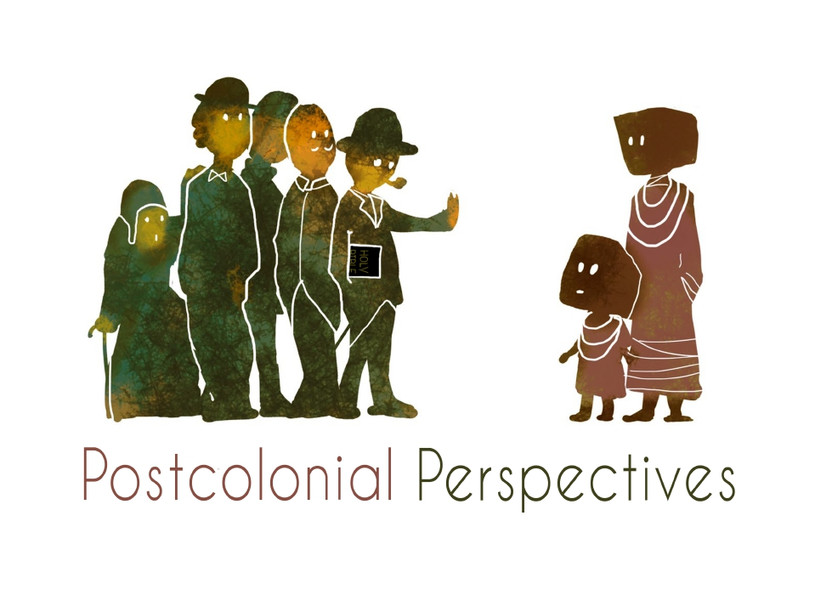
Dr Jessica Mary Keady
j.keady@uwtsd.ac.uk

Slide 2
Defining Terms - Colonialism
Is generally defined as the occupation and control of one nation by another.

Slide 3
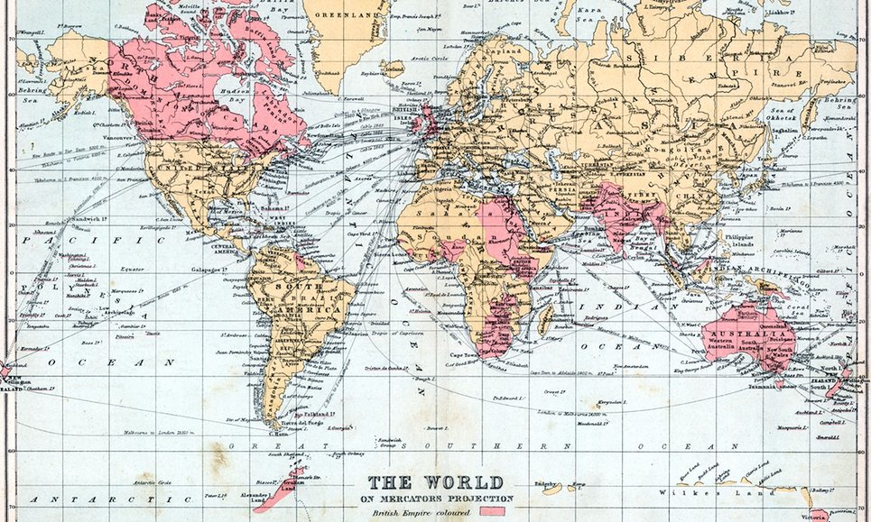
Colonialism: British Empire

Slide 4
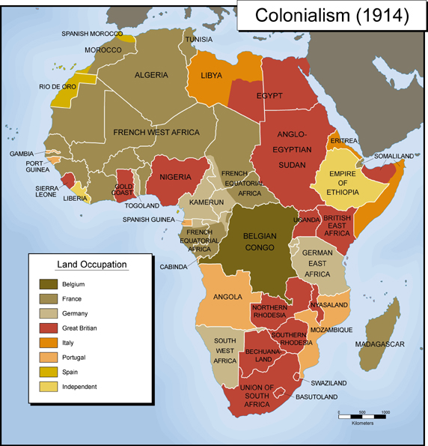

Slide 5
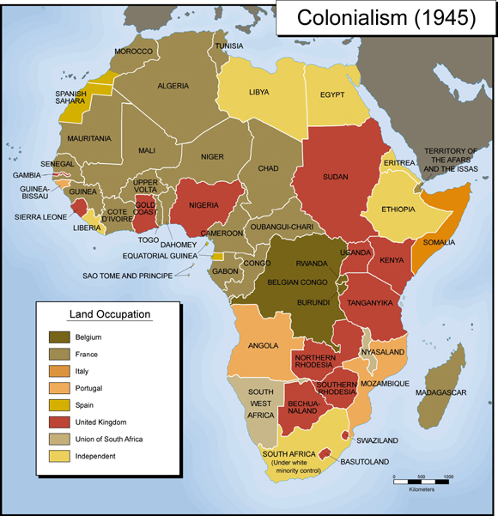

Slide 6
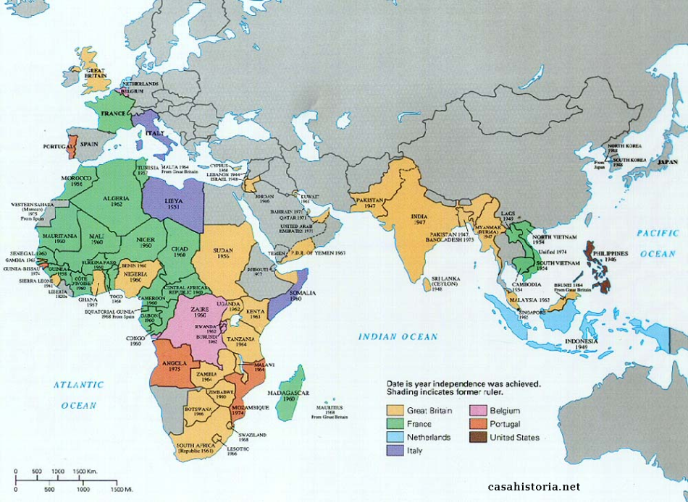

Slide 7
Defining Postcolonialism
Postcolonialism speaks about the human consequences of external control and the exploitation of native people and their lands.

Slide 8
Postcolonial Studies
Is an academic discipline that analyzes, explains, and responds to the legacy of colonialism.
Sugirtharajah,
“What postcolonial theory does is it offers a space for the once colonized” (1999, 4)
“It is an act of reclamation, redemption and reaffirmation against the past colonial tendencies” (1999, 4)
In theology and biblical studies, this includes reading strategies grounded in the experience of people in formerly-colonized nations.

Slide 9
Postcolonial critique of feminism
Too white and too middle class
Ignores other dimensions of oppression
Takes too little account of the ways in which white, academic feminists benefit from patriarchy and race/class privilege
WOMANISM
INTERSECTIONALITY
RESPONSES :
Intersectionality - a tool “designed to combat feminist hierarchy, hegemony and exclusivity” (Nash 2008)

Slide 10
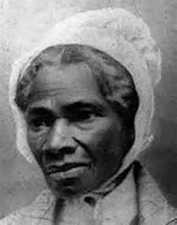
Sojourner Truth (1797-1883)
Born into enslavement in New York
New York emancipated all slaves on
July 4th 1827 (in 1863 President
Lincoln issued the Emancipation
Proclamation)
She converted to Christianity and
worked as a housekeeper
From 1843 Truth devoted the rest of
her life to campaigning for abolishment
Truth is remembered as one of the
foremost leaders of the abolition
movement and an early advocate of women's rights.

Slide 11
“Ain’t I a Woman” - Sojourner Truth, May 1851, Ohio Women's Rights Convention
https://www.bing.com/videos/search?q=ain+t+i+a+woman+speech&&view=detail&mid=68BF83DE86E93260A20968BF83DE86E93260A209&&FORM=VDRVRV

Slide 12
Postcolonialism and the Bible
How to read a biblical text from a postcolonial perspective…
https://journals.sagepub.com/doi/pdf/10.1177/0142064X9902107301

Slide 13
The Bible and Power
A postcolonial reading would question the text….
Whose interpretation?
What agendas?
What is privileged?
Who is writing?
Who is the intended audience?
It also wants to ask questions about the power dynamics in and behind biblical text.

Slide 14
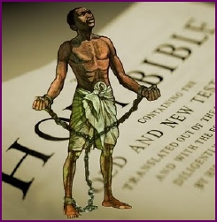
A Postcolonial Reading:
Slavery in the Bible
²⁰ When a slaveowner strikes a male or
female slave with a rod and the slave dies
immediately, the owner shall be punished.
²¹ But if the slave survives a day or two,
there is no punishment; for the slave is the owner’s property. (Exodus 21.20-21)
⁵ Slaves, obey your earthly masters with fear and trembling, in singleness of heart, as you obey Christ. (Eph. 6.5)
6 Let all who are under the yoke of slavery regard their masters as worthy of all honor, so that the name of God and the teaching may not be blasphemed. ² Those who have believing masters must not be disrespectful to them on the ground that they are members of the church; rather they must serve them all the more, since those who benefit by their service are believers and beloved. (1 Tim. 6.1-3)

Slide 15
A Postcolonial Reading of the Canaanite Woman (Mathew 15: 21-28/parallel Mark 7: 24-30 )
Use Sugirtharajah’s reading (especially A and B) to re-read this narrative from a postcolonial perspective
Look at the differences between Matthew and Mark (where is the woman from in Mark?)
Why do you think Matthew has edited some of the narrative?
Context: The colonisation of Canaan by Israel after the Exodus and the forty years in the wilderness (cf. Gen. 12: 4-6; Deut 7; Josh 13-22)
Think about issues of POWER, BOUNDARIES, GENDER, MARGINALIZATION, HYBRIDITY (cross cultures/race)

Slide 16
Initial Bibliography
Moore, S. (2006), Empire and Apocalypse: Postcolonialism and the New Testament. Sheffield: Sheffield Phoenix Press.
Nash, J. (2008), “Re-Thinking Intersectionality,” Feminist Review 89, 1-15.
Sugirtharajahm R.S. (2001), The Bible and the Third World: Precolonial, Colonial and Postcolonial Encounters. Cambridge: Cambridge University Press.
Young, R. (2003). Postcolonialism: A Very Short Introduction. Oxford: Oxford University Press.

