Slide 1
Theoretical Perspectives and Research Methodologies

Slide 2
Objectives
By the end of this session you will be able to:
Distinguish between ontology and epistemology in research.
Distinguish between inductive and deductive methods.
Explain the different perspectives taken by positivism and interpretivism.
Describe the different research methodologies and the conditions for their selection.

Slide 3
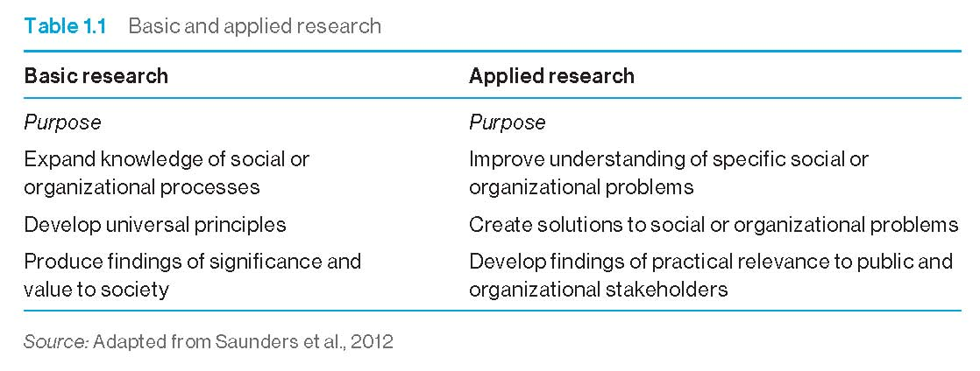
Basic and applied research

Slide 4
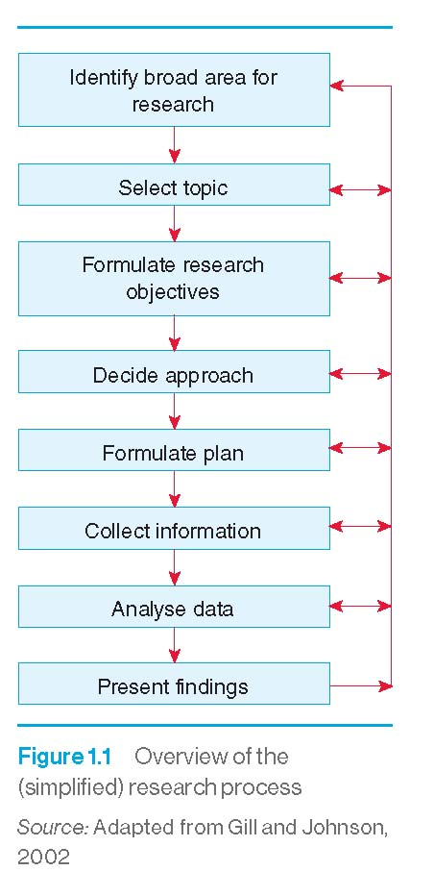
Overview of the (simplified) research process

Slide 5
The nature of theories
A theory has been defined as:
‘A set of interrelated constructs (concepts), definitions, and propositions that present a systematic view of phenomena by specifying relations among variables, with the purpose of explaining and predicting phenomena.’ (Kerlinger, 2000: 9)

Slide 6
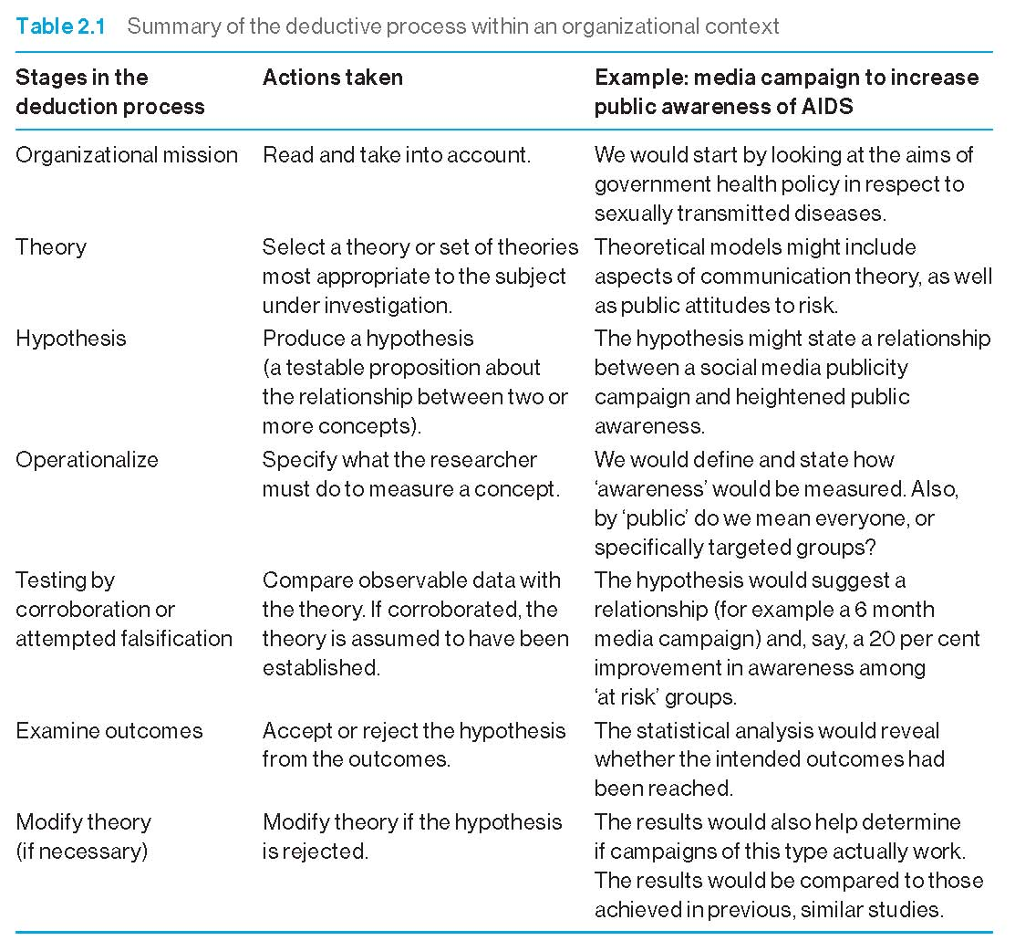
Summary of the deductive process

Slide 7
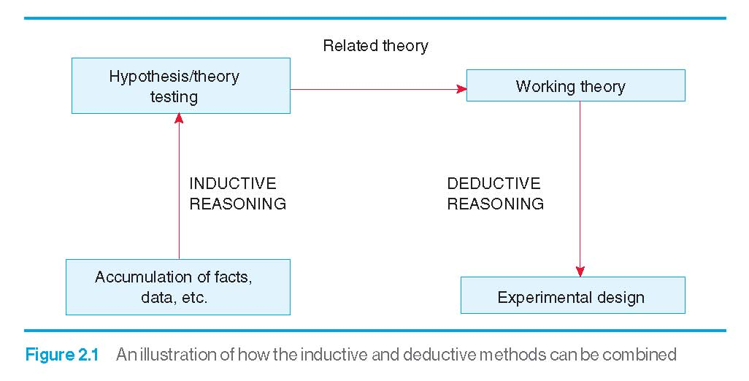
Combining inductive and deductive methods

Slide 8
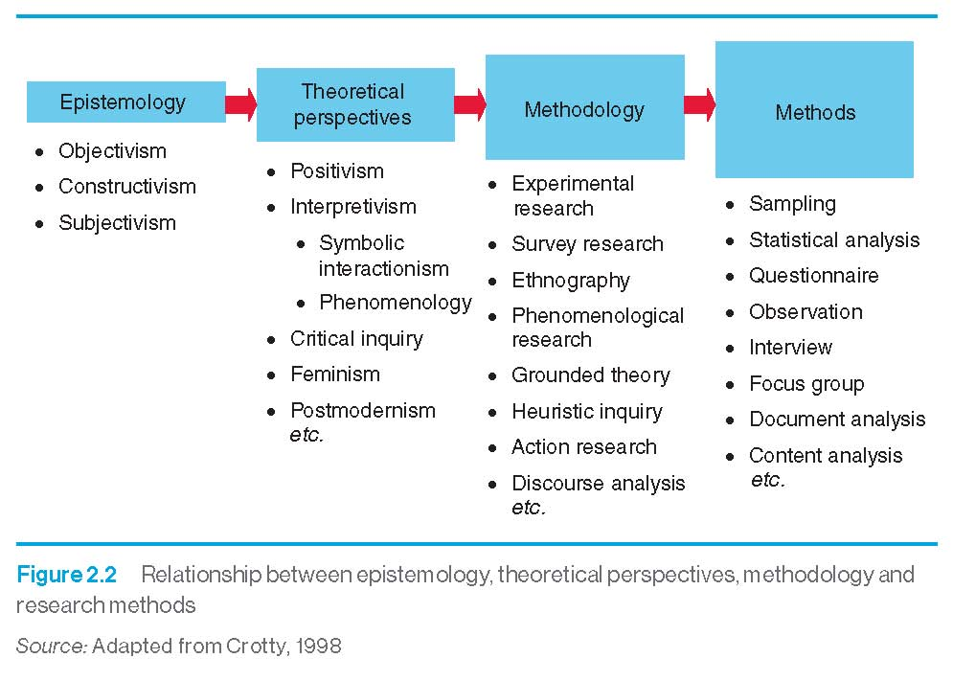
Epistemological perspectives

Slide 9

Opposing ontological traditions
Ontology of becoming. Formlessness, chaos. There is a constant law of transformations and cycle of changes.
Heraclitus
c535 – c475BC
Ontology of being. Reality composed of clearly formed entities with identifiable properties. Permanent and unchanging realities can be represented by symbols, words and concepts – orientates our thinking towards outcomes and end-states.
Parmenides
c515 – c445BC

Slide 10
Epistemological positions
Objectivism
Things exist as meaningful entities, independent of consciousness and experience.
Constructionism
Meaning emerges from our engagement with the realities of the world – and are constructed.
Subjectivism
An external reality exists, but its nature is imposed on the object by individual consciousness.

Slide 11
Theoretical perspectives: positivism
Positivism argues that:
Reality consists of what is available to the senses – that is, what can be seen, smelt, touched, etc.
Inquiry should be based upon scientific observation (as opposed to philosophical speculation), and therefore on empirical inquiry.
The natural and human sciences share common logical and methodological principles, dealing with facts and not with values.
Ideas only deserve their incorporation into knowledge if they can be put to the test of empirical experience.

Slide 12
Theoretical perspectives: interpretivism
Interpretivism, looks for:
‘culturally derived and historically situated interpretations of the social life-world’ (Crotty, 1998: 67).
Examples of the interpretivist approach include:
  symbolic interactionism
  phenomenology
  realism
  hermeneutics
  naturalistic inquiry .

Slide 13
Interpretivism: symbolic interactionism
People interpret the meaning of objects and actions in the world and then act upon those interpretations.
Meanings arise from the process of social interaction.
Meanings are handled in, and are modified by, an interactive process used by people in dealing with the phenomena that are encountered.

Slide 14
Interpretivism: phenomenology
The world is socially constructed.
The observer is a party to what is being observed.
Science is driven by human interests.
Focus on meanings – trying to understand what is happening.
Construct theories from the data (inductively).
Using multiple methods to establish different views of the phenomenon.

Slide 15
Interpretivism: realism
There is an external reality ‘out there’ that can be measured – but achieving this can be difficult.
The picture that science paints of the world is a true and accurate one.
Knowledge is advanced through the process of theory-building in which discoveries add to what is already known.
But some observable ‘facts’ may be merely illusions.

Slide 16
Interpretivism: hermeneutics
Social reality is seen as socially constructed.
Interpretation should be given more standing than explanation and description.
Social reality is too complex to be understood through the process of observation.
The scientist must interpret in order to achieve deeper levels of knowledge and also self-understanding.

Slide 17
Interpretivism: naturalistic inquiry
There are multiple constructed realities that can only be studied holistically.
Inquiry itself cannot be detached but is value-bounded by the perspectives of the researcher.
Rather than aiming to generalize, inquiry develops an ideographic body of knowledge that describes individual cases.
Phenomena can only be understood within their environment or setting.

Slide 18
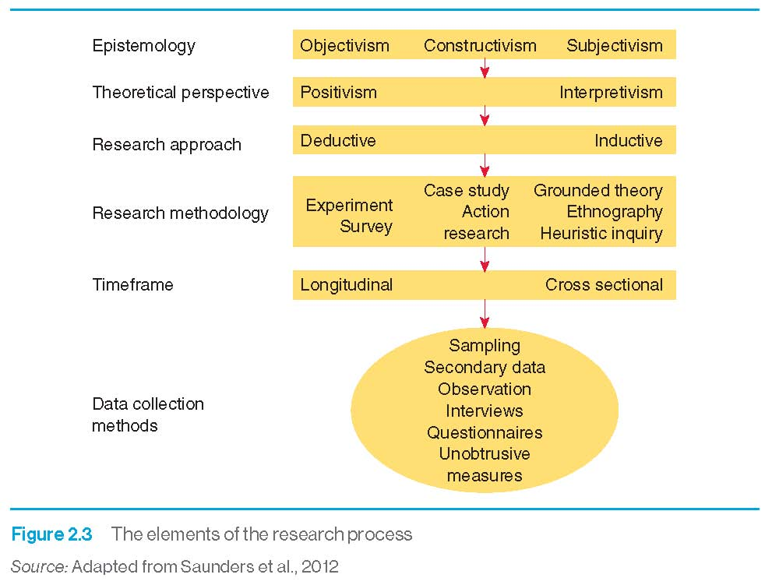
Elements of the research process

Slide 19
Research methodologies
Experimental and quasi-experimental.
Phenomenological research.
Analytical surveys.
Action research.
Heuristic inquiry.

Slide 20
Research methodologies: Experimental and quasi-experimental
Experimental and quasi-experimental research places an emphasis on:
  Reproducing the techniques of the laboratory experiment with highly structured methods.
  The generation of initial hypotheses.
  The control of variables.
  Accurate (quantitative) measurement of outcomes.
  Generalization from samples to similar populations.

Slide 21
Research methodologies
Experimental design (example)
Group
Allocation of
subjects
Treatment
Pretest
Posttest
1
Yes
Yes
Yes
Random
2
No
Yes
Yes

Slide 22
Research methodologies: phenomenological research
Phenomenological research:
  Emphasizes inductive logic.
  Seeks the opinions and subjective accounts and interpretations of participants.
  Relies on qualitative analysis of data.
  Is not so much concerned with generalizations to larger populations, but with contextual description and analysis.

Slide 23

Research methodologies: analytical surveys
Analytic surveys emphasize:
  A deductive approach.
  The identification of the research population.
  The drawing of a representative sample from the population.
  Control of variables.
  The generation of both qualitative and quantitative data.
  Generalizability of results.

Slide 24
Research methodologies: action research
Action research:
  Places an emphasis on promoting change within an organization.
  Involves both researchers and practitioners (or practitioners as researchers within their own organization).
  Can be highly structured and involve the use of experimental and control groups used to test a hypothesis.
  Can also be quite unstructured and used inductively (and qualitatively).

Slide 25
Research methodologies
Action research

Slide 26
Research methodologies: heuristic inquiry
Heuristic research involves the researcher in:
  A deep personal questioning of what it is they wish to research.
  Living, sleeping and merging with the research question.
  Allowing inner workings of intuition to extend understanding of the question.
  Reviewing all the data from personal experiences to identify tacit meanings.
  Forming a creative synthesis, including ideas for and against a proposition.

Slide 27
Summary
Basic research seeks to develop universal principles and to produce findings that are of value to society.
A theory consists of a set of interrelated concepts, definitions and propositions that demonstrate relationships between variables.
The dominant research paradigm for much of the 20th century was positivism. Today, this has been largely replaced by anti-positivist or post-positivist stances such as interpretivism.
Through the inductive approach, data are accumulated and analysed to see if relationships emerge between variables.
The deductive approach uses a theory to generate a working hypothesis concerning relationships between variables.
Approaches to research include both truth-seeking and perspective-seeking methods. Truth-seeking methods tend to adopt more experimental or quasi-experimental approaches. Perspective-seeking methods tend to be more interpretivist (e.g. phenomenology).

