Slide 1

DIFU
Richard Small
Marketing Report
4 April 2019
presented by Franziska Uecker (1807490)

Slide 2




Introduction DIFU
released 3 singles early 2018
attention in Austrian music market
moody ambient pop sound

Slide 3
SWOT-Analysis

Slide 4
Strategy
publish album with 11 tracks
1 single release beforehand
expand fanbase in the UK
European Tour with focus on the UK

Slide 5
4 C’s
Customer | Cost
Create bond between artist and fans Providing a unique product | Make people feel different emotions Easy to access and listen Brand image should be consistent
Convenience | Communication
Music available on all streaming services DIFU should be found easily online | Advertise product the right way Through various promotion tools

Slide 6
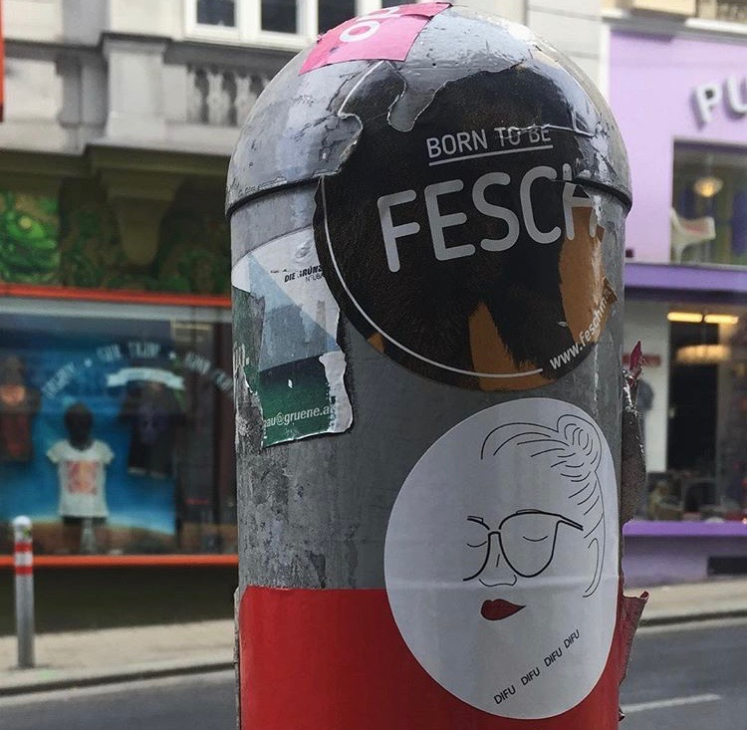
Promotion
Print Advertisement
    Posters, Flyers, Stickers
Social Media Ads
    Instagram, Facebook, Google Ads
Public Relations
    Free Stickers, Interviews during European Tour
Direct Marketing
    Free link for whole album

Slide 7
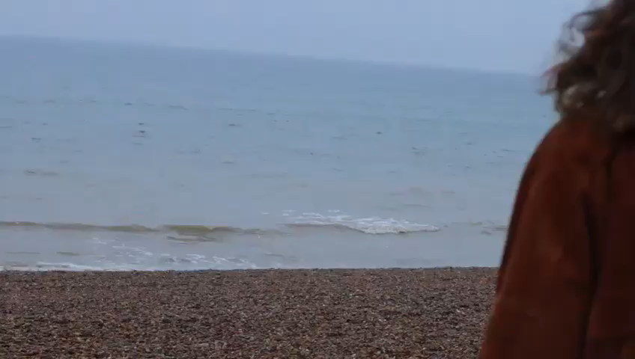

Slide 8
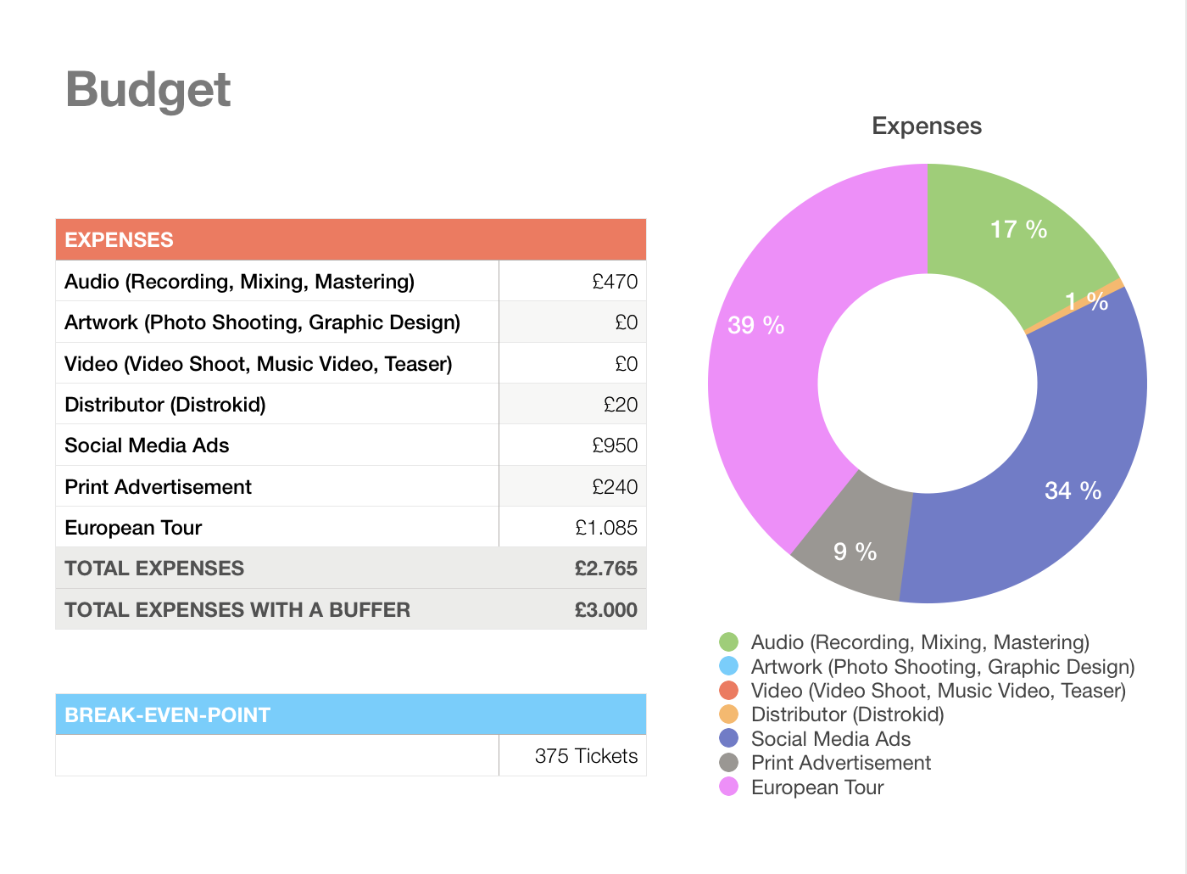
Marketing Budget

Slide 9
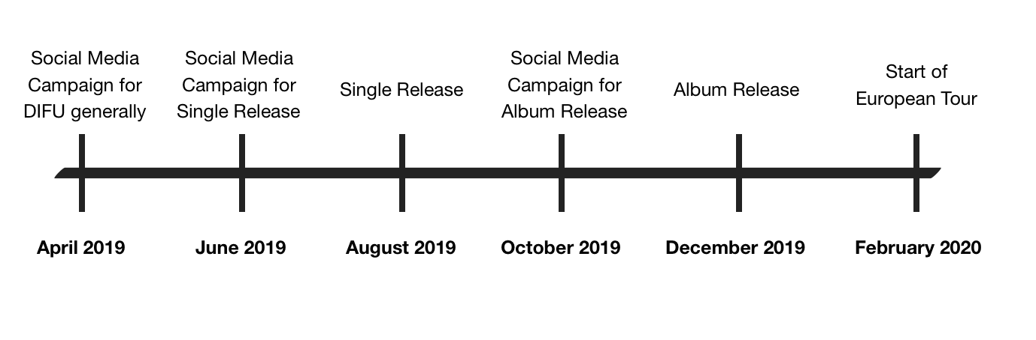
Marketing Timeline
over 11 months with 2 months steps

Slide 10
European Tour
Thursday, 6th Feb 2020 | Leeds, UK | Brudenell Social Club (100 people capacity)
Friday, 7th Feb 2020 | Manchester, UK | Band On The Wall (300 people capacity)
Saturday, 8th Feb 2020 | Liverpool, UK | The Shipping Forecast (150 people capacity)
Monday, 10th Feb 2020 | Birmingham, UK | Sunflower Lounge (120 people capacity)
Tuesday, 11th Feb 2020 | Brighton, UK | The Old Market (100 people capacity)
Friday, 14th Feb 2020 | London, UK | Two Tribes (100 people capacity)
Saturday, 15th Feb 2020 | London, UK | The Courtyard Theatre (100 people capacity)
Friday, 21st Feb 2020 | Vienna, A | Chelsea (250 people capacity)

Slide 11
Thank you for you attention!
DIFU

Slide 12
Bibliography
Business To You (2017) SWOT Analysis: Bringing Internal and External Factors together [Online]. Available at: https://www.business-to-you.com/swot-analysis/ [Accessed: 3 April 2019].
Clark, W. (n.d.) How to Develop a Marketing Strategy Timeline [Online]. Available at: https://bizfluent.com/how-8329615-develop-marketing-strategy-timeline.html [Accessed: 27 March 2019].
Just Go (2019) Get Your Motorhome Hire Quote [Online]. Available at: https://www.justgo.uk.com/ [Accessed: 27 March 2019].
Hamel, G., Doz, Y.L. and Prahalad, C.K. (1989) Collaborate with Your Competitors - and Win [Online]. Available at: https://globalgyan.in/wp-content/uploads/2018/12/Collaborate-with-your-Competitors.pdf [Accessed: 27 March 2019].
Public Relations Tactics (1999) Happy 5th birthday Public Relations Tactics. Public Relations Tactics, 6 (7), 16-18.

