Slide 1
Introduction to Python - 2
Mahesh Kannath

Slide 2
Introduction to Python
https://www.programiz.com/python-programming/online-compiler/
https://www.tutorialspoint.com/execute_python_online.php

Slide 3
Topics
1. Hello, World! | 7. Conditions
2. Variables and Types | 8. Loops
3. Basic Operators | 9. Functions
4. Basic String Operations | 10. Classes and Objects
5. String Formatting | 11. Dictionaries
6. Lists / Tuples | 12. Modules and Packages

Slide 4
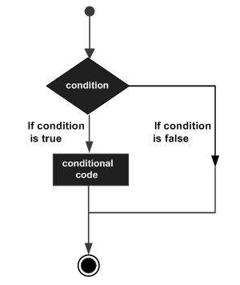
Decision making
Decision making is implementing of conditions while execution of the program and specifying actions taken according to the conditions. Decision structures evaluate multiple expressions which produce TRUE or FALSE as outcome. You need to determine which action to take and which statements to execute if outcome is TRUE or FALSE otherwise.

Slide 5
Decision making
If statement
if expression:
statement(s)
e.g. x = 5
if x == 5:
print (x)

Slide 6
Decision making
If – else statement
if expression: num = 3
Body of if if num >= 0:
else: print("Positive or Zero")
Body of else else:
print("Negative number")

Slide 7
Decision making
If elif else statement
if expression:
Body of if
Elif expression:
Body of elif
else:
Body of else

Slide 8
Decision making
If elif else statement
num = 3.4
if num > 0:
print("Positive number")
elif num == 0:
print("Zero")
else:
print("Negative number")

Slide 9
Decision making
Nested if statement
num = 8
if num > =0:
if num == 0:
print("Zero")
else:
print("Positive number")
else:
print("Negative number")

Slide 10
Exercise 1
Write a program to print whether it is a working day or holiday based on the input.
Hint: Sunday is the only holiday

Slide 11
Exercise 1 - Solution
day = ‘Sunday’
if day == ‘Sunday’:
print(“Holiday")
else:
print(“Working day")

Slide 12
Exercise 2
Write a program to print “Good morning”, “Good afternoon”, “Good evening” and “Good night” based on the different times using if elif else method
Good morning - before 12pm
Good afternoon – between 12pm and 16pm
Good evening – between 16pm and 20pm
Good night – between 20pm and 24pm

Slide 13
Exercise 2 - Solution
time = 20
if time <= 12:
print("Good morning")
elif time <=16:
print("Good afternoon")
elif time <=20:
print("Good evening")
else:
print("Good night")

Slide 14
Loops
Loops are used in programming to repeat a specific block of code

Slide 15
For loop
The for loop in Python is used to iterate over a sequence (list, tuple, string) or other iterable objects. Iterating over a sequence is called traversal.
Syntax:
for val in sequence:
Body of for

Slide 16
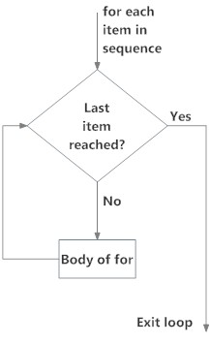
For loop

Slide 17
For loop
Example:
numbers = [6, 5, 3, 8, 4, 2, 5, 4, 11]
# variable to store the sum
sum = 0
# iterate over the list
for val in numbers:
sum = sum+val
print("The sum is", sum)

Slide 18
Exercise 3 – For loops
Write a program to print out the following objects by using for loop
Sunday
Monday
Tuesday
Thursday
Friday
Saturday

Slide 19
Exercise 3 - Solution
days = [“Sunday”, “Monday”, “Tuesday”, “Thursday”,
“Friday”, “Saturday”]
for x in days:
print(x)

Slide 20
Exercise 4
Write a program to print the letters of a word using for loop
for x in “apple":
print(x)

Slide 21
For loop
For loop with else: A for loop can have an optional else block as well. The else part is executed if the items in the sequence used in for loop exhausts.
digits = [0, 1, 5]
for i in digits:
print(i)
else:
print("No items left.")

Slide 22
Exercise 5 – For loop
Try this code
for x in range(6):
print(x)
else:
print("Finally finished!")

Slide 23
While loop
The while loop in Python is used to iterate over a block of code as long as the test expression (condition) is true.
We generally use this loop when we don't know the number of times to iterate beforehand.
Syntax: while test_expression:
Body of while

Slide 24
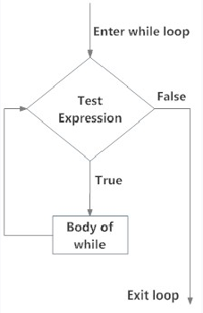
While loop – Flowchart

Slide 25
While loop
Printing from 1 to 5
i = 1
while i < 6:
print(i)
i = i+1
Problem:
Write a code to print all even numbers from 0 to 20

Slide 26
While loop
Solution:
i = 0
while i < 20:
print(i)
i = i+2

Slide 27
While loop
n = 10
# initialize sum and counter
sum = 0
i = 1
while i <= n:
sum = sum + i
i = i+1 # update counter
# print the sum
print("The sum is", sum)

Slide 28
While loop with else
counter = 0
while counter < 3:
print("Inside loop")
counter = counter + 1
else:
print("Inside else")

Slide 29
Break & Continue
In Python, break and continue statements can alter the flow of a normal loop.
Loops iterate over a block of code until the test expression is false, but sometimes we wish to terminate the current iteration or even the whole loop without checking test expression.
The break and continue statements are used in these cases.

Slide 30
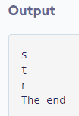
Break
for val in "string":
if val == "i":
break
print(val)
print("The end")

Slide 31
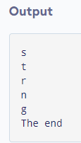
Continue
for val in "string":
if val == "i":
continue
print(val)
print("The end")

Slide 32
Pass
pass is used as a placeholder for future implementation of functions, loops, etc.
sequence = {'p', 'a', 's', 's'}
for val in sequence:
pass

Slide 33
Functions
A function is a group of related statements that performs a specific task.
Functions help break our program into smaller and modular blocks. As our program grows larger and larger, functions make it more organized and manageable.
Furthermore, it avoids repetition and makes the code reusable.

Slide 34
Functions
Types:
Built it functions
User defined functions
Syntax:
def function_name(parameters):
statement(s)

Slide 35
Functions
User defined functions

Slide 36
Functions
def greet(name):
print("Hello, " + name + ". Good morning!")
greet(‘Hamad')
Output:-
Hello, Hamad. Good morning!

Slide 37
Exercise - Functions
Write a function to find the absolute value of 2 numbers
Hint: if num >= 0:
return num
else:
return -num

Slide 38

Exercise - Functions
def absolute_value(num):
if num >= 0:
return num
else:
return -num
print(absolute_value(2))
print(absolute_value(-4))

Slide 39
Exercise - Functions
Write a function to find the sum of 2 numbers
def add_numbers(x,y):
sum = x + y
return sum
num1 = 5
num2 = 6
print("The sum is", add_numbers(num1, num2))

Slide 40
Recursive Functions
In Python, we know that a function can call other functions. It is even possible for the function to call itself. These types of construct are termed as recursive functions.

Slide 41
Recursive Functions
def factorial(x):
if x == 1:
return 1
else:
return (x * factorial(x-1))
num = 3
print("The factorial of", num, "is", factorial(num))

Slide 42
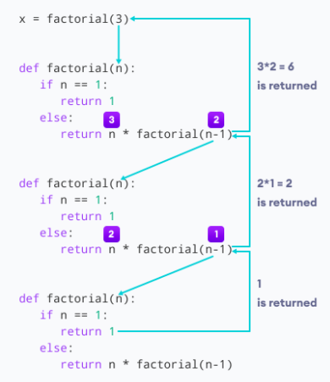
Recursive Functions

Slide 43
Lambda Functions
In Python, an lambda / anonymous function is a function that is defined without a name.
While normal functions are defined using the def keyword in Python, anonymous functions are defined using the lambda keyword.
Hence, anonymous functions are also called lambda functions.

Slide 44
Lambda Functions
We use lambda functions when we require a nameless function for a short period of time.
In Python, we generally use it as an argument to a higher-order function (a function that takes in other functions as arguments). Lambda functions are used along with built-in functions like filter(), map() etc.

Slide 45
Lambda Functions - Filter
Here is an example use of filter() function to filter out only even numbers from a list
my_list = [1, 5, 4, 6, 8, 11, 3, 12]
new_list = list(filter(lambda x: (x%2 == 0) , my_list))
Print(new_list)
Output: [4,6,8,12]

Slide 46
Exercise - Lambda Functions
1 – Filter all odd numbers from the list
my_list = [3, 6, 9, 12, 7, 15, 22, 31, 37, 44]
2 – Filter all numbers divisible by 3 from the list
my_list = [3, 7, 9, 13, 15, 22, 31, 36, 42]
Hint: new_list = list(filter(lambda x: (x%2 == 0) , my_list))
Print(new_list)

Slide 47
Lambda Functions - map
The map() function in Python takes in a function and a list. The function is called with all the items in the list and a new list is returned which contains items returned by that function for each item.
my_list = [1, 5, 4, 6, 8, 11, 3, 12]
new_list = list(map(lambda x: x * 2 , my_list))
print(new_list)
Output: [2, 10, 8, 12, 16, 22, 6, 24]

Slide 48
Exercise - Lambda Functions
1 – Add 2 to all numbers from the list
my_list = [1, 5, 4, 6, 8, 11, 3, 12]
2 – Divide by 2 to all numbers from the list
my_list = [1, 5, 4, 6, 8, 11, 3, 12]
Hint: list(map(lambda x: x * 2 , my_list))
print(new_list)

Slide 49
Functions
Built-in functions

Slide 50
Functions
Print()
Max()
Min()
Len()
Range()
Type()
Hex()
Abs()

Slide 51
Q & A

