Slide 1


Serious and Organised Crime Within the UK :
(SOC)
By: Ella Jade Smith
Assignment 2:SOC
02/05/2024

Slide 2
What is SOC?
Serious and Organised Crimes describe grave offences planned and executed by people who coordinate their criminal activities, whether as single entities or as a group (Crimestoppers, 2020).
According to the Centre for Social Justice (2018), perpetrators of SOC are often motivated by financial gain.
Notes:
O’Hagan and Edmundson (2021), communicate the coordination and orchestration of serious and organised crimes include the participation of groups or individuals within a network, whether national or international, that poses a critical threat to societies. Consequently, based on how the groups coordinate and execute their criminal practices, examples of SOC in the UK and across the globe include: human trafficking, illegal trade of drugs and firearms, child sexual exploitation and abuse, cybercrimes, and street gang violence (National Crime Agency, 2023).

Slide 3
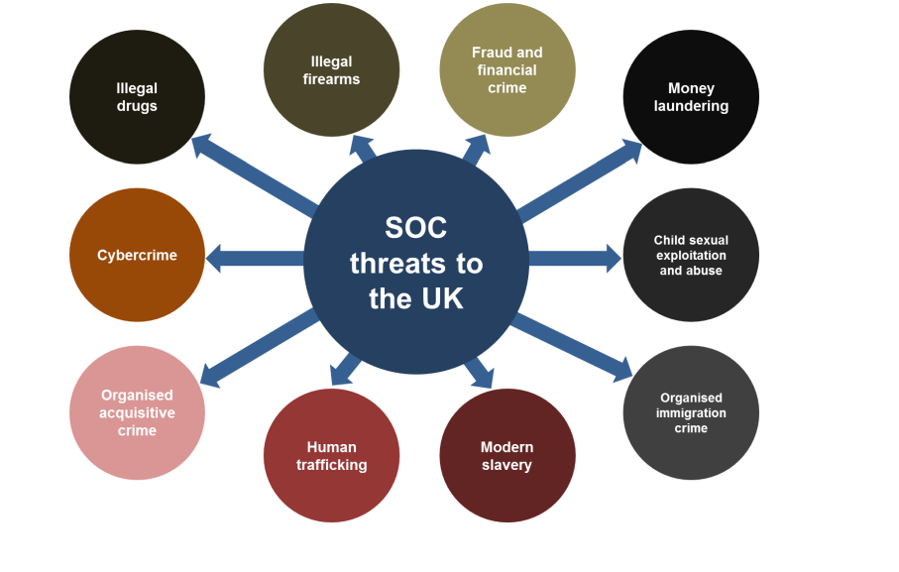
Examples of SOC:
(Home Office, 2023)
Notes:
The National Crime Agency (2022), states that SOC has become increasingly problematic in the UK. Statistics from the annual crime plan (2022-2023) state that 896 arrests and 474 convictions were made regarding perpetrators of serious and organised crime within the UK in the year ending 2022 and commencing the year 2023.
•According to the NCA (2023), the main themes of how SOC affects society are relevant to:
•Geopolitical instability and International Conflict:
-Organised crime groups take advantage of global conflict by using the vulnerability of communities who are suffering from poverty and instability. Most serious and organised crime has an international scope that can be demonstrated by the number of migrants coming into the UK through small boats, increased drug smuggling and an increase in firearms supply.
•The Cost of Living:
-Criminals use the vulnerability of the cost of living to their advantage by exploiting individuals and businesses through cybercrime in committing fraud and exploiting the vulnerable through modern slavery and trafficking.
•The Exploitation of Technology:
-Technology is the catalyst for SOC and enables criminals to target people who are vulnerable by communicating on social media. In addition, criminals often use technology to facilitate criminality by hiding their activities. For example, encryption. Cryptocurrency to exploit for ransom and tracking to monitor illegal shipments.
•Criminal Resilience and Adaptability:
-Organised crime groups are adaptable to the environment, disregarding criminal enforcement’s attempt at prevention. For example, in both the COVID-19 pandemic and the EU exit, organised crime groups evolved through the use of technology to continuously exploit victims’ by adapting their methods of operation.
The most comprehensive yet dangerous impact of the crimes is the threats of organised acquisitive crime. Threats of physical violence, harm, and even death in communities, exploitation of vulnerable members of communities, and increased use of drugs and firearms poses a threat to society within the UK (Local Government Association, 2015; Brandon and Hafez, 2008).
Additionally, HM Government’s (2023) report on the SOC strategy 2023-2028 indicates that in the UK, SOC undermines the sovereignty and legitimacy of social institutions, businesses, and administrative infrastructures, sabotaging societies, politics, and economic progress.
Consequently, the impacts of the crimes sabotage the integrity of the government towards safeguarding its people and undermine satisfactory delivery of service and economic development (HM Government, 2023).

Slide 4

The Hidden Nature of SOC:
Hidden Nature of SOC and Underreporting:
The Office for National Statistics (2023) states that fraud accounts for over 40% of crime in England and Wales.
Fraud is also the least reported crimes within the UK. According to the NCA ( 2022) cases as little as 13% are reported to Action Fraud or police by victims.
Potential victims of modern slavery have risen by 80% compared to last year (House of Lords, 2020).
County lines drugs supply have risen drastically , from 720 to 2,000 over the last 4 years (House of Lords, 2020).
(Stock Images, 2022)
Notes:
Hidden Nature of SOC and Underreporting:
NAO (2018) states a significant amount of serious and organised crime is ‘hidden’. For example, child sexual exploitation, abuse and modern slavery are difficult to track and prevent as organised crime networks adapt their methods of exploitation. Due to the hidden nature of SOC, many crimes involving fraud and cybercrime remain underreported.
•Fraud is one of the most common crimes to be committed within the UK. The Office for National Statistics (2023) states that fraud accounts for over 40% of crime in England and Wales.
•Fraud is also the least reported crime within the UK. According to the NCA ( 2022) cases as little as 13% are reported to Action Fraud or police by victims.
•Potential victims of modern slavery have risen by 80% compared to last year (House of Lords, 2020).
•County lines drug supply has risen drastically, from 720 to 2,000 over the last 4 years (House of Lords, 2020).
How does underreporting affect prevention strategies?
Due to the large scale of SOC that goes unreported, the government can’t prevent SOC as efficiently. The implementation of the 4 P’s counter-terrorism strategy means that whilst the strategy is a way of moving forward, the government can’t efficiently implement the strategy to deter larger-scale SOC. For example, one of the 4 P’s is to pursue SOC offenders and prevent involvement in such crimes, however, the police and other institutions can’t proactively pursue SOC prevention if the number of crimes unrecorded is on a large scale, without accurate data representation it is difficult to measure how effective the prevention strategy is (College of Policing, 2023).

Slide 5

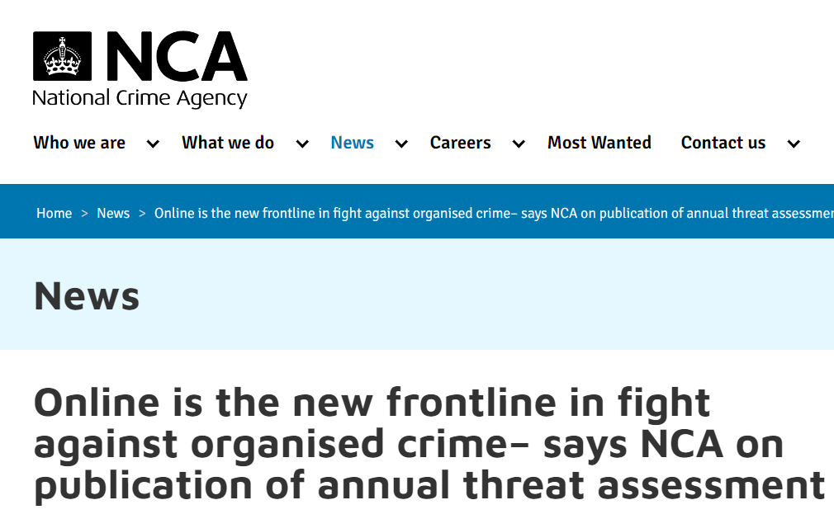
Advances in Technology
The Dark Web
Encryption Tools
Child Sexual Exploitation
Notes:
Advances in technology:
The National Crime Agency state that the advances in technology are contributing to the rise in SOC (NCA, 2021). For instance, ransomware has increased in frequency as £3bn of estimated fraud losses were recorded within the last year for individuals in the UK and businesses. The figure remains as an estimate as underreporting persists as an ongoing issue for concern.
The dark web has become increasingly popular for organised crime networks because the use of encryption tools to hide communications and tracking commodities has made monitoring difficult. Large numbers of offenders use the dark web to trade illegal material such as drugs, weapons and for exploitation and human trafficking (NCA, 2021).
Child sexual exploitation is happening at a much larger scale since advances in technology facilitate grooming activities and enable child physical abuse and blackmailing. In the UK, over 80,000 people are a threat to children online (Home Office, 2019).

Slide 6



Communities and Violence
(Stock Images, 2022)
Notes:
Communities and Violence in the UK:
Knife crimes and gangs, as examples of serious and organised crimes (SOC), represent one of the most prevalent and critical threats to the safety of communities in the UK. According to West Northamptonshire Council (2023), knife crimes define offences that involve the use of tools with sharp blades, like knives that are used to threaten, rob, hurt, or kill a victim, while gangs related to violence perpetrate their acts as individuals with networks and are armed when participating in criminal endeavours.
What is a gang?
According to S34(5) of the Policing and Crime Act 2009, revised by the Serious and Organised Crime Act 2015, activity is gang-related if it occurs in the course of or is related to the activities of a group of at least 3 people and has one or more characteristics that enable its members to be identified by others as a group (Home office, 2023).
The extent to which knife and gang-related crime remain an issue for concern is significant. The extent of concern can be examined from the scope of statistics recorded within the last 4 years. According to national statistics recorded by Allen et al., (2023), there were about 50,500 cases of knife crimes involving sharp tools in England and Wales from 2022 to 2023, representing a 4.7% increase from the previous year. In support of this is academic Burke (2024), who reports that almost 50,000 cases are reported annually as knife crimes continue to be a pressing concern.

Slide 7
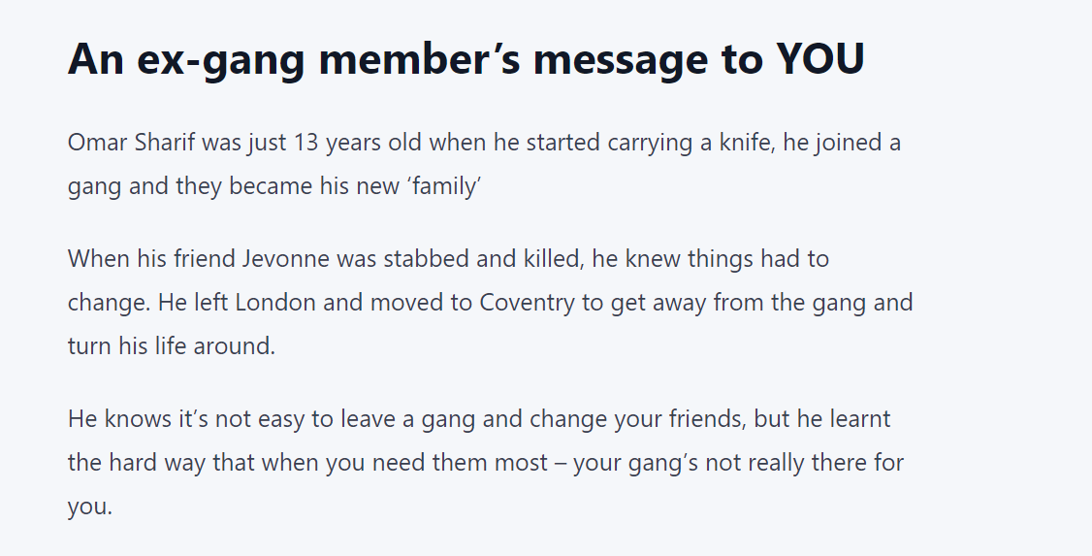
(Office for National Statistics 2023)
Notes:
The Office for National Statistics (2023) communicate that the geographical presentation of areas mostly affected by knife crime and gang related activity include; London, Birmingham, Manchester and Leeds. Considering the different factors related to the existence and prevalence of knife crimes and gangs, youths and teenagers face critical vulnerabilities as victims (Ng, 2023; Townsend, 2023; Vinnakota et al., 2022). For instance, communities are faced with challenges regarding knife and gang related crimes as friendships, families and individuals suffer losses and reputational damage.
For example, the message above displays the remorse and lack of understanding of the consequences relevant to gang and knife crime.

Slide 8

Why do people join gangs?
Recognition
Acceptance
Money
Protection
Territory
Respect
(Stock Images, 2022)

Slide 9
Risk Factors associated with Knife Crime:
Age
Gender
Educational Attainment
Ethnicity
Adverse Childhood Experiences
Notes:
Is there a correlation between gangs and knife crime ?
According the College of Policing (2024), gangs are often associated with knife crime as criminal activity involving crimes such as theft, assault and burglary are used to facilitate criminal behaviour.
Other risk factors to knife-gang related violence is the desire to establish a reputation on the street, peer-influence, and motivation.

Slide 10
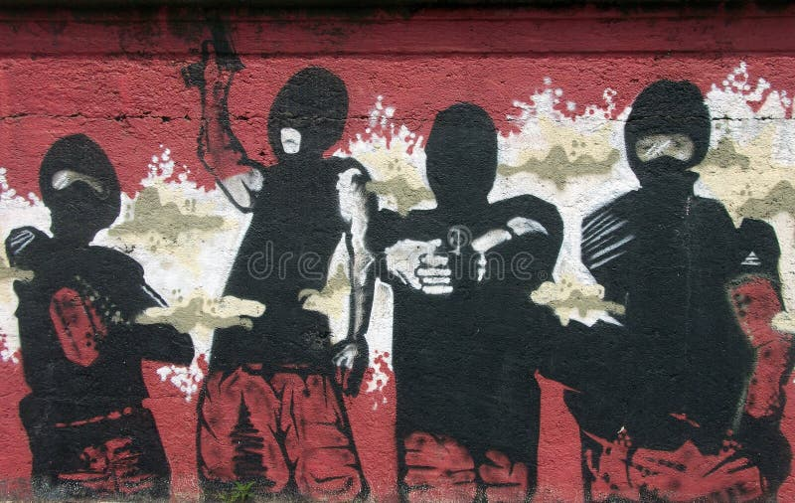

Knife Crime in the UK:
(Stock Images, 2022)
Notes:
Knife Crime:
The prevalence of knife crime in the UK demonstrates a more concerning issue within the scope of SOC. According to Havard (2022), violence in the streets is often related to gang activities that link crimes like stabbings and knife possession to other types of organised offences, like county lines drug dealing. Statistics indicate that gangs are associated with about 50% of all knife crimes and 60% of shootings (The Centre for Social Justice, 2018). Consequently, knife crimes are not isolated occurrences and represent how organised gangs influence community violence. Examples of gangs in the UK include the ‘KD’ County Line, Old Trafford Crips, and ABM Crips (Uniquetalent.org, n.d.; Bagdi, 2022). The operational offence of the gangs is not only limited to knife crimes but also includes firearm possession and drug dealing.
Considering patterns of knife crimes and their effects on communities, different factors are linked as contributors to the crisis in the UK. McNeill and Wheller (2019) outline that the most crucial risk factors include: gender, age, education, ethnicity, and childhood experiences as pivotal influencers, with men above the age of 15 years with low school attainment and experienced abuse and neglect in the upbringing being vulnerable to the crimes.
Haylock et al., (2020) also attribute the increase to societal discrimination, economic inequalities, and mental health as contributing factors. Consequently, the strain theory effectively explains the occurrences of knife crimes, Skoczylis and Andrews (2022) note that negative life experiences and normalised social and cultural structures lead to extremism and participation in crimes.
How can a lack of trust in the police affect knife crime?
Within the UK, the ideal policing response is referred to as “policing by consent”, therefore a lack of trust from the public toward policing is an issue of major concern. Young people are less willing to co-operate and this catalyses feelings of unsafety. Consequently, leading young people to carry weapons on them as a form of self-defence, in particular, knives (SageJournals, 2021).
Another reason that an individual is likely to carry a weapon, is because the lack of trust in the police means that vicitms could become perpetartors, as a result of dismissal of police procedures and seeking revenge (College of Policing, 2024).
What constitutes a trustworthy police force?
According to Bradford et al., (2021), a trustworthy police force is a force that has shared values, strong commitment to their job and the community, and to bare fair and kind characteristics.

Slide 11
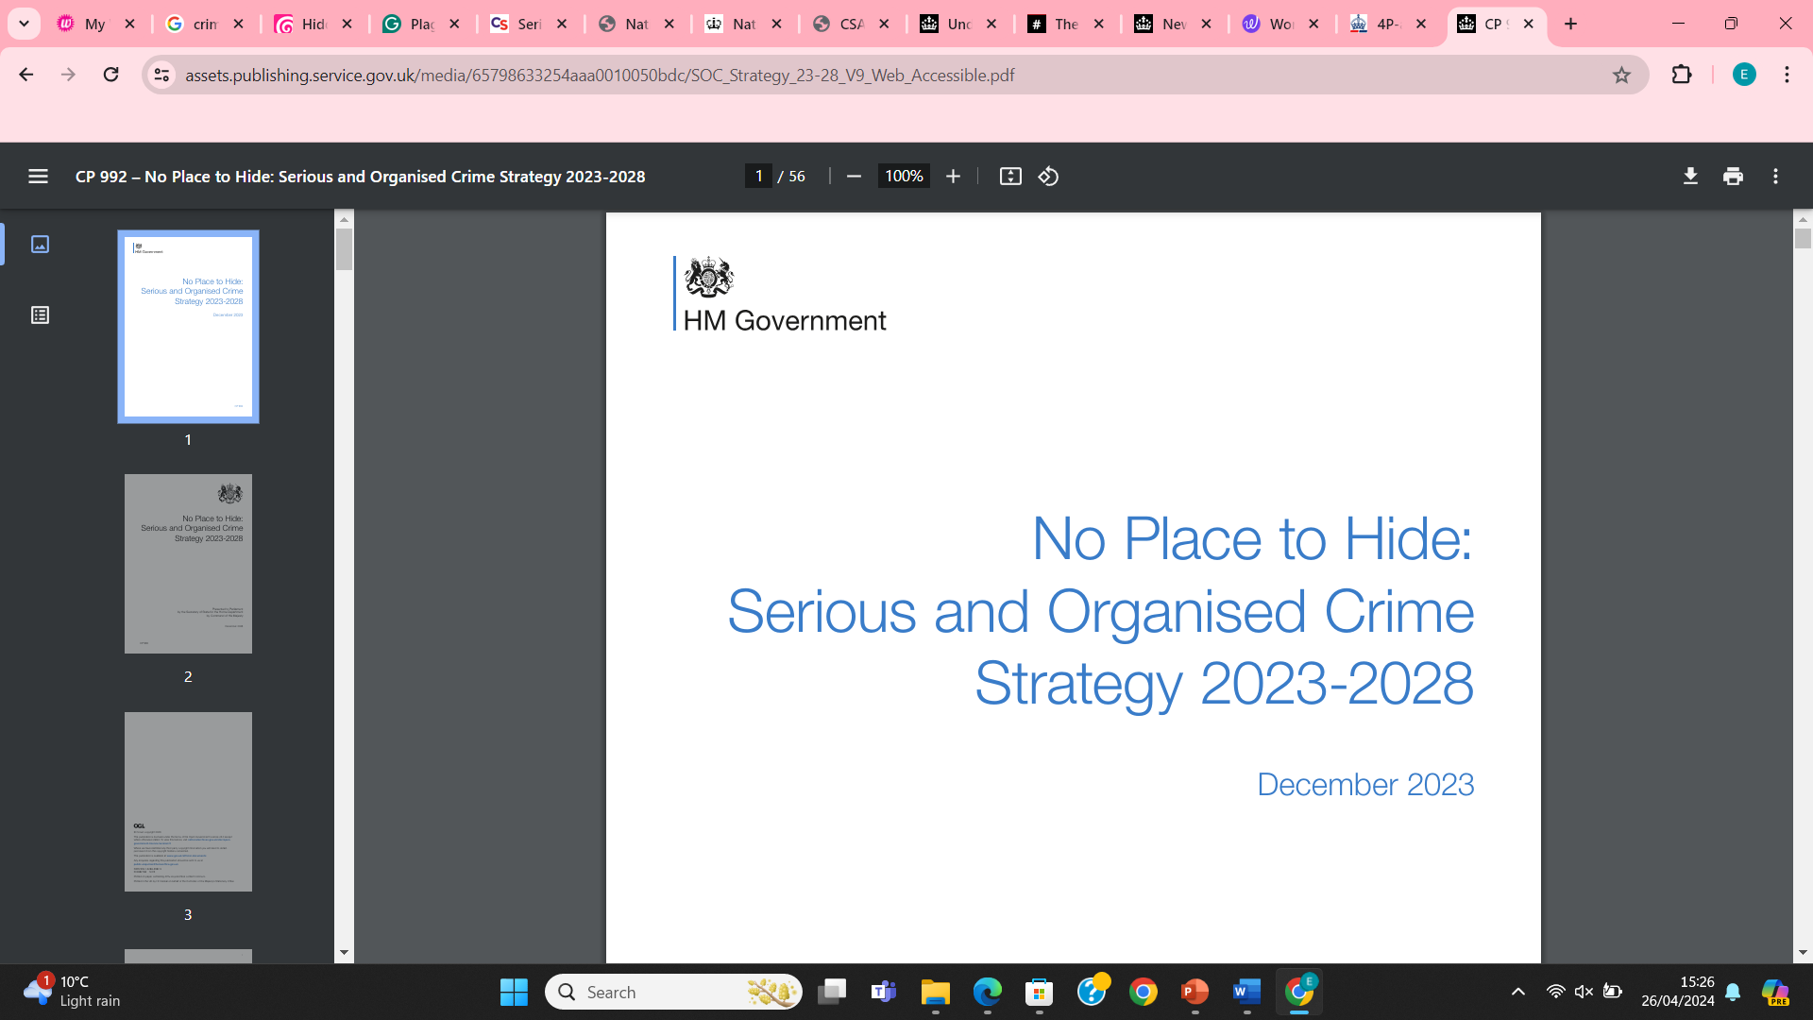
Notes:
Prevention strategy:
As a proactive response against crimes in the UK, the HM Government’s “No Place to Hide: Serious and Organised Crime Strategy 2023-2028” takes a multidimensional approach to combat enterprises engaging in criminal offences, including addressing safety in the upcountry, within the UK borders, extending their efforts to overseas destinations, through technological initiatives and multiagency collaboration (HM Government, 2023). In the context of knife crimes, the strategy sets out a framework to address the crisis by deterring criminals through dismantling their supporting structures like businesses, corruption dealings, and online platforms that aid their acts. Unlike in traditional approachs to addressing knife crimes as studied by Bullock et al. (2023), which had inefficiencies, the strategy is also centred on multiagency corporations, both local and international, in sharing intelligence, technological systems, and efforts to divert crimes from occurring in the UK. The multidimensional approach to addressing serious and organised crimes is effective based on the structural resilience of the systems involved.
A key goal of the strategy is to strengthen local communities' resilience to serious and organised crime, ensuring that once one gang has been dismantled, another can’t take its place.
All police forces in England and Wales will be able to employ the 'Clear, Hold, Build' policing tactic to clear their communities of these gangs, prevent criminals from exploiting the vacuum created by the initial disruption in the 'hold' phase, and tackle the local drivers of crime. This will stop further serious and organised crime becoming re-established in the future, ‘building’ a safer community. Currently, this approach is being used in 18 forces across 31 sites. Since January 2022, anti-social behaviour has decreased by 45% in Easington Lane, on the outskirts of Sunderland, and for the first two months of the programme, 160 individuals were arrested for 272 offences, including murder, aggravated burglary, and kidnapping in Barnet.

Slide 12
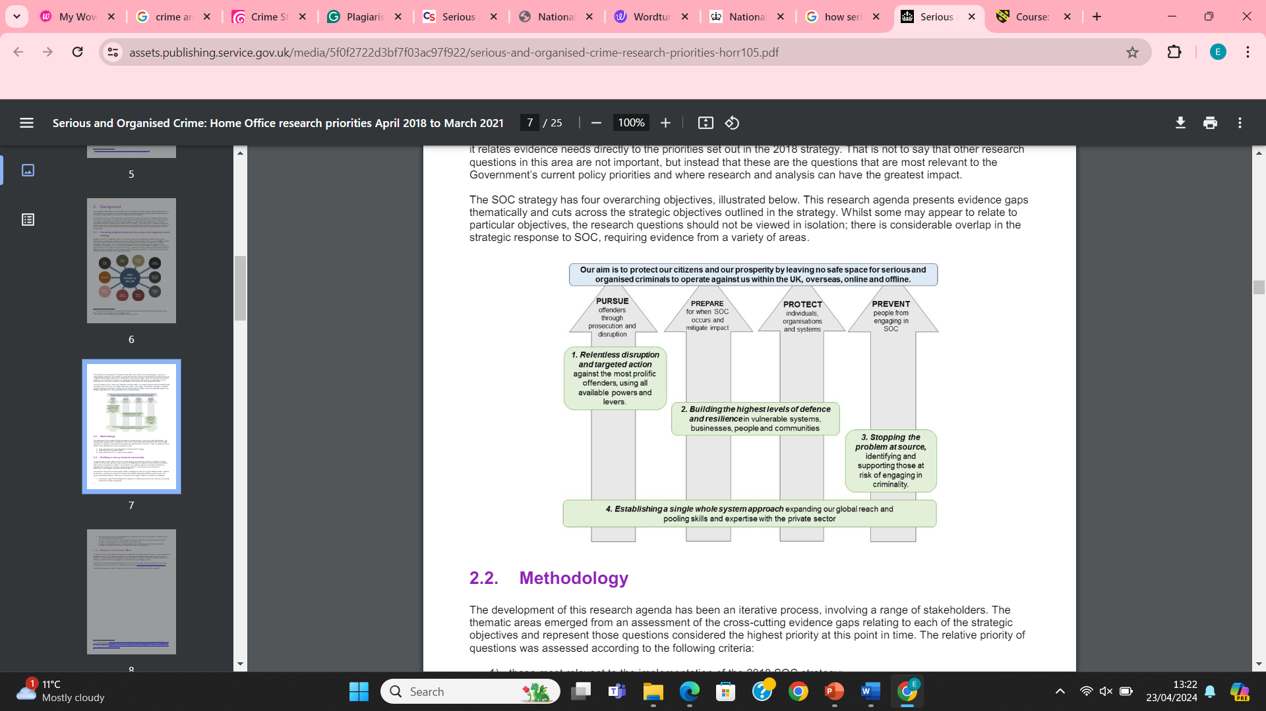
(HMICFRS, 2023)
Notes:
The 4P’s Approach to counter-terrorism in the UK (HMICFRS, 2023):
Prevents terrorist attacks from happening through disruption and tackles offending behaviour through prosecution of offenders.
Prepares for terrorist attacks and builds resilience in the communities.
Protects individuals, businesses and communities from terrorist attacks and the effects of SOC crime.
Prevents individuals from engaging in terrorist or criminal activity.

Slide 13
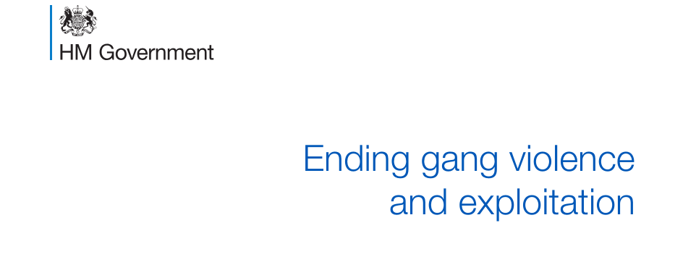
Cordis Pulse (2016) states that ending gang violence starts with:
County Lines.
Protect Vulnerable Locations.
Reduce Violence and Knife Crime.
Safeguard gang associated women and girls.
Promote early-intervention.
Promote meaningful alternative to gangs.
(HM Government, 2016)
Notes:
According to the HM Government (2016), ending gang violence is a national priority:
The government are implementing preventative measures outlined as follows:
County lines: exploitation of vulnerable individuals by ruthless gang members to sell drugs
Many gang member relocate outside urban areas for market value as vulnerable youths and people are more easily targeted in areas with less police presence and therefore homes are used as drug dens and people exploited due to vulnerabilities such as finances, caretakers, homelessness and many more reasons.
More than 57% of areas affected by county lines include coastal towns.
The police have implemented a strategy known as “Operation Engaged”, while working alongside other policing agencies and the National Police Chief’s Council.
Protect vulnerable locations:
Those areas such as care homes and pupil referral units make children more susceptible to exploitation through gangs.
Gang members often target schools and wait for children to willing leave school during periods of time that the school would not notice the child's absence. For example, break time and waiting for parents to collect their children after school, and then returning the youths before the activity is noticed.
The Department for Education are taking appropriate measures to raising the quality and safeguarding of children in care homes and are advising those who are particularly vulnerable to exploitation to refrain from leaving their home when there is immediate risk to their safety.
Reduce violence and knife crime:
The Ending Gangs and Youth Violence Programme have effectively developed a local response to gang violence by collaborating with key partners in local areas.
In June 2015, the government implemented an amended gang injunction power, including a statutory definition of gang violence and drug dealing so that police can effectively respond to gang violence in local areas through hot-spot and problem-orientated policing .
Information sharing on gang-affected offenders is another method that the Home Office and Ministry of Justice are collaborating to enforce national information sharing that will reduce duplication between agencies and improve resettlement for offenders back into society.
Safeguard gang associated women and girls:
Improvements in safeguarding women and girls has improved at local level due to local partners and agencies working together to educate and identify vulnerable women and girls.
A combination of innovative approaches and tools to help women and girls who are involved in gang related activity to improve their lifestyle and encourage leaving gangs.
Promote early intervention:
Through using evidence from the Early intervention Foundation, children who are vulnerable can be easily identified and supported.
Promoting early-intervention is crucial to deter people from joining gangs.
The Home Office are working with the Department of Health to identify mental health issues and combat vulnerability through providing support for those who are vulnerable.
Promote meaningful alternative to gangs:
Present alternative hobbies and employment opportunities to decrease the likelihood that people who are vulnerable to join gangs.
DWP is implementing demand led jobcentre support to ensure smooth transition from school to employment by offering training opportunities.

Slide 14

Ending Knife Crime
(Stock Images, 2022)
Notes:
Ending knife crime:
Stop and Search:
S.60 of the Criminal Justice and Public Order Act 1994 allows police officers to stop and search anyone without suspicion. The need for the ‘reasonable grounds’ element is not required for section 60. The power under this section allows officers to prevent the carrying of weapons and dangerous instruments, however, challenges presented with s.60 of stop and search powers are relevant to concerns regarding the targeting of specific communities such as BAME communities. Accordingly, Tuckers Criminal Solicitors (2024) state that BAME individuals were 9 times more likely to be stop and searched by the police compared to white individuals. Consequently, leading to distrust within the police and degrading police-community relationships, one of the core foundations of policing (College of Policing, 2023). The Home Office (2023) has been collaborating with police partners in order to improve s.60 stop and search challenges relevant to police-community relationships and trust by ensuring transparency and lawful conduct.
The Home Office (2022) presents statistics that suggest that stop and search has increased by 85% since 2019 and has contributed to the removal of over 50,000 deadly knives and offensive weapons, preventing potential crimes of fatality.
On the contrary, the government exclaims that complete transparency and confidence in the police may differ due to operational policing methods that cannot be changed (Home Office, 2022).
Beating Crime Plan 2021: The plan aims to improve community safety by reducing neighbourhood crime, decreasing homicide, tackling serious violence and setting out a strategic approach to the UK’s capability and capacity to deal with fraud and cybercrime.
The UK Government (2021) confirms that the approach is effective as statistics display that in 2020, serious violence decreased by 8% and neighbourhood crime fell by 12%.

Slide 15

What more could be done to prevent SOC?
(Stock Images ,2022)
Notes:
What more could be done for SOC?
Despite the HM Government Strategy (2023-2028) for SOC – “No Place to Hide”, more specific interventions are necessary to prevent SOC from happening.
For example : What more could be done to prevent knife crime?
Despite targeted interventions to stop young people from being exploited by gangs, police enabling s.60 Stop and Search without any suspicion will alienate and lower trust in police legitimacy (Murray et al., 2020). Therefore, increasing offending rates. Sage Publications (2024) state that one of the primary factors contributing to weapon carrying is self –protection. carrying a weapon for self-protection seems to outweigh the possibility of getting caught with the weapon or the possibility of victimisation (Sage Publications, 2024). An increase in distrust means that offending will increase as feelings of seeking revenge and individuals lack of faith in police resources and capability means that individuals will take justice into their own hands.
Crime Journals suggest that tackling knife crime is increasingly difficult as police databases continue to collect and record data regarding crimes such as robbery and violent acts with the use of weapons such as firearms and other violent weapons, making it difficult to distinguish knife crime within the data. Accordingly, due to the inability to accurately filter the amount of knife crimes that occur, police need a more consistent approach to recording knife crimes by being more precise about what types of knives have been used in crime and seized through police intervention. Therefore, raising awareness for the public and increasing reporting (Bullock, 2023).
Similarly, Bullock (2023) communicates that over-reliance on police recorded data only shows a fraction of the issue regarding knife crime and therefore policing interventions are less specific.

Slide 16
References:
Notes:
references

Slide 17
Allen, G., Carthew, H. and Zayed, Y., (2023). Knife Crime in England and Wales. [online] Parliament.uk. House of Commons Library. Available at: https://researchbriefings.files.parliament.uk/documents/SN04304/SN04304.pdf [Accessed 20 Apr. 2024].
Bagdi, A., (2022). Most Fearsome Gangs, Their Nicknames and How They Became Notorious. [online] Birmingham Live. Available at: https://www.birminghammail.co.uk/black-country/most-fearsome-gangs-nicknames-how-24527948 [Accessed 21 Apr. 2024].
Bailey, L., Harinam, V. and Ariel, B., (2020). Victims, Offenders and victim-offender Overlaps of Knife Crime: a Social Network Analysis Approach Using Police Records. PLOS One, 15(12).
Bradford et al., (2021) Understanding knife crime and trust in police with young ..., Understanding Knife Crime and Trust in Police with Young People in East London. Available at:<// https://discovery.ucl.ac.uk/id/eprint/10148313/1/Skarlatidou_Understanding%20Knife%20Crime%20and%20Trust%20in%20Police%20with%20Young%20People%20in%20East%20London_AOP.pdf// >Accessed: 21 April 2024).
Brandon, J. and Hafez, S., (2008). Crimes of the Community: Honour-based Violence in the UK. [online] Civitas. London: Centre for Social Cohesion. Available at: https://www.civitas.org.uk/pdf/CrimesOfTheCommunity.pdf [Accessed 20 Apr. 2024].
Bullock, K., Agar, I., Ashby, M., Brennan, I., Hales, G., Sidebottom, A. and Tilley, N., (2023). Police Practitioner Views on the Challenges of Analysing and Responding to Knife Crime. Crime Science, 12(1).
Burke, D., (2024). Knife Crime Rises to Nearly 50,000 Cases a Year - See How Your Area’s Affected. [online] The Mirror. Available at: https://www.mirror.co.uk/news/politics/breaking-knife-crime-rises-nearly-31962939 [Accessed 21 Apr. 2024].

Slide 18
Crimestoppers, (2023) Available at: < https://crimestoppers-uk.org/keeping-safe/community-family/serious-and-organised-crime#:~:text=The%20definition%20of%20serious%20and,the%20potential%20of%20financial%20gain./ /> (Accessed: 22 April 2024).
Densley, J., Deuchar, R. and Harding, S., (2020). An Introduction to Gangs and Serious Youth Violence in the United Kingdom. Youth Justice, 20(1-2), pp.3–10.
Gani, I., Chandan, J.S., Bandyopadhyay, S., Pathmanathan, A. and Martín, J., (2023). Health Outcomes in Those Who Have Been Victims of Knife crime: a Protocol for a Systematic Review and meta-analysis. BMJ Open, 13(12), pp.e078020–e078020.
Havard, T., (2022). Serious Youth Violence: County Lines Drug Dealing and the Government Response. [online] Parliament.uk. House of Commons Library. Available at: https://researchbriefings.files.parliament.uk/documents/CBP-9264/CBP-9264.pdf [Accessed 20 Apr. 2024].
Haylock, S., Boshari, T., Alexander, E.C., Kumar, A., Manikam, L. and Pinder, R., (2020). Risk Factors Associated with knife-crime in United Kingdom among Young People Aged 10–24 years: a Systematic Review. BMC Public Health, 20(1).
HM Government, (2023). No Place to Hide: Serious and Organised Crime Strategy 2023-2028. [online] HM Government. Available at: https://assets.publishing.service.gov.uk/media/65796db30467eb000d55f677/SOC_Strategy_2023_28.pdf [Accessed 21 Apr. 2024].

Slide 19
Home Office, (2013) Understanding organised crime: Estimating the scale and ..., Understanding organised crime: estimating the scale and the social and economic costs Research Report 73. Available at: <// https://assets.publishing.service.gov.uk/media/5a7c74e8e5274a5255bcec63/horr73.pdf// > (Accessed: 22 April 2024).
Local Government Association, (2015). Tackling Serious and Organised Crime a Local Response Report. [online] local.gov.uk. Available at: https://www.local.gov.uk/sites/default/files/documents/tackling-serious-and-orga-44a.pdf [Accessed 20 Apr. 2024].
McNeill, A. and Wheller, L., (2019). Understanding the Causes of Knife Crime. [online] College of Policing. Available at: https://www.college.police.uk/guidance/knife-crime-evidence-briefing/understanding-causes-knife-crime [Accessed 20 Apr. 2024].
National Crime Agency, (2023). National Strategic Assessment (NSA) Campaign 2023 - Overview of SOC - National Crime Agency. [online] nationalcrimeagency.gov.uk. Available at: https://nationalcrimeagency.gov.uk/nsa-overview-of-soc [Accessed 21 Apr. 2024].
National Crime Agency., (2023) Fraud - National Crime Agency, The Threat from Fraud. Available at: <// https://www.nationalcrimeagency.gov.uk/what-we-do/crime-threats/fraud-and-economic-crime// > (Accessed: 24 April 2024).
Ng, E., (2023). Knife Crime on Rise Due to ‘Teenagers Made Vulnerable by Pandemic’. [online] The Independent. Available at: https://www.independent.co.uk/news/uk/london-office-for-national-statistics-england-wales-gangs-b2279272.html [Accessed 20 Apr. 2024].
O’Hagan, A. and Edmundson, C.J., (2021). County lines: the Exploitation of Vulnerable Members of Society. Forensic Research & Criminology International Journal, 9(2), pp.47–57.
Office for National Statistics, (2023). Multiple Variables Map. [online] www.ons.gov.uk. Available at: https://www.ons.gov.uk/visualisations/dvc653/index.html [Accessed 21 Apr. 2024].

Slide 20
Sidebottom, A., Brennan, I., Agar, I., Ashby, M.P.J., Bullock, K., Hales, G. and Tilley, N., (2024). Knife Crime – a Problem Solving Guide. College of Policing. [online] Available at: https://assets.production.copweb.aws.college.police.uk/s3fs-public/2021-11/Knife-crime-a-problem-solving-guide.pdf [Accessed 21 Apr. 2024].
Skarlatidou, A., Ludwig, L., Solymosi, R. and Bradford, B., (2021). Understanding Knife Crime and Trust in Police with Young People in East London. Crime & Delinquency, 69(5), pp.943–970.
Skoczylis, J. and Andrews, S., (2022). Strain theory, resilience, and far-right extremism: the Impact of gender, Life Experiences and the Internet. Critical Studies on Terrorism, 15(1), pp.1–26.
The Center for Social Justice, (2018). It Can Be Stopped. [online] The Centre for Social Justice. Available at: https://www.centreforsocialjustice.org.uk/library/it-can-be-stopped [Accessed 21 Apr. 2024].
Townsend, M., (2023). Half of Teenagers in England and Wales Have Witnessed or Been Victims of Violence, Study Reveals. The Observer. [online] 11 Nov. Available at: https://www.theguardian.com/uk-news/2023/nov/11/teenager-victims-violence-knife-crime-gangs [Accessed 20 Apr. 2024].
Vinnakota, D., Kabir, R., Rahman, Q.M., Sathian, B., Bai, A.C.M., Deividas, N., Pellissery, M.-V., Kareem, S.K.A., Hasan, Md.R. and Parsa, A.D., (2022). Exploring UK Knife Crime and Its Associated factors: a Content Analysis of Online Newspapers. Nepal Journal of Epidemiology, 12(4), pp.1242–1247.
West Northamptonshire Council, (2023). Knife Crime and Gangs. [online] www.westnorthants.gov.uk. Available at: https://www.westnorthants.gov.uk/personal-safety/knife-crime-and-gangs [Accessed 21 Apr. 2024].

