Slide 1
Name: Carina Gomes
Student number: 2222912
Module code: MBHP6030

Slide 2

introduction
This presentation will examine the integration of health, well-being, and sustainable development in the delivery of care, using real world policies models and case studies (Nunes, Lee and O’Riordan, 2016).
Integrating health, wellbeing, and sustainable development in health and social care is crucial. It ensures that care not only addresses immediate health needs but also promotes overall wellbeing and long-term sustainability (Nunes, Lee and O’Riordan, 2016).
This approach leads to better health outcomes, a healthier environment, and more resilient communities, ultimately creating a holistic system that benefits individuals and society as a whole (Nunes, Lee and O’Riordan, 2016).
Also, this presentation will be looking at sustainable development goals particuly goal 3

Slide 3
Models of health- Ecological,
Health is a state of complete physical, mental, and social well-being, according to the World Health Organization (WHO). It goes beyond merely not having a disease, emphasizing the importance of overall wellness for a fulfilling life (World Health Organization, 2025).
Models of health- ecological, biomedical
The ecological model highlights how various factors, such as individual behaviours, social connections, community resources, and environmental conditions, impact health outcomes (Rural Health Information Hub, 2025).. It recognizes that health is influenced not just by biological factors, but also by socio-economic status, cultural elements, and environmental conditions, advocating for a comprehensive approach to health promotion and disease prevention (Rural Health Information Hub, 2025).
Applying ecological principles benefits areas like sustainable agriculture, biodiversity conservation, and urban planning. In sustainable agriculture, these methods improve soil quality, decrease pesticide use, and increase crop diversity, resulting in healthier ecosystems and enhanced food security (Getz et al., 2017).

Slide 4
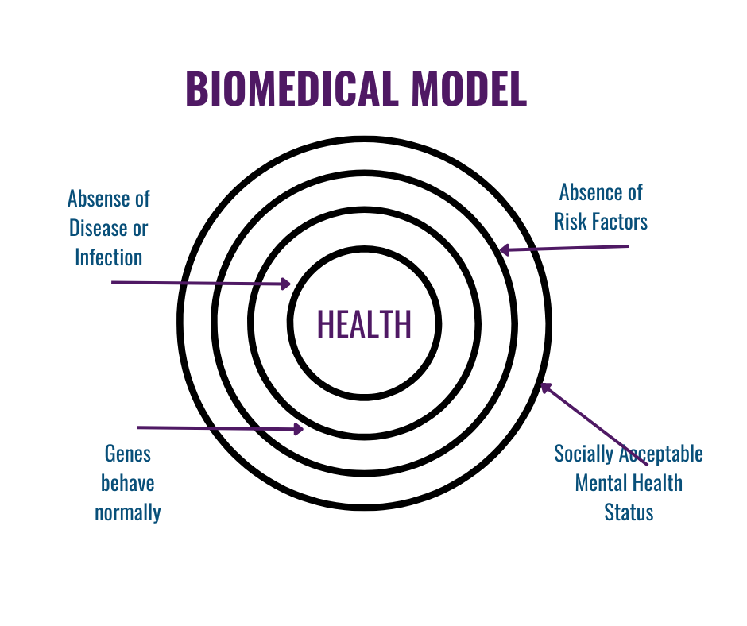
Models of Health Biomedical
In contrast, the biomedical model focuses on the biological and physiological aspects of health. It suggests that diseases stem from specific biological causes like pathogens or genetics, leading to treatments that prioritize diagnosis and medical interventions such as medications or surgery. This model tends to overlook the larger social determinants of health (Farre and Rapley, 2017).
Biological methods are valuable in medicine, agriculture, and environmental science. In medicine, techniques like gene therapy and stem cell research are essential for treating genetic disorders and regenerating damaged tissues (Rocca and Anjum, 2020).
(Kaoverii, n.d.)

Slide 5
Theories
The Biopsychosocial Model- Service designers can create more comprehensive programs that address not only the physical needs of clients but also their psychological experiences and social environments (National Health Service, 2023).
The Ecological Model- For service design, this means evaluating how community resources, organizational policies, and societal attitudes impact client experiences. A service are thus shaped to not only meet individual needs but also to engage with wider systems that promote resilience and support (Vink et al., 2020).
The Holistic Model- This model suggests that services be designed to encompass all aspects of a client’s life, including emotional, spiritual, and physical needs. By adopting this model, service delivery can be transformed into a more comprehensive experience that respects and incorporates the diverse backgrounds and circumstances of clients (Nursing and Midwifery Council, 2024).

Slide 6

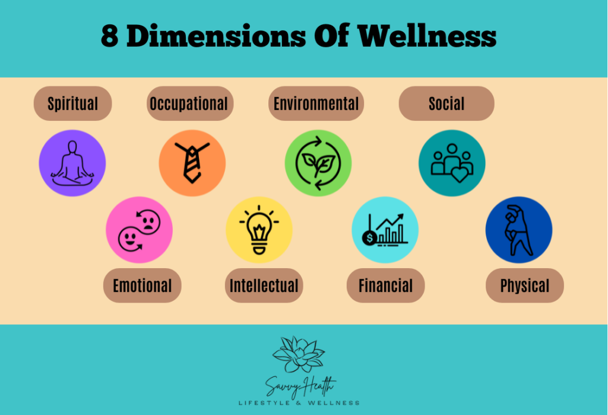
Wellbeing- 8 Dimensions
Well-being
Wellbeing is intricately connected to our overall health, as achieving a state of good health is fundamental to fostering a sense of wellbeing. When our physical or mental health deteriorates, it can significantly impact our sense of wellbeing, leading to increased stress, anxiety, and a diminished quality of life. Conversely, when we prioritize our wellbeing through practices such as regular exercise, balanced nutrition, and mindfulness our health improves, creating a positive feedback loop that enhances both physical vitality and emotional resilience (NHS, 2022).
Subjective and Objective.
Subjective measures rely on individuals' personal assessments of their own wellbeing, often captured through surveys and questionnaires. These tools typically ask respondents to evaluate their happiness, life satisfaction, and emotional state, providing valuable insights into personal perceptions and experiences (Alatartseva and Barysheva, 2015) . .
On the other hand, objective measures involve quantifiable factors that can be observed and assessed externally, such as economic indicators, health statistics, and social conditions. These might include metrics like income levels, employment rates, access to healthcare, and education quality. (Alatartseva and Barysheva, 2015). .
(s_price, 2022)

Slide 7
Sustainable Development
The United Nations Sustainable Development Goals (SDGs) consist of 17 interconnected goals aimed at creating a sustainable future for all by 2030 (Abubakar, Gillam and Sastry, 2025).
Sustainable Development: Defined by the United Nations (UN), seeks to balance social, economic, and environmental needs for today without compromising the future (Jansen et al., 2024).
The UN's Sustainable Development Goals (SDGs) focus on creating equitable, inclusive, and resilient societies while promoting environmental sustainability (Jansen et al., 2024).
This approach tackles issues like poverty, inequality, and climate change, highlighting the connection between health, wellbeing, and sustainability(Jansen et al., 2024).

Slide 8
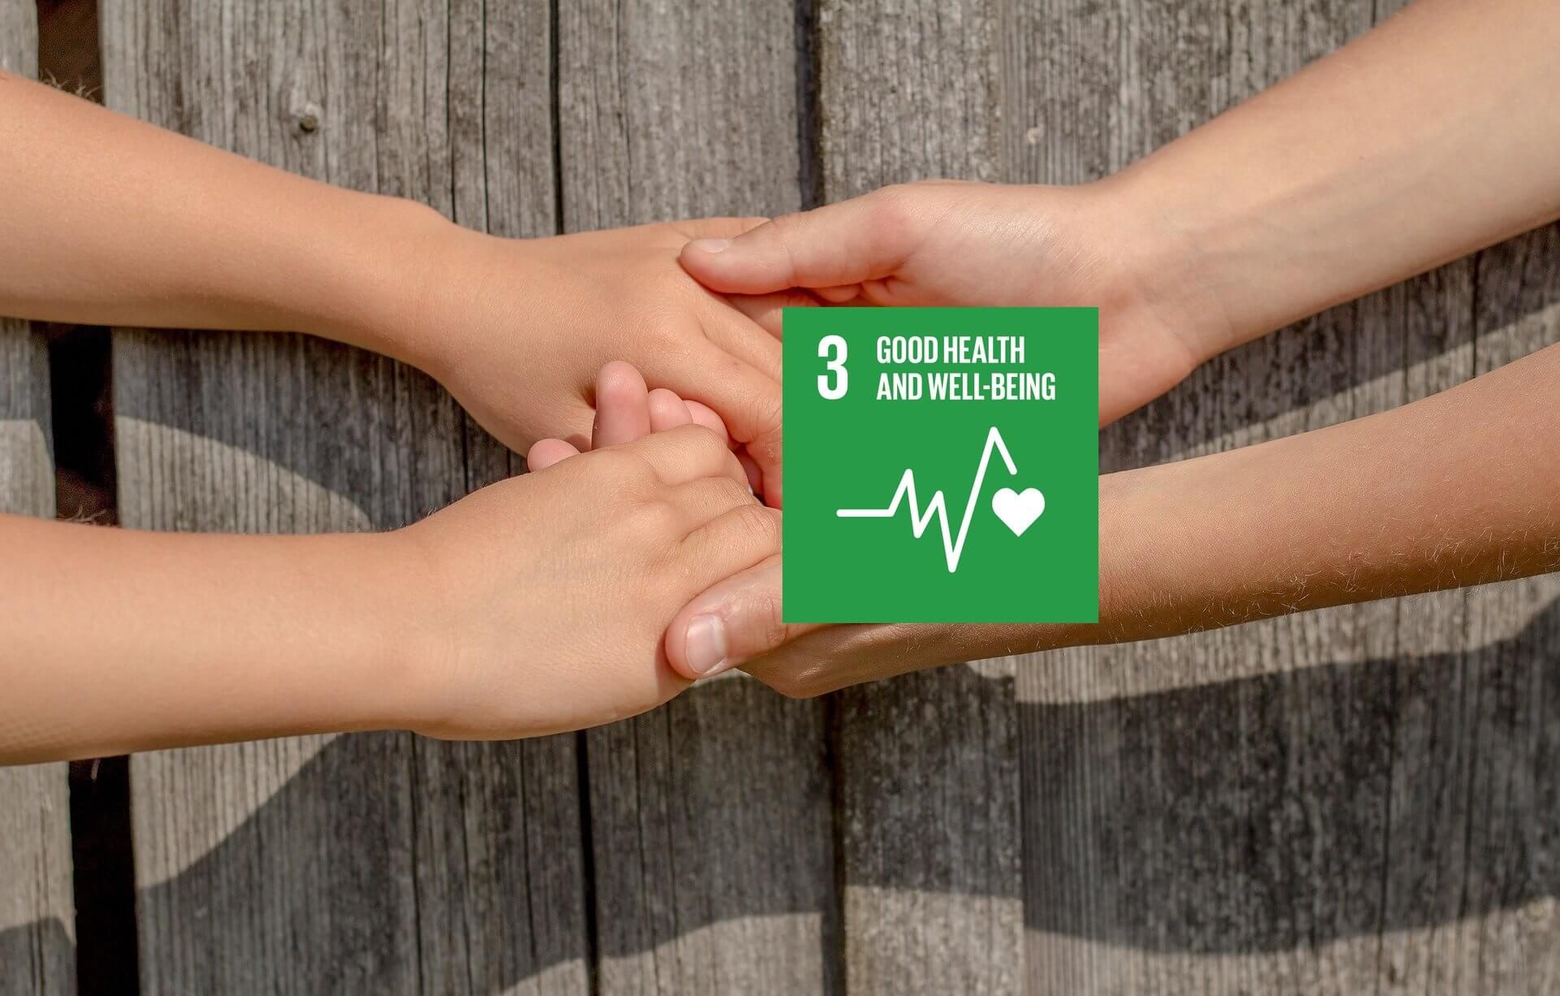
SDG 3 goal
Sustainable Development Goal 3 (SDG 3) focuses on ensuring health and well-being for everyone, addressing key issues like maternal and child health, communicable and non-communicable diseases, mental health, and universal health coverage (BBC Bitesize, no date).
SDG 3 views health as more than just the absence of illness; it encompasses complete physical, mental, and social well-being. It highlights the need for equitable access to quality healthcare, essential medicines, and vaccines, especially for underserved populations (BBC Bitesize, no date.).
Promoting health leads to economic benefits through increased productivity, reduced healthcare costs, and long-term stability. Tackling health disparities and supporting mental health contributes to building resilient communities capable of overcoming challenges like pandemics, climate change, and socio-economic inequalities (BBC Bitesize, no date .).
Goal 3 focuses on ensuring healthy lives and well-being for everyone, targeting issues such as reducing maternal mortality, combating diseases, and achieving universal health coverage, emphasizing health as a human right (Abubakar, Gillam and Sastry, 2025).
(Silva, 2021)

Slide 9
UK Integration
In the UK, integrating health, well-being, and sustainability into health and social care systems is vital. This is seen in policies and practices that aim to enhance health outcomes while promoting sustainable healthcare (Abubakar, Gillam and Sastry, 2025).
A notable initiative is the Diabetes Prevention Programme (DPP), which targets individuals at high risk for Type 2 diabetes, providing personalized support through lifestyle interventions like nutrition guidance and physical activity (Abubakar, Gillam and Sastry, 2025).
By prioritizing prevention over treatment, the DPP seeks to improve health outcomes and lessen the long-term strain on the healthcare system (Abubakar, Gillam and Sastry, 2025).

Slide 10
Policy and Governance
When examining the influence of key frameworks on health and social care in the UK, several significant policies stand out.
The Health in All Policies approach integrates health considerations into all public policy areas, promoting collaboration across sectors to enhance community health and well-being we integrated into the UK (Glasby, 2012).
The NHS Long Term Plan is essential for shaping healthcare delivery. It outlines the NHS's future direction, focusing on improving patient care, preventive services, and addressing health inequalities. By prioritizing these areas, the NHS seeks to create a more sustainable and responsive health system ( NHS, 2025).

Slide 11
Examples of the UK Initiative
Change of Life Programs
These programs are designed to encourage individuals to adopt healthier lifestyles through education and support. They often include workshops focused on nutrition, exercise, and mental well-being, aiming to reduce obesity rates and promote physical activity (Barradale, 2024). Participants may receive personalized plans and ongoing coaching to help them navigate lifestyle changes effectively (Barradale, 2024).
Smoking Cessation Access Programs
These initiatives aim to reduce smoking rates across the UK by providing accessible resources and support for individuals who want to quit. The programs typically offer a combination of counselling services, access to nicotine replacement therapies, and behaviour modification techniques (Department of Health and Social Care, 2023). Many are community-based and provide tailored support groups, alongside digital resources, to ensure that individuals receive the necessary guidance and encouragement to successfully quit smoking (Department of Health and Social Care, 2023).

Slide 12
Apps
Apps that enable individuals to monitor their health include a variety of tools designed to track different aspects of wellness. These applications can monitor key metrics such as physical activity, sleep patterns, heart rate, nutrition, and even mental health (NHS, 2025).
Many of these health monitoring apps offer personalized features, allowing users to set fitness goals, log their meals, and receive tailored feedback based on their progress.
Popular examples include MyFitnessPal for nutrition tracking, Fitbit for activity and sleep monitoring, and Headspace for mental well-being (NHS, 2025).

Slide 13
Equality and Access
Health inequalities represent a significant challenge in healthcare in the UK, resulting in disparities in access, treatment quality, and health outcomes among different groups (NHS, 2023). These inequalities arise from various factors, including ethnicity, socioeconomic status, and digital exclusion.
Ethnic minorities often face obstacles such as language barriers, cultural differences, and discrimination, which can lead to delays in diagnosis and treatment and ultimately result in poorer health outcomes (GOV.UK, 2024).
Digital exclusion is becoming increasingly important as more healthcare services transition to online platforms. Those without reliable internet access or digital skills can struggle to utilize telehealth services and find health information, further widening the gap in care (GOV.UK, 2025).

Slide 14
Conclusion
In conclusion, the importance of the SDGs in the context of the UK's health and social care services cannot be overstated. They provide a framework for promoting integrated systems that prioritize equity and sustainability. By aligning national health policies with these goals, the UK can work towards a future where quality health care is accessible to all, ultimately leading to healthier communities and improved public health outcomes.

Slide 15
Reference
Abubakar, A.K., Gillam, L. and Sastry, N. (2025). The Role of the Internet of Things (IoT) in Achieving the United Nations (UN) Sustainable Development Goals (SDGs) - A Systematic Review. ACM Computing Surveys. doi:https://doi.org/10.1145/3765516.
Alatartseva, E. and Barysheva, G. (2015). Well-being: Subjective and Objective Aspects. Procedia - Social and Behavioral Sciences, 166, pp.36–42. doi:https://doi.org/10.1016/j.sbspro.2014.12.479.(Accessed: 24/09/2024).
BBC Bitesize. (n.d.). Global health and wellbeing - UN Sustainable Development Goal 3: Good health and wellbeing - 3rd level Learning for Sustainability Revision. Available at: https://www.bbc.co.uk/bitesize/guides/z8rt6g8/revision/1. (Accessed: 06/10/2025).
Barradale, G. (2024). Feeling like change in the UK isn’t possible? Let these 28 purposeful campaigns prove otherwise. Big Issue. Available at: https://www.bigissue.com/news/activism/campaigns-uk-activism-sheila-mckechnie-awards/ (Accessed: 06/ 10/ 2025)..
‌Department of Health and Social Care (2023). Stopping the start: Our New Plan to Create a Smokefree Generation. GOV.UK. Available at: https://www.gov.uk/government/publications/stopping-the-start-our-new-plan-to-create-a-smokefree-generation/stopping-the-start-our-new-plan-to-create-a-smokefree-generation. (Accessed: 06/10/2024).
Farre, A. and Rapley, T. (2017). The new old (and old new) medical model: Four decades navigating the biomedical and psychosocial understandings of health and illness. Healthcare, 5(4), p.88. doi:https://doi.org/10.3390/healthcare5040088. (Accessed: 06/10/2025).
Getz, W.M., Marshall, C.R., Carlson, C.J., Giuggioli, L., Ryan, S.J., Romañach, S.S., Boettiger, C., Chamberlain, S.D., Larsen, L., D’Odorico, P. and O’Sullivan, D. (2017). Making ecological models adequate. Ecology Letters, 21(2), pp.153–166. doi:https://doi.org/10.1111/ele.12893. (Accessed: 06/10/2025).
GOV.UK. (2024). Inclusive Britain second update report – May 2024. Available at: https://www.gov.uk/government/publications/inclusive-britain-update-report/inclusive-britain-second-update-report-may-2024. (Accessed:09/10/2025).
Glasby, J. (2012). UNDERSTANDING HEALTH AND SOCIAL CARE Second Edition 2. Available at: https://cmls.org.uk/online/wp-content/uploads/2019/07/Understanding-health-and-social-care.pdf. (Accessed: 06/10/2025).
Jansen, M.A.K., Andrady, A.L., Bornman, J.F., Aucamp, P.J., Bais, A.F., Banaszak, A.T., Barnes, P.W., Bernhard, G.H., Bruckman, L.S., Busquets, R., Häder, Donat-P., Hanson, M.L., Heikkilä, A.M., Hylander, S., Lucas, R.M., Mackenzie, R., Madronich, S., Neale, P.J., Neale, R.E. and Olsen, C.M. (2024). Plastics in the environment in the context of UV radiation, climate change and the Montreal Protocol: UNEP Environmental Effects Assessment Panel, Update 2023. Photochemical & Photobiological Sciences, 23(4), pp.629–650. doi:https://doi.org/10.1007/s43630-024-00552-3.(Accessed: 24/09/2024).
Kaoverii (n.d.). biomedical model. Subtle Yoga. Available at: https://subtleyoga.com/you-are-not-a-car-blog/biomedical-model/.(Accessed: 06/10/2025).
NHS, N. (2025). NHS England» Planning framework for the NHS in England. England.nhs.uk. Available at: https://www.england.nhs.uk/long-read/planning-framework-for-the-nhs-in-england/.(Accessed: 06/10/2025).
NHS, (2022). Wellbeing. [online] NDRS. Available at: https://digital.nhs.uk/data-and-information/publications/statistical/health-survey-england-additional-analyses/ethnicity-and-health-2011-2019-experimental-statistics/wellbeing-copy. (Accessed:09/10/2025).
England, N. (2025). NHS England» New NHS online hospital to give patients more control over their care. England.nhs.uk. Available at: https://www.england.nhs.uk/2025/09/new-nhs-online-hospital-to-give-patients-more-control-over-their-care/. (Accessed: 06/10/2025).
‌NHS, (2023). What Are Healthcare Inequalities? [online] NHS England. Available at: https://www.england.nhs.uk/about/equality/equality-hub/national-healthcare-inequalities-improvement-programme/what-are-healthcare-inequalities/. (Aceesed: 09/10/2025).
GOV.UK (2025). Digital Inclusion Action Plan: First Steps. GOV.UK. Available at: https://www.gov.uk/government/publications/digital-inclusion-action-plan-first-steps/digital-inclusion-action-plan-first-steps. (Accessed: 09/10/2025).
Nunes, A.R., Lee, K. and O’Riordan, T. (2016). The importance of an integrating framework for achieving the Sustainable Development Goals: the example of health and well-being. BMJ Global Health, 1(3), p.e000068. doi:https://doi.org/10.1136/bmjgh-2016-000068. (Accessed: 24/09/2024).
NHDS, (2023). THE BIOPSYCHOSOCIAL MODEL OF CARE. Available at: https://ppss-static.cumbria.nhs.uk/images/general-images/THE-BIOPSYCHOSOCIAL-MODEL-OF-CARE.pdf. (Accessed: 06/10/2025).
Nursing and Midwifery Council (2024). Holistic Care - the Nursing and Midwifery Council. Available at: https://www.nmc.org.uk/standards/guidance/holistic-care/. (Accessedf: 06/10/2025).
Rocca, E. and Anjum, R.L. (2020). Complexity, Reductionism and the Biomedical Model. Rethinking Causality, Complexity and Evidence for the Unique Patient, [online] 1(1), pp.75–94. doi:https://doi.org/10.1007/978-3-030-41239-5_5. (Accessed: 06/10/2024).
‌Rural Health Information Hub (2025). Ecological models. Ruralhealthinfo.org. Available at: https://www.ruralhealthinfo.org/toolkits/health-promotion/2/theories-and-models/ecological. (Accessed: 06/ 10/2025).
s_price (2022). High-Value Mindset: Understanding Yourself and The 8 Dimensions of Wellness. Savvy Health Nutrition and Wellness. Available at: https://savvyhealth.blog/8-dimensions-of-wellness/ (Accessed: 06/10/2025).
Silva, E.S. da (2021). The SDGs Series (Goal 3): Ensure healthy lives and promote well-being for all. [online] Global Change Ecology. Available at: https://globalchangeecology.com/2021/06/04/the-sdgs-series-goal-3-ensure-healthy-lives-and-promote-well-being-for-all/. (Accessed: 06/10/2025).
Vink, J., Koskela-Huotari, K., Tronvoll, B., Edvardsson, B. and Wetter-Edman, K. (2020). Service Ecosystem Design: Propositions, Process Model, and Future Research Agenda. Journal of Service Research, 24(2), p.109467052095253. doi:https://doi.org/10.1177/1094670520952537. (Accessed: 06/10/2025).
‌World Health Organization (2025). World Health Organization. Who.int. Available at: https://www.who.int/. ( Accessed: 24/09/2025).
‌

