Slide 1
AI STATEMENT
The research, ideas, and business concept were created by me,

Slide 2
Module: Managing Entreprise
Module code: BMSW4011
Name: Mirovaldo Danfa
Student Number: 2435826
Date: 09/03/2026

Slide 3
Presentation Overview slide
1. Business Proposition
1.1 Business name, concept and story
1.2 Mission statement, aims, SMART objectives and USP
1.3 Legal structure (pros and cons)
1.4 HRM strategy
1.5 Location
1.6 Brief financial overview
1.7 SWOT Analysis
1.8 Market research
2. 12 Month Marketing Strategy
2.1 Strategy initiatives
2.2 Marketing examples
2.3 Branding
3. 2 Minute Elevator Pitch
3.1 Features and benefits
3.2 Why you should invest in my business idea
4. References

Slide 4


Slide 5
CONCEPT
Nene Café is a sustainable coffee shop focused on providing high-quality organic coffee while promoting environmentally conscious goods and practices.
Main Products
Organic coffee and speciality drinks
Plant-based milk options (oat, almond, soy)
Locally produced baked goods and snacks
Reusable coffee cups and eco-friendly products

Slide 6
Misson Statement
To provide high-quality coffee while promoting sustainable practices that benefit customers, the community, and the environment.
Business Aim
To build a strong reputation as a trusted sustainable coffee shop in the local community.
SMART Objectives
Generate €100,000 revenue in the first year
Gain 500 loyal customers within 12 months
Reduce single-use packaging by 70%
Achieve 5,000 social media followers within one year
Unique Selling Proposition (USP)
Nene Café combines premium coffee with strong environmental responsibility. All packaging is recyclable or biodegradable, and customers receive discounts when using reusable cups.

Slide 7
Legal Structure (Pros and Cons)
Nene Café will operate as a sole proprietorship.
Advantages
Easy and inexpensive to set up
Owner has full control of business decisions
Owner keeps all profits
Disadvantages
Owner has unlimited liability
Personal assets may be at risk if the business fails
Harder to raise large amounts of funding
This structure is suitable for a small start-up business in the early stages.

Slide 8
HRM Strategy
Nene Café will begin with five employees.
Staff Roles
Owner / Manager – manages finances and operations
Two Baristas – prepare drinks and serve customers
Kitchen Assistant – prepares snacks and baked goods
Marketing Assistant (part-time) – manages social media and promotions
Recruitment Methods
Online job websites
Social media advertisements
Job boards at local universities
Organisation Structure
Owner / Manager
↓
Baristas
Kitchen Assistant
Marketing Assistant

Slide 9
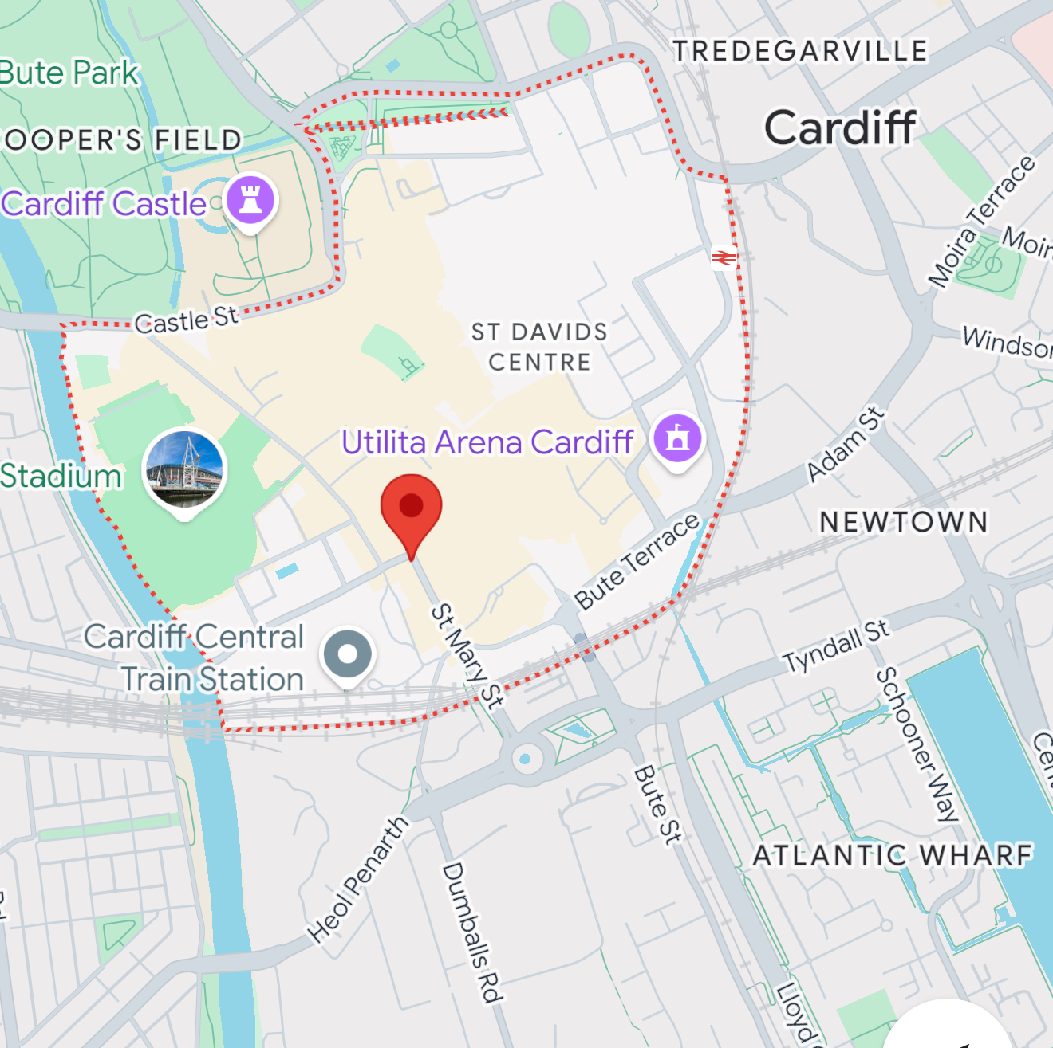
Location
The café will be located in a busy city centre area close to:
Offices
Universities
Public transportation
Advantages of the Location
High foot traffic
Easy access for commuters
Regular demand from students and office workers

Slide 10
Brief Financial Overview
Start-Up Costs
Total Start-Up Cost: €30,000
Funding Sources
Personal investment: €15,000
Bank loan: €15,000
Item | Cost
Coffee equipment | €15,000
Rent deposit | €5,000
Furniture & interior | €6,000
Initial stock | €3,000
Marketing launch | €1,000

Slide 11
SWOT Analysis
Strengths
Eco-friendly brand concept
High-quality organic coffee
Growing demand for sustainable businesses
Weaknesses
New brand with limited recognition
Higher costs for organic products
Opportunities
Increasing consumer interest in sustainability
Growth of coffee culture among young professionals
Threats
Competition from major chains like
Starbucks and
Costa Coffee

Slide 12
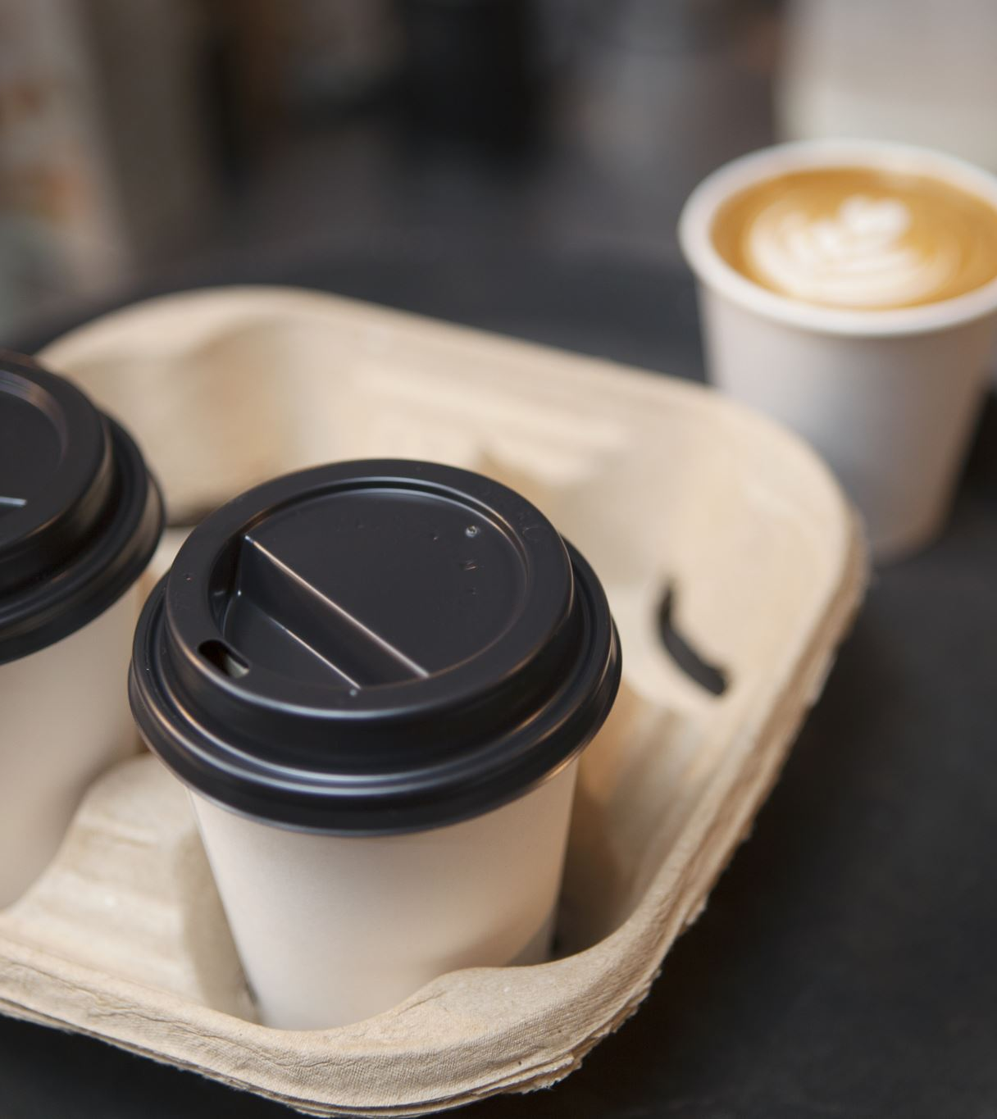
Market Research
Primary Research
Survey conducted with 50 students and young professionals
Results:
78% buy coffee at least three times per week
65% prefer environmentally responsible businesses
55% would bring a reusable cup for a discount
Secondary Research
Industry data shows the global coffee shop market is growing, and customers are increasingly supporting sustainable businesses.
These results support the demand for a sustainable coffee shop like Nene Café.

Slide 13
12 Month Marketing Strategy
Strategy Initiatives
Nene Café will use a mix of online and offline marketing strategies.
Key initiatives:
Social media marketing campaigns
Loyalty reward programmes
Local community partnerships
Promotions encouraging reusable cups
The goal is to increase brand awareness and attract loyal customers.

Slide 14
Marketing Examples
Example launch promotion
“Grand Opening of Nene Café!
Enjoy organic coffee while supporting the environment.
Bring your reusable cup and receive 10% off your drink.”
Other marketing tools:
Flyers distributed locally
Loyalty cards (free coffee after several purchases)
Promotional social media posts

Slide 15
Branding
Nene Café’s brand identity focuses on sustainability and modern design.
Brand elements include:
Green and earthy colour palette
Eco-friendly packaging
Modern café interior design
Strong sustainability message in marketing
The brand aims to appeal to environmentally conscious consumers.

Slide 16
2 Minute Elevator Pitch
Features and Benefits
Features
Organic coffee and plant-based drinks
Eco-friendly packaging
Reusable cup discount programme
Locally sourced baked goods
Benefits
Customers enjoy high-quality coffee
Reduced environmental impact
Support for sustainable businesses
Affordable and convenient coffee experience

Slide 17
Why You Should Invest
Nene Café offers a strong business opportunity because:
Demand for coffee shops continues to grow
Sustainability is increasingly important to customers
Clear marketing and financial strategy
Strong potential to build a loyal customer base
Investing in Nene Café means supporting a profitable business that also benefits the environment.

Slide 18
References
International Coffee Organization (2023) Coffee market report. Available at: https://www.ico.org(Accessed: 6 March 2026).
British Coffee Association (2024) Coffee statistics. Available at: https://www.britishcoffeeassociation.org(Accessed: 6 March 2026).
Statista (2024) Coffee shop industry statistics worldwide. Available at: https://www.statista.com(Accessed: 6 March 2026).
World Economic Forum (2023) The global waste problem and sustainability trends. Available at: https://www.weforum.org (Accessed: 6 March 2026).
Environmental Protection Agency (2023) Reducing waste in food and beverage businesses. Available at: https://www.epa.gov (Accessed: 6 March 2026).
European Commission (2023) Sustainability and circular economy in businesses. Available at: https://commission.europa.eu (Accessed: 6 March 2026).
Fairtrade International (2024) Fairtrade coffee and sustainable sourcing. Available at: https://www.fairtrade.net (Accessed: 6 March 2026).
World Coffee Research (2023) Sustainability in the global coffee industry. Available at: https://worldcoffeeresearch.org (Accessed: 6 March 2026).
Entrepreneurship and Small Business (2019) Pearson Education.
Principles of Marketing (2020) Pearson Education.

