Slide 1
Portfolio Part Two (20%0
You have a choice -
Poster, 800 word Report, Bibliography
Substantial PowerPoint (at least 10 slides) and Bibliography
Due in on Friday June 5th 2020
Remember: Topic of this section needs to be different from your Assessment 1

Slide 2
Chose on primary source from the time period that we are looking at (167BCE – 74CE)
Examples could include…
1 or 2 Maccabees
Dead Sea Scrolls
Qumran as an archaeological site
Second Temple
Josephus

Slide 3
WHAT, WHERE, WHY, HOW?
Some questions you may want to think about:
- What is the significance of the primary source in relation to the time period that we are studying?
- Where was the primary source found? – might not be relevant to all primary sources.
- Why is the primary source significant?
- How was it discovered? How has it been used in history?
- Does it have any bias within the source?
- What is its religious significance?
- Could there be any political significance to the primary source?

Slide 4
Creating a Poster/Presentation
Understanding what makes an effective poster/presentation:
  Techniques
  Aesthetics
  Information
For those who have chosen a poster, there is a template available for you on Moodle

Slide 5
Aims of a Poster / PowerPoint
Clear visual presentation of your research
Concise presentation of key points of research
Explains research visually (images, graphs etc) with limited textual information
Should inform viewers & stimulate discussion

Slide 6
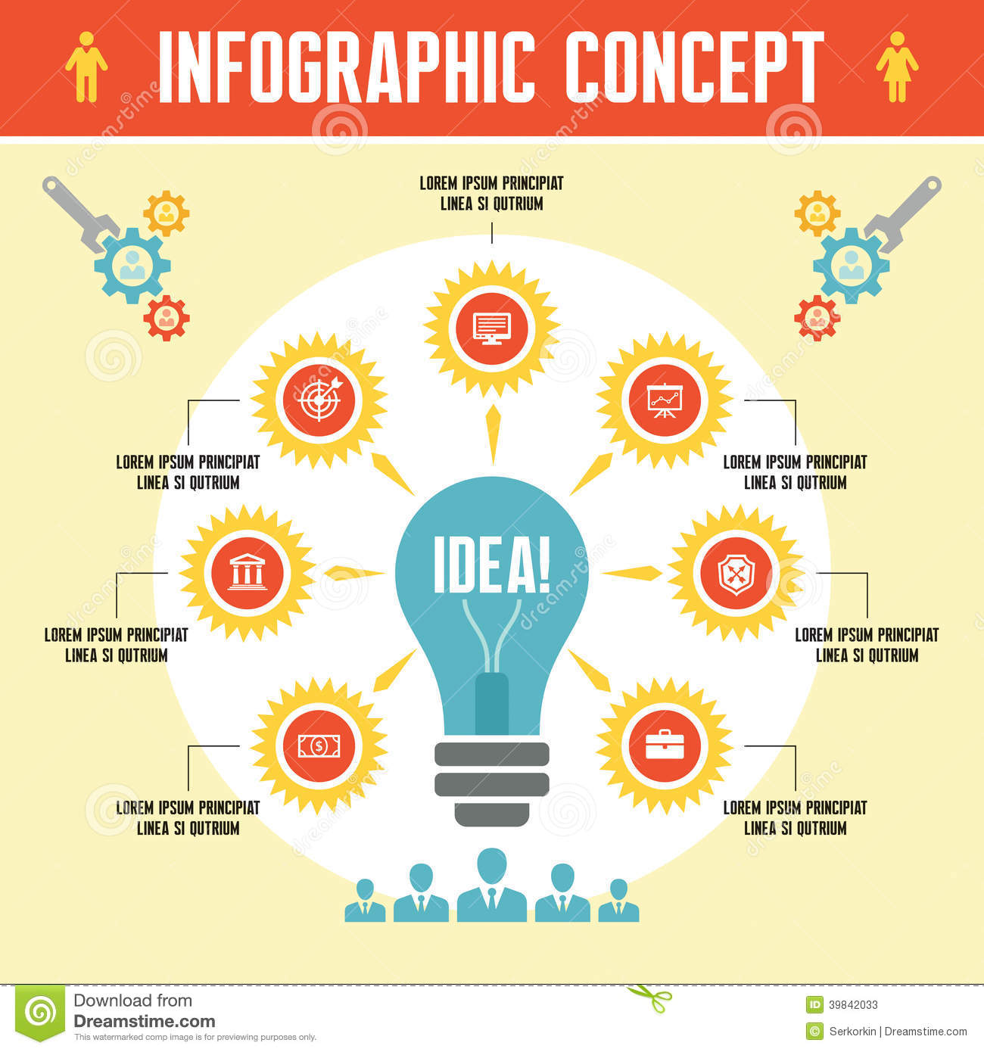
Creating a Clear Poster
Think about:
  Background
  Text
  Images
  Clarity
  Balance

Slide 7
Backgrounds
White is bad…
Dark backgrounds might be easier on the eye
Coloured posters might stand out from the crowd
Think about the contrast of background & text
Photos as background:
  Too much detail might be confusing
  Be careful of pixelation

Slide 8
Text
Think about text size:
  You should be able to read from 1-2m away (poster size A1)
Think carefully about choice of font & colour contrast to background – how visible are these?
  Use sans serif (eg. Arial)
Font size: hierarchy of information:
  Title: 65 – 108 point
  Subheadings: 35-54 point
  Body text: 18-27 point
  (smaller text [12pt?] for references)

Slide 9

Text
Left justify your text
Double spacing
Short sentences for clarity
Do not forget to spell check and to proofread your text

Slide 10
Images
A picture speaks a thousand words:
  This is a key source of information & should be reproduced to a high standard
JPEG, TIFF or Bitmap
Neutral background will enhance your photo
Image size: 4” x 5”
For the PowerPoint you may want to use a video clip
Remember to include:
  Your name
  Your institutional affiliation (logo)
  Module code

Slide 11
Marking Criteria
The marking criteria that will be used is available on Moodle and includes areas such as:
-Layout/Design
Language
Content
Engagement with scholarship (both primary and secondary)
Bibliography

Slide 12
More information on Moodle ☺

