Slide 1
Master of Business Administration
International Marketing
Cultural impacts on International Marketing

Slide 2
Learning Outcomes
To define the Culture
To explain the cultural difference between host country
To understand the cultural impact on international marketing.

Slide 3
What is culture?
0
3
No single accepted definition of culture. It is multifaceted.
Indicative definitions of culture:
  ‘Culture is the total way of life in a society’ (Fletcher, 1979)
  Culture is the collective programming of the mind (Hofstede, 1980)

Slide 4
Culture Defined
Definition:
An integrated system of learned behavior patterns that are characteristic of the members of any given society.
It includes everything that a group thinks, says, does, its customs, language, material artifacts, and shared systems of attitudes and feelings (Robert L, Kohls, 1979, p3)
Culture can cause problems for managers as you could violate the cultural norms of another country due to lack of knowledge
It is an integrated system of learned behaviour patterns that are distinguishing characteristics of the members of a society
Culture is passed on from parents to children, from social organisations, special interest groups, school and church

Slide 5
Why is it important for businesses to understand culture?
Culture is the lens through which people view products as well as your company
Culture channels our values, attitudes, motives and goal directed behavior, as well as our personality
Culture influences the overall priorities consumers attach to different activities and products
Consumption choices cannot be understood without considering the cultural context in which they are made
Determines the success or failure of specific products or services
Determines the success or failure of marketing communications

Slide 6
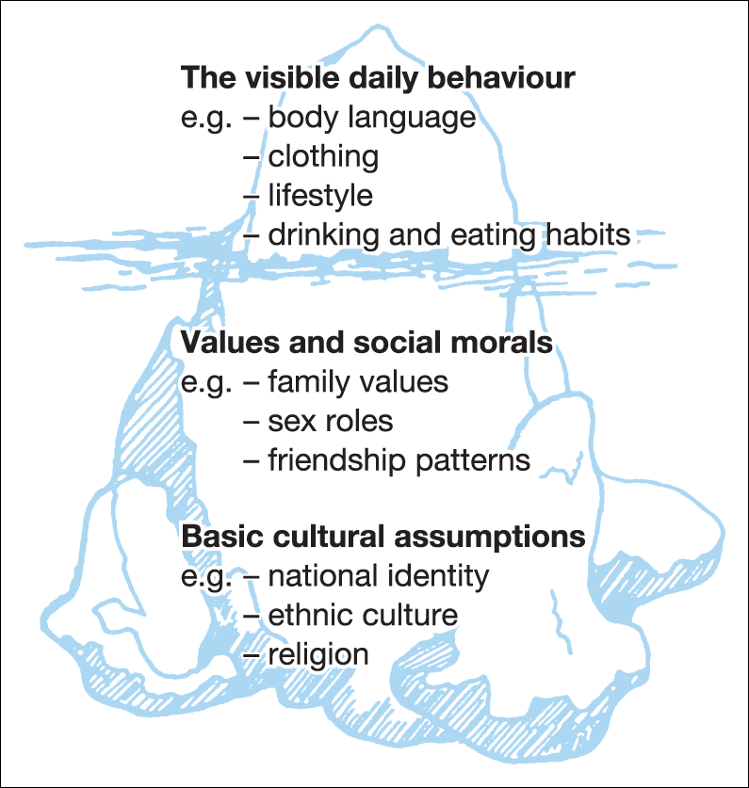
The visible and invisible parts of culture

Slide 7
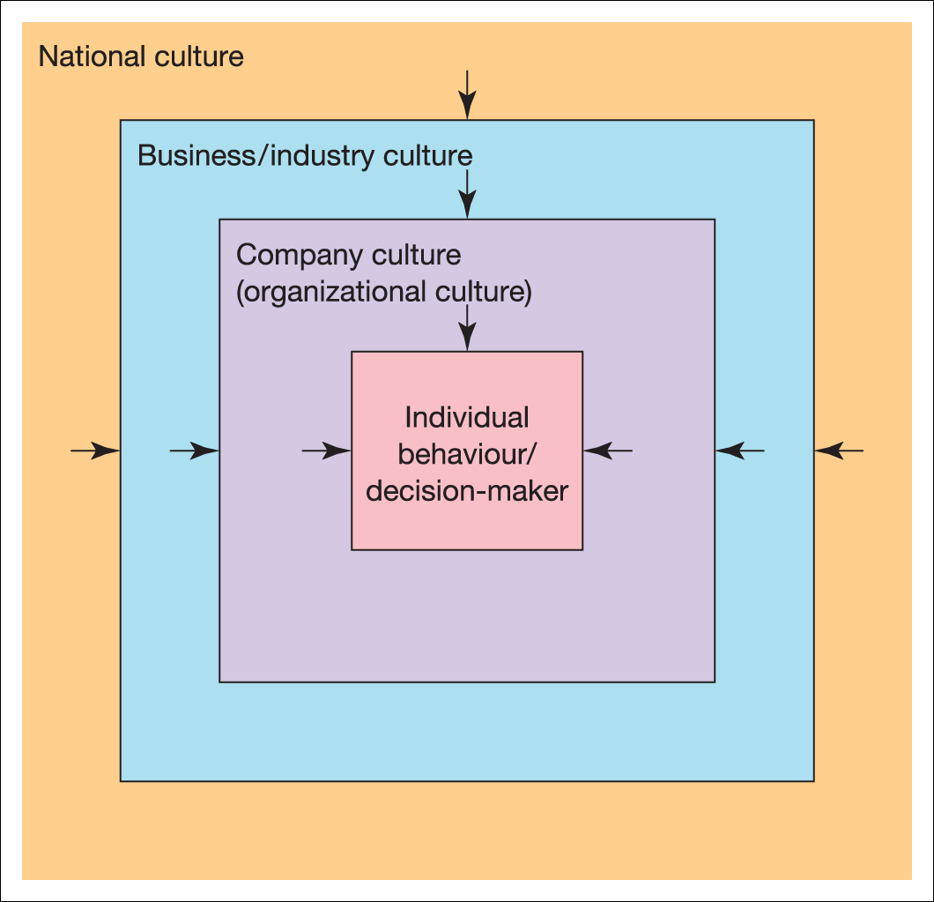
The different layers of culture

Slide 8

Electrolux is adapting its vacuum cleaner for the Japanese market
Electrolux Vacuum cleaners are standardised worldwide but in Japan it is customised.
Japanese houses are relatively small
Vacuum cleaners need to be relatively quiet in Japanese households

Slide 9
The Home and Host Country Environments
International Marketing Environment
Home country
Culture
Host country
Culture
Existing
Market
New
Market
Cultural
barriers
0.56

Slide 10
How Culture Impacts International Business
Product : Standardize or Adapt
Communication : Standardize or Adapt
Modes of Entry into International Markets may differ due to cultural differences
Negotiations between culturally different market participants
Management Style
Successful international managers understand the cultural context and cultural norms of their markets and formulate strategies accordingly
Differences between Indian and
Western Management styles

Slide 11
Examples of Cultural Impact
To avoid situations of ‘cultural shock’, Multi-national company (MNCs) tends to follow ‘Adaptation’ process instead of ‘Standardization’, and to come up with adapted marketing mix to avoid failure and to succeed in any foreign market
E.g. Indians do not consume beef (religious belief), which McDonald did not realize when they initially entered the Indian market, for which they faced lots of agitation and losses. Later on they had to change their product strategy which would suit the Indian market by introducing chicken burgers instead of beef.
Johnson’s floor wax (which made wooden floors very slippery) failed in Japan because they failed to take into account the Japanese custom of not wearing shoes at home.

Slide 12
Examples of Cultural Impact
Any multi-national that enters into a business venture in China might find out that they will have to deal with the practice of the Chinese to hire their own relatives for important company positions—regardless of their management abilities.
Another cultural practice that a multi-national wishing to enter the Chinese market should be aware of is China’s accounting practices. It has been noted that Chinese accounting and auditing firms don’t object when false accounting entries are made. In fact the auditing firms often times help falsify the books. Furthermore, local governments encourage these practices to promote companies in their areas.
Companies while entering international markets have to take care of nitty-grittys of culture and the consequences which can come up later on if they do not adapt themselves according to respective market’s culture.

Slide 13
Importance of Culture
Increasingly, managers must deal with multiple ethnic groups in very different cultures
You are likely to work with Japanese, French, Chinese, German and all sorts of other nationalities
It is important to recognize that people from different cultures are different in a variety of ways, including :
  different ways of looking at things
  different ways of dressing
  different ways of expressing personality/goodness
Three basic kinds of problems: interpreting others comments and actions, predicting behavior, and conflicting behavior
What is Culture

Slide 14
Importance of Culture
As firms expand their operations across borders, they acquire new customers and new partners in new environments
Two distinct tasks become necessary:
  First, to understand cultural differences and the ways they manifest themselves and
  Second, to determine similarities across cultures and exploit them in strategy formulation
Success in new markets is very much a function of cultural adaptability: patience, flexibility, and appreciation of others' beliefs.
Doing business in China

Slide 15

The Hofstede Model
"Culture is more often a source of conflict than of synergy. Cultural differences are a nuisance at best and often a disaster."
Culture is the “collective programming of the mind”
- Dr. Geert Hofstede
Dr. Geert Hofstede
http://www.cyborlink.com/besite/hofstede.htm#geert_hofstede_countries#geert_hofstede_countries
Geert Hofstede on Culture

Slide 16
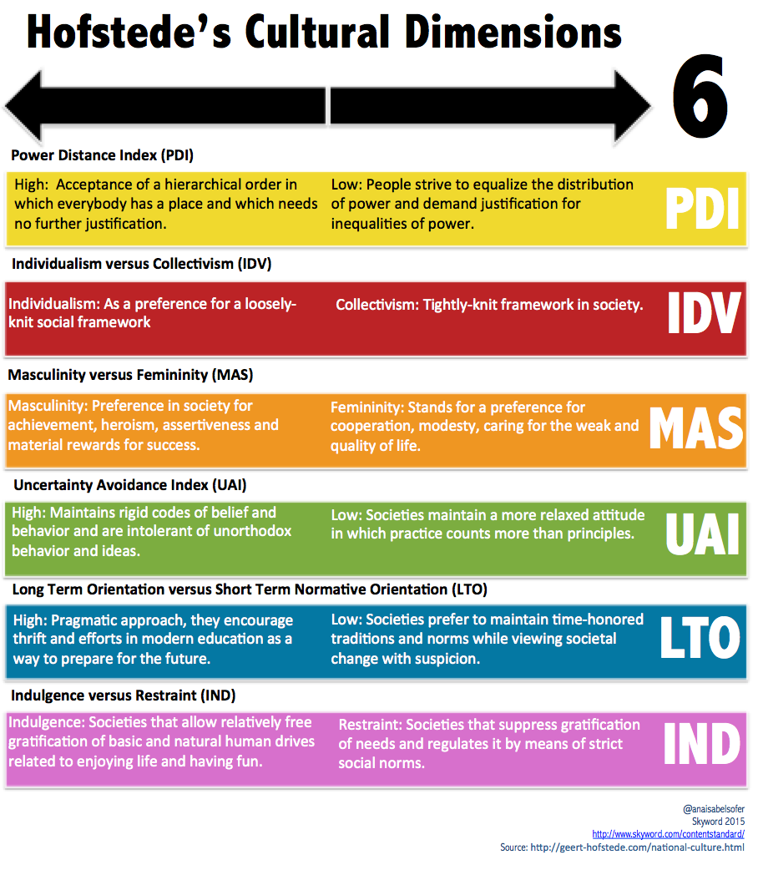

Slide 17
Keegan and Smith (2011) identify several learning points for marketers from Hofstede’s research.
Where cultures are identified as having a longer term focus, for example, those cultures with a focus on the “now” will need to take a more relaxed approach to dealings.
Uncertainty avoidance gives an insight into risk tolerance, with cultures having a low uncertainty avoidance threshold being more focused on brand names and brand loyalty than those with a high threshold focusing on guarantees and warranties.
Power distance indicates the degree of trust – the higher the power distance, the lower the amount of trust. If setting up a business in an overseas territory, the UK would be comfortable using joint ventures, given its low power distance approach.
Hard sell approaches would work well in the UK as a relatively high masculine nation, rather than a softer approach (although the actual target market would still need to be considered if sex is a key identifier of the segment).
The more individualistic a nation, the less group consensus is required, with a single person making the decisions.

Slide 18
Cultural concepts and cultural differences
0.56
18
Maslow’s hierarchy of needs: impacts on how consumers respond to cultural stimuli
Self-reference criterion: develop awareness
Context and Culture : verbal versus non-verbal cues
Psychic distance: factors that differentiate the foreign market from the home market

Slide 19
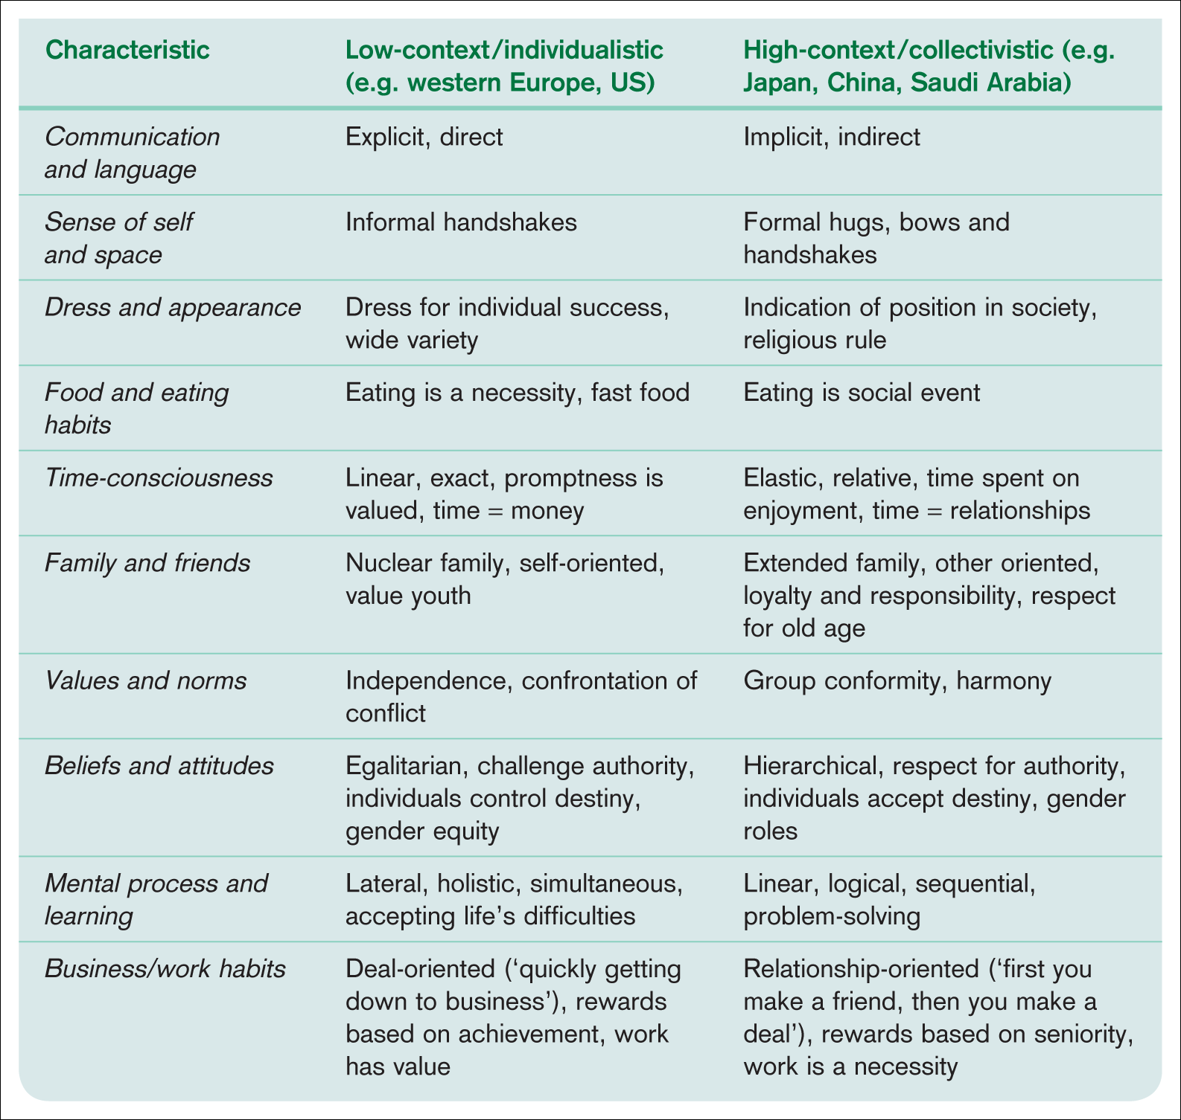
General comparative characteristics of cultures

Slide 20
Psychic Distance affects international business
Definition
The distance that is perceived to exist between characteristics of a firm’s home country and a foreign country with which that firm is or is contemplating doing business or investing (Child et al 2009)
High psychic distance (perceived large differences between home and host country) will discourage international expansion into a given country due to uncertainty
Factors affecting psychic distance :
  Geographical distance, language, religion, education level, level of industrial development, infrastructure, political and legal system, government influence on business

Slide 21
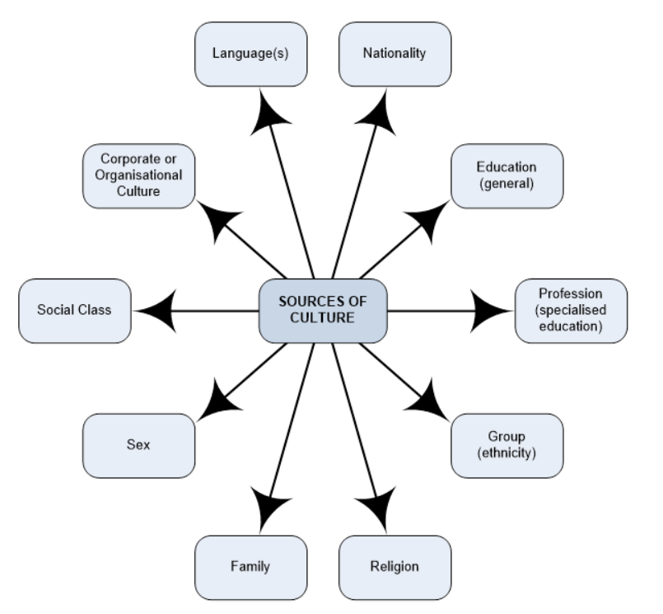
Sources of Culture
Source: Usunier and Lee 2009 p.8)

Slide 22
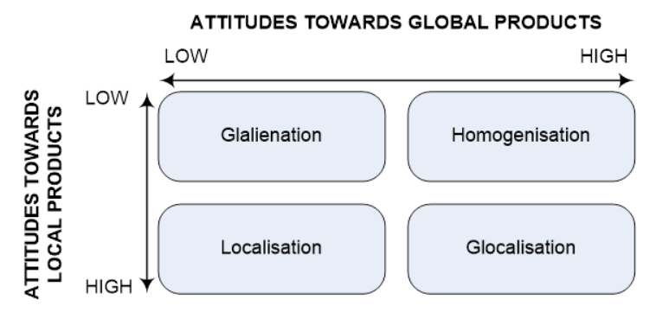
Culture and the Marketing Mix
Culture influences on the marketing mix elements in different ways.
PRODUCT
Steenkamp and de Jong (2010) conducted global research to find out more about consumer attitudes towards local and global products.

Slide 23
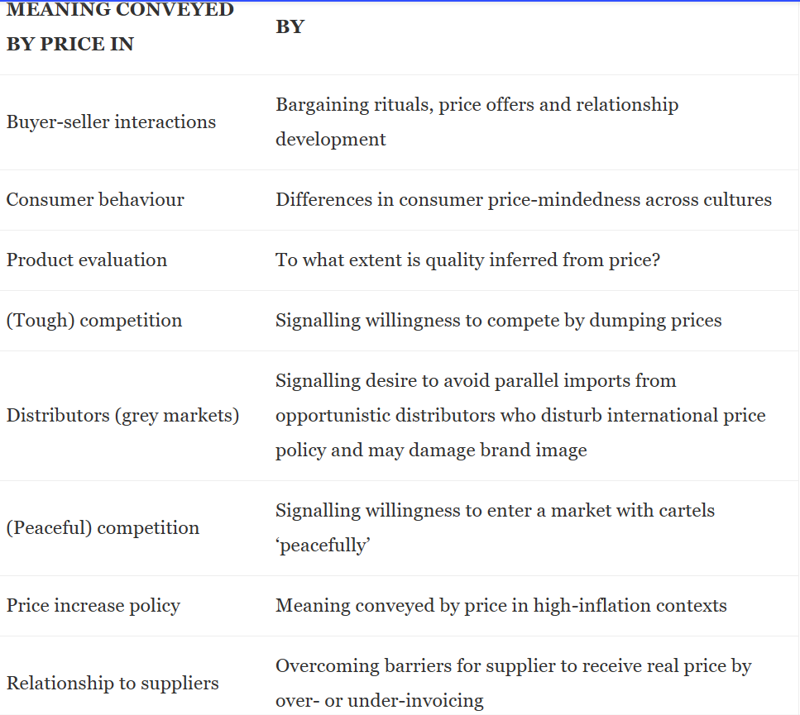
Usunier and Lee (2009) identify nine different ways that meanings are conveyed by price:
PRICE

Slide 24
PLACE
Country's customs and traditions play an important role in the structure of the distribution channel.
Decisions about the most appropriate distribution channel must take into account several factors such as consumer needs, the type of channels available, the possible presence of intermediaries.
The high collectivist cultures with extended family settings rather prefer to take purchasing decisions collectively. To succeed in these cultures, marketers will have to design their distribution channels by focusing on families.

Slide 25
Usunier and Lee (2009, p.342) identify four aspects of communication that are relevant to business communications:
PROMOTION
Verbal communication styles and contextual factors
2. Non-verbal communication, such as body language
3. How language shapes world views
4. How international business can deal with language differences.

Slide 26
Example: Gillette European vs Indian Advertising
Gillette European managers studied Indian culture and recognised that its European advertising needed to be adapted to suit local culture if its products were to successfully compete
Gillette Right Guard was launched after detailed studies of Indian consumer lifestyles and preferences before entering the market
The “Best a Man can get” campaign was successfully adapted to suit Indian culture
  Gillette – European TVC
  Gillette – Indian TVC

Slide 27
How do Managers Overcome the Challenges ?
Visit the market of potential entry to obtain first-hand information
Use a local partner in expanding into the host country to obtain local know how on culture and other aspects
Talk to other companies that have experience in that market
Use the Hofstede model to obtain a general understanding
Have a flexible approach – adapt your approach where necessary rather than using the ethnocentric approach
Obtain knowledge of the market with minimum commitment at first (test market basis) until the culture is known

Slide 28
Strategic Alternatives
For International Managers
Promotion
Standardization
Customization
Standardization
Pure Standardization
Same product with
promotion
tailored to specific
countries
One product, one message
worldwide
Product
Customization
Pure Customization
Same promotion with
the product
tailored to specific
countries
New product invention
Source: McDONALD, M. (2007) International Marketing Plans. 6th ed. Italy: Butterworth-Heinemann, p.471.

Slide 29
Case Example : Walt Disney Co
When Walt Disney launched the Euro Disney theme park outside Paris in 1992, it was harshly criticised as being an example of American cultural imperialism. A number of local French customs and values, such as serving wine with meals, were ignored. As one Euro Disney Executive noted, “when we first launched, there was the belief that it was enough to be Disney. Now we realise our guests need to be welcomed on the basis of their own culture and travel habits.” Renamed Disneyland Paris, the theme park eventually became Europe’s biggest tourist attraction by adding a number of changes and adding more local touch.

Slide 30
Group Case discussion: Kellogg’s Enters India
What is your key learning from this case?
Identify key cultural issues found in the case study with evidences.
Explain how Kellogg’s address these issues.

