Slide 1


Presenting Your Dissertation
Essential Guidelines & Requirements
A Comprehensive Guide for Final Submission

Slide 2




Dissertation Front Matter
Cover & Declarations
Front Cover: Name, Title, Degree, and Year.
Originality: Confirming work is independent.
Consent: Availability for library and IT systems.

Slide 3





Core Dissertation Elements
Dissertation
Title Page
=
Abstract
+
Contents
+
The Abstract
Acknowledgements
A concise 300-word summary covering scope, design, and conclusions.
A statement recognizing support from organizations or individuals.

Slide 4














Standard Chapter Structure
Chapter
Title
Focus Area
Introduction & Literature Review
Context and existing research study
1 & 2
Research Methodology
Design and data collection methods
3
Data Analysis & Discussion
Interpreting results and primary data
4
Conclusions & Recommendations
Final findings and future suggestions
5

Slide 5



The Four Rules of Referencing
Correctness: Double-check every detail of your cited sources.
Completeness: Include page numbers, dates, and volume details.
Consistency: Adhere to one style throughout the entire work.
Alphabetical Order: List all references alphabetically in the bibliography.

Slide 6









Using Appendices Effectively
1. Verification
2. Content
3. Integration
Allows readers to verify conclusions reached in the main body.
Detailed statistics and blank survey questionnaires only.
Direct the reader via notes at relevant points in the text.

Slide 7






Word Count & Formatting
Specification
Requirement
8,000 words (+/- 10% tolerance)
Word Limit
Arial or Times New Roman, Size 11 or 12
Typography
At least 1.5 spacing (Double-spaced preferred)
Line Spacing
Arabic numerals, centered at the bottom
Page Numbers

Slide 8






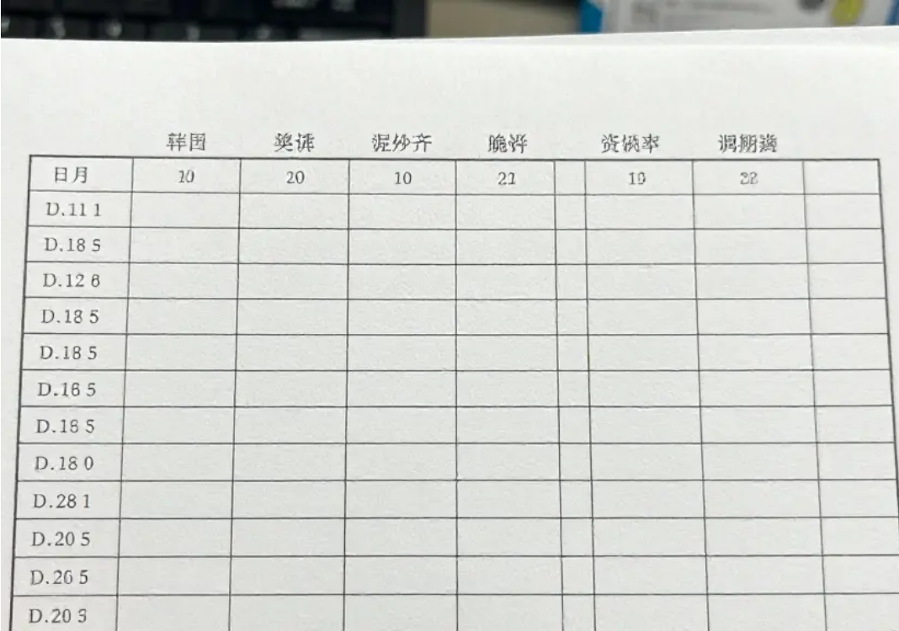


Data & Language Conventions
Visual Labeling
Table Rules
Proofreading
Graphs and diagrams must be clearly labeled and placed near relevant text.
Number every table and include a title and source for all data.
Use UK English spell-check and ensure third-person pronoun usage.

Slide 9



Submission & Viva Voce
Final submission is mandatory via Turnitin on Moodle by the July deadline.
In specific cases, a Viva Voce (oral exam) may be required to corroborate your research findings.
Timely submission ensures smooth marking and external examination.

Slide 10







Final Review Checklist
Review
Focus
Writing & Clarity (30%)
Referencing Accuracy (25%)
Methodology & Design (20%)
Analysis & Ethics (25%)

