Slide 1
PRS
Problem solving and decision making
Week 6
Assignment workshop
By Husam Helmi

Slide 2
Lesson Aims
The aim of this session:
To introduce and discuss the importance of problem solving and decision making in workplace.
Learning outcomes:
Demonstrate the importance of problem solving and decision making in workplace.
Discuss the process of developing a rational decision in workplace.
Discuss different ways of approaching the given assessment.

Slide 3
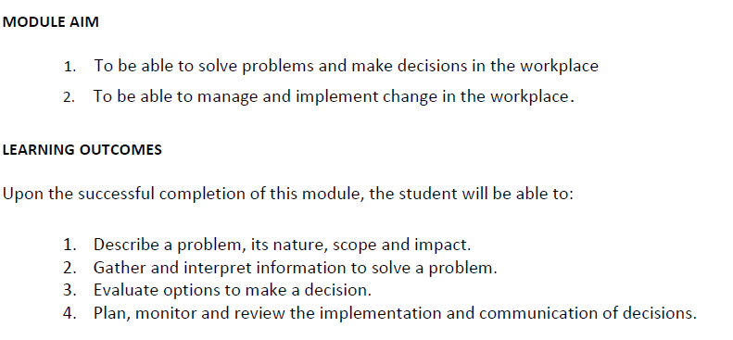
Module aims and LOs

Slide 4
The assessment task
Write a report of 4,000 words, in which you apply recognized problem solving tools and techniques to
identify and propose solutions to a work based problem, to include an evaluation of possible solutions. Discuss
and agree with your tutor a suitable problem to be solved which may be drawn from your current or past work
experiences or an agreed situation.

Slide 5
Points to consider
Define a complex problem in the workplace including its scope and impact.
analyse information on the identified problem, to help inform the decision making process.
Propose a range of alternative solutions to the problem.
use a decision making technique to evaluate a range of solutions to identify the most appropriate option.

Slide 6
Points to consider …
5. develop a plan for implementing the solution.
6. communicate the plan to stakeholders.
7. Assess appropriate monitoring and review techniques to ensure successful implementation of the solution.

Slide 7
Defining problem solving
What do you think??
“ensuring that you deal with the real problem – not its symptoms.”

Slide 8
Defining problem solving
“A doubtful or difficult matter requiring a solution”
“Something hard to understand or accomplish or deal with.”
(Skills you need.com, 2018)

Slide 9
Example
if performance in your department is substandard, you might think the problem is with the individuals submitting work. However, if you look a bit deeper, the real issue might be a lack of training, or an unreasonable workload.

Slide 10
Features of problems
Goals: Problems involve setting out to achieve some objective or desired state of affairs and can include avoiding a situation or event.
Barriers: If there were no barriers in the way of achieving a goal, then there would be no problem. Problem solving involves overcoming the barriers or obstacles that prevent the immediate achievement of goals.

Slide 11
Example of a goal
Goals can be anything that you wish to achieve, where you want to be. If you are hungry then your goal is probably to eat something, if you are a head of an organisation (CEO) then your main goal may be to maximise profits.
In the example of the CEO the main goal may need to be split into numerous sub-goals in order to fulfil the ultimate goal of increasing profits.

Slide 12
Example of a barrier
If you feel hungry then your goal is to eat. A barrier to this may be that you have no food available - you take a trip to the supermarket and buy some food, removing the barrier and thus solving the problem.
Of course for the CEO wanting to increase profits there may be many more barriers preventing the goal from being reached. The CEO needs to attempt to recognise these barriers and remove them or find other ways to achieve the goals of the organisation.

Slide 13
The rational decision process
Problem Identification
Implementation
Alternative generation and evaluation
Criteria definition

Slide 14
Stage one: Problem identification
To come up with a rational solution, decision makers first should recognise the problem that exist.
Discussion:
Do you consider a decrease in sales by 10% as a problem??

Slide 15
Stage one…
Working across cultures may have its own challenge in the process of problem identification due to having different considerations such as timing, beliefs, networks, and investments.

Slide 16
Stage one….
Problems can arise from several key aspects in organizations such as:
Offering (Products/Services), Structure, Psychological climate, Management, and culture.

Slide 17
Stage two: Criteria definition
Most problems can be viewed as multidimensional. Decision makers should be able to determine the key factors influencing the problem.
The objective of possible problems might be as the following:
- Price, quality, quantity, features, dependability, reputation, and so on.

Slide 18
Stage three: Alternative generation and evaluation
During this stage the decision maker should be able to identify a range of possible courses of action and evaluates each course based on the previous two stages (The problem itself and the criteria or factors) .
Advantages and disadvantages of each can be weigh to establish the most appropriate action/solution.

Slide 19
Stage three: Alternative generation and evaluation
Consequences of each solution suggested should be considered to enable a successful process of rational decision making based on the given facts/analysis.
Evaluation is required to further clarify the given actions.

Slide 20
Stage four: Implementation
Once the main option/solution is established, the implementation step is required to apply the solution.
Implementation means acting on the chosen solution. During implementation more problems may arise especially if identification or structuring of the original problem was not carried out fully.

Slide 21
One added stage: Monitoring/Seeking Feedback
The last stage is about reviewing the outcomes of problem solving over a period of time, including seeking feedback as to the success of the outcomes of the chosen solution.
The final stage of problem solving is concerned with checking that the process was successful. This can be achieved by monitoring and gaining feedback from people affected by any changes that occurred. It is good practice to keep a record of outcomes and any additional problems that occurred.

Slide 22

Session two
Assignment approach/ structuring

Slide 23
First step
Building an introduction: Tell us what you are going to include in the work (key points) and define key terms: Problem solving and decision making.
Why problem solving and decision making are important in work place?

Slide 24
Second step
You are required to consider an organisation of any type (Public, Private or Voluntary). It could be an organisation that you have worked for, currently working for or you are aiming to work for in the future after successful completion of your studies.
You may consider organisations that you can find information about.

Slide 25
Third step
You are required to approach the organisation that you have selected as a case study meaning that in the assignment you are encouraged to introduce the case considering the following:
(who they are?: You can bring statistics, key information about the organisation such as their history or number of employees…..etc).

Slide 26
Fourth step
In order to understand the organisational problem you need to understand their internal and external environment:
PESTLE and SWOT to be considered

Slide 27
Fifth step
The challenge/problem: Through your analysis of PESTLE and SWOT you are required to highlight a key problem faced by the firm. The problem might be around innovation and creativity, Human resource related, finance, technology, legality, inability to change and keep with competition, culture, management………….etc

Slide 28
Sixth step
Once the problem has been identified based on the internal and external analysis:
Further details should be presented in the work: analysis around the nature of the problem itself.

Slide 29
Seventh step
Tools/models/theories to apply
The systems and consulting approach (Page 232 of the core text) , Force filed analysis, Burk Litwin model, Lewin's Change Management Model, or other related tools/models/theories to apply. (To be explained in week 7/8).

Slide 30
Eighth step
Solutions (You may offer multiple solutions for consideration: Solution A, B, C..etc)
Consider their advantages and disadvantages/their consequences.
Indicate the best solution to be taken forward by the organisation and why?.

Slide 31
Ninth step
Highlight possible aspects to be considered during the implementation of the proposed solution.
(You may consider the outcomes of step 6: Tools and models to apply ).
Aspects such as human resource required, finance, training and development, timing…..etc.

Slide 32
Tenth step
Consider ways of Monitoring/Seeking Feedback. It can be developed as the following:
Feedback can be from the workforce, customers’ satisfaction, after purchase feedback…etc (The feedback should related the change occurred).
Monitoring: Setting up KPIs (Key performance indicators)
You are required to explain on this in your work.

Slide 33
Eleventh step
Conclude the work by:
key points that you have included (A summary of your points/recommendations)

Slide 34
Thank you
Do you have any Questions?

Slide 35
References
Maund, A., Schreik, M. and Tinkler, P. (2017). Certificate in higher education: Skills for the workplace student yearbook. london: london, pp.181-201.
Skillsyouneed.com. (2018). Problem Solving Skills | SkillsYouNeed. [online] Available at: https://www.skillsyouneed.com/ips/problem-solving.html [Accessed 22 Jul. 2018].

