Slide 1

Student name: Glenn Catalan
Student number : 2442791
Lecturer’s name : Peace Ukachukwu
The module title/code: (LCHS4010 - Psychology in Health and Social Care)
LCHS4010
Psychology in Health and Social Care
I confirm that I have used AI tools to source images and/or for proofreading this work (AI TOOL USED IS CoPilot).
I confirm I have copies of my drafts, notes, and other resources I used, which I may be asked to provide in evidence.

Slide 2
Jenny’s Case
Study
Scenario:
Jenny, now 16, has spent five years caring for her mother following her father’s death. She manages cooking, cleaning, shopping, and administrative tasks due to her mother’s mobility difficulties, memory problems, forgetfulness, and low mood.
Community Support Plan for Jenny
(Piaget’s Cognitive Development Theory)
Understanding Jenny’s Developmental Stage
Jenny is now in the Formal Operational Stage (11-12yrs old), enabling abstract and hypothetical thinking, identity exploration, perspective‑taking, and more advanced moral reasoning (McLeod, 2018).
Impact of Becoming a Young Carer
• Her caring role may have pushed her to use advanced reasoning skills earlier.
• Less time with peers, limit chances to practise higher‑level thinking socially.
• Stress may make it harder for her to use abstract reasoning consistently.
Applying Piaget to Community Support
• Offer activities that build abstract thinking, reflection, and problem‑solving.
• Support her identity through goals and interests beyond caring.
• Increase peer contact, such as young carer groups, to build perspective‑taking.
• Lighten her caring load so she has space to grow cognitively and emotionally.

Slide 3
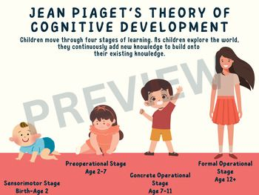
What is Piaget’s Cognitive Development Theory
Piaget proposed that children progress through four stages of thinking, actively constructing knowledge through environmental interaction and gradually developing increasingly complex, logical, and abstract understanding of the world (McLeod, 2018).
Piaget’s 4 Stages of Cognitive Development
1. Sensorimotor stage (0–2 years) - Infants learn by using their senses and physical actions.
2. Preoperational stage (2–7 years) - Children begin to use language and imagination but still think in very literal, concrete ways.
3. Concrete operational stage (7–11 years) - Children develop logical thinking, though mainly about real, hands‑on situations.
4. Formal operational stage (11+ years) - Adolescents can think abstractly and solve complex problems
(McLeod, 2018)

Slide 4
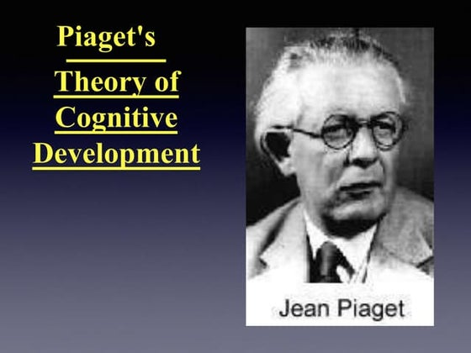
Bringing the Theory and Practice Together
Piaget’s theory implies Jenny’s caring duties may have accelerated her cognitive development, fostering prematurely adult reasoning. Rogers similarly argues that environmental pressures can shape or restrict a child’s developmental pathway (Rogers, 2011).
A support plan should therefore prioritise:
• Reducing her caring load
• Re‑establishing opportunities for learning, socialising, and exploration
• Supporting her emotional and mental wellbeing
• Helping her rebuild an identity beyond her caring role (Rogers, 2011).

Slide 5
Strategies and Intervention for Jenny
1. Reduce Caring Burden
Interventions:
Arrange Carer’s Assessment and Adult Social Care support.
Provide support with paperwork by using advocacy or community services.
Make sure Jenny is not the person mainly responsible for organising her mother’s care.
2. Support Social & Cognitive Development
Interventions:
Encourage Jenny to get involved again in school clubs and activities.
Connect her with young carers’ groups so she can receive support from peers with similar experiences.
Promote activities that build creativity and problem‑solving skills.
3. Strengthen Emotional Wellbeing
Interventions:
Offer counselling or emotional support specifically for young carers.
Teach Jenny basic techniques to help manage stress.
Provide Jenny with a trusted adult mentor within the school. (Andrews, 2023)

Slide 6
Continuation
4. Promote Identity Development
Interventions:
Use person‑centred planning to identify her interests and goals.
Encourage her to take part in activities outside her caring role.
Offer guidance on careers and future pathways.
5. Enhance Safety & Stability
Interventions:
Create a simple safety plan for Jenny and her mother, including key emergency contacts.
Work with school and social care to keep track of any changes in Jenny’s caring role.
Share details about local services, crisis contacts, and community support options.
Check what changes or equipment at home could reduce physical strain on Jenny.
(Andrews, 2023)

Slide 7
Biological & Environmental Influences on Jenny’s Development
Biological Factors
• Cognitive development may be slowed due to stress and tiredness.
• Less hands‑on exploration may delay progress to higher‑level thinking.
• Stress can weaken memory and attention, affecting problem‑solving
Environmental Factors
• Heavy caring duties reduce time for peers, exploration, and learning.
• Less social contact limits chances for collaboration and perspective‑taking.
• Home stress can disrupt how she processes and adapts to new experiences.
• Fewer stimulating activities may slow hands‑on learning and cognitive growth
(Cherry, n.d.).

Slide 8
Strengths
Advanced Reasoning Skills
Jenny’s early caring responsibilities may have accelerated her formal operational development, strengthening abstract thinking, planning, and problem‑solving skills.
Increased Independence and Responsibility
Supporting her mother has likely strengthened Jenny’s independence and practical problem‑solving, reflecting the advanced cognitive abilities typical of the formal operational stage.
Perspective‑taking and Empathy
Jenny’s caring role may have enhanced her ability to understand others’ perspectives, strengthening her empathy and emotional awareness.
(Andrews, 2023)

Slide 9
Weaknesses
Compressed or Disrupted Adolescent Development
Jenny’s heavy caring responsibilities may have restricted the abstract thinking and identity‑forming experiences typical of adolescence, potentially limiting her social, emotional, and cognitive development.
Premature Shift into Adult Reasoning
Jenny’s early adult‑like responsibilities may have increased her stress and limited space for typical adolescent development.
Reduced Opportunities for Peer Interaction
Jenny’s caring role may have limited peer interaction, reducing opportunities to share ideas, gain perspectives, and develop social reasoning.
Identity Foreclosure
Jenny’s caring identity may dominate her self‑concept, limiting broader identity development and reducing her
independence.
(SimplyPutPsych, 2022)

Slide 10
Conclusion
Piaget’s theory suggests that taking on caring duties early may have sped up Jenny’s cognitive development, leading her to think more like an adult than a typical adolescent. Her support plan should therefore reduce her caring load, increase opportunities for learning and socialising, boost her emotional wellbeing, and help her build an identity beyond being a carer.

Slide 11
References
Andrews, N. (2023) Piaget’s stages of cognitive development: What they are and why they matter. Medical News Today. Available at: https://www.medicalnewstoday.com/articles/325030 (Accessed: 5 March 2026).
Cherry, K. (n.d.) Jean Piaget: Biography (1896–1980). Verywell Mind. Available at: https://www.verywellmind.com/jean-piaget-biography-1896-1980-2795549 (Accessed: 9 March 20226).
McLeod, S. (2024) Piaget’s theory of cognitive development. Simply Psychology. Available at: https://www.simplypsychology.org/piaget.html (Accessed: 5 March 2026).
Rogers, K. (n.d.) Formal operational stage. Encyclopaedia Britannica. Available at: https://www.britannica.com/science/formal-operational-stage (Accessed: 6 March 2026).
SimplyPutPsych (2022) What are Piaget’s stages of cognitive development? Available at: https://simplyputpsych.co.uk/psych-101-1/what-are-piagets-stages-of-cognitive-development#google_vignette (Accessed: 5 March 2026).
Unlocking Children (2021) Jean Piaget’s cognitive development theory. Available at: https://unlockingchildren.co.uk/cat/child-development/jean-piagets-cognitive-development-theory (Accessed: 5 March 2026).

