Slide 1



Quantitative Methods
Primary Data
Remember quantity

Slide 2
Questionnaires
Distributing a set of questions to a large group or population, in the hope of acquiring a general baseline perception of the opinions of an individual cohort

Slide 3

Questionnaires
Surveys = Involve the physical process of
surveying responses
whereas
Questionnaires = written aspect of the survey
process

Slide 4
Questionnaire Data

Slide 5

Structured Interviews
Structured interviews follow a predetermined and standardised list of questions (Dunn, 2005).
They possess a set structure. Questions are pre-prepared and the researcher does not deviate from this structure.
In this manner, they are more commonly associated with quantitative research designs, because they are easy to standardise and regulate, enabling statistical analyses to be performed.

Slide 6
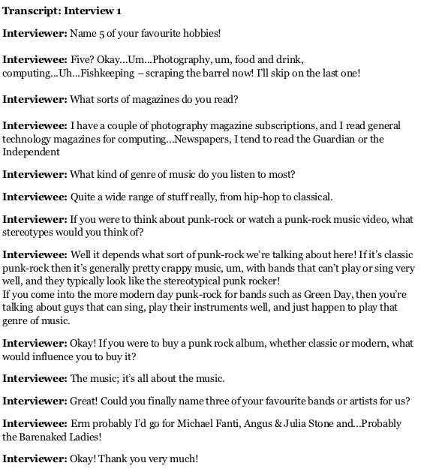
Structured Interview Data

Slide 7

Experiments
Direct investigation of the relationship between independent and dependent variables
Not really used in management-related research/social science disciplines as putting a group of individuals in a lab and performing experiments upon them is unethical.

Slide 8

To summaries…
Qualitative methods of primary data collection include semi-structured & unstructured interviews, observations, and focus groups.
Quantitative methods of primary data collection include questionnaires, structured interviews, and experiments

Slide 9

Advantages & Disadvantages of Primary Data

Slide 10

Advantages of Primary Data
Higher level of control
Up-to-date data
Better accuracy
You own the information

Slide 11

Disadvantages of Primary Data
More time-consuming
Not always achievable

