Slide 1
Global Business Ethics
PART ONE: THE NECCESSITY, JUSTIFICATION AND RESEARCH INTO CROSS CULTURAL BUSINESS ETHICS

Slide 2
Session 1 - Background
The necessity for business ethics;
The advantages of being ethical;
The importance of corporate governance;
The need for strong ethical guidelines, and
The role of goodwill.

Slide 3
The necessity for business ethics
Regulation requires it (Stock market listing rules)
Ethical breeches in one country can impact business in another
The risk to the overall system
The disruption to the social order caused by technology
Borderless environment and loyalty to country
The legal system cannot keep up with the complexity of modern business

Slide 4
Key ethical dilemmas today
Using overseas tax havens
Responsibilities to customers
Responsibilities to suppliers
Responsibilities for workers in logistics chain
Responsibilities for the environment
Differences of values across cultures
The balance between profit and responsibility to the wider community?

Slide 5
Advantages of being ethical
Right thing to do (build the community)
Commercially advantageous
  Certainty for staff
  Reputation in the marketplace
  Legal defense

Slide 6
Barriers to ethical behavior
Ethics is:
  complicated,
  not profitable, and
  a luxury that businesses cannot afford.

Slide 7
Corporate governance
Corporate governance is the process of decision making in an organisation (including resource allocation, strategic planning)
Good corporate governance promotes ethical organisational culture

Slide 8
Why the focus on corporate governance?
Corporate failures of the 1980’s (Worldcom, Enron etc.) and the Global Financial Crisis
Identified failings included:
  Inappropriate remuneration policies,
  Insufficient independence of Board members,
  Inadequate reporting,
  Minority and foreign shareholders disproportionately impacted, and
  A lack of comprehension of risks.

Slide 9
OECD principles of corporate governance
“… promote transparent and efficient markets, …,”
“…protect and facilitate the exercise of shareholders’ rights.”
“…ensure the equitable treatment of all shareholders, including minority and foreign shareholders…,”
“…recognise the rights of stakeholders … and encourage active co-operation between corporations and stakeholders in creating wealth, jobs, and the sustainability of financially sound enterprises,”
“… ensure that timely and accurate disclosure is made on all material matters…,” and
“…ensure the strategic guidance of the company,...”

Slide 10
Why ethical guidelines?
To provide clear direction in a complex and often conflicting environment
Guidelines cover relationships between:
  organizations (eg rival companies, suppliers),
  unions and employers,
  individuals within the organization, and
  organizations and the community at large,
  different cultures within the workplace (e.g. discrimination at home, foreign subsidiaries abroad),
  different cultures when working across borders .

Slide 11
The Marlowe declaration
Britain 1963 (a period of turbulence and transition)
18 people from industry, education, unions, churches
Purpose was to direct public opinion to better understand individual and economic reality
The core was the need for business to be conducted ethically

Slide 12
Marlowe principles
Individual responsibility
Everyone has a responsibility to improve the society
The declaration valued:
  Education (including induction and technical training),
  Safety (including stress management) ,
  Security of employment,
  Leisure, (including early retirement),
  The indivisibility of work/home life; each of which has a significant impact on the other), and
  Consultation and negotiation

Slide 13
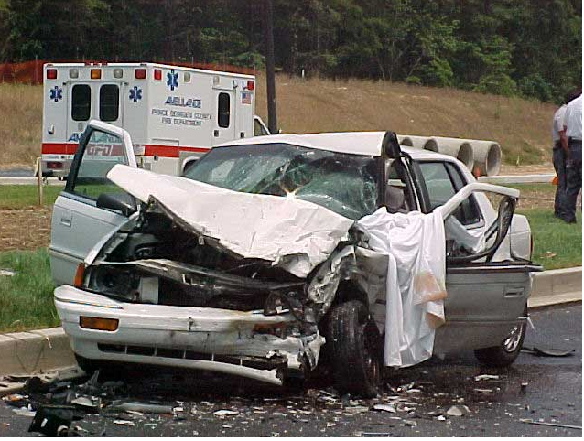
Ends versus means
(cost versus benefit)
Notes:
LECTURE NOTES
The lecture could raise the topic of ends versus means stating that the society could said to sanction killing because it allows cars to drive on the road, i.e. if there were no cars then there would be no road deaths. This is a major killer in the western world and growing significantly in the developing economies. WHY? Because the benefit of the car outweighs the costs.

Slide 14
Session 2 - Justification for ethics
Ethics:
Is rational
Is profitable
Helps companies maintain their relationship with shareholders
Can facilitate opportunities
Assists in the management of privacy issues
Is core to the sustainability of the financial system.

Slide 15

Profits v. Social responsibility
Notes:
Western business often sees ethical behavior as a cost.
A dominant paradigm prior to the GFC was that social responsibility was the business of government not business of business.
It is important to that we understand that we cannot turn this is into a simple dichotomy, companies are simply moral or immoral
Imagine a business that does not keep up with the efficiency of technology or globalization, how long will it last if its products are twice the cost of its opponents?
Modern business must constantly balance profitability and social responsibility to remain in business

Slide 16
Ethical corporate behavior is better for staff
Ethical corporations:
  have fewer problems recruiting and retaining good staff
  they do not lose their best people to competitors.
Ethical conduct has also shown to:
  lessen absenteeism,
  improve productivity,
  reduce pilfering, and
  reduce theft like the padding of expense accounts. .

Slide 17
Ethical corporate behavior is better for business
Ethical corporations:
Have greater repeat business (increasing trade as well as saving on advertising),
Have fewer problems with
  raising venture capital,
  drops in share price, and
  loss of market share.

Slide 18
Ethics under pressure
Managers in an ethics versus profit dilemma have four responses :
    fraud,
    crisis,
    competition, and
    innovation.
Companies will have a natural preference for one of these strategies
Source: Barraquier (2011)

Slide 19
Profitability is linked to ethical corporate behaviour
Grensing-Pophal (1998) used a rating system and found that the corporations with the highest score on social responsibility over the long term also made the most money
Bastien (1997) found a correlation between responsible performance and long-term profit.

Slide 20
Sustainable business in the Global environment
Corporate citizenship and sustainability in this age of globalisation requires special skills:
    knowledge of other cultures,
    ethical leadership, and
    business acumen.
Source: Crane & Matten (2010)

Slide 21
Behaving ethically in a crisis
Snow foods (Japanese company)
No. 1 dairy food brand,
Major defect in production,
Caused thousands of people to become sick and there were some deaths
Response
-played down the role, reluctant to recall or co-operate with health authorities

Slide 22
Behaving ethically in a crisis
Johnson and Johnson
Key product, Tylenol (massive market share)
Deliberately poisoned
Caused deaths
Response
Put consumers before any cost issues
Recalled all product
Massive PR campaign to alert people
Notes:
The campaign went as far as having police cars going down street with their loud hailers.
RESULT: Snow foods as a brand wiped out, Executives jailed. Tylenol brand was saved, because community had confidence in Johnson and Johnson
IMPORTANT POINT: Swift action / public welfare before profit. Ethics is in the company’s interest

Slide 23
Ethical corporations have better relationships with their shareholders
Presumption: shares are purchased for profit
BUT persons have other or parallel reasons for investing:
-approval of the direction, and
-contribution to the national economy.
AND NOW
There is a greater expectation that profit can be made while acting in a socially responsible way
Notes:
- Refer to the Hershey’s example as to how institutional shareholders suing for information on the logistics chain

Slide 24
KEY DILEMMA: How to act conscionably in an country that is often corrupt?
Corporations are accountable:
– a number of countries have an equivalent of the US ‘Foreign Corrupt Practices Act’
consumer backlash
Consequences are severe:
Massive fines
Brand damage
Years of embarrassing litigation
Notes:
Ethical companies avoid these consequences
If in a crisis, where there is an instance of corruption within a major company operating overseas, evidence of a sincere ethical culture will act as a defense subtantially mitigating penalties (more about that later in the book)

Slide 25
Record keeping
Accuracy of records is vital to understanding how a company operates
‘Creative accounting’ undermines transparency and the ability to manage
Notes:
There is an opportunity here to discuss complex securities and their role in the GFC.
Not being able to understand the risk because of the complexities was a major contributor to the downturn

Slide 26
Privacy
Unprecedented data available about individuals (mostly volunteered)
Algorithms supported by massive data crunching machines can combine information (piecing together a ‘mosaic’)
BUT
Ethical corporate culture can avoid unlawful breaches of privacy

Slide 27
Supporting the System
    UNETHICAL BEHAVIOR
    SHORT TERM BENEFITS
    Big returns,
    growing dividends,
    contented shareholders, and
    fat bonuses
    MEDIUM TO LONG TERM COSTS
    Devaluing (destruction of) corporations,
    Damage to careers
    Loss of jobs
    Loss of investors revenue / capital
    Loss of confidence in business
    Greater government intervention
    Risk to the social fabric

Slide 28
CURRENT EXAMPLES
Shifting income offshore to minimize tax liability
Not creating safe working environments
Not creating safe products and services
Inappropriate responses in crisis
Shifting risk (environmental / employee safety) offshore
Inappropriate use of the litigation system
Bribing government officials (particularly in developing economies);
Inappropriate use of bankruptcy to avoid debts
Shifting borrowing costs to suppliers by failing to pay them promptly; and
Participating in the black or shadow economy.

Slide 29
Discriminant analysis or ‘gut reaction’
GUT REACTION = impulse (unprofessional arrogance / ignorance)
DISCRIMINANT ANALYSIS
  Gather the facts
  Give weight to the evidence
  Decide

Slide 30
Session 3: CROSS CULTURAL ISSUES IN BUSINESS ETHICS
(Hofstede) for assessing business ethics across cultures.
INFLUENCING FACTORS
Geography (e.g. climate, population density, natural resources);
Social institutions (e.g. media, family, religion, government, education);
Dominant cultural values;
Economy and economic systems;
Public opinion, political systems and the law;
Language; and
Industry norms.

Slide 31
LEARNING FROM OTHER CULTURES
The interaction of foreign culture and ethics
Forms of Social control
Taking a different cultures’ perspective.

Slide 32
Hofstede and IBM
Hofstede in 1965 was the head of personnel for International Business Machines (IBM)
Psychologist
117,000 staff
50+ countries
Developed an extensive survey, conducted between 1967-1973
Notes:
Hofestede in an exceptional position and gathered a huge amount of data

Slide 33
Hofstede’s 4 dimensions
Individualism-collectivism continuum
Power distance
Masculinity-femininity continuum
Uncertainty avoidance
Notes:
Individualism-collectivism continuum In an individualistic culture you would expect the members to be more self-oriented looking to their own interests and that of their immediate families. In the collectivist culture people consider that they are members of a wider group, an extended family or a tribe or some other collective, like a business.
Power distance This dimension is about how the members of the society view themselves in the business hierarchy. In a community with a high ‘power distance’, leaders are given very high status and are considered to be very important. In low ‘power distance’ countries there is a more egalitarian mindset. The status of the manager is not considered significantly greater than that of the workers themselves.
Masculinity-femininity continuum Some cultures are male oriented and consequently adopt more masculine strategies in the workplace. They are aggressive in their approach, driven by monetary reward, competitive and expect that women will act in a traditional way. In a society that is orientated towards the feminine side, members are less competitive, more co-operative and are more accepting of women in non-traditional roles. Feminine cultures have a greater concern for the wider social good.
Uncertainty avoidance Members in a community with a high ‘uncertainty avoidance’ rating have a greater need for stability, structure and certainty. Typically there is greater corporate loyalty and an expectation that the corporation will return that loyalty. The members are also likely to be insecure, less tolerant of deviance and more aggressive in the workplace. In a community at the low end of the ‘uncertainty avoidance’ scale, the members are more open to diversity, accepting of difference and less risk-averse.

Slide 34
Later additions to the model
Long-term versus short-term orientation (formerly referred to as “Confucian dynamism”)
Indulgence-self-restraint
Notes:
Long-term versus short-term orientation (formerly referred to as “Confucian dynamism”) This dimension relates to a culture having either a short or a long term focus. In a culture where a long-term approach is taken, business people place a greater emphasis on cultivating relationships and building a market position; family and business often fuse. The social as well as the commercial element of their businesses are important for their personal satisfaction. Cultures with a short term orientation split their business and family lives and look for quick results.
Indulgence-self-restraint This refers to whether the members of a particular culture do or do not feel inhibited by the social expectations of their community. In the indulgent culture members feel that they can live life as they choose while those in the self-restraint culture believe that they are more bound to live by the community’s rules.
***
The dimensions all influence a business person’s values and therefore how they approach ethical problems. It is important to recognize that there is a difference between an individual and their society. The statistical analysis is about ‘trends’ not on absolute rules but it is instructive in understanding cultural differences. It is also important to note that culture is only one aspect of building a picture of what influences individual values and behavior.
Hofstede’s work is often the starting point for research into cross-cultural ethical behavior and is referred to throughout this chapter; particularly under the Dominant cultural values section.

Slide 35
INFLUENCING FACTORS
Geography (e.g. climate, population density, natural resources)
Social institutions (e.g. family, friendship groups, religion, government, education, media)

Slide 36
DOMINANT CULTURAL VALUES
Individualist culture (e.g. USA)
Less weight given to codes of behavior than personal views
More likely to give weight to self that other stakeholders
Collectivist culture (e.g. Asian countries)
More weight given to codes of behavior than personal views
More likely to give weight to other stakeholders than self

Slide 37
‘POWER DISTANCE’
Low ‘power-distance’ cultures (e.g. USA)
More weight given to opinions of peers than superiors
Informal industry norms given more weight than formal code
High ‘power-distance’ cultures (e.g. France)
More weight given to opinions of superiors than peers
Formal codes given more weight than informal industry norms

Slide 38
‘UNCERTAINTY AVOIDENCE’
High ‘uncertainty avoidance’ cultures (e.g. Japan)
High levels of conformity
High levels of trust
Give formal codes greater weight than their personal views
More readily able to see the negatives of a poor ethical decision
More likely to give weight to other stakeholders than self
Low ‘uncertainty avoidance’ cultures (e.g. USA)
Greater acceptance of deviant behavior
High levels of mistrust
Give formal codes less weight than their personal views
Less willing to accept the negatives of a poor ethical decision
Less able to recognize an ethical dilemma
More likely to give weight to self than other stakeholders

Slide 39
Masculine – Feminine
Masculine cultures (e.g. Japan & USA)
Overly ambitious
Very competitive
Focused on monetary benefit
Increased likelihood of poor ethical decisions
Less able to recognize an ethical dilemma
Feminine cultures(e.g. Sweden)
Co-operative
Collaborative
Less focused on monetary benefit
Less likelihood of poor ethical decisions
More able to recognize an ethical dilemma

Slide 40
More influencing factors
Economy and economic systems
-what is the degree of systemic corruption
Public opinion, political systems and the law
- comparing democratic with undemocratic
Language
- vagaries of language
Industry norms
  - availability of resources
  - trading conditions

Slide 41
Language as an ethical analysis tool
Does management have a clear vision for the organization and is it consistent with their understanding of the organizations realities?
Do the employees have a clear understanding of the vision and does it match their perception of the organization’s realities?
Do management and staff share the vision?
Do management and staff share the perception of the organizations realities?
Notes:
These four questions can assist you in analyzing the cultural alignment of an organization, how well does the organization as a whole share a common ethical perspective and direction?

Slide 42
LEARNING FROM OTHER CULTURES
The interaction of foreign culture and ethics
- Are there rules that transcend culture
Forms of Social control
- Informal versus formal rules
Taking a different cultures’ perspective
- Productivity - a question of process or culture

Slide 43
Learning from other cultures
The interaction of foreign culture and ethics
Taking a different culture’s perspective

Slide 44
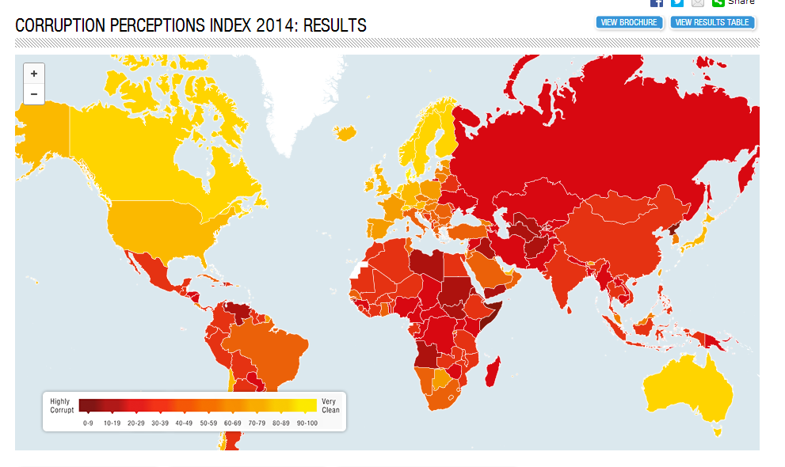
CORRUPTION
SEEKING COPYWRITE PERMISSION TO USE FROM TRANSPARENCY INTERNATIONAL

Slide 45
Session 4: ORGANIZATIONAL FACTORS IN BUSINESS ETHICS
KEY POINTS
The moral development of a corporation,
Demonstrated ethics of leadership,
Presence and enforcement of ethical codes,
Culture, history and climate of an organization, and
The opportunity to act unethically.

Slide 46
ORGANIZATIONAL FACTORS IN BUSINESS ETHICS
FURTHER KEY POINTS
Organizations and ethics
Industrial relations
Emergent ethics

Slide 47
Moral development of a corporation
STAGE | CORPORATION TYPE | CONCERN OR PROFIT COMPARED TO ETHICS
5 | Ethical | Most balanced (profit and ethics equal)
4 | Emerging ethical | More balanced (strong recognition of social responsibility)
3 | Responsive | Some balance (recognition that social responsibility needs to be addressed but usually reactively)
2 | Legalistic | Little balance (Belief that compliance with the law is the only responsibility)
1 | Amoral | Unbalanced (Profit oriented only, even legal constraints might be ignored)
Based on Reidenbach and Robin, 1991

Slide 48
The ‘modes of managing morality’ (MMM) model
Immoral Mode
Reactive Mode
Compliance Mode
Integrity Mode
Totally Aligned Organization Mode

Slide 49
Qualities of an ethical leader
People oriented (cares about people);
Visible role model (this is less about their values and more about what is seen);
Have processes to ensure values are applied (rewards and punishments);
Concern for profit but understand the wider social responsibility;
Ensure fairness in decision-making (have quick tests to assess decisions).

Slide 50

JAPANESE LEADERSHIP STYLE
Spring season cherry blossom on Miyajima Island by Jordan Emery is licensed under CC by 2.0

Slide 51
JAPANESE LEADERSHIP STYLE
Morality and profitability are linked
Driven by Transcendentalism
Japanese leadership ideals are:
self-realization (of themselves, employees and other stakeholders)
Acceptance of diversity; and
To trust other people.

Slide 52
COMPARISON OF JAPANESES AND AMERICAN LEADERSHIP STYLES
 | JAPAN | AMERICA
PRIORITY | employees | shareholders
FEATURES | Commitment to self-realization Sackings are a last resort Executive committed to improving good of the whole All work considered of equal value All opinions respected and listened to Acceptance of diversity Trust in employees Long term focus | Commitment to profitability Sackings if in the interest of profitability No commitment from executive to improving the whole Some jobs seen as more important than others Short term focus
ETHICAL CONSEQUENCE | Underlying assumption that ethical conduct is profitable | Constant tension between ethical behavior and profitability

Slide 53
Rewards and behavior
Learning theory tells us reward is a powerful influence on behavior
Organizations get the behavior they reward
Rewards can be direct money, promotion, kudos
BUT
Rewards go deeper into the psyche – they address our need as social animals to be accepted and are VERY IMPORTANT.

Slide 54
Early Education and ethics
‘Just communities’ (High schools), and
‘Honor codes’ (US colleges)
These systems:
- have ‘codes of conduct’
- the ‘codes’ are lived (rewards and punishments)
-allow students have the opportunity to live in an environment based on mutual trust.
**Both have shown to reductions of unethical conduct
IMPORTANTLY continuing in a working environment has shown ongoing improvement in ethical behavior

Slide 55
Scripts
SCRIPTS are programs that individuals use to make sense of the world
SCRIPTS are progressively built up
THE MORE SCRIPTS a person has the greater their capacity to deal with ethical issues
**Indicative that the greater the training the greater the ethical behavior

Slide 56
Company or medieval church
its hierarchy (bishops and laity/CEOs and workers),
rites (services/company events),
sackings (excommunication), and
catechism (belief in the company ethos).
HERETICS
Are removed not because they are wrong but because they might be right.

Slide 57
Industrial relations
CODES OF CONDUCT can be a mechanism to define the relationship that a corporation wants to have with its employees.
NOTING THAT TANGIBLE WORKING CONDITIONS are usually protected at a National and an international level (OECD, ILO and UN)
A CODE OF CONDUCT CAN BE A POWERFUL MECHANISM TO ADRESS INTANGIBLES LIKE:
quality-of-working-life (including status),
scope for self-development and self-fulfilment,
comradeship,
pride in skill,
a sense of belonging, and
value to others of the work done.
AND BUILD A BETTER RELATIONSHIP WITH ITS WORKFORCE

Slide 58
Companies-monsters or miracles?
Lloyd considers:
Companies collectively constitute a conscious, intelligent, non-human species at a relatively early stage in their evolution.
The theory of evolution represents a powerful, ready-made model for a dynamic theory of business economics.
Recent changes in corporate make-up suggest ‘nicer’ strategies than in the past.

Slide 59
Session 5: INDIVIDUAL FACTORS IN BUSINESS ETHICS
Individual’s ethical decision making.
Education, language and religion,
Cross cultural ethical intelligence,
Personal experience and background, and
Field dependence, ego strength and locus of control.
Psychological theory
the deprivation of benefits,
motivation and ethics

Slide 60
INDIVIDUAL FACTORS (cont)
Social influences
Formal versus informal relationships,
The benefits of co-operation, and
Business and the professions
Physical influences
Brain evolution,
Environmental factors, and
Diet

Slide 61
Moral developmental stages in humans (Kohlberg)
Pre-Conventional
Compliance focus (avoiding punishment)
Self focus (the benefit for me)
Conventional
Conforming to social norms (behaving per the rules)
Adhering to the community’s laws (recognition need for law and order)
Post-Conventional
Recognizing the ‘social contract’
Recognizing underlying moral principles (Principled conscience)

Slide 62
INDIVIDUALS APPROACH ETHICAL DILEMMAS BY
Assessing the right or wrongness of the choices AND/ OR
An assessment of the consequences of each action
Relying upon a personal set of norms collected over their lifetime

Slide 63
High or low ‘field-dependence’ - how important are the opinions of those around you?
Locus of control - do you influence the world or does the world influence you ?
Ego strength - how committed are you to your values?
Education – increases moral development
Gender – research has shown females to give more ethical response

Slide 64
Cross Cultural Ethical intelligence
High or low Ethnocentricity
degrees of accepting another culture
High or low empathy
degrees of identification with another’s situation

Slide 65
Phases of developing a cross cultural approach - Strubler et al (2012)
Phase 4 creating a common identity and undertaking the project or work required.
Phase 3 a set of norms and objectives is established.
Phase 2 continuing to learn about the other culture, using the ground rules established in the first stage to reconcile any differences. There is still a focus on building trust.
Phase 1 entering the new cultural environment, focusing on processes including rules to build trust and understanding between members of the group.
**with each project the cycle repeats increasing trust and ability to work as a team

Slide 66
Psychological reactance
‘... a set of motivational consequences that can be expected to occur whenever freedoms are threatened or lost’ (Brehm & Brehm, 1981).
How far deprivation can go before provoking ethical breaches?

Slide 67
Sociobiology
Definition ‘the study of the biological nature and foundations of social behaviour.’
‘Sociobiology’ tries to explain altruism
Balancing Darwinian emphasis on competition with virtues of co-operation.
Altruism may be founded in biology

Slide 68
Organizational identity
Do organizations have an identity greater than the individuals that make it up?
How important is this corporate identity? Like individuals stable organizations are difficult to derail, and fickle ones easy.
What are the office politics? A common ‘conflict of interest’ is where personal interests may be at variance with those that benefit the organization.

Slide 69
The ‘Prisoner’s dilemma’
Two players (masquerading as prisoners),
Each of whom has two choices (co-operate or defect). Neither player knows what the other will do.
Two individuals are detained by the police and charged with a bank robbery, which carries a hefty jail sentence
If neither speak, the sentence will be small
If one admits however, they go free and the other receives a heavier jail sentence.

Slide 70
Physical factors
BRAIN EVOLUTION AND ETHICS
The brain can be divided into three structures:
The ‘reptilian’ brain
The ‘primitive mammal’ brain; and
The ‘fore brain’ / the higher functioning brain
ENVIRONEMENTAL FACTORS
noise, air pollution, crime rates and a feeling of safety, temperature, barometric pressure, wind, rain, humidity, ozone, the quality of the light, and hours of sunlight per day
Notes:
he air contains bromide leached into it by evaporation. The resultant combination of warmth and a calming agent may have something to do with its popularity as a holiday resort.

Slide 71
Diet
Vitamin deficiency, allergies, aberrant metabolism, impact mood
Mercury, carbon disulphide and thallium poisoning cause behavioral disorders)
Abnormal mineral levels; high levels of lead and cadmium can produce deviant behavior
Low levels of potassium and sodium also tend to be associated with undesirable behavior.
Disinhibiting effects of alcohol as mentioned
Iodine deficiency can cause mental retardation
Nutrition may impact mood changes and IQ performance.

Slide 72
Summary of physical factors
Like certain psychotropic medications physical factors change mood states
Among the effects they can produce are changed dispositions to others and to events
Mood is important to decision making
THEREFORE Physical factors may affect ethical judgement

Slide 73
Global Business Ethics
PART TWO: THEORETICAL ISSUES IN BUSINESS ETHICS

Slide 74
Session 6 – Theoretical approaches in Business ethics
THEORIES OF MORLITY
    Deontology
    Utilitarianism and Act Utilitarianism,
    Confucianism,
    Virtue ethics,
    God’s ordinances, and
    Kant.
EXCELLENCE
    Excellence in Western values,
    Ethics as part of the judgment of excellence, and
    Excellence is positive and profitable

Slide 75
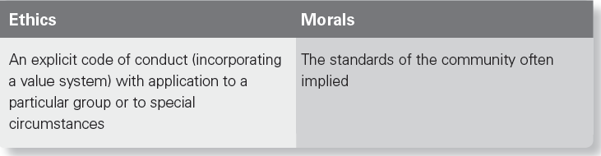
Ethics and Morals
Ethics and morals both share common features:
    knowing what is right,
    doing what is right, and
    feeling what is right

Slide 76
DEONTOLOGY | CONSEQUENTIALISM
Behavior is assessed by the act itself It is wrong to lie, steal, or kill | Behavior is assessed by the consequences A lie may be justifiable

Slide 77
UTILITARIANISM | ACT UTILITARIANISM
The act should do the greatest good for the greatest number | The act should produce at least as much good as any other choice

Slide 78
Confucianism
Very early bases of ethics
Behaviour appropriate to relationships
Emphasis on traditional relationships
Individual behaviour must be appropriate to the specific relationship (optimise the benefit to both)

Slide 79
GUANXI
Definition: the relationships a person has
HOWEVER it has a deeper meaning:
the cultivation of a personal network who mutually support one another
Participant in relationship network will take account of each others interests when making decisions

Slide 80
VIRTUE ETHICS
Originally known as Aristotle’s Nicomachean ethics
Virtue ethics sees:
human nature is defined by its aims
the most important one was to aim at ‘the good’.
Decisions and actions are about the ends to be achieved.

Slide 81
VIRTUE
Definition: ‘moral excellence or goodness’
HOWEVER morality needs to be understood at several levels:
moral virtues (such as honesty and decency);
intellectual virtues (such as intelligence and curiosity);
communal virtues (such as charity and respect for others); and
political virtues (such as a respect for law and a belief in the common good).

Slide 82
Maslow’s original hierarchy of needs
Self actualization (deep self-fulfilment)
Esteem (valued in the community)
Love and belonging (friends, relationships, intimacy)
Safety
Biological needs
Notes:
IT IS IMPORTANT TO NOTE: the weakness in Maslow’s theory, that people do not always work their way sequentially up the steps. On occasion people perform acts of great self sacrifice for the greater good even though they have not meet earlier criterion. A person can enter the hierarchy at different points, skipping levels.

Slide 83
RELIGION AND ETHICS
Popular opinion would see religion as a valid basis for a code of ethics.
The difficulty here is subjectivity as demonstrated by the multiplicity of interpretations
Ethics is about a code of behavior that is rationale, the foundations of religion are irrational
THE HUMAN NATURE DEBATE
A key debate here is whether good and evil are in our nature, or that behaving in a way that is good or evil is ‘situationally determined.’
**philosophical debate and research supports the latter

Slide 84
Kant
Kant’s theory is known as the ‘categorical imperative’,
Morality is about the intention not the result
Ethical behavior is based on law determined by reason
Rule of morality should be treated as though they believe it to be a universal principle

Slide 85
Excellence and Western values
Cormack (1991) considered that Western culture has a set of values underpinned by excellence.
He cites the importance of service to;
    customers,
    neighbours,
    subordinates,.
    community,
He argues that it is only by the adoption of these wider community values that we can become excellent.

Slide 86
Ethics as part of the judgment of excellence
Excellence is:
    more easily recognised than codified
    a journey as well as a destination,
    a process as well as an achievement.
    about overall evaluation (not narrow assessment like profit alone.)
Ethics is a part of excellence – The Nazi regime was not considered excellent, despite their efficiency.
Economic, environmental and human rights issues of recent times is stressing the relationship between excellence and ethics.

Slide 87
Excellence is positive and profitable
Peters and Waterman (1982) – criteria of excellence correlated to market leaders
Values inherent in excellence:
personal worth and self-esteem based on the uniqueness, significance and importance of the individual;
loving our neighbours, of esteeming them and promoting their growth and well-being rather than pursuing our own interests at the expense of those around us;
community and the responsibility of businesses to take the social and human dimension into their areas of shareholder accountability;
the importance of our personal and corporate responsibility for tomorrow as well as for today (Peters & Waterman, 1982).

Slide 88
Session 7 – LEGAL ASPECTS OF ETHICS
The relationship between morals and the law:
Is there a role for morality in business or does the sole responsibility rest with law makers?
The relationship between informal and formal codes,
The Hart-Devlin debate,
The difference between complying with the law and complying with an ethical code, and
Natural Justice

Slide 89
Session 7 – LEGAL ASPECTS OF ETHICS (cont.)
The commonalities between law and ethics:
The difference between hard and soft law, and
Legal pluralism.
The Relationship between ethical codes and the law.
The legal weight of codes,
Ethics as contract, and
Self-regulation.

Slide 90
Limitations of the law
The law is not comprehensive The law is not current
Not everyone has equal access to the law
Laws are not always fair and just

Slide 91
FORMAL CODES
V.
INFORMAL CODES

Slide 92
Natural justice
The decision maker does not have a conflict of interest
Proper notice ( information and time to prepare – proportionate to the issue)
Opportunity to be heard

Slide 93
HARD LAW
V.
SOFT LAW

Slide 94
Legal pluralism
A community of people is subject to 2 or more legal codes
France’s African colonies (different classes of citizen);
Egypt’s civil code (filled in with Sharīʿah law);
Former European colonies (Western law & tribal law)
Bedouin, (Traditional Bedouin law and Sharīʿah law)
**Multinational companies?

Slide 95
Conflict of laws
Pluralism resolved by:
prescribe the conditions under which the court is competent to entertain any given matter;
determine for each class of case the particular jurisdiction will apply; and
specify the circumstances in which a foreign judgment resolves the conflict.

Slide 96
Codes of conduct as law
Stock exchange requirement.
UK - Regulations of the Financial Reporting Council.
Sarbanes-Oxley Act (2002).
Federal Sentencing Guideline for Organizations (FSGO).

Slide 97
Global Business Ethics
PART THREE: SOLVING PROBLEMS

Slide 98
Session 8 – ETHICAL GRADUALISM, CREATING ETHICAL CULTURE, QUANTIFICATION OF ETHICS AND THE IMPORTANCE OF ETHICAL CODES

Slide 99
Ethical Gradualism propositions
No compromise on core principles .
Solutions should be captured as part of the corporate memory
Do not over emphasize perfection just a commitment to improvement over time
An approach that meets a basic standard and is seen to be achievable will have a greater chance of success
Small successes are less abrasive and accrue both in the conduct of the work force and creditability of the drivers

Slide 100
Ethical Corporate Culture
Defining the corporate climate,
Corporate climate audits,
Ethics consultants,
Quantification of ethics,
Social and environmental accounting,
Urgency versus importance,
Sequence of questions, and
Essential elements of an ethical corporate culture.

Slide 101
Corporate climate audit
Basic measures:
  staff turnover,
  absenteeism,
  customer/client complaints,
  sales (or clients seen),
  amount of service provided,
  quantity and quality of products,
  increases in receivables, and
  decreases in orders or referrals.

Slide 102
Corporate climate audit (cont.)
Higher level considerations:
  corporate philosophy,
  prevailing attitudes within the organization,
  the quality of the leadership,
  the efficiency of the organization, and
  the emphasis placed on the team.

Slide 103
Corporate climate audit (cont.)
Measured by:
staff morale and job satisfaction,
occupational health and safety,
staff selection and promotion, and
compliance with legislation.
relationships with customers and suppliers, and
dealings with other organizations.

Slide 104
Ethical Audit
questioning perceptions of the value of an ethical code,
degree of commitment to its implementation,
what ethical issues are perceived to be important, and
how an organization is rated ethically.

Slide 105
Quantification of ethics
Fine balance of probabilities
Minimising tragedy
Forbidden considerations
Prudence (or by practical outcomes)
By an absolute moral value
According to a moral precept

Slide 106
Delphi technique
FIRST PHASE
identifying the issues;
identifying the options; and
determining an initial position.
SECOND PHASE
exploring the disagreements, and the reason for them; and
evaluating the underlying reasons for such disagreements.

Slide 107
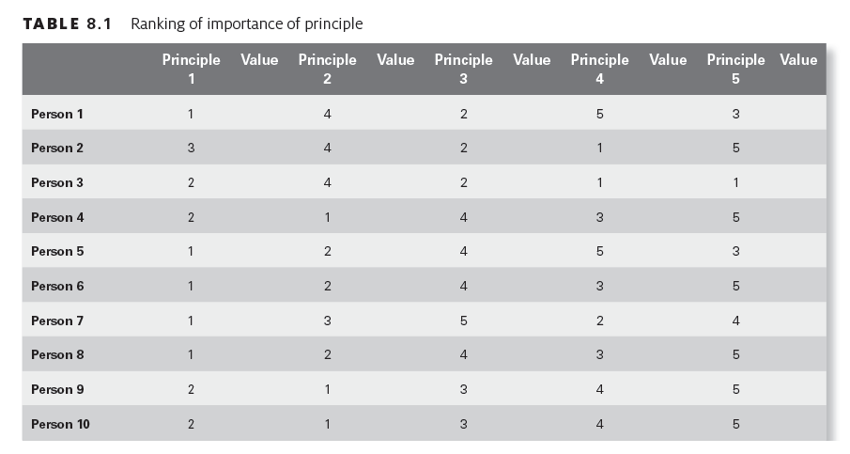

Slide 108
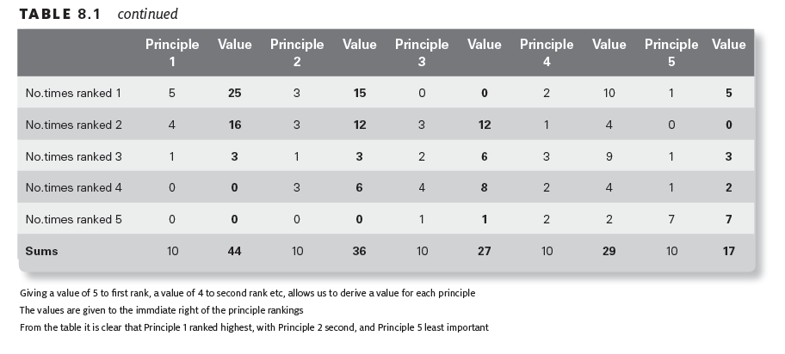

Slide 109
Social and environmental accounting
Who is the report for?
How should the information be reported ?
What should the company report on?

Slide 110
Assessing an ethical code
Examine how the code translates into behaviour);
The provision of precise ethical learning goals to staff;
showing how the achievement of ethical goals contributes to self-worth and company profile;
continue to look for (be creative with) assessing ethical behaviour; and
the provision of appropriate non-tangible rewards (such as acknowledgement, which should not be undervalued).

Slide 111
Assessing an ethical code (cont.)
Examples of direct measures:
How many insider trade deals were done?
How many technical breaches occurred?
How many customers complaints suggesting unethical behavior were received?
How many union principles were breached?
*List is a modified version of that appearing in Drummond (1991).

Slide 112
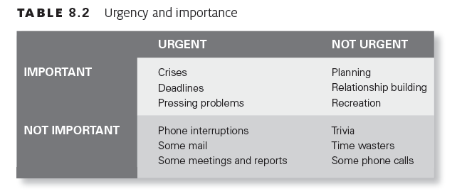

Slide 113
Fostering an ethical code
Clear ethical code,
Roles and responsibilities,
Open, fair and transparent processes for dealing with breaches,
Conditions of reporting on particular ethical cases,
Comprehensive training program

Slide 114
Advantages of a known ethical code
clarifying management’s thoughts on what constitutes unethical behaviour;
helping employees to think about ethical issues before they are confronted with the realities of the situation;
providing employees with the opportunity for refusing compliance with unethical action;
defining the limits of what constitutes acceptable or unacceptable behaviour; and
providing a mechanism for communicating managerial policy.

Slide 115
Commitment to an ethical code
Knowing the code
Knowing the applicability of state and federal laws and regulations
Knowing the rules and regulations of the corporation where the employee works
Engaging in continuing education in ethics
Identifying when there is a potential ethical problem
Learning a method of analysing ethical obligations in often complex situations; and
Consulting professionals knowledgeable about ethics
Bennett (1994)

Slide 116
Learning strategies
On-line training,
Lectures
The use of case studies,
Simulations, and
Mentoring

Slide 117
On-line training
Its cheap
Generic training can be purchased off the self Training can be readily tailored to an organization,
Its quick,
A form of assessment can be built into the course, and
is useful for reporting

Slide 118
Case studies
enable managers to recognise the ethical component of a business decision;
decide what to do about it once it is recognised; and
learn how to anticipate emerging ethical issues.
Drummond (1991)

Slide 119
Simulations
Role playing
Using the ‘hypotheticals’
Using videos on ethical issues
Larger scale projects

Slide 120
Why have a learning strategy?
promotes and supports the organizations’ values and standards;
makes managers more aware of the ethical dimensions of their business decisions and conduct;
re-educates staff in the organization’s ethical policies;
strengthens the ability of the staff to apply the organization’s ethics; and
provides a forum for managers to identify ethical issues and areas of vulnerability.

Slide 121
The responsibilities of managers
Are to:
behave ethically themselves;
screen potential employees;
have a meaningful code of ethics;
implement ethics awareness training;
reinforce ethical behaviour; and
create a structure to deal with ethical issues.

Slide 122
Major barrier to introducing ethical culture
A prevailing ethos in a business community that morality has no role in business
An ineffective government unwilling or unable to address structural flaws.
Economically difficult times compelling questionable actions.
Leadership that is not committed to ethics but profit
Managers being measured on profitability, and
a corporate culture focused on profitability with no concern for social responsibility.

Slide 123
What makes up an ethical organization?
An ethical code
A visibly ethical leadership team
Employees will be valued
There is a clear ethical infrastructure.
Selection and recruitment will be specifically targeting candidates with a demonstrated commitment to ethics.
There are appropriate rewards and sanctions for ethical compliance.
Ethical training will form part of all relevant training courses.
Ethic will form part of day-to-day decision-making.
Ethical conduct will be the subject of reporting.

Slide 124
Principle features of codes
Ethical codes are:
Active not passive
Aspirational
About the inequality in relationships
About smoothing relationships
About helping future generations

Slide 125
Session 9 – Investigating ethical breaches
PRELIMINARY CONSIDERATIONS
What constitutes an ethical dilemma and
The value of conducting the investigation.
INVESTIGATION STAGE
Who should deal with the breach; and
The process of dealing with the breach.

Slide 126
Session 9 – Investigating ethical breaches (cont.)
OTHER FACTORS TO CONSIDER:
The importance of quality decision making
The three quick tests,
Promptness of dealing,
Chatham House rules,
Creativity,
Apologies as solutions, and
Whistle blowing.

Slide 127
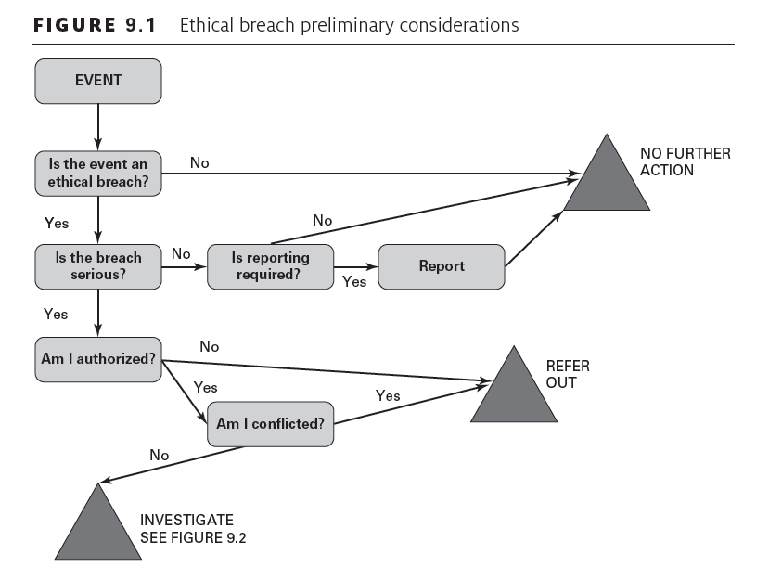

Slide 128
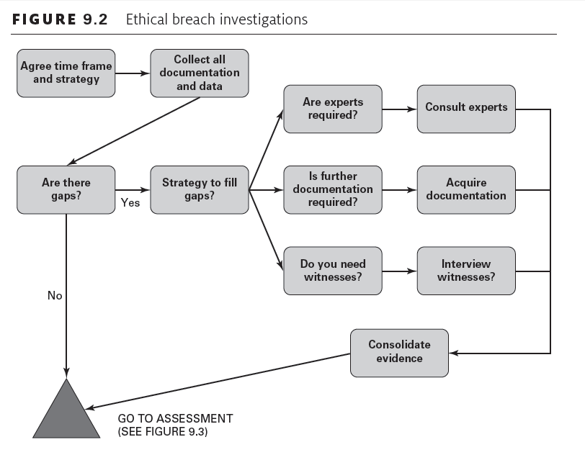

Slide 129
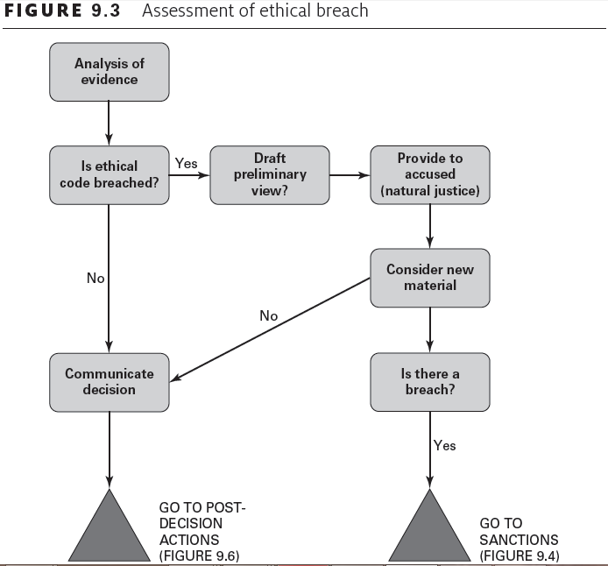
Notes:
This Figure was changed.

Slide 130
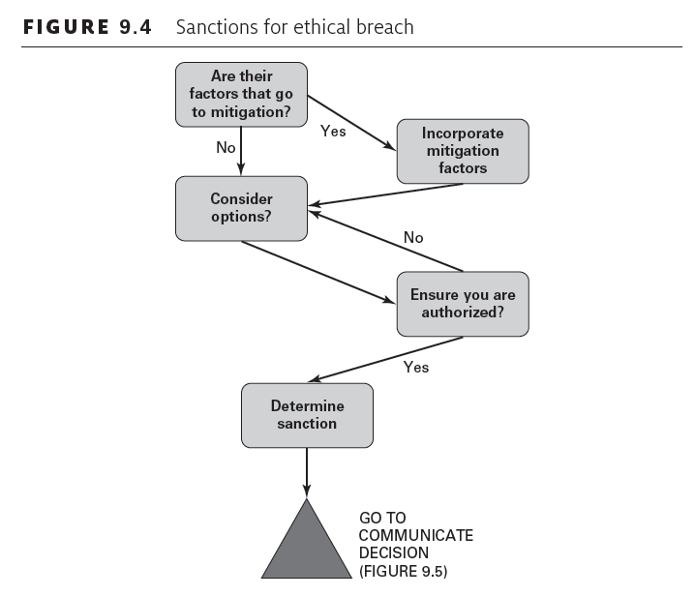

Slide 131
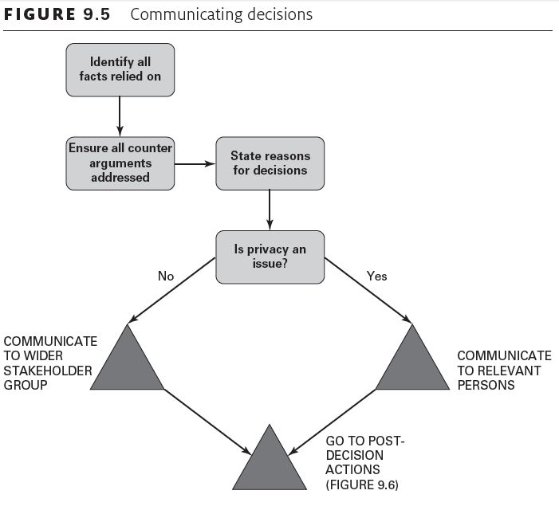

Slide 132
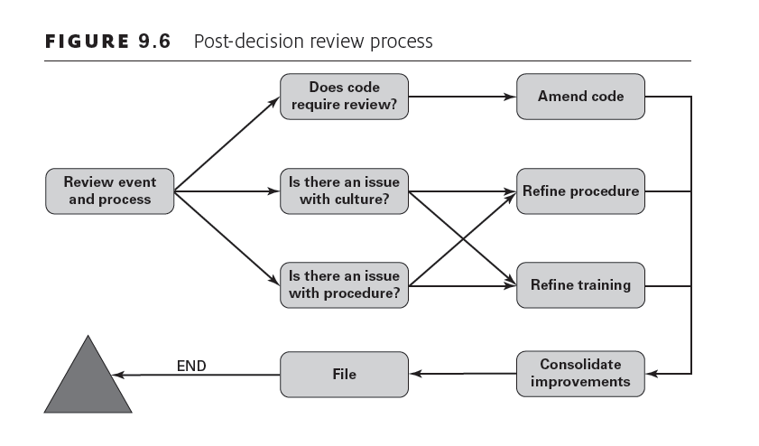

Slide 133
Three quick tests
How would this be explained in the witness box?
How would this look on the front page of tomorrow’s newspaper or news website?
Would your family still be proud of you?

Slide 134
Session 10 – INTERNATIONAL STANDARDS AND FIRST PRINCIPLES

Slide 135
International standards
(OECD) guidelines for multinational enterprises,
(OECD) principles on privacy, and
(OECD) corporate governance principles

Slide 136
Disclosure
Financial,
Performance,
Shareholding,
Relationships,
Risks,
Governance, and
(where appropriate) Corporate Social Responsibility reporting

Slide 137
Human Rights
OECD -‘Protect, Respect and Remedy’ related to
The International Bill of Human Rights, and
The International Labour Organizations Declaration on Fundamental Principles and Rights at Work

Slide 138
Employment and industrial relations
A right to freedom of association,
The elimination of child labour,
The elimination of compulsory or forced labour,
Provide non-discriminatory employment policies,
Provide reasonable and safe working conditions, and
Use local labour where possible and improve their skill levels.

Slide 139
Environment
Collect and appropriately report on the environmental impacts
Be proactive
Not use scientific uncertainty as an excuse to not promptly and appropriately respond to likely damage,
Have plans ready for emergency situations
Commit to continuous improvement of environmental management
Provide information to consumers about the environmental impacts of the corporation’s products,
Ensure that employees are aware of the corporation’s environmental policy and responsibilities, and,
Help governments to shape public policy.

Slide 140
Combatting bribery, bribe solicitation and extortion
Not offer, promise or pay bribes in any form
Ensure that they have appropriate programs, systems and monitoring to detect bribery.
Have appropriate systems to monitor and report on the use of ‘agents’.
Ensure that there is an appropriate learning strategy for employees
Not make improper payments to political campaigns.

Slide 141
Consumers
Ensure goods and services are safe and fit for purpose,
Ensure customers have clear and helpful information,
Provide inexpensive, convenient and fair complaints processes,
Ensure that customer privacy is maintained,
Not use any deceptive or misleading practice,
Assist authorities to address misleading advertising and practices in their industries, and,
Take particular care with disadvantaged consumers.

Slide 142
Science and Technology
Work within strategies national policies and objectives,
Have to quickly distribute technology
Undertake research and development work in all their countries of operation,
Reasonable use of intellectual property; and,
Develop relationships with local universities, other public research organizations and industry groups

Slide 143
Competition
Act within all relevant rules and regulations
Not engage in anti-competitive behavior
Co-operate with local competition authorities.

Slide 144
Taxation
A commitment to paying taxation not only according to the law but in the spirit of the law.
That taxation risk be a focus for boards and governance.

Slide 145
Privacy
Collection limitation
Data quality
Specified purpose
Use limitation
Security safeguards
Openness
Individual participation
Accountability

Slide 146
Corporate Governance
Ensuring the basis for an effective corporate governance framework
The rights of shareholders and key ownership function
The equitable treatment of shareholders
The role of stakeholders in corporate governance
Disclosure and transparency
The responsibilities of the Board

Slide 147
First Principles
D - Dignity
E - Equitability (Fairness),
P - Prudence,
H - Honesty,
O - Openness,
G – Good will, and
S - Suffering (Prevention of suffering).

Slide 148
Related issues
Relative and absolute ethics
The pervasiveness of actions, and
Where principles are in conflict.

