Slide 1
AHHI5017 Week 3: The American Civil War
Monday lecture
Class discussion: The American Civil War – key information
Group discussion: leisure and the Civil War (North v. South)
Class discussion: music and the Civil War
Class discussion: art and the Civil War
Class discussion: photography and the Civil War
This week discusses the American Civil War (1861–1865), examining both its immediate impact and lasting legacies. Special attention is paid to impact that the advent of photography had on coverage of the war, plus how the war has since been memorialised. Battlefield re-enactments act as a key reference for the latter.
Initially, the Monday lecture aims to build-up and consolidate students’ general knowledge of the American Civil War – i.e. causes, consequences, key belligerents, etc. Having done so, the next aim will be to discuss the manner in which the Civil War was represented in popular culture, both in the North and South of the United States. We shall compare and contrast the image of the war betrayed by paintings and photographs, giving thought both to the respective potentialities of these media for depicting war but also how they can be considered to have played a part in mythologizing it.

Slide 2
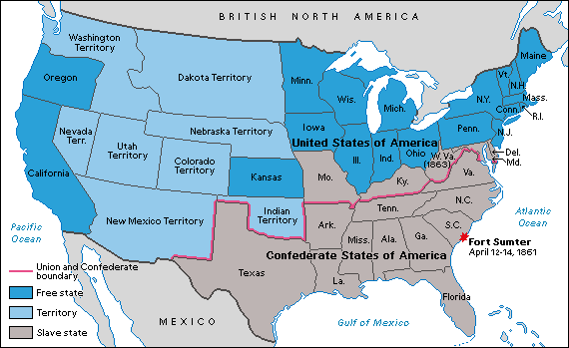
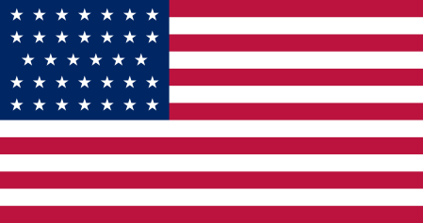
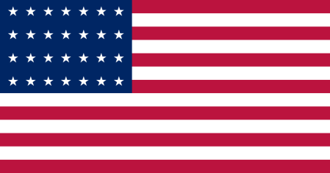

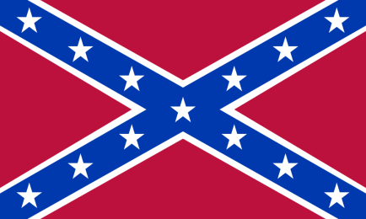
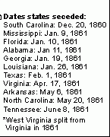
The American Civil War
(April 12 1861–April 9 1865)
CAUSES
Conflict between northern states (the Union) and southern states (the Confederacy)
Eleven states eventually seceded from the United States on the issue of ‘states rights’ – individual states’ right to resist imposition of laws from US Federal government – and est. the Confederate States of America
Overriding states rights issue pertained to the institution of slavery, the bedrock of the Southern economy
1860s = northern states increasingly abolitionist, plus tensions about the potential admission of expanding Western territories to the United States as ‘free’ or ‘slave’ states

Slide 3
The American Civil War
(April 12 1861–April 9 1865)
KEY EVENTS
Combat began with capture of Union base at Fort Sumter, South Carolina April 12 1861
Union president Abraham Lincoln explicitly endorsed abolition in the rebel states (note: not border states) as a war goal with Emancipation Proclamation, January 1 1863. This too formally permitted African American troops’ entry into the military.
Surrender of General Robert E Lee’s forces, April 9 1865; assassination of Lincoln, April 14; new President Andrew Johnson declares end of insurrection, May 9

Slide 4
RECONSTRUCTION (1865–1877)
CONSEQUENCES
The Reconstruction era saw attempts to put Union victory on legal footing, and to transform Southern society accordingly:
13th Amendment to US Constitution abolished slavery (1865)
14th Amendment grants citizenship rights to “all persons born or naturalized in the US” (inc. former slaves)
15th Amendment prohibits federal/state governments from denying the right to vote based on “race, color, or previous servitude”
Resistance in South; Reconstruction effectively ended with election of President Rutherford B Hayes, 1877
Jim Crow laws instituted “separate but equal” status of African Americans in South (ruled constitutional 1896); Southern society organised on principle of legalised segregation up to Civil Rights era (1950s, 1960s)

Slide 5
David S Heidler and Jeanne T Heidler, The Encyclopaedia of the American Civil War: A Political, Social and Military History (ABC-CLIO: Santa Barbara, California, 2000)
‘Leisure’ (by Jim Weeks)
“Leisure of the Civil War generation reveals much about the divergence between North and South that only war could reconcile.”
On what basis does Weeks mount the above claim?
What were the key differences between Northern and Southern society, and how did they manifest themselves in the two regions’ leisure cultures?

Slide 6
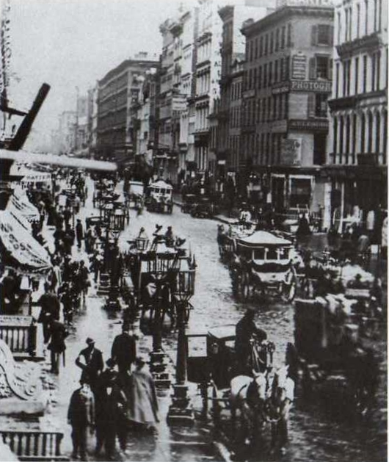
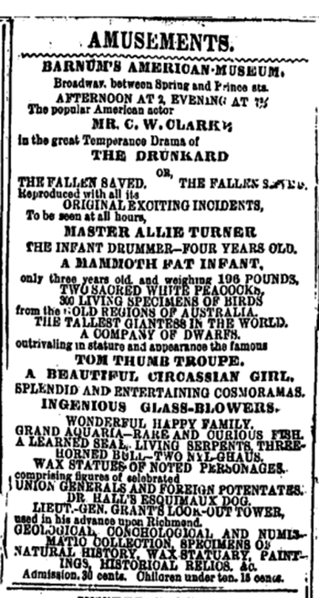
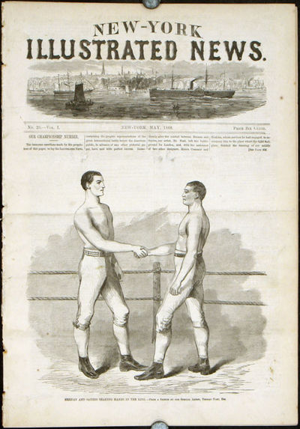
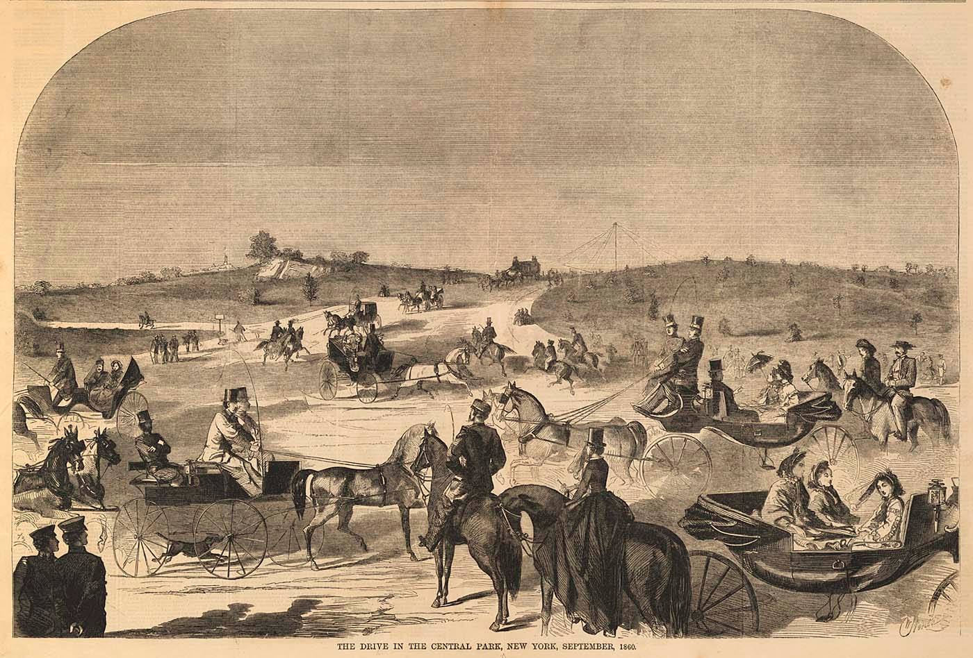
‘NORTHERN’ LEISURE
Photograph of Broadway, New York, 1860; illustration of Central Park, New York, 1860; New York Times advertisement for PT Barnum’s American Museum, New York, 1856; New York Illustrated News coverage of John Heenan and Tom Sayers prizefight, 1860

Slide 7
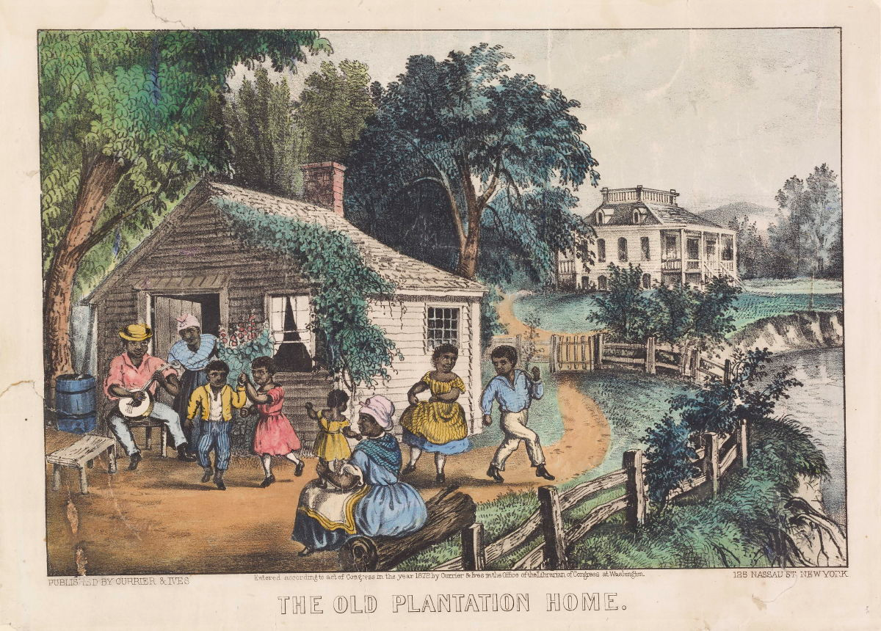
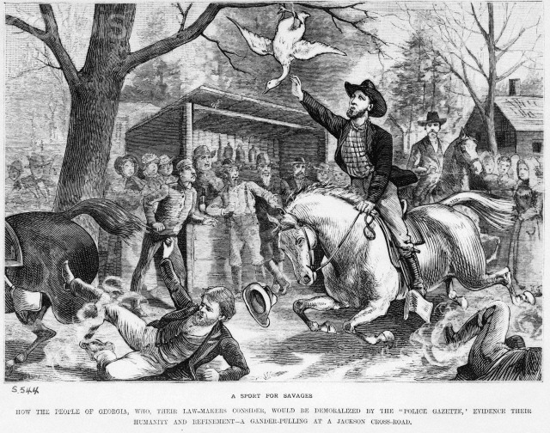
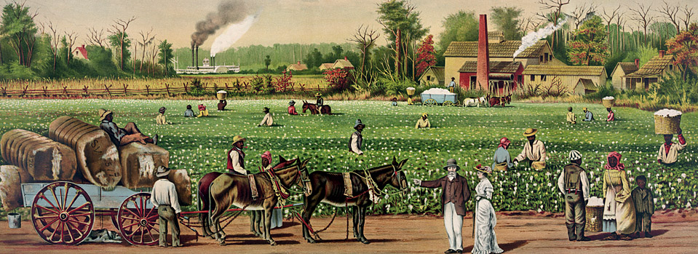
Antebellum ‘SOUTHERN’
LEISURE
Illustration of a Georgia gander pulling contest, National Police Gazette (New York); Currier & Ives (New York) prints of plantation life

Slide 8
David S Heidler and Jeanne T Heidler, The Encyclopaedia of the American Civil War: A Political, Social and Military History (ABC-CLIO: Santa Barbara, California, 2000)
‘Photography’ (by Angela Schwarz). See also: ‘Brady, Matthew’ and ‘Gardner, Alexander’ (by Heidi Campbell-Shoaf)
‘Leisure’ (by Jim Weeks)
‘Music’ (by Charles E Kinzer). See also: ‘“Battle Hymn of the Republic” (by Mark A Lause) and ‘“Dixie”’ (by Rory T Cornish)
‘Art of the Civil War’ (by Rosemarie S. Cardoso)
‘Newspapers’ (by Richard Digby-Junger)
How was the Civil War represented in the above media, and did these representations differ greatly in the Union and Confederate states respectively?

Slide 9
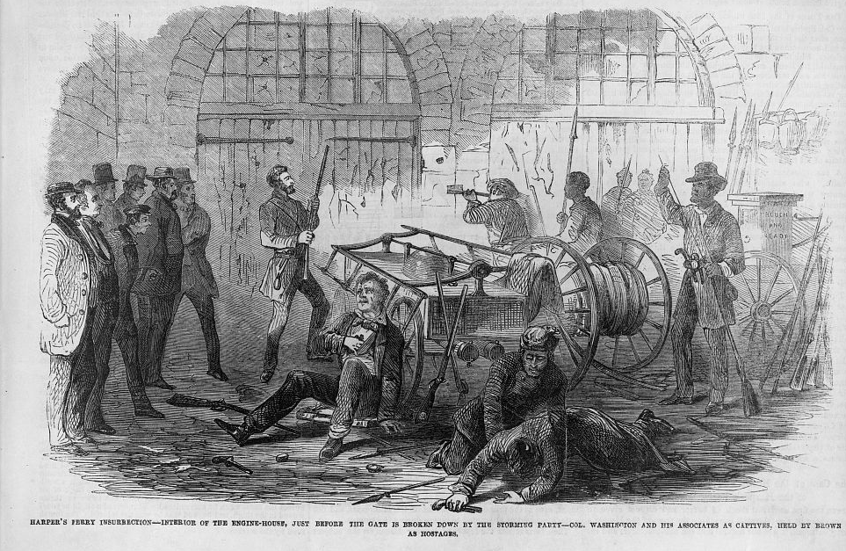
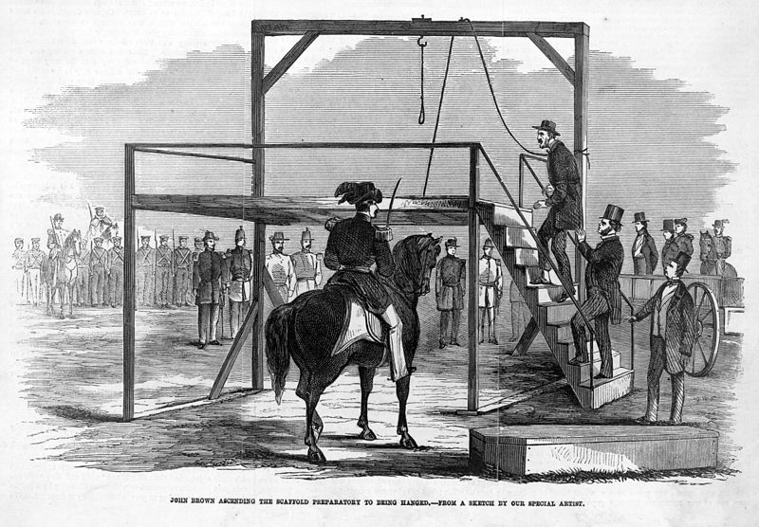
‘John Brown’s Body’ (anon)
John Brown’s body lies a-mouldering in the grave,
John Brown’s body lies a-mouldering in the grave,
John Brown’s body lies a-mouldering in the grave,
But his soul goes marching on.
Glory, glory, hallelujah!
Glory, glory, hallelujah!
Glory, glory, hallelujah!
His soul goes marching on.
The slave revolt led by John Brown at Harpers Ferry arsenal; John Brown’s hanging. From Frank Leslie's Illustrated Newspaper, November 5 1859, December 17 1859

Slide 10
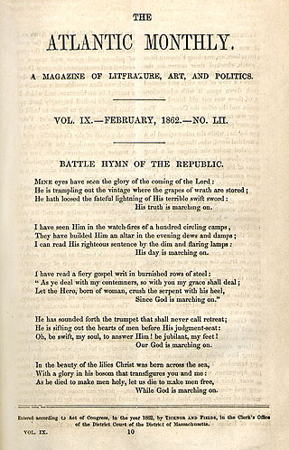
‘John Brown’s Body’ (anon)
John Brown’s body lies a-mouldering in the grave,
… But his soul goes marching on.
Glory, glory, hallelujah!
…His soul goes marching on.
‘Battle Hymn of the Republic’ (Julia Ward Howe, 1861)
Mine eyes have seen the glory of the coming of the Lord;
He is trampling out the vintage where the grapes of wrath are stored;
He hath loosed the fateful lightning of His terrible swift sword:
His truth is marching on.
Glory, glory, hallelujah!
Glory, glory, hallelujah!
His truth is marching on …

Slide 11
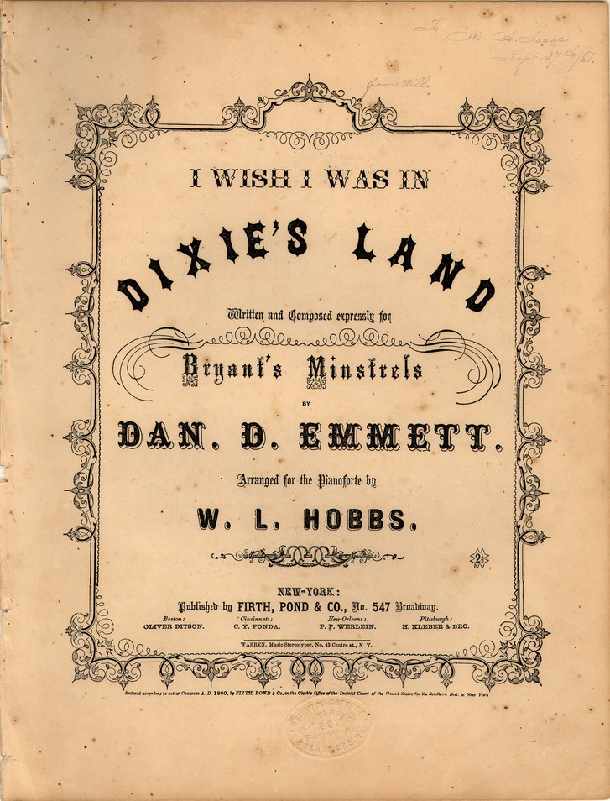
Oh, I wish I was in the land of cotton,
Old times there are not forgotten.
Look away, look away, look away Dixie Land!
In Dixie's Land, where I was born in,
early on one frosty mornin'
Look away, look away, look away Dixie Land!
I wish I was in Dixie, Hooray! Hooray!
In Dixie's Land I'll take my stand,
to live and die in Dixie.
Away, away, away down south in Dixie!
Away, away, away down south in Dixie!
There's buckwheat cakes and Injun batter,
Makes you fat or a little fatter.
Look away! Look away! Look away! Dixie Land
Then hoe it down and scratch your gravel,
To Dixie's Land I'm bound to travel.
Look away! Look away! Look away! Dixie Land
I wish I was in Dixie, Hooray! Hooray!
In Dixie's Land I'll take my stand,
to live and die in Dixie.
Away, away, away down south in Dixie!
Away, away, away down south in Dixie!
‘Dixie’
(aka ‘I Wish I was in Dixie’s Land,’ etc.)
(Daniel Emmett lyrics)

Slide 12
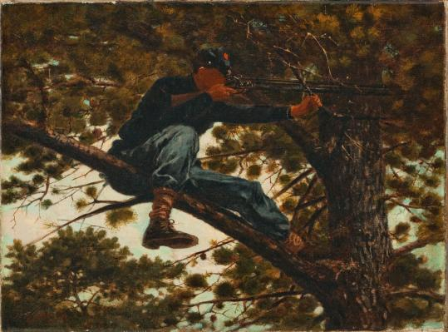
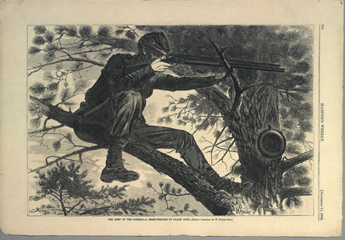
Winslow Homer, ‘Sharpshooter on Picket Duty’ (1862)

Slide 13
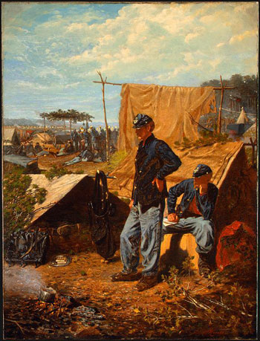
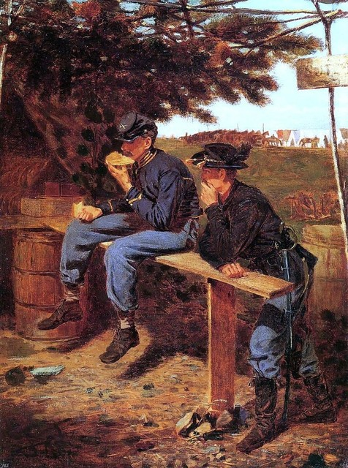
Winslow Homer, ‘Home Sweet Home,’
‘Rations’ (1863)

Slide 14
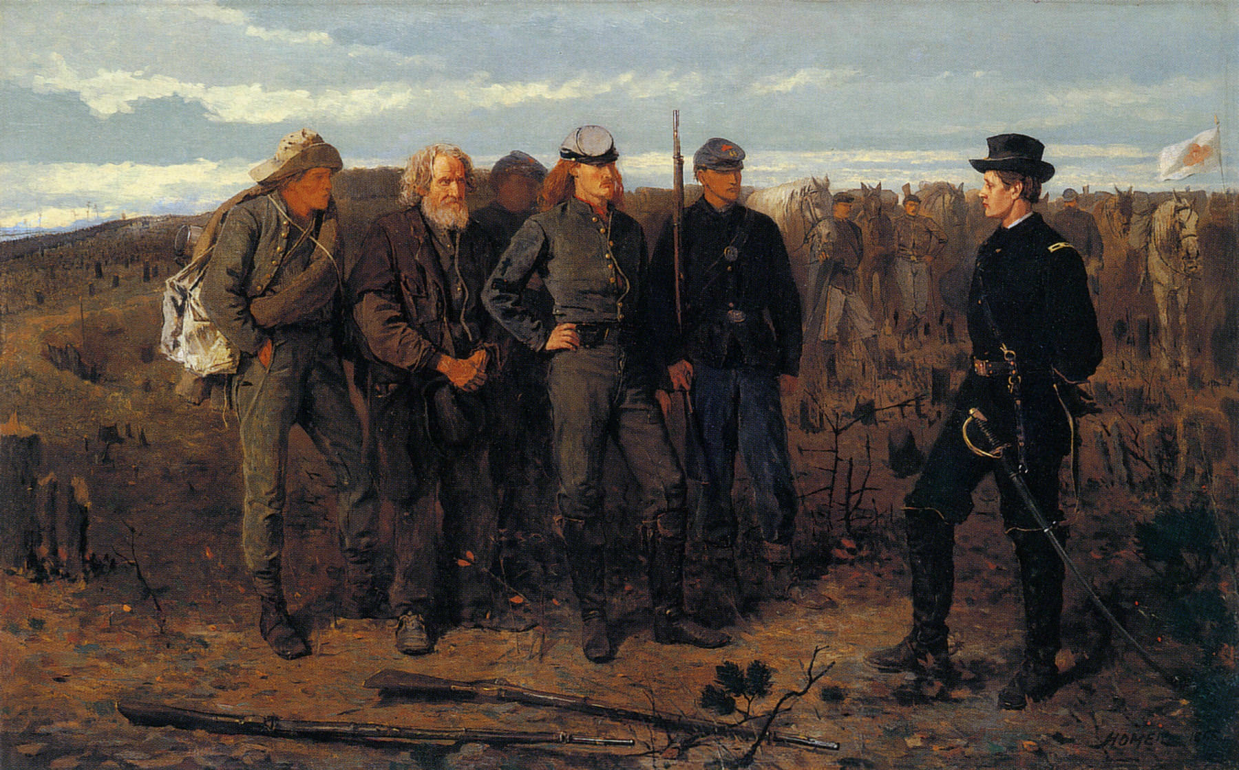
Winslow Homer, ‘Prisoners from the Front’ (1866)

Slide 15
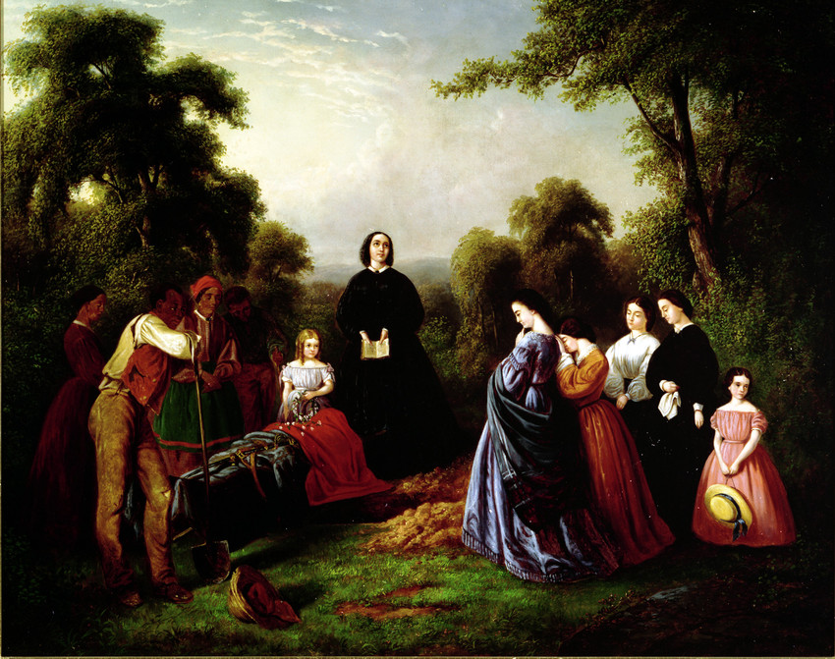
William DeHarburton Washington, The Burial of Latane’ (1864)

Slide 16
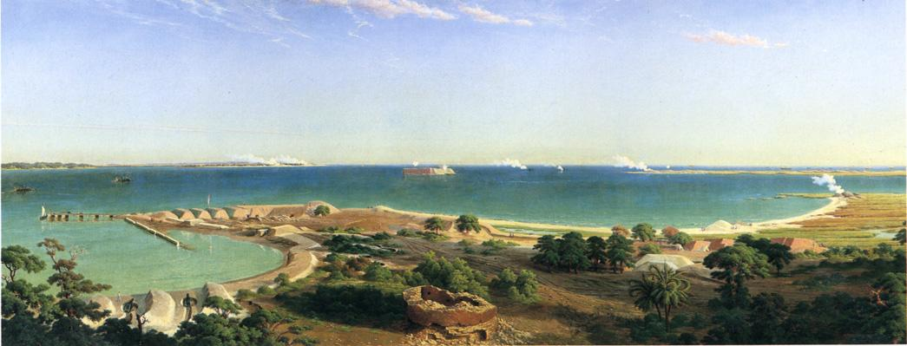
John Ross Key, ‘Bombardment of Fort Sumter’ (1865)

Slide 17
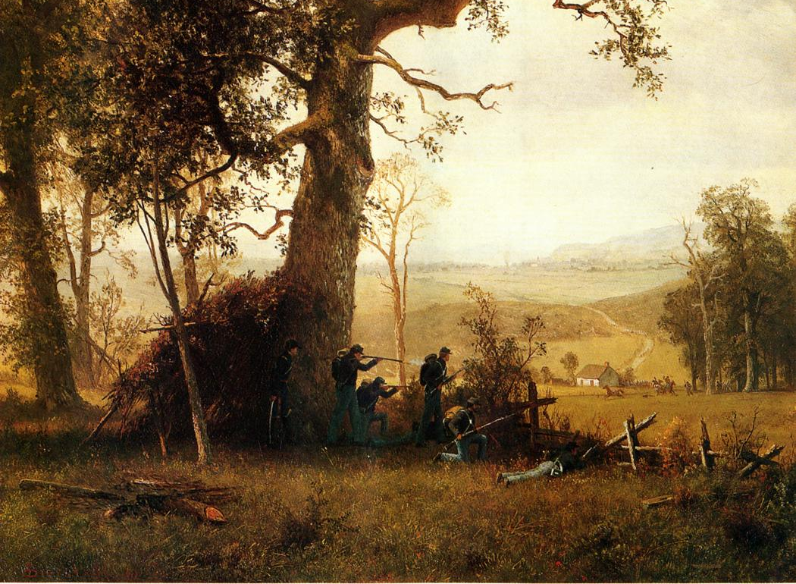
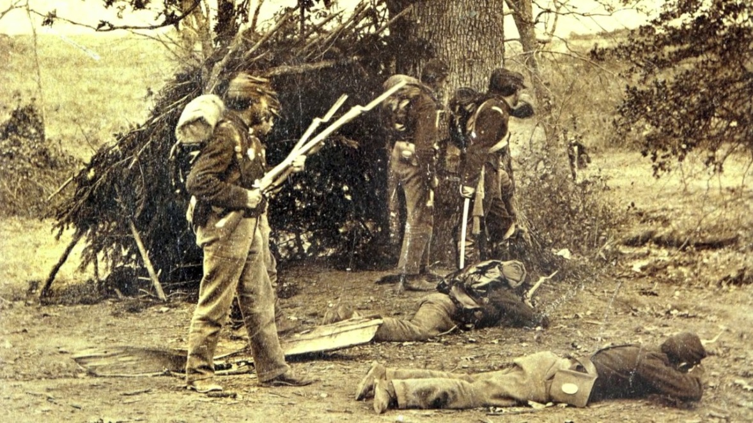
‘Guerrilla Warfare: Picket Duty in Virginia,’ Albert Bierstadt (1862); stereoscopic photograph by his brother Edward Bierstadt

Slide 18
How did representations of the Civil War in painting and photography compare and contrast with one another?
Did the advent of photography open up new possibilities for representing war, and if so in what ways?
Did photography open up possibilities for representing war which exceeded the potentialities of figurative painting?

Slide 19
Friday lecture
Required reading:
Tony Horwitz, ‘Confederates in the Attic’ and ‘Cats of the Confederacy’ in Confederates in the Attic: Dispatches from the Unfinished Civil War (Vintage: New York, 1999), pp. 3–44.
Kirk Savage, ‘The Politics of Memory: Black Emancipation and the Civil War Monument,’ in John R. Gillis ed., Commemorations: The Politics of National Identity (Princeton University: Princeton, New Jersey, 1994), pp. 128–147.

