Slide 1
Effective team working – presentation
Benefits of team working - Asif - 1715319
Stages of team development - Shareen – 1713331
Team roles- Asif - 1715319
Successful team development – Samad - 1714494
Managing conflict – Shareen - 1713331
Notes:
Hi my name is Asif Munshi and over here is Shareen Hussain and next to her is Abdul Samad
As you can see on this slide I will be covering what the benefits of team working and team roles are
Shareen will be covering stages of development and managing conflict and Samad will be covering successful team development.
Todays presentation we are here to consult on my wife’s home based fashion and gift hamper business that she has. This business has been operating for the last 6 months with 3 members in her team. We have considered all these key points in order to introduce effective team working that will help this business expand and grow and make it more profitable.

Slide 2
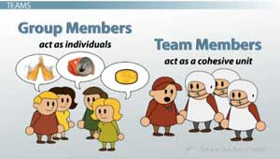
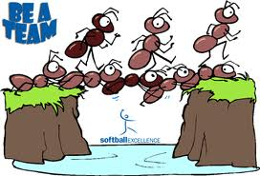
Difference between groups and teams
Groups | Teams
Individually accountable | Working jointly to maximise strengths and minimise weaknesses
More focused on individual goals | Team of people who share the same goal
Only one leader | More than one leader
There are 2 types of groups formal and informal | Sharing responsibilities
Notes:
What is the difference between being in a team or a group? As you can see on these slide being in a team or a group as they are very similar but they have there different aspects.
A group can be also defined as a collection of individuals who co ordinate there individual efforts
And a team is a group of people who share a common team purpose and a number of challenging goals.
What is formal group and informal group?
Formal groups when people come together to accomplish specific goals and objectives.
Informal groups are formed by the individuals they don’t have a organisational structure or management in place

Slide 3

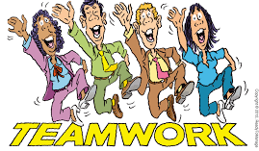
Benefits of Team working
Achieve goals quicker rather than on your own.
Getting better results.
Better productivity.
Work load becomes easier if divided between team members.
Better staff morale.
More creativity.
Notes:
What are the benefits of working in a team?
Organisations are much more likely to perform well when their people work effectively as a team. This is because good teamwork creates synergy – where the combined effect of the team is greater than the sum of individual efforts. Working together a team can apply individual perspectives, experience, and skills to solve complex problems, creating new solutions and ideas that may be beyond the scope of any one individual.

Slide 4
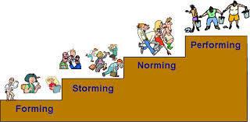
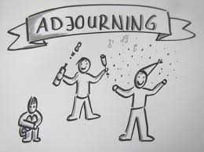
Forming stage
Storming stage
Norming stage
Stages of team development
Performing stage
Adjourning stage
Notes:
Forming stage – build structure and leadership, see what behaviours are acceptable, this stage is complete when everyone feels part of the group.
Storming stage – there is conflict over who will lead the group, everyone excepts being in a group, when this is complete you will know who the leader is.
Norming stage – Close relationships develop between the group-group is now stronger, this is complete when the group becomes solid and there are expectations set and what defines correct member behaviour.
Performing stage – At this point everything is fully functional, and the group is now able to understand each other.
Adjourning stage – Performing is the last stage-some members are upbeat, basking in the glory of the group accomplishments.

Slide 5
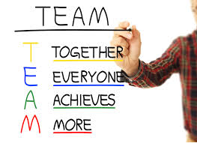
.
Stages of team development - how they help in our business?
Notes:
Stages of team development, everyone has built structure and understood what they're role is and what they have to do, there isn’t any conflict because everyone knows they're positions and what is required of them. All team member have become one and understand the end goal, everyone is fully functional and understand what needs to be achieved, towards the end the members are happy with the achievement they have done.

Slide 6
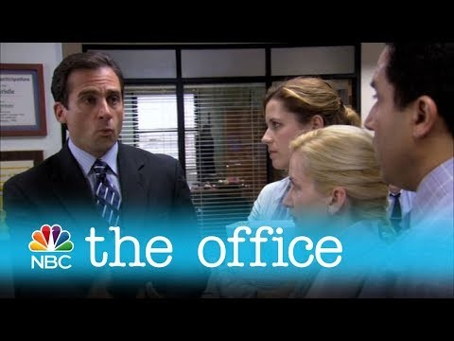
Managing conflict
What's managing conflict?
How does conflict happen?
How to resolve conflict?
Notes:
What is it? Turning negative aspects of conflict into positive aspects of conflict.
Why does it happen? Sometimes people clash as personalities are very similar, or it could be your personality is the complete opposite to another individuals and that also may lead you to clash and not get on.
How to resolve it? Try compromising as everyone's different, listen to what has been said and ask why and try to come up with a few different solutions that everyone can choose from, everyone put they're input into the few different solutions, and then finally try to agree to one at the end.
Acknowledge the conflict – has to be acknowledged to be resolved.
Understand the situation in hand.
Reach and agreement.

Slide 7
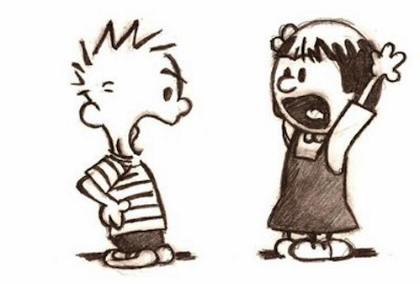
How to achieve in managing conflict?
Strong leadership.
Teams in which members values are different or opinions, tend to experience more conflict.
Leaders can get the group to focus on the task at hand and encourage group learning are able to reduce these conflicts and enhance discussion of group issues.
This Photo by Unknown Author is licensed under CC BY-NC-ND

Slide 8
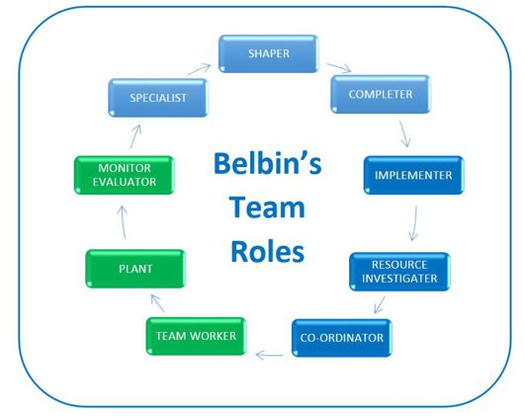
TEAM ROLES
Notes:
Belbin’s theory states that there are nine roles which need to be occupied within any team. These are: Shaper, Coordinator, Plant, Resource Investigator, Monitor Evaluator, Specialist, Team worker, Implementer, Completer Finisher
What is a team role?
Belbin and his team began to identify separate clusters of behaviour, each of which formed distinct team contributions or “Team Roles.” They defined a team role as: “A tendency to behave, contribute and interrelate with others in a particular way.
Belbin’s research also gives team members a common language to help individuals form productive working relationships, develop high-performing teams, raise self-awareness, identify talent, and aid in recruitment.

Slide 9

BENEFITS OF TEAM ROLES
Notes:
For a business like fashion & gift hampers
Team worker is essential because this keeps the team running smoothly any confrontation they would help parties understand one another
Also this business requires more complete finisher as you cant rely on 1 person all the time and The Completer Finisher has a strong inward sense of the need for accuracy, and sets his or her own high standards rather than working on the encouragement of others

Slide 10

SUCCESSFUL TEAM DEVELOPMENT
TEAMWORK
INOVATION
IDEAS
FUTURE PLANNING
LEADERSHIP
COMMUNICATION
Notes:
Thank you Shareen, successful team development there are many steps involved for the success of the fashion&gift hampers business because the business is at its early stages and consist of 3 employees each employee has many extra roles to develop and take on board

Slide 11
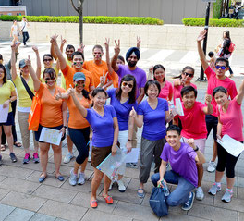
BENEFITS OF SUCCESSFUL TEAM DEVELOPMENT
Fosters Creativity and Learning. Creativity thrives when people work together on a team
Blends Complementary Strengths
Builds Trust
Teaches Conflict Resolution Skills
Promotes a Wider Sense of Ownership
Encourages Healthy Risk-Taking
Notes:
There are many benefits of successful team development's, as we can see on the slide these are only a few of many key points.
Working as a team allows team members to take more risks, as they have the support of the entire group to fall back on in case of any failure which makes it a healthy risk taking. (minimising stress levels)

Slide 12

conclusion
Notes:
To conclude fashion& gift hamper business is heading in the right direction there is a lot to improve on and develop. In terms of improving this business there needs to be an internet strategy a website in place a lot more marketing is required and being professional as possible and meeting those deadlines. Being a very young business overheads are very low and the forecast and planning going forward will need budgeting/premises and increase of overheads and staff and a full business plan which includes all this aspects thank you all for listening.

