Slide 1
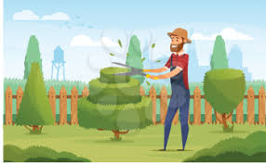
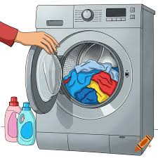
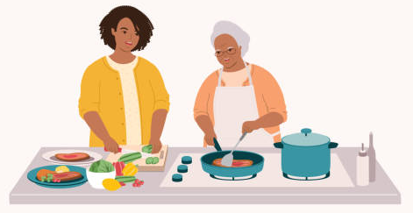

FUN-CTIONAL FRIDAY
GROUP!
Supported by people with lived experience of stroke recovery!
“Group peer support may improve stroke survivor’s activities of daily living and limb function, as well as decrease their depression and anxiety” (Wan et al 2021)
Bringing rehab into real life!
Build your
independence!
Boost your confidence!
Build your skill set!
…and sometimes we get cake!
Wan, X., Chau, J.P.C., Mou, H. and Liu, X. (2021) ‘Effects of peer support interventions on physical and psychosocial outcomes among stroke survivors: A systematic review and meta-analysis’, International Journal of Nursing Studies, 121, pp.10. Available at: https://doi.org/10.1016/j.ijnurstu.2021.104001.
Dorning, H., Davies, M., Ariti, C., Allen, K. and Georghiou, T. (2016) ‘Knowing you’ re not alone: Understanding peer support for stroke survivors Evaluation of Stroke Association Voluntary Groups Research report’. Pp.23. Available at: https://www.nuffieldtrust.org.uk/sites/default/files/2017-01/savgs-evaluation-main-web-final.pdf. (Accessed 14.03.2026)
The National Archives (2026) Social Services and Well-being (Wales) Act 2014. Available from: https://www.legislation.gov.uk/anaw/2014/4 (Accessed 14 March 2026).
Mohapatra, S. and Kulnik, S.T. (2020) ‘Kitchen-related tasks used in occupational therapy during rehabilitation of adults with acquired brain injury: A systematic review’, British Journal of Occupational Therapy, 84(1), pp.030802262095097. https://doi.org/10.1177/0308022620950975.
McLeod, S. (2025) Albert Bandura’s Social Learning Theory. Simply Psychology. Available at: https://www.simplypsychology.org/bandura.html (Accessed 14/03/2026)
SCIE (2022) Co-production: What It Is and How to Do It | SCIE. Social Care Institute for Excellence (SCIE). Available at: https://www.scie.org.uk/co-production/what-how/. (Accessed 15.03.26)

