Slide 1
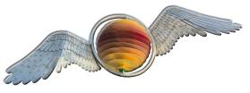


Mike Durke
CEO
Communities First Co-ordinator
The Hill Community Development Trust Ltd
24th February 2011
Notes:
1

Slide 2
Links
The Big Society Network
Development Trusts Association
Social Enterprise Coalition
Communities First in Wales
The Mutual State (2001)
- New Economics Foundation

Slide 3
The Hill CDT Ltd
Company set up in September 2000 to build on the URBAN Community Initiative foundation
Company limited by guarantee with charitable aims
Community Development Trust (PCDT)
Townhill Ward – 3 communities

Slide 4
Vision
To work with the community and a wide range of colleagues towards the common aim of making the Hill a wealthier, happier, healthier and safer place to live and work

Slide 5
Board
Maximum of up to 21 directors with independent Chair
3 categories stipulated in M&As
Advisors – some invited to each monthly board meeting, others as and when required
Observers
Communities First Partnership Board for Townhill

Slide 6
Phoenix Centre
13 business units
Playground
All weather sports pitch with floodlights plus changing rooms
Townhill library
Conference rooms
Paradise Children’s Nursery
Community café with catering service

Slide 7
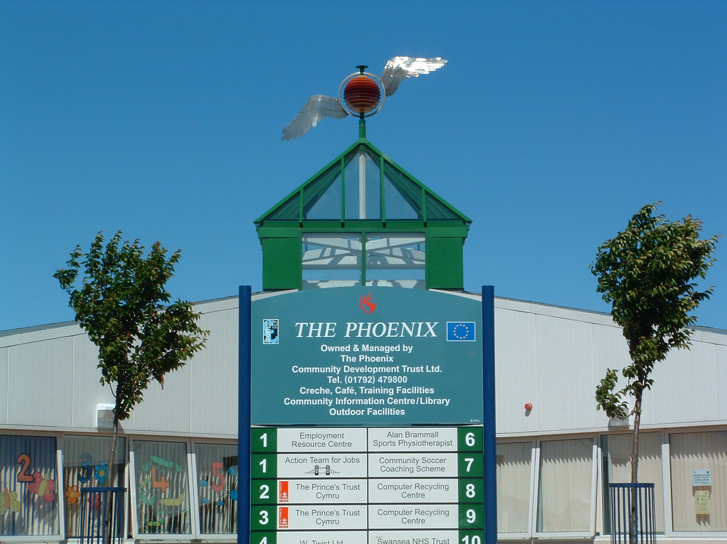
The Phoenix Centre

Slide 8
Phoenix Centre
Opened by PM Tony Blair in March 2001
Dual challenge:
To meet community need
To generate an income stream and reduce dependency on government grants
From a standing start we generate £250,000 of our own funding each year

Slide 9
From the air

Slide 10
Estate Origins
Ref. Homes for Heroes – Nigel Robbins – we are part of a long story
Victorian slum dwellings
Garden City movement from 1850s on
South Wales Cottage Exhibition (summer 1910)
2 Housing committee councillors (Ruthen and Solomon) attended a housing reform conference in 1906
Council at cutting edge!
First Council house in Mayhill 1914

Slide 11
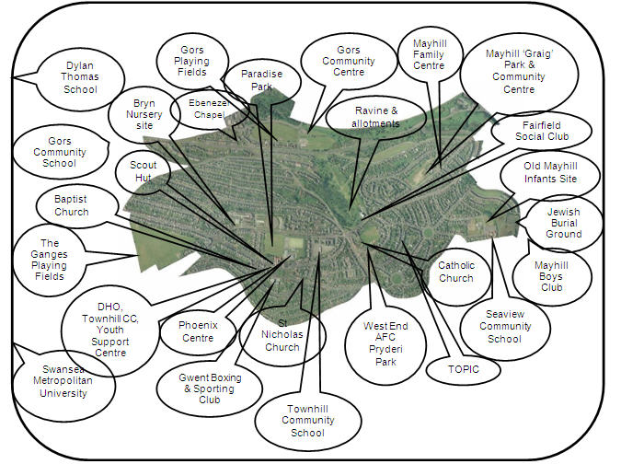

Slide 12
Why?
Statistical evidence of deprivation suggests we can draw lines on maps around the most deprived communities. These communities suffer from the effects of multiple-deprivation
Welsh Index of Multiple Deprivation
‘Mayhill’ looks very different to ‘Mayhill’ on the Index but they are within 3 miles of each other
Some parts of the Hill have the worst level of child poverty of anywhere in Wales

Slide 13
Multiple Deprivation
LSOA (areas) | Overall | Income | Employment | Health | Education, Skills and Training | Housing | Physical Environment | Geographical Access to Services | Community Safety
Townhill 1 | 6 | 4 | 17 | 60 | 6 | 677 | 1682 | 1185 | 6
Townhill 2 | 37 | 5 | 46 | 288 | 33 | 348 | 1738 | 1438 | 449
Townhill 3 | 20 | 13 | 32 | 146 | 8 | 503 | 1598 | 1342 | 14
Townhill 4 | 428 | 253 | 499 | 752 | 125 | 1010 | 1717 | 1612 | 944
Townhill 5 | 57 | 67 | 72 | 82 | 30 | 474 | 1637 | 1651 | 240
Townhill 6 | 74 | 15 | 155 | 249 | 53 | 808 | 1657 | 1455 | 212

Slide 14
Mayals
LSOA (areas) | Overall | Income | Employment | Health | Education, Skills and Training | Housing | Physical Environment | Geographical Access to Services | Community Safety
Mayals 1 | 1728 | 1553 | 1507 | 1669 | 1855 | 1716 | 1287 | 314 | 1770
Mayals 2 | 1833 | 1847 | 1822 | 1752 | 1861 | 1863 | 1846 | 411 | 1875

Slide 15
Child Poverty
.

Slide 16
We need to take a target rifle to issues of deprivation, and put away the blunderbuss.
Let’s pin-point the issues from the perspective of the professionals and the people then see what can be done to make a measurable difference

Slide 17
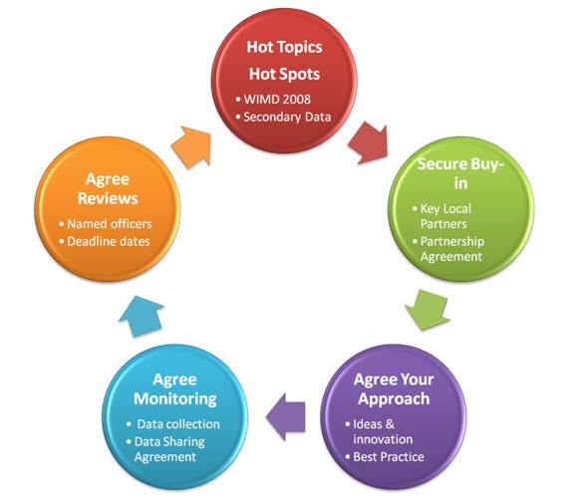
5 Steps of Street Level Performance Management

Slide 18
Jobseeker’s Allowance?
If a family with two children are on benefits they will receive money from the government and allowances for rent, school meals etc.
The household income would have to be circa £23k to meet what the benefit system provides
Quite a challenge for people who may never have worked, who may have numeracy and literacy difficulties, who have never known life in a working household

Slide 19
Particular geographical areas are a melting point for economic and social issues, with huge public service dependency
Reduce dependency – save money

Slide 20
Where’s the money?
If the 157 Communities First partnerships in Wales generated £250,000 of their own income this would create a revenue stream of £39 million. If the 10% most deprived communities in England followed suit this would amount to over £800 million
If benefit claimants could be reduced by 10% year on year in 5 years this would represent a saving of around £7 million for Townhill. The same thinking applied to all Communities First areas in Wales would bring savings of over £ 1 billion. For the UK this could amount to around £20 billion.
How big would the potential savings be if we did the same back of an envelope exercise for all areas of public service delivery?
Crime - £60 billion with 40% committed in 10% poorest areas!! (£24billion)

Slide 21
Assumption
The social enterprise model shows there are alternatives to the traditional top-down approach to public service delivery, and we believe that if we can explore these potentials together then we can make some transformational improvements not just to Townhill, Mayhill and Gors, but also to Swansea, Wales and the UK.

Slide 22
Thanks

