Slide 1

MANAGING BUSINESS INFORMATION
LCLM_5004
DR. AMER KAREEM
Ion Jechiu - 2337010
Ottavio Altana - 2331607
Ioan-Stefan Madaras - 2332801
Luiza Florentina Pascu - 2246735
Cristina Graur - 2332971
Group Presentation on
Different Information Systems

Slide 2

Summary
Business information systems
Types and their key functions
Benefits and limitations
Ethical and real-world applications
Conclusion & Recommendations
Notes:
Businesses use information systems in order to handle data and ensure smoother operations. These systems are also helpful for leaders in making smart choices. In this presentation, systems such as TPS and ERP, among others will be examined along with comparing their functions. Ethical and security considerations will be explored and real-world examples will be presented. Organisations are able to choose the rights tools when they understand these systems. This further enables them to drive efficiency along with improving experiences of the customers. In the long term, organisations are able to maintain a competitive edge in their respective market.

Slide 3
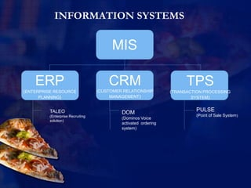
Introduction of information systems
Support business operations (Ozay et al., 2024).
Efficiency and decision-making.
Customer experience and competitive advantages.
Drive growth and adaptability.
EXAMPLES
Role of Information Systems (Ozay et al., 2024)
Notes:
Information systems are essential for modern businesses to run in a smooth manner. Using these systems, they collect and handle data from different parts of the company. This makes it easier for workers and managers to make quick and smart decisions. These systems are helpful in saving time along with reducing mistakes (Soori et al., 2024). Using these systems, daily tasks can be made more efficient. They also improve efficiency of services for customers by offering faster help. Customers are also able to receive personalised experiences. Further, these systems give useful insights to businesses which help them in staying ahead of competitors. Every type is employed in improving efficiency along with supporting decision-making. They also enhance engagement of customers in unique ways (Alawamleh et al., 2021). Therefore, right system is important for companies so that it can perform better.

Slide 4

ERP System Analysis
Connects core processes
Streamlines workflows
Grows with your Business
Enables better decisions
Requires planning and resources
ERP systems; (Vassilakopoulou and Hustad, 2023)
Notes:
ERP systems are essential for ensuring improvements in the efficiency of an organisation. Using these systems, teams are also able to collaborate. Major business-related processes are integrated in this namely- finance, operations, and HR into one platform. In this way, sharing of data is ensured between departments. This, in turn, allows the management to make good decisions. However, high investments is required for these systems along with offering training to the staff.

Slide 5

Transaction Processing System Analysis
Handles daily tasks such as sales, billing, and payroll.
Ensures data accuracy and timely processing.
Supports smooth workflow and operational efficiency.
Maintains reliable business records automatically.
TPS; Source: Mulaydinov (2024)
Notes:
Different types of information systems are helpful for businesses in different ways. Each supports business operations differently, from routine tasks to strategic decision-making. TPS (Transaction processing system) can handle routine transactions which ensures accuracy and efficiency.

Slide 6

Management Informaton Systems Analysis
Gather and process business data (Pearlson et al., 2024).
Convert raw data into meaningful reports.
Assist managers in evaluating performance.
Support planning, controlling, and decision-making.
It help identify trends and improve business efficiency.
MIS; Source: (Pearlson et al., 2024)
Notes:
MIS (Management information system) collects and organises data in order to create reports that aid managers in understanding the ways in which the business performs (Vassilakopoulou and Hustad, 2023).

Slide 7
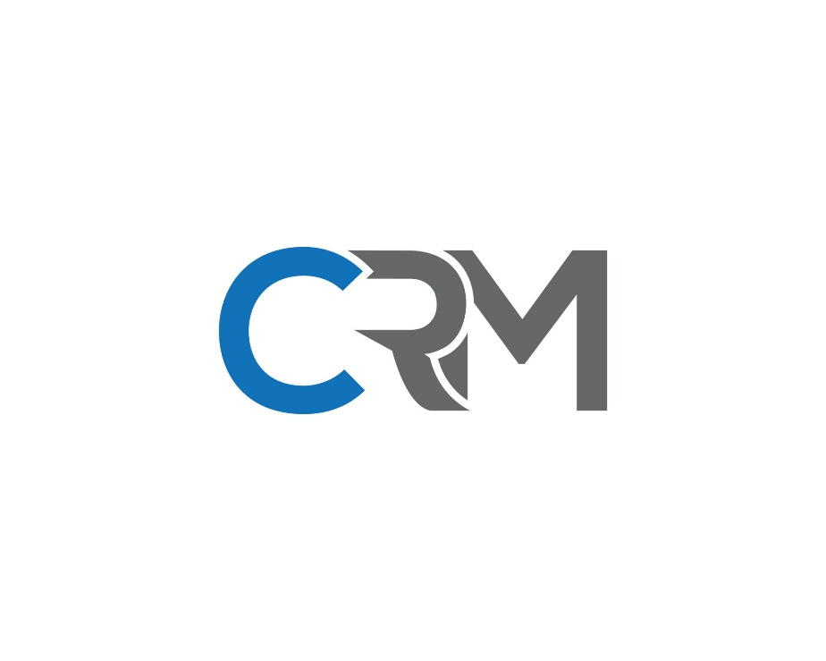
CRM System Analysis
Manages customer interactions.
Analyses data across the customer lifecycle.
Helps businesses understand customer needs and behaviour.
Boosts satisfaction, loyalty, and sales performance.
Centralises data and automate communication for efficiency.
Source: (Wahsheh et al., 2023)
Notes:
CRM (Customer relationship management) keeps track of customer interactions so that services can be improved and loyalty can be built. Business operations can be optimised using the right combination (Wahsheh et al., 2023). Through comparison of these systems, best fit for the company can be found.

Slide 8
Comparison in information systems
System | Function | Benefits | Limitations
ERP | Integrates all business processes | Enhances efficiency and data accuracy | High cost, complex implementation
TPS | Automates daily transactions | Efficient, accurate, reduces errors | Limited strategic insight
MIS | Supports management decisions | Aids strategic planning and reporting | Limited flexibility and customization
CRM | Manage costumers interactions | Improve customer retention and loyalty | Data privacy concerns
Notes:
ERP is helpful in the integration of functions like finance, HR, and logistics. This is effective in improving efficiency, however, the implementation-related costs is quite high. On the other hand, CRM focuses on developing relationships with the customers. These systems work toward boosting satisfaction and loyalty. However, it is not without challenges related to data security. Whereas, MIS turns daily data into reports. These reports, then can be monitored to check the performance of the business. However, when solving complex issues, this system is quite ineffective (Mulaydinov, 2024). These systems give deeper insights as well as more options. However, these systems are costly and hard to be set up. Such differences of these systems are important to be identified so that best ones can be selected. The correct system will improve daily working as well as long-term planning of the company.

Slide 9
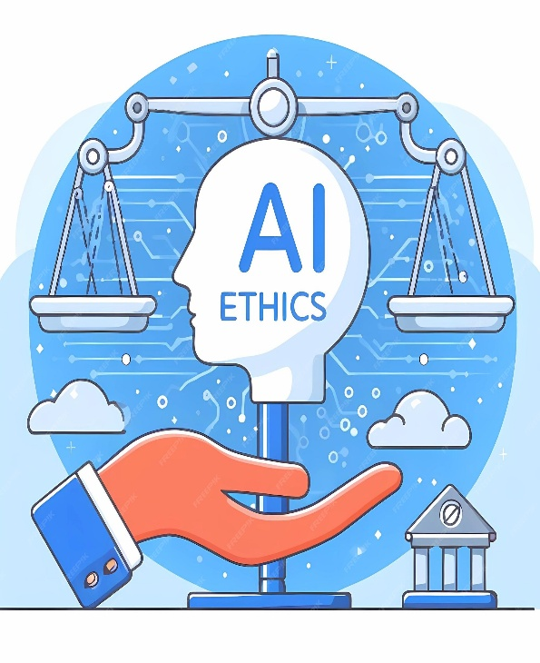
Ethical considerations
Ethical data use is essential.
Tech raises privacy risks.
AI bias and monitoring are key issues.
Responsible use builds trust.
Ethics promote fairness and sustainability.
(Pearlson et al., 2024)
Notes:
Numerous ethics are involved when using information systems. When using such systems, companies are required to ensure the protection of data of customers and employees. When saving data, privacy has also to be ensured (Valacich and Schneider, 2022). Further, potential biases can be introduced by AI-driven systems. Watching employees too closely can also be seen as unfair or even illegal. Problems can be avoided and trust can be maintained by following clear rules. Businesses should also be honest with the ways they are using these systems. This, in turn, will ensure fairness and safety of the business.

Slide 10

Ethical considerations
Strengthen data security.
Perform regular audits.
Monitor AI fairness.
Train staff on ethics.
Promote responsible use.
(Wahsheh et al., 2023).
Notes:
Risks can be addressed by businesses through the implementation of strong cybersecurity (Ozay et al., 2024). They can also check their systems regularly along with monitoring the fairness of the results produced by AI. It is also important to offer training to employees. In this way, they will be able to handle the data properly. Clear rules can be established about privacy. Using these steps, trust among stakeholders is built (Soori et al., 2024). These strategies will also ensure that the regulations are followed. In this way, businesses can enhance their reputation in the market.

Slide 11

Real world case studies
Information Systems at Amazon
TPS- Manage and track customer orders.
MIS- Analysing performance, generating reports.
ERP- systems streamline supply chain, finance, and inventory.
CRM- Customer engagement and satisfaction
Notes:
Amazon show that the smart use of information contributes to boosting business. Daily orders as well as sales are handled by TPS. Whereas, MIS is helpful for the management in keeping a track on the performance. ERP systems are used by Amazon by integrating as well as managing its supply chain and finance. In this way, smooth coordination is ensured. Using CRM systems, the company is able to strengthen its relationships with customers. This is done by keeping a track on preferences as well as personalising services (Vassilakopoulou and Hustad, 2023). The company faces risks such as data breaches and biases introduced by AI. But, these issues are managed with the help of strong security as well as ethical rules. Efficiency of the business is improved by these systems.

Slide 12

Real world case studies
Information Systems at Walmart
TPS- Handle daily sales transactions.
MIS- Monitor and analyse sales performance.
ERP- Coordinate supply chain, finance, and inventory operations.
CRM- Builds customer loyalty through personalized service.
Key challenges are data privacy and bias. (Wahsheh et al., 2023).
Notes:
Walmart shows that business can be made efficient by using good information systems. Therefore, TPS used in the company so that its sales can be managed. Performance is tracked using MIS. Using ERP systems, Walmart streamlines its logistics. This also allows the company to reduce its operational costs. Further, CRM systems are essential for the collection and analysis of data of customers. With the use of technology, there are risks related to data breaches, but the company is able to manage its using strong measures for security as well as ethics.

Slide 13
Conclusion
Operational efficiency
Strategic decision-making
Customer satisfaction
Responsible and transparent technology usage
Maximize benefits and minimize potential business risks
Notes:
From this presentation, it is clear that the selection of the right information system is helpful for businesses in ensuring their better working. Using such systems, they are also able to make smart decisions. Companies should think about what each system does in order to use them in a responsible manner. It is also important to know about their pros and cons, as well as ethical issues involved. Through real-life examples, it has been depicted that long-term success can be ensured. Further, it is also important to keep these systems secure so that the business can stand out in the modern world.

Slide 14
Recommendations
TPS = daily operations
01
MIS = performance
02
ERP = integration
03
CRM = customer relationships and loyalty
04
Regular updates, employee training, and cybersecurity = productivity and competitive advantage
05
Notes:
Companies should make use of TPS so that their performance can be enhanced. Using this system, transactions can be managed in an effective manner. Further, MIS can be used for the analysis of performance and ERP for business integration. On the other hand, CRM systems has use for obtaining understanding as well as engaging customers. Also, information can be protected through the implementation of strong cybersecurity protocols. Companies should also consider the usage of ethical practices for the management of data.

Slide 15
References
Alawamleh, H.A. et al. (2021) The challenge, barriers and advantages of management information system development: Comprehensive review. Academy of Strategic Management Journal, 20(5), 1-8.
Mulaydinov, F. M. (2024) Integrated information systems in industrial enterprises and business activities. University Research Base.
Ozay, D. et al. (2024) Artificial Intelligence (AI)-based Customer Relationship Management (CRM): a comprehensive bibliometric and systematic literature review with outlook on future research. Enterprise Information Systems, 18(7), 2351869.
Pearlson, K. E., Saunders, C. S., and Galletta, D. F. (2024) Managing and using information systems: A strategic approach. John Wiley & Sons.
Soori, M. et al. (2024). AI-based decision support systems in Industry 4.0, A review. Journal of Economy and Technology.
Valacich, J. S., and Schneider, C. (2022) Information systems today. Pearson Education, Limited.
Vassilakopoulou, P., and Hustad, E. (2023) Bridging digital divides: A literature review and research agenda for information systems research. Information Systems Frontiers, 25(3), 955-969.
Wahsheh, F. R. et al. (2023, October) Operational Level System: Transaction Processing System and Decision Making. In 2023 International Conference on Computer Science and Emerging Technologies (CSET) (pp. 1-7). IEEE
Notes:
Alawamleh, H. A., ALShibly, M. H. A. A., Tommalieh, A. F. A., Al-Qaryouti, M. Q. H., and Ali, B. J. (2021). The challenges, barriers and advantages of management information system development: Comprehensive review. Academy of Strategic Management Journal, 20(5), 1-8.
Mulaydinov, F. M. (2024). Integrated information systems in industrial enterprises and business activities. University Research Base.
Ozay, D., Jahanbakht, M., Shoomal, A., and Wang, S. (2024). Artificial Intelligence (AI)-based Customer Relationship Management (CRM): a comprehensive bibliometric and systematic literature review with outlook on future research. Enterprise Information Systems, 18(7), 2351869.
Pearlson, K. E., Saunders, C. S., and Galletta, D. F. (2024). Managing and using information systems: A strategic approach. John Wiley & Sons.
Soori, M., Jough, F. K. G., Dastres, R., and Arezoo, B. (2024). AI-based decision support systems in Industry 4.0, A review. Journal of Economy and Technology.
Valacich, J. S., and Schneider, C. (2022). Information systems today. Pearson Education, Limited.
Vassilakopoulou, P., and Hustad, E. (2023). Bridging digital divides: A literature review and research agenda for information systems research. Information Systems Frontiers, 25(3), 955-969.
Wahsheh, F. R., Marie, Z., Farea, M. M., Al-Haithami, W. A., Mohamad, F. S., and Bisht, N. (2023, October). Operational Level System: Transaction Processing System and Decision Making. In 2023 International Conference on Computer Science and Emerging Technologies (CSET) (pp. 1-7). IEEE.

Slide 16



