Slide 1
Periodic table
HNC Y1 2024
Lecture 2
Dr Ewa Kazimierska
e.kazimierska@uwtsd.ac.uk
Notes:
one of the absolute most important lessons for anybody who is just starting to learn chemistry because here we take apart and disassemble and examine and understand the periodic table which is something you have to become friends with to do any chemistry.
in the beginning, when you look at a periodic table it just looks like a chart with squares on it

Slide 2

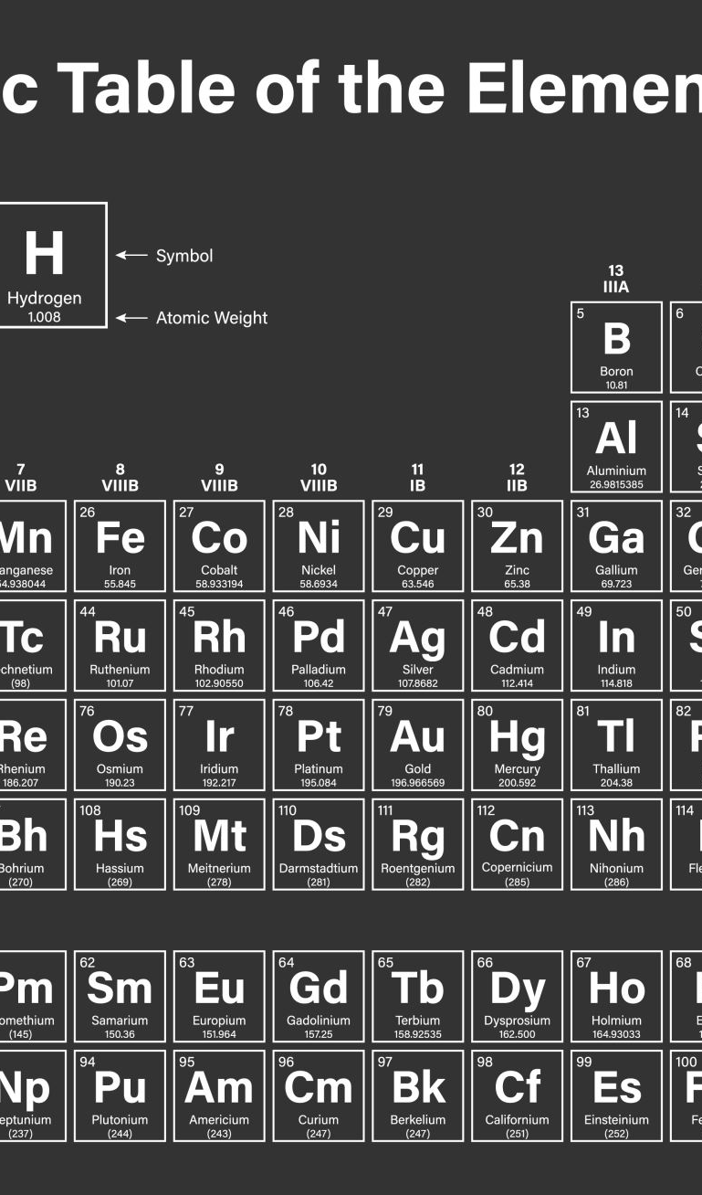
Objectives
why do we need a periodic table?
how is the periodic table organised?
how to classify the elements by family name, group number, and period number
how the physical properties of the elements change within a period (metals, nonmetals, metalloids)
definitions: element, atom, subatomic particles, isotopes, etc
Notes:
but then at the end of this lesson the goal is going to be to take that apart and understand why it's constructed the way it is, what value does it bring, why do we care about it, how do we use it and a few other things along the way as well

Slide 3
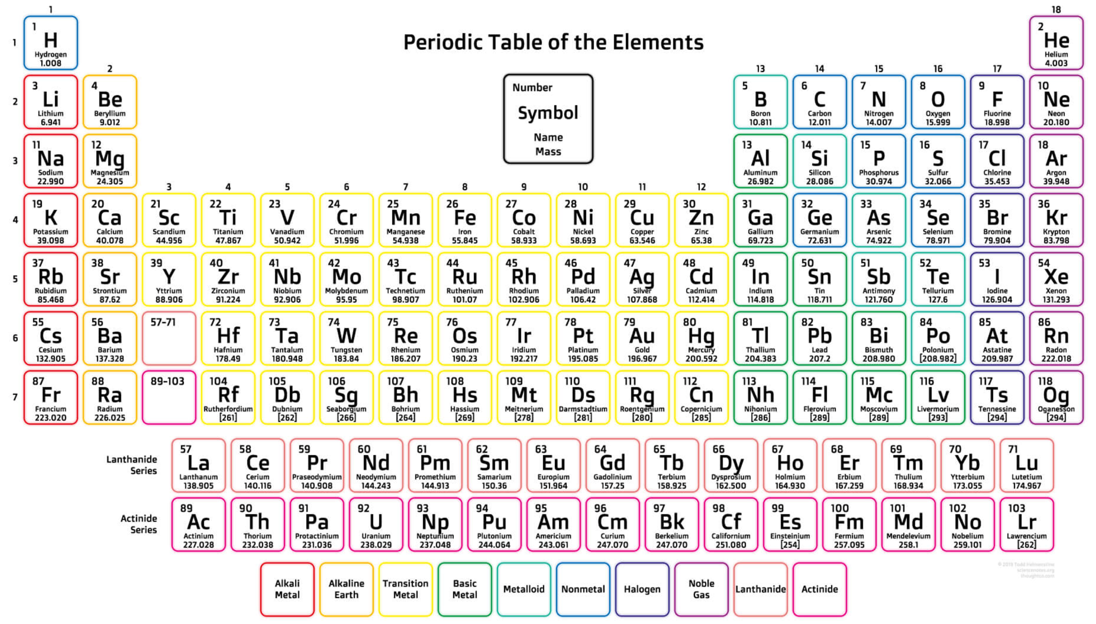
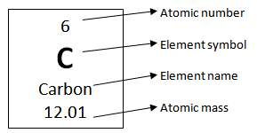
PERIODIC TABLE –BASIC TOOLBOX OF EVERY CHEMIST
Notes:
What can you see when you look at the periodis table?

Slide 4
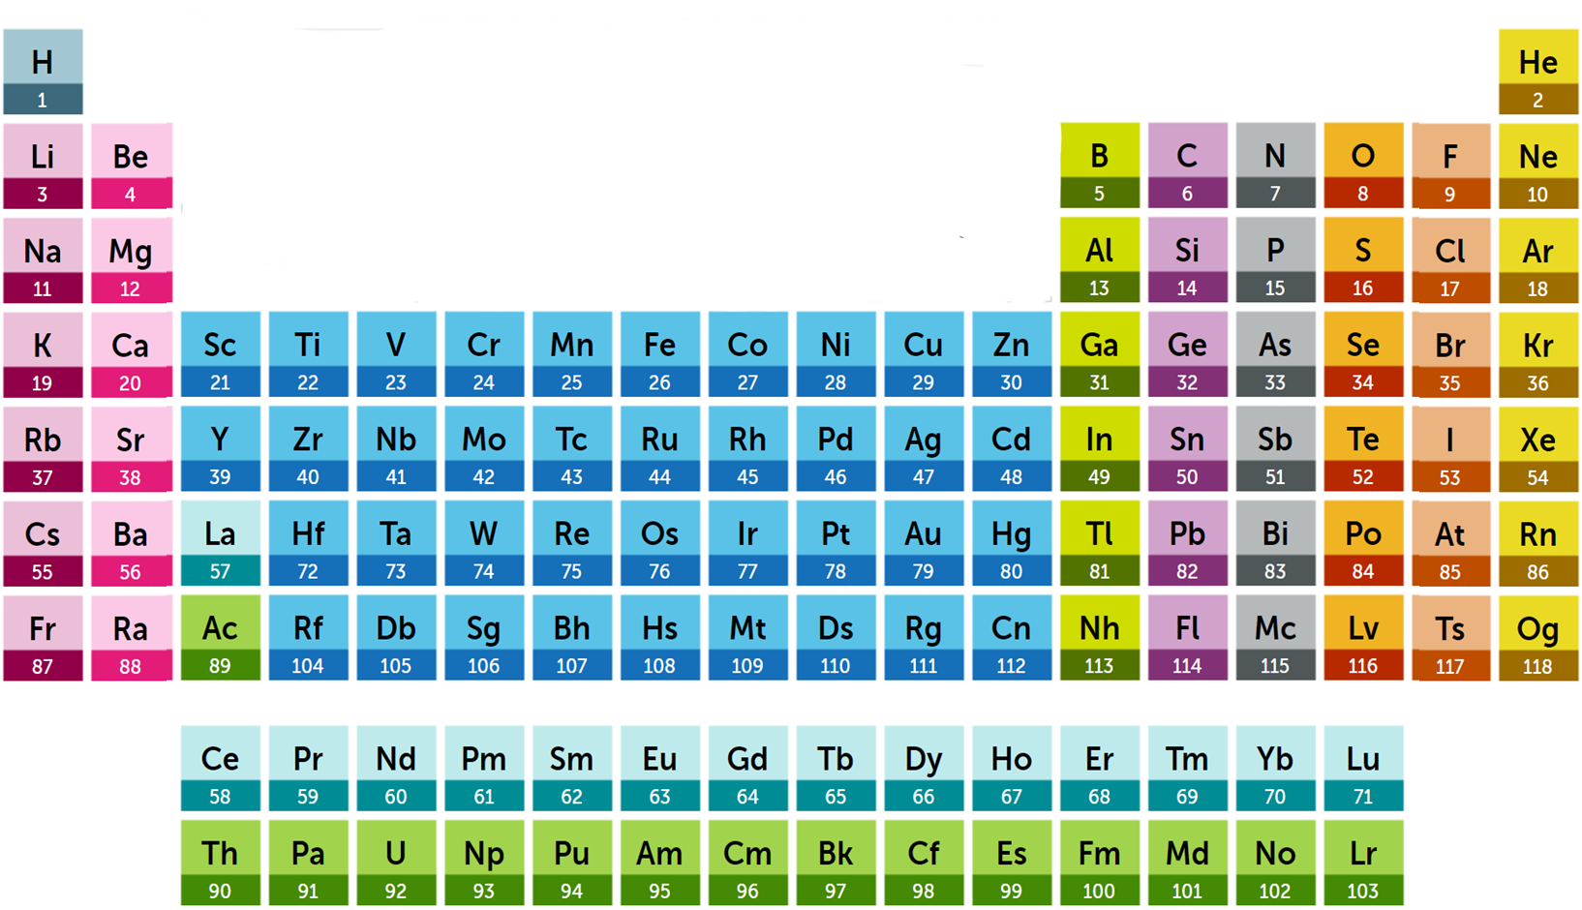
PERIODIC TABLE OF ELEMENTS
https://www.rsc.org/periodic-table

Slide 5
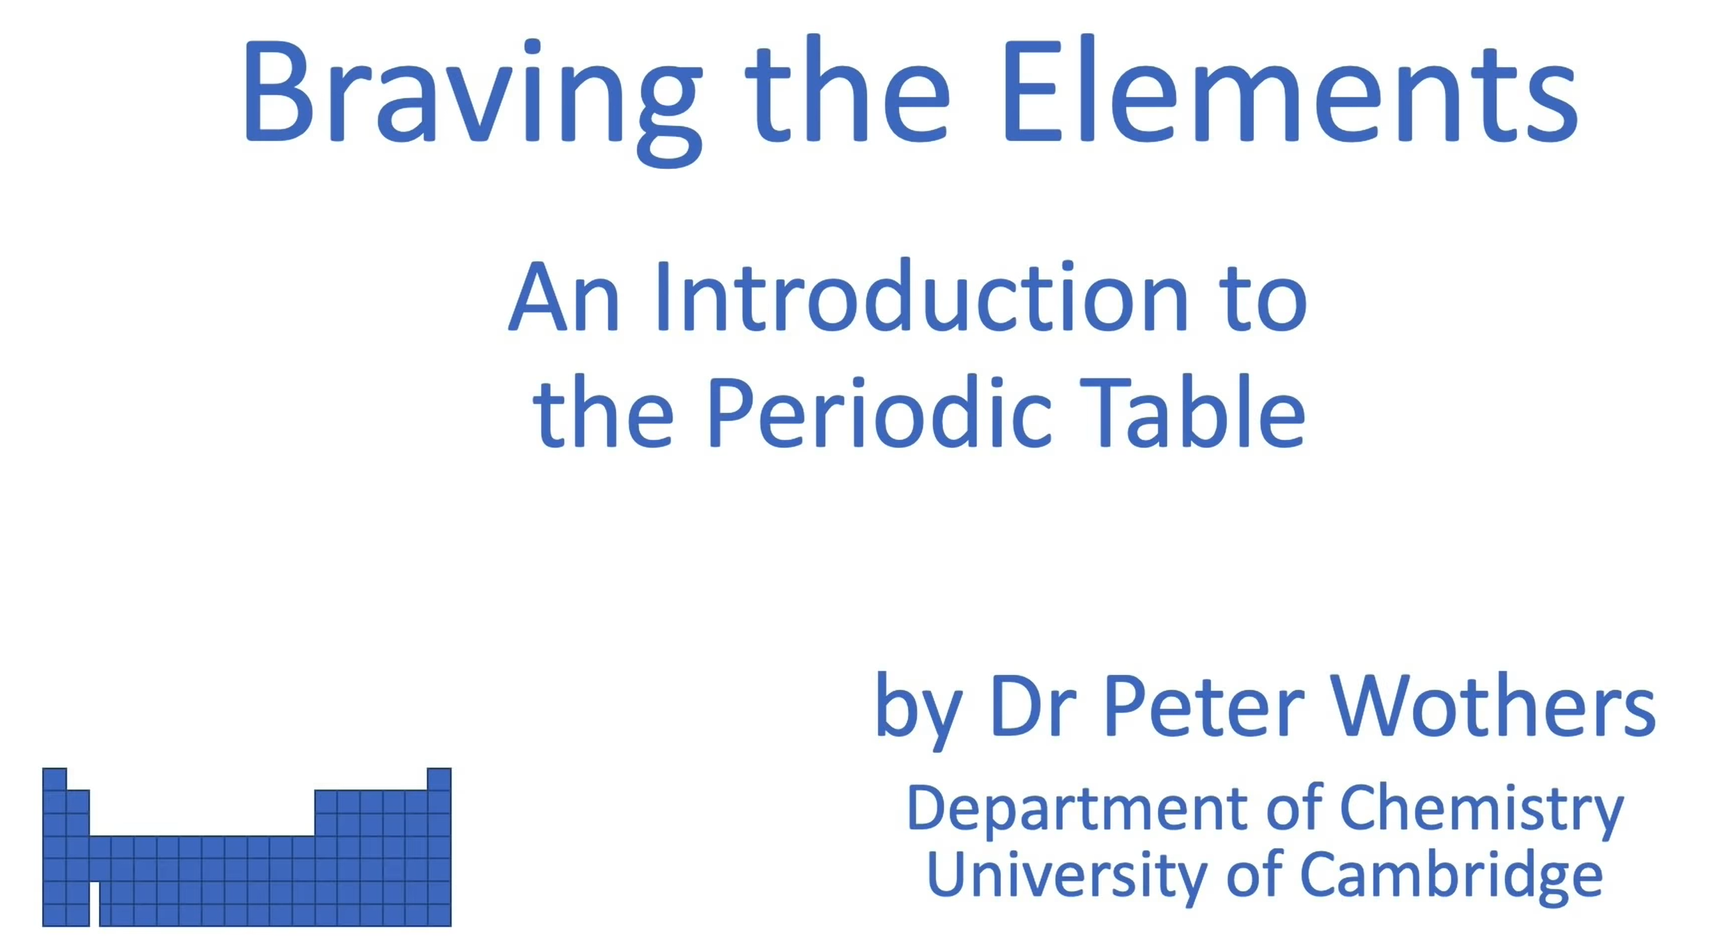
Why do we need a periodic table?
Organised to provide a great deal of information about elements and how they relate to one another
Elements within a specific group have similar chemical properties
Provides information on relative size, ionisation energy, electronegativity, metallic/nonmetallic character, etc.
.
OME related questions:
Why NH₃ is stable and NCl₃ is not?
Why is nitrogen used in explosives?
Why can carbon form only four bonds in high-energy materials?
Why white phosphorus is more reactive than red?
https://youtu.be/kqe9tEcZkno
Notes:
Why NH₃ is stable and NCl₃ is not? Ammonia (NH₃) is stable because nitrogen (N) forms strong covalent bonds with hydrogen (H), resulting in a stable molecule which does not readily decompose under normal conditions. On the other hand, nitrogen trichloride (NCl₃) is unstable (highly reactive) because chlorine (Cl) is more electronegative than nitrogen. This results in a polarized N-Cl bond, making the molecule prone to decomposition and explosive sensitivity; NCl₃ can decompose explosively even with slight disturbances. There is also effect of size; H is much smaller than Cl. With Cl there is large steric hindrance.
Why is nitrogen used in explosives? Nitrogen is used in explosives primarily because when suchmolecules detonate they release large amounts of energy related to the formation of the strongest N-N triple bond. Additionally, nitrogen gas (N₂) makes up about 78% of Earth's atmosphere, making it readily available for the production of explosives.
Why carbon can form only four bonds in high-energy materials? Carbon can form only four bonds in high-energy materials due to its electron configuration and the concept of valency. Carbon has four valence electrons, allowing it to form up to four covalent bonds with other atoms. This tetrahedral arrangement of bonds is stable and maximizes electron density around the carbon atom. While carbon atoms can form double or triple bonds in certain molecules, such as in alkenes or alkynes, the formation of such bonds does not contribute to the stability of high-energy materials, where single bonds predominate.
Why white phosphorus is more reactive than red? White phosphorus (P₄) is more reactive than red phosphorus because of its molecular structure and higher energy content. White phosphorus exists as discrete tetrahedral P₄ molecules, which are highly strained due to the presence of weak P-P bonds. This strain makes white phosphorus highly reactive and prone to spontaneous combustion upon exposure to air. In contrast, red phosphorus has a polymeric structure with stronger P-P bonds, resulting in lower reactivity and greater stability. Red phosphorus is used in safety matches and as a less reactive form of phosphorus in various applications.

Slide 6
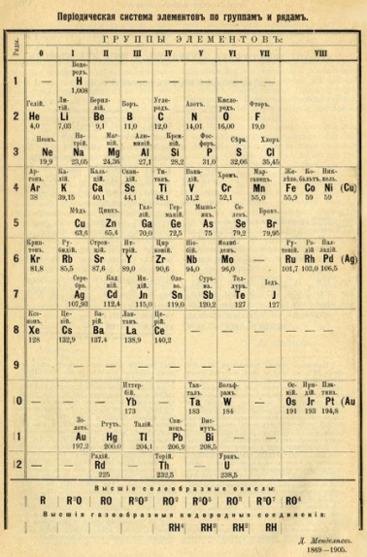
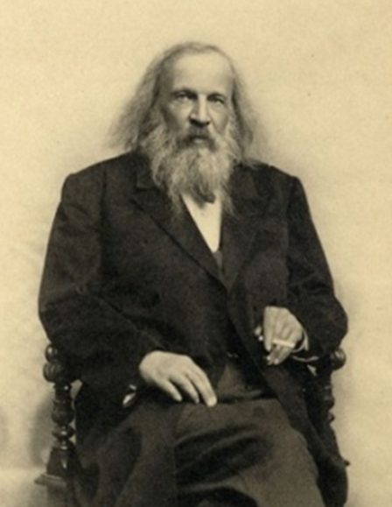
1869 – Dmitri Mendeleev
created the framework that became the modern periodic table
arranged 63 known elements according to their atomic weight* and similar properties
left gaps for elements that were yet to be discovered
WRONG!
1834-1907
nominated for Nobel Prize 9 times but never won
He was vindicated by the discovery of Germanium in 1885

Slide 7
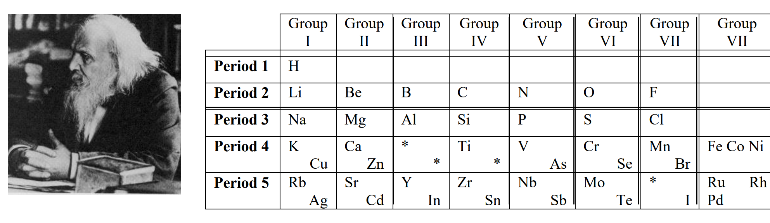
Can you work out the missing elements?
Sc
Scandium 1879
Ge
Germanium1886
Ga
Gallium 1875
Tc
Technetium 1937

Slide 8

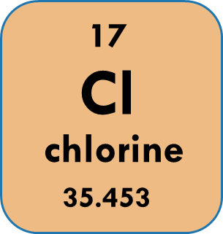
PERIODIC TABLE OF ELEMENTS
groups
periods
element box
https://www.rsc.org/periodic-table

Slide 9

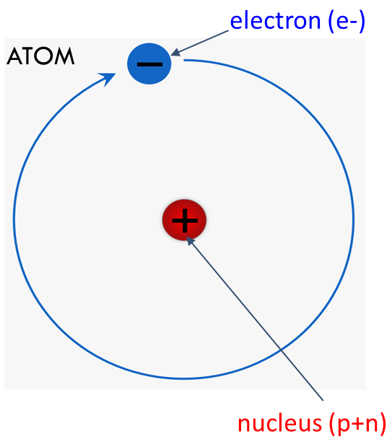
Few definitions as reminder
ELEMENT:
a substance that cannot be broken down into any other substance
a building block of matter
ATOM:
the smallest unit of a chemical element
atoms of the same element have the same size, average mass, and other properties
There are 92 elements occurring naturally on Earth (118 total)
Elements formed in the process of fusion of He and H
the subatomic particles: proton, neutron (both in nucleus), electron (elementary particle)
Every element is made up of its own type of atom therefore the chemical elements are all very different from each other

Slide 10
Groups (columns) in Periodic table
1
18
IA
0
2
GROUPS
13
14
15
16
17
IIA
Old IUPAC (UK, Europe)
New IUPAC
IIIA
IVA
VA
VIA
VIIA
3
4
5
6
7
8
9
10
11
12
IIIB
IVB
VB
VIB
VIIB
VIII
IB
IIB
IUPAC- International Union of Pure and Applied Chemistry
The number of a group (old IUPAC, groups A) signifies the number of electrons in the outermost shell (valence electrons) that take part in formation of bonds.
The more filled the outermost (valence) shell is, the more stable the element.
https://www.rsc.org/periodic-table

Slide 11
Groups in PERIODIC TABLE
Noble gases
Alkaline earth metals
Halogens
Alkali metals
Transition metals
Inner transition metals
Lanthanides
Actinides
https://www.rsc.org/periodic-table

Slide 12
Periods (rows) in periodic table
1
The number of a period signifies the number of shells that are occupied by electrons.
Shells correspond to the energy levels. The more shells are filled, the larger the atom.
2
3
P E R I O D S
4
5
6
7
https://www.rsc.org/periodic-table

Slide 13
PERIODIC TABLE OF ELEMENTS
propellants, HE compounds
pyrotechnics
https://www.rsc.org/periodic-table

Slide 14
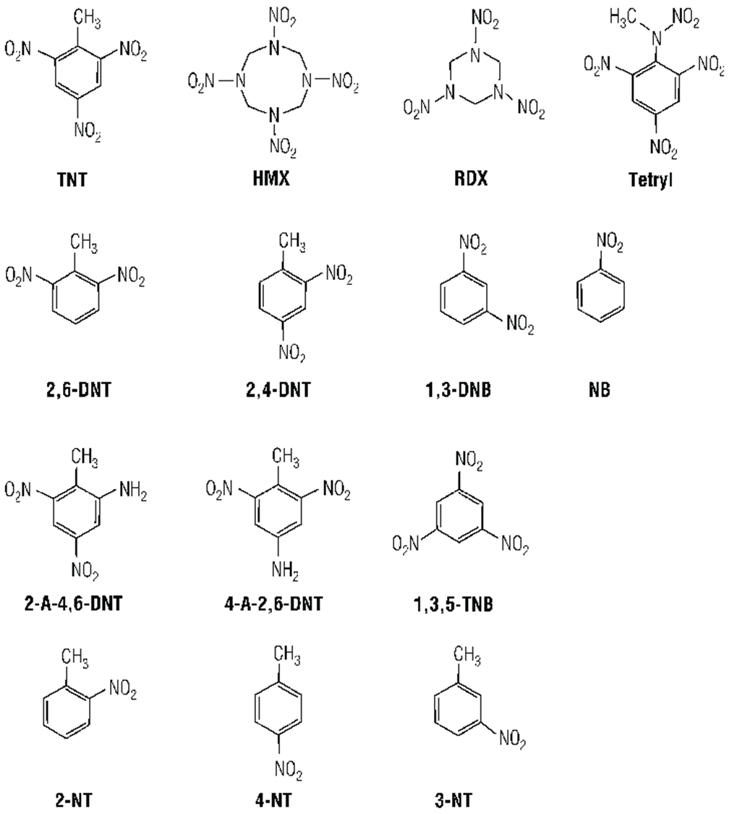
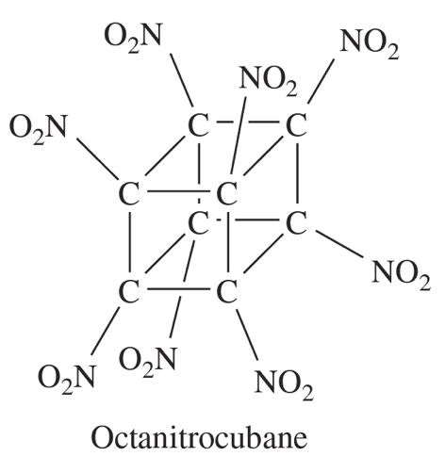
all are organic molecules
compounds of carbon (C), hydrogen (H), oxygen (O), and nitrogen (N)

Slide 15
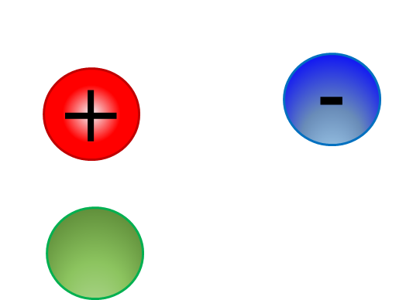
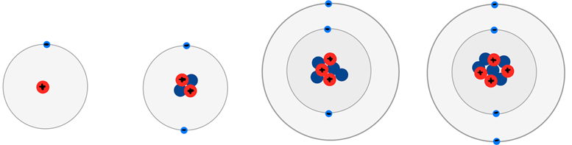
Structure of atoms
electron (e-)
nucleus (p+n)
H - hydrogen
He - helium
Li - lithium
Be - berilium
p =
n =
e =
1
0
1
p =
n =
e =
2
2
2
p =
n =
e =
3
4
3
p =
n =
e =
4
5
4
Subatomic / elemental particles:
proton mass = 1amu* charge = +1
neutron mass = 1amu* charge = 0
electron mass = 0.0005 amu* charge = -1
*amu – atomic mass number = 1.67 × 10⁻²⁷ kg
nucleus (p+n)
Notes:
The masses of the proton, neutron, and electron are typically expressed in terms of their relative masses compared to each other:
Proton: The mass of a proton is approximately 1 atomic mass unit (amu), which is equivalent to 1.6710⁻²⁷ kilograms.
Neutron: The mass of a neutron is also approximately 1 atomic mass unit (amu), which is equivalent to 1.67×10⁻²⁷ kilograms.
Electron: The mass of an electron is much smaller compared to that of a proton or neutron. It is approximately 0.0005 atomic mass units (amu), or 9.11×10⁻³¹ kilograms.

Slide 16
Atomic and mass numbers
Atomic Number Z
DEFINES THE ATOM
17
Symbol
Cl
chlorine
Name
35.453
Average Atomic Mass
atomic number (Z) =
number of protons = number of electrons
mass number (A) =
number of protons + number of neutrons
A = Z + n

Slide 17


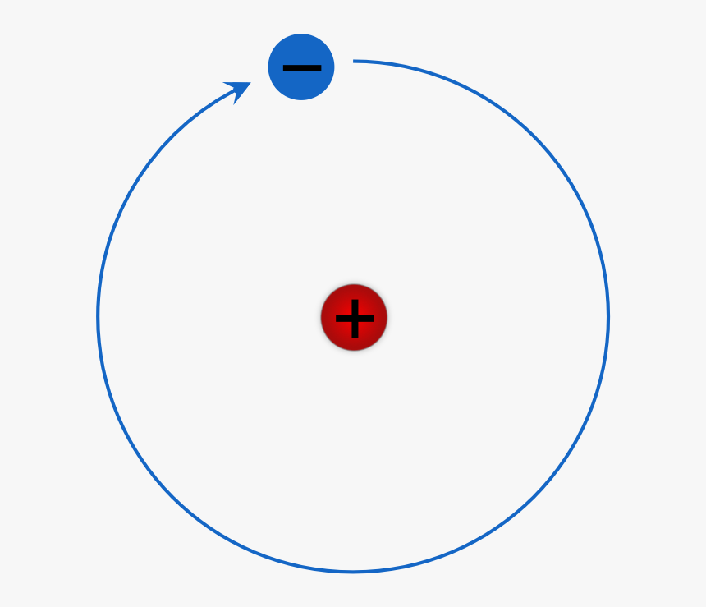
Atomic and mass numbers
-
Subatomic / elemental particles:
nucleus (p+n)
+
proton mass = 1* charge = +1
neutron mass = 1* charge = 0
electron mass = 0* charge = -1
*m (p,n) >> m(e)

Slide 18
Atomic and mass numbers
electron (e-)
ATOM
Atomic Number Z
DEFINES THE ATOM
17
Symbol
Cl
chlorine
Name
35.453
Average Atomic Mass
atomic number (Z) =
number of protons = number of electrons
nucleus (p+n)
Subatomic / elemental particles:
proton mass = 1* charge = +1
mass number (A) =
number of protons + number of neutrons
neutron mass = 1* charge = 0
electron mass = 0* charge = -1
A = Z + n
*m (p,n) >> m(e)

Slide 19
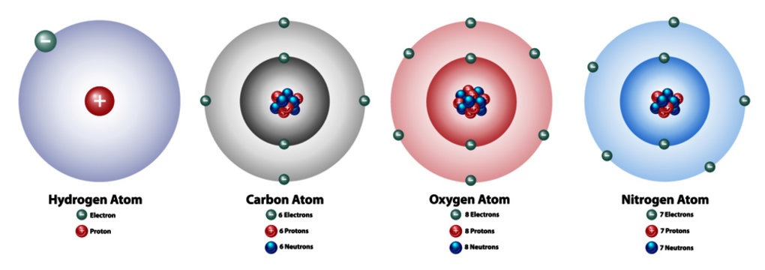
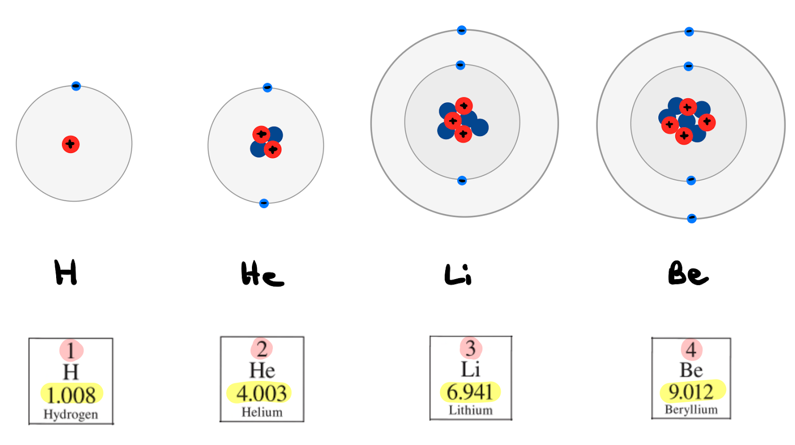

Slide 20
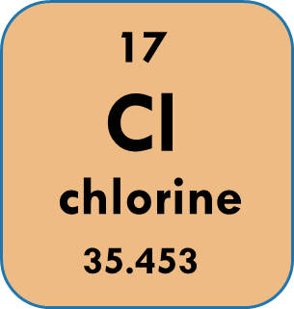
isotopes
two or more types of atoms that have the same atomic number (Z) (number of protons) and same number of electrons but different numbers of neutrons in their nuclei
all isotopes of a given element have almost the same chemical properties but they have different atomic masses and physical properties
Two stable isotopes :
one with 18 neutrons and one with 20 neutrons
Z = 17 17 protons in every chlorine atom
n = 18 A = Z + n = 17 + 18 = 35 Cl-35 or ³⁵Cl
n = 20 A = Z + n = 17 + 20 = 37 Cl-37 or ³⁷Cl
Notes:
The term isotope is formed from the Greek roots isos (ἴσος "equal") and topos (τόπος "place"), meaning "the same place"; thus, the meaning behind the name is that different isotopes of a single element occupy the same position on the periodic table.

Slide 21
(average) atomic mass
In a sample of element, all isotopes are present. So, need average mass
average mass = total mass ÷ number of atoms
NOT simple average of isotopes
weighted
average
mass
= Σ (mass of isotope) × fraction of atoms of this isotope
Chlorine: ¾ are Cl-35 and ¼ are Cl-37
Average atomic mass =
= (35)(0.75) + (37)(0.25) = 35.5 amu
amu – atomic mass unit

Slide 22

METALS, non-metals, metalloids
non-metal
NON-METALS
METALS
METALLOIDS

Slide 23
METALS, non-metals, metalloids
Metals:
Lustrous solids
High melting points
Conduct electricity
Malleable and ductile
Act as reducing agents in reactions
Non-Metals:
Poor structural materials
Low melting points
Often gases or liquids
Non conductors
Discrete molecular structures
Often act as oxidising agents (oxygen)
Metalloids:
Solids
Giant molecular structures
High melting points
Semiconductors (Silicon)

Slide 24
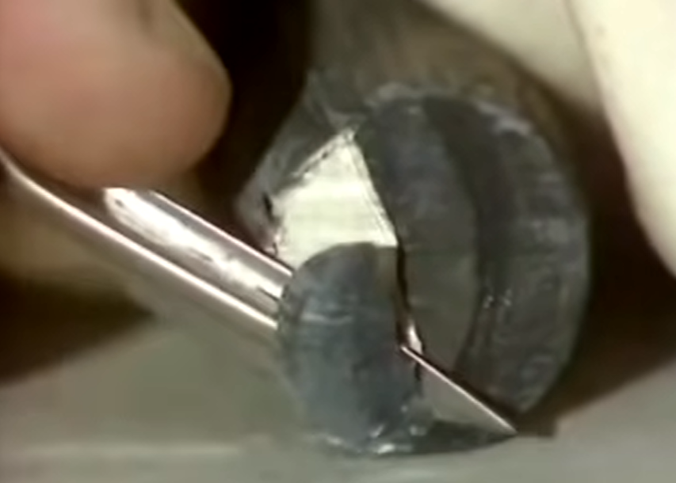
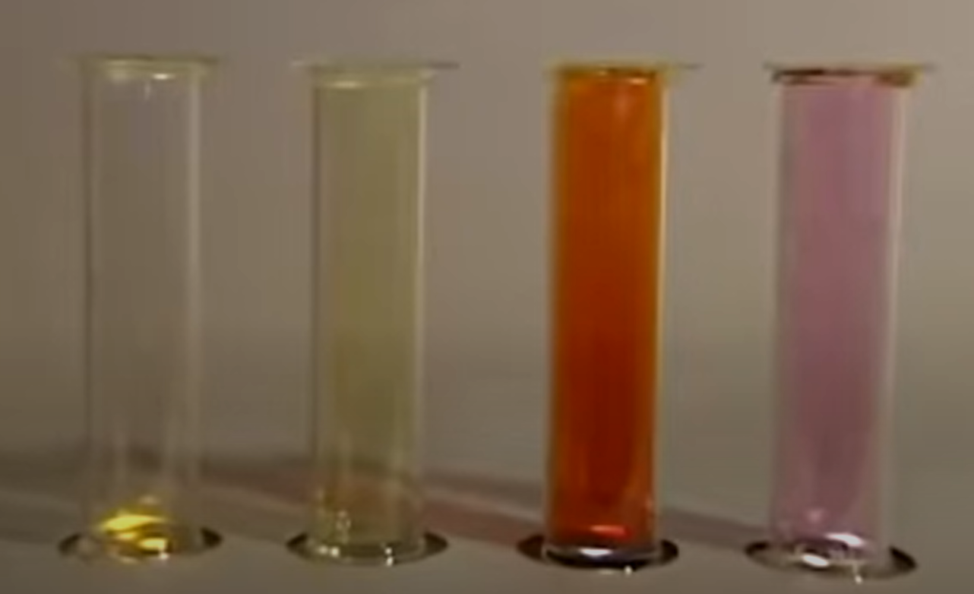
Periodic properties
Group 1 elements: Li, Na, K, Rb, Cs, Fr
Group 7 elements: F, Cl, Br, I (F₂, Cl₂, Br₂, I₂)
Reaction of Alkali metals with water
Reaction of Halogens with aluminum
https://youtu.be/6ZY6d6jrq-0
https://youtu.be/u2ogMUDBaf4

Slide 25

SUMMARY
Elements of the same kind are made of the same atoms
Atoms of a given element have the same average mass
Elements are arranged in a periodic table according to their number of PROTONS !!!
Periodic table consists of vertical groups and horizontal periods
Elements are either metals, non-metals, or metalloids
Elements in the same group have similar properties

Slide 26

Class activity
Solve the following practice problems:

Slide 27
Sample problems
PROBLEM 1:
Name the elements: a) P, b) Sb, c) Fe, d) Ag. Give their group and period numbers in the periodic table. What is the atomic number? Identify each element as metal, non-metal or metalloid.
Problem 2:
Identify the isotope that has atoms with a) 63 neutrons, 48 protons, 48 electrons, b) 6 neutrons, 5 protons, 5 electrons.
Problem 3:
State the number of protons, neutrons and electrons in an atom of: a) carbon-13, b) ⁶⁰Co, c) calcium-44.

Slide 28
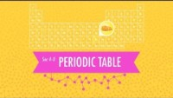
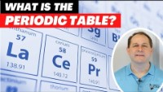
https://www.dymockstutoring.edu.au/the-periodic-table-a-beginners-guide-for-a-confused-mind/

