Slide 1
BMSW5001 Developing workplace critical thinking
Week 3
Validating evidence

Slide 2
Validating evidence

Slide 3
Group activity ( Evaluate these sources)
TV – ‘popular’ programmes Common sense Lectures Discussions with business leaders TV – ‘factual’/documentary/news Study guides (i.e. short booklets about the essentials you need to know, typically brief and with bullet points) | Discussions with other students Wikipedia Textbooks Discussions with tutors Popular magazines Journal articles Blogs Comments on Facebook, Weibo, etc. Rumours and opinions

Slide 4
Factors to consider when making a critical evaluation of what you have read:
What is the writer’s argument?
What are the main points/ideas that support that argument?
Does the writer attempt to address their stated point of view? What point of view? Is it successful?
Argument
Support
Question?
Logical
Evidence
Assumptions

Slide 5

Factors to consider when making a critical evaluation of what you have read:
Are the main points directly and logically linked to the argument and therefore, the question? If so, give examples and explain how they are linked. If not, give examples and explain why they are not linked.
What kinds of evidence does the author present to support these points? (Quality and quantity) Consider—is the evidence provided relevant, reliable and believable? Where does it come from?
Are there hidden assumptions that lie behind the evidence presented? What are they? Are the assumptions believable? Explain why/why not.
Argument
Support
Question?
Logical
Evidence
Assumptions

Slide 6
Qualities of good Evidence / sources:
Authenticity
Validity
Currently relevant
Reliable
Sample sizes
Few generalisations
Facts, not opinions
The C.R.A.A.P. Test
Currency
Relevance
Authority
Accuracy
Purpose
Notes:
Currency: The timeliness of the information. When was the information published or posted? Has the information been revised or updated? Does your topic require current information, or will older sources work as well? Are the links functional?
Relevance: The importance of the information for your needs. Does the information relate to your topic or answer your question? Who is the intended audience? Is the information at an appropriate level (i.e. not too elementary or advanced for your needs)? Have you looked at a variety of sources before determining this is one you will use? Would you be comfortable citing this source in your research paper?
Authority: The source of the information. Who is the author/publisher/source/sponsor? What are the author's credentials or organizational affiliations? Is the author qualified to write on the topic? Is there contact information, such as a publisher or email address? Does the URL reveal anything about the author or source? examples: .com .edu .gov .org .net
Accuracy: The reliability, truthfulness and correctness of the content. Where does the information come from? Is the information supported by evidence? Has the information been reviewed or refereed? Can you verify any of the information in another source or from personal knowledge? Does the language or tone seem unbiased and free of emotion? Are there spelling, grammar or typographical errors?
Purpose: The reason the information exists. What is the purpose of the information? Is it to inform, teach, sell, entertain or persuade? Do the authors/sponsors make their intentions or purpose clear? Is the information fact, opinion or propaganda? Does the point of view appear objective and impartial? Are there political, ideological, cultural, religious, institutional or personal biases?

Slide 7
Critical Thinking models

Slide 8
Critical thinking models
The Pearson’s RED critical thinking model
Socratic questioning.

Slide 9
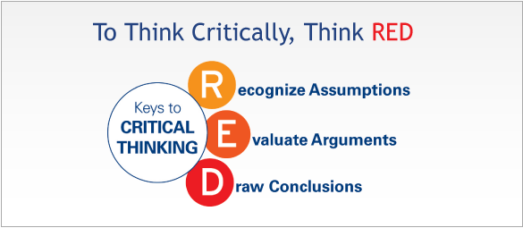
Pearson's RED Critical Thinking Model
Notes:
This is a model to encourage students to make use of as it is easy to commit to memory.

Slide 10
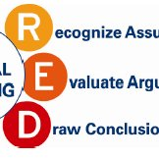
Pearson's RED Critical Thinking Model
Recognise Assumptions:
This is the ability to separate fact from opinion
It is deceptively easy to listen to a comment or presentation and assume the information presented is true even though no evidence was given to back it up
Noticing and questioning assumptions helps to reveal information gaps or unfounded logic

Slide 11
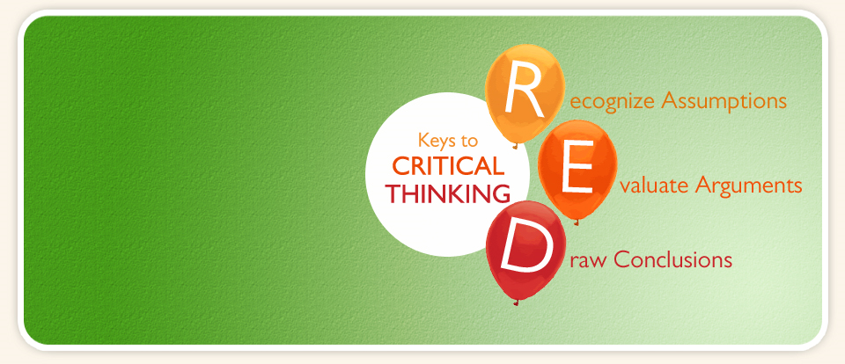
Pearson's RED Critical Thinking Model
Recognise Assumptions
Taking it a step further, when we examine assumptions through the eyes of different people (e.g., the viewpoint of different stakeholders), the end result is a richer perspective on a topic.
Notes:
Example: Walk a mile in my shoes – have you heard this phrase? What does it mean? “See and experience things from My perspective”.

Slide 12

Pearson's RED Critical Thinking Model
Recognise Assumptions
How to use it:
When you’re gathering information, listening to what people say, or assessing a situation, think about what assumptions they have made
Perhaps you assume that a trusted co-worker is providing reliable information – but is there really evidence to back that up? Learn to see gaps in logic, and opinion disguised as fact
Notes:
We find the underlying assumptions by looking at what people write, then making guesses about what they must believe in oreder to have written that. We look for the gap between the evidence and the claim by asking the following questions:
What must be true if the claim is to follow from this evidence?
What general principle might link this particular claim to this particular evidence?
What beliefs might I expect from this type of person? For example, if you were role-playing a consultant, what would you think about the evidence about consultants being a waste of money?
Could someone believe this evidence and still disagree with the claim? Why?

Slide 13
Pearson's RED Critical Thinking Model
Evaluate Arguments
The art of evaluating arguments entails analysing information objectively and accurately, questioning the quality of supporting evidence, and understanding how emotion influences the situation.
Common barriers include confirmation bias, or allowing emotions-yours or others-to get in the way of objective evaluation
People may quickly come to a conclusion simply to avoid conflict
Notes:
Confirmation bias? What is this? “The tendency to interpret new evidence as confirmation of one’s existing beliefs or theories”. Any examples?

Slide 14

Pearson's RED Critical Thinking Model
Evaluate Arguments
Being able to remain objective and sort through the validity of different positions helps people draw more accurate conclusions.

Slide 15

Pearson's RED Critical Thinking Model
Evaluate Arguments
How to use it:
We often have problems sorting through conflicting information because we unknowingly let our emotions get in the way, or because – like just about everyone – we sometimes only hear what we want to hear.
Learn how to push all that aside, and analyse information accurately and objectively

Slide 16

Pearson's RED Critical Thinking Model
Draw Conclusions
People who possess this skill are able to bring diverse information together to arrive at conclusions that logically follow from the available evidence.
Furthermore, they will change their position when the evidence warrants doing so. They are often characterized as having "good judgment"

Slide 17

Pearson's RED Critical Thinking Model
Draw Conclusions
How to use it:
This is the payoff. When you think critically, the true picture becomes clear, and you can make the tough decision, or solve a difficult problem

Slide 18
Socratic questioning
Notes:
Socratic questioning is “disciplined questioning that can be used to pursue thought in many directions and for many purposes, including: to explore complex ideas, to get to the truth of things, to open up issues and problems, to uncover assumptions, to analyse concepts, to distinguish what we know from what we don’t know, to follow logical implications of thought or to control the discussion. Socratic questioning is usually systematic, disciplined, deep and usually focuses on fundamental concepts, principles, theories, issues or problems. Used in teaching and Psychology…..also coaching?

Slide 19
Six Types of Socratic Questions
Probing underling concepts
Probing Assumptions
Probing evidence
Probe implications and consequences
Questioning underling position
Questions about the question
Notes:
Probing underling concepts
Get them to think more about what exactly they are asking or thinking about. Prove the concepts behind their argument. Basic 'tell me more' questions that get them to go deeper.
Here are some useful examples:
Why are you saying that?
What exactly does this mean?
What do we already know about this?
Can you give me an example?
Are you saying ... or ... ?
Probing assumptions
Probing of assumptions makes them think about the presuppositions and unquestioned beliefs on which they are founding their argument. People often use weakly understood assumptions to supports for their arguments.
Here are some useful examples:
What else could we assume?
You seem to be assuming ... ?
How did you choose those assumptions?
Please explain why/how ... ?
How can you verify or disprove that assumption?
What would happen if ... ?
Do you agree or disagree with ... ?
Probing the evidence
When they describe the evidence behind the arguments, prove if those are fact or fiction. Facts are stubborn things. People often use weak, refutable evidence to support for their arguments.
Here are some useful examples:
Why is that happening?
How do you know this?
Show me ... ?
Can you give me an example of that?
What do you think causes ... ?
What is the nature of this?
Are these reasons good enough?
How can I be sure of what you are saying?
Why is ... happening?
What evidence is there to support what you are saying?
On what authority are you basing your argument?
Questioning underling position
If arguments are given from a particular position you can try not attack the arguments directly but attack the underling foundation -- the position on which they are explicitly or implicitly based. It is important that there might be other, equally valid, viewpoints.
Here are some useful examples:
Does this approach is reasonable, justifiable?
What alternative ways of looking at this are there?
Why it is ... necessary?
Who benefits from this?
Why is it better than ...?
What are the strengths and weaknesses of...?
What are similarities between ... and ... ?
What are differences between ... and ... ?
How could you look at this in another way?
Probe implications and consequences
The argument that they give may have logical implications/consequences that can be predicted. Do these make sense? Are they desirable?. Here are some useful examples:
Then what would happen?
What are the consequences of that assumption?
How could ... be used to ... ?
What are the implications of ... ?
How does ... fit with what we learned before?
Why is ... important?
Why this approach is considered to be the best ... ?
Questions about the question
Sometimes it is useful to become reflexive about the whole thing, turning the question in on itself.
Here are some useful examples:
What was the point of asking that question?
Why do you think I asked this question?
What does that mean?

Slide 20
Valid & Authentic evidence ?
Does it measure or describe what it is supposed to measure ?
Is it authentic? – what’s the source
Is it reliable?
Notes:
Reliability
Depends on how consistent the findings are with other research.

Slide 21
Critical Analytical Thinking - Checklist
What is the main line of reasoning (the main argument)?
Is the line of reasoning clear, both in the introduction and in the conclusion?
What is the key evidence used to support the line of argument?
Is the evidence presented in a way that develops the argument and leads clearly to the conclusion?
When was the evidence produced? Is it up to date? Is it still relevant?

Slide 22
Critical Analytical Thinking - Checklist
Is there sufficient evidence to prove the case? Is the evidence relevant? What might be missing?
What (if any) would have been a better order in which to present the evidence, so as to strengthen the line of reasoning?
Are there any examples of flawed reasoning? Attempts to persuade the reader through an appeal to the emotions? Is evidence interpreted and used correctly?
Has the writer given sufficient consideration to alternative points of view?

Slide 23
ANY QUESTIONS?

