Slide 1
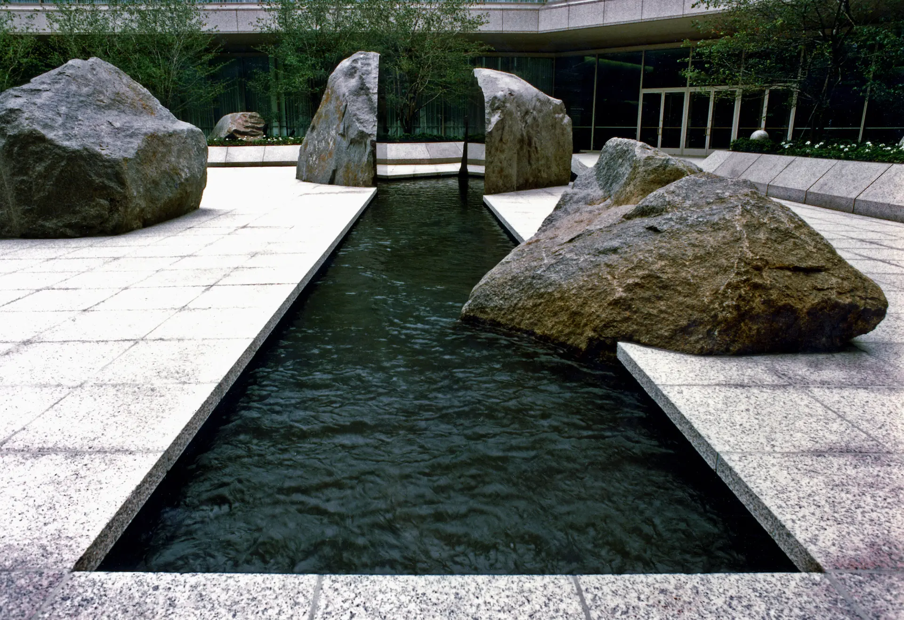
CAN YOU CHANGE A
SITE-SPECIFIC ARTWORK?
A resource which could create a discussion for your visual diary on the relationship to site.

Slide 2
THEARTNEWSPAPER.COM ARTICLE
https://www.theartnewspaper.com/2022/01/28/site-specific-art-unprotected-under-us-law
The article uses several examples of site-specific artworks which have in some been changed with relation to their location.
The article discusses the definition of site, legality and the problems that arise when sites change.

Slide 3
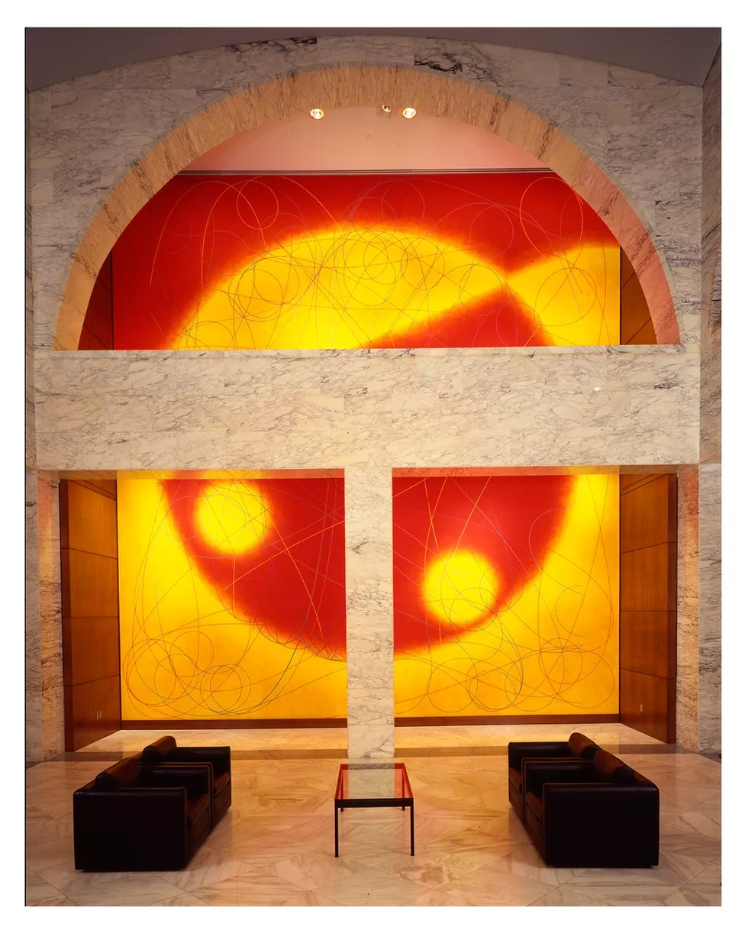
ALTERING THE SITE
In an example, the article discusses the re-modelling of a site for two reasons
Redevelopment – the building/site needs or has been chosen to be redeveloped.
Change of usage – The building has been changed
Dorothea Rockburne, Northern Sky (1993)
From the article:
The installation “will be different, not less meaningful, but it will have a different meaning”, Zimmerman says, “based on its new location and how it interacts with the local community”.
She adds: “You can’t say that nothing can ever be changed.” Still, some artists try.

Slide 4
RELOCATING THE WORK
In the example, the article discusses the re-housing of an artwork:
The original site is being changed (much like the previous slide) however the work is moved to preserve it.
What problems does this create? Are there any potential possibilities that arise out of this?
Elyn Zimmerman, Marabar. 1984

Slide 5
RELOCATING THE WORK
From the article:
The installation “will be different, not less meaningful, but it will have a different meaning”, Zimmerman says, “based on its new location and how it interacts with the local community”.
She adds: “You can’t say that nothing can ever be changed.” Still, some artists try.

Slide 6
IN YOUR VISUAL DIARY…
You could discuss the ideas raised in the article around one or more:
Talk about the legality and ownership of an artwork
The rights of the artist to dispute/discuss the work
You could ‘sympathise’ with both groups.
You could consider other locations for the artwork.
This is a form of artist research that gives you the opportunity to discuss complex ideas and analyse situations around art.

Slide 7
FEASIBILITY
In your groups, consider the following feasibility issues as discussed in Wednesday’s session.
Timescale – 5 weeks start to finish
Permission – gaining, agreeing, legal.
Public-response – considering challenge/responsibility.
Environment – weather, time of year (xmas market)
Approach – adapting contact for different
Space – consider the size/availability for space.

