Slide 1
leo luke
Student number-2416802 lecturer -gemma unit - 4004

Slide 2
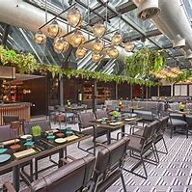
How I would go about Managing a restaurant
Key to managing a restaurant in my opinion is leading a team and communication pay key roles to a function hierarchy without negativity

Slide 3
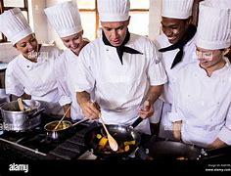
Kitchen roles
in this hypothetical establishment my team would consist of
1 head chef , 1 sous chef , 1 commis chef and a kitchen porter to cater for the service in question which would have 60 booked and a potential 20 strutting in

Slide 4
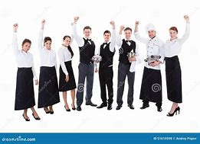

Front of house roles
I will be taking the role of front of house manager in my team I will have a additional head waiter/sommelier , 3 waiters , 1 mixologist and 1 additional bar member too to aid them on the bar and this is the team that will be station over the evening

Slide 5
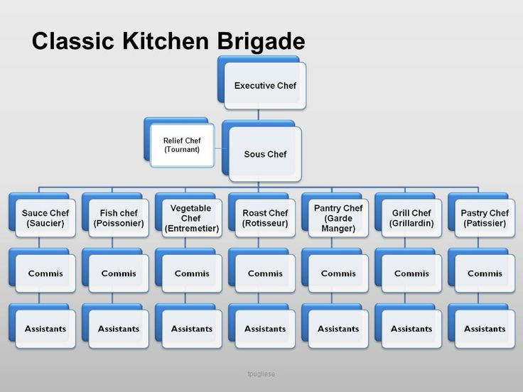
The team roles will follow the brigade system
The brigade system was formed by a man called august escoffier who was a pioneer in the organisation of order in the kitchen bringing specific roles to the chefs inside helping them specialise in certain areas of the kitchen to raise the efficency of service and in tern boost the buisnesses

Slide 6
A short video on the functionality of the brigade system
Escoffier's Brigade System The First Master Chef׃ Michel Roux on Escoffier - YouTube

Slide 7
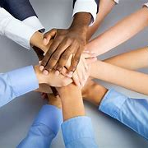
In this scenario me and my team will be going about how we would deal with
Prior to the service or when we open to customers. me and my team will go into the kitchen and have a meeting about how the staff are feeling, how the service will go
Preparation and understanding how people are feeling is a key role to a healthy workplace and a smooth service
20-25 minutes will be made to de brief with the team

Slide 8
Service brief
In service due to all of the staff communicating and arranging the roles for the night in the brief things will be going smoother and more orderly than if my team dived head first without organisation and communication of roles and duties needed in the service
My role as foh manager is to make sure my team runs smoothly if that means making sure the food orders are getting done correctly to maintaining order and communication between my waiters and bar staff etc

Slide 10
In this service we will have the head waiter and 2 other waiters on the prebooked tables and if anyone takes our vacated seats the remaining waiter will cover them tables with the help of the head waiter
We will have the people greeted and seated by our waiters
This will then be followed by a drink order and see if there ready to order explain the dishes

Slide 11
In service protocol
In service I will be making sure my waiters are going to check on customers and keeping them comfortable
My role as FoH mananger is to make sure my operations of service and team is running smooth and this means keeping a close monitor without becoming overbearing as that can stress staff members out it’s a strong belief of mine that negative emotions between staff members can cause hindrances so I would like to remove any possibility of that by showing authority without coming across as arrogant if theres a issue

