Slide 1
Library Resources

Slide 2
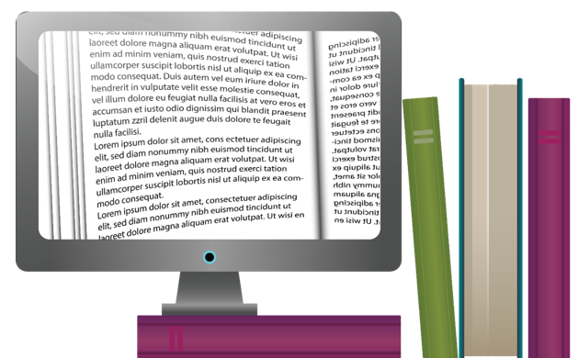
What we’re covering today
The Basics – where everything is
Search Terms – the right words
Boolean Searching
Refine your results for efficient searching

Slide 3
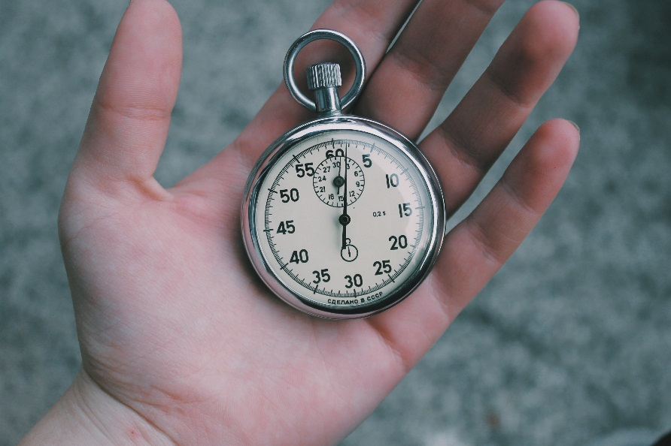
Where do I find the resources?
The library catalogue
The ‘Online Library’
BrowZine
https://www.uwtsd.ac.uk/library/

Slide 4
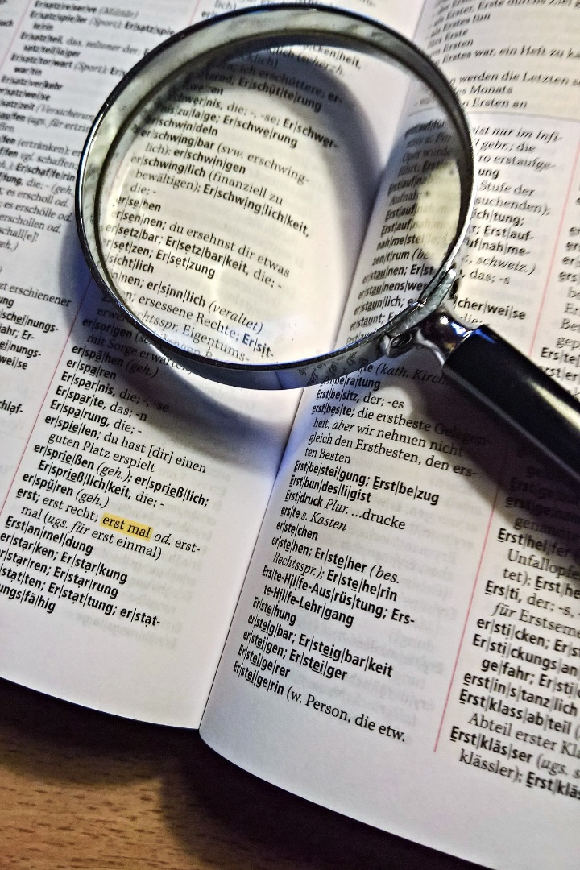
Finding more information;
Wide vocabulary
Knowledge of linked terms
Think outside the box
Connect the dots
Use punctuation

Slide 5
Search Terms: ‘Skills’
Skills
Qualities
Attributes
Traits
Characteristics

Slide 6

Search Terms – why your words matter
Different words result in different articles and resources
Phrases are more common in some disciplines than in others
The right words can reduce the results from millions to a more manageable level
The right words make your research more efficient, and saves you time

Slide 7
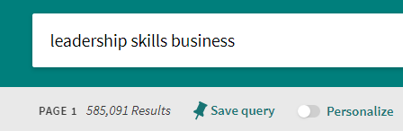
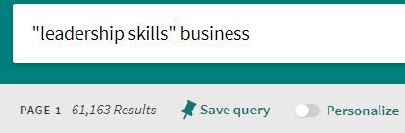
Create phrases
Using quotation marks create phrases, rather than searching each separate word i.e
“leadership skills” Business , instead of leadership skills business

Slide 8
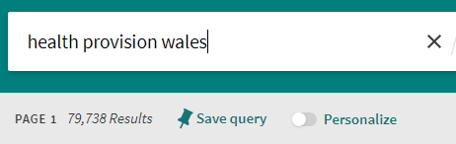
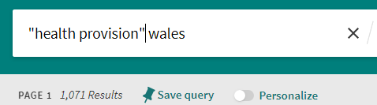
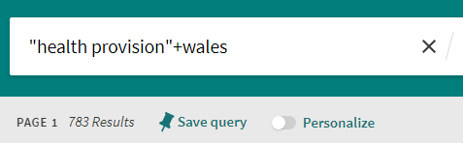
Search string example
Health provision wales
"health provision" wales
"health provision"+wales

Slide 9
Boolean Searching
Boolean Searches help create these ‘search strings’ to limit, widen or refine your search term.
AND “+”
NOT “-”
OR – this is the default of most search engines, returning results with any of the words you include in the search
NEAR

Slide 10
RefWorks

Slide 11
Referencing – why does it matter
Puts your work in academic context
Enables readers to find your sources
Prevents accidental plagiarism
Demonstrates the breadth of research you have undertaken

Slide 12

What do I need to reference
Direct quotations from a resource
Paraphrased or summarized content
If you read something but don't use it in your work, put it in the Bibliography

Slide 13

Reference Generators
Be Careful!
Generated from information given by publishers
No way of telling whether the generator is using the most up to date version of a referencing style

Slide 14
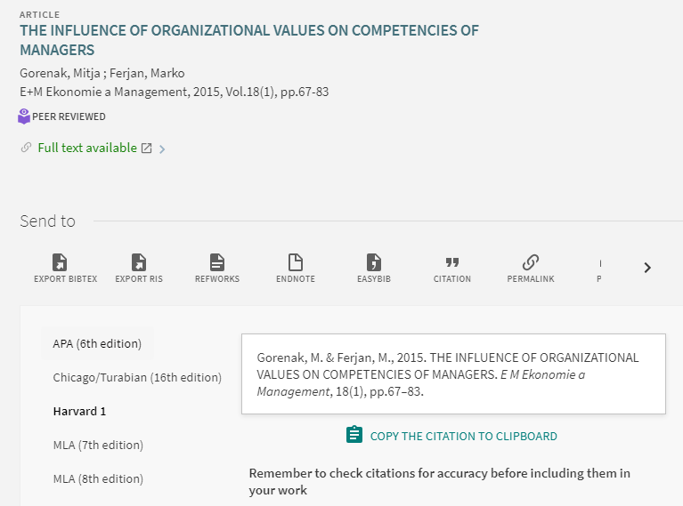
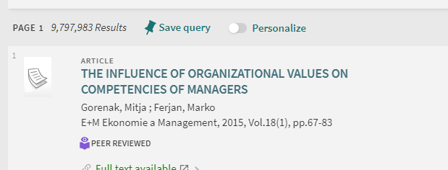
These are examples of generated references…
This reference was generated by the library catalogue
No brackets around the year
Title of article is in capitals, and not in quotations
No link to the article online

Slide 15
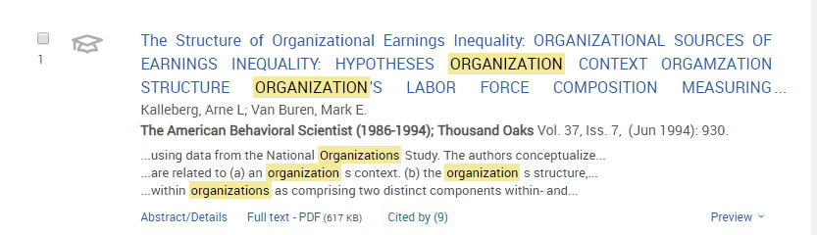
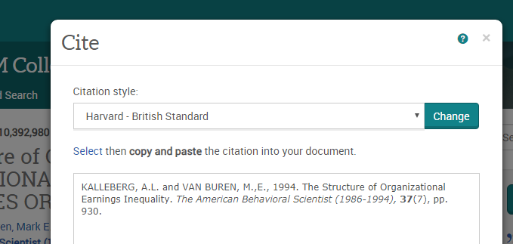
These are examples of generated references…
ABI Inform
Authors are capitals and shouldn’t be
Date is not in brackets
Article title is not in quotation marks
No link to online article

Slide 16
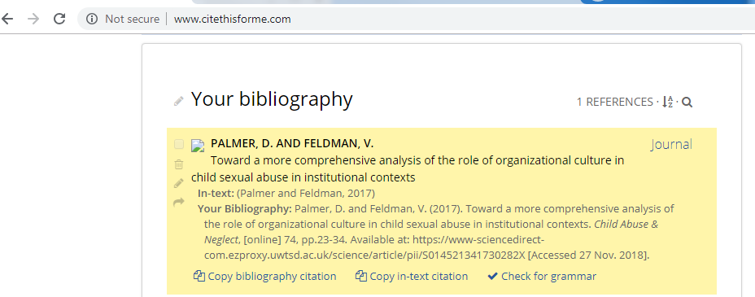
These are examples of generated references…
Cite this for me, free website
Article title is not in quotation marks
[online] is not necessary

Slide 17
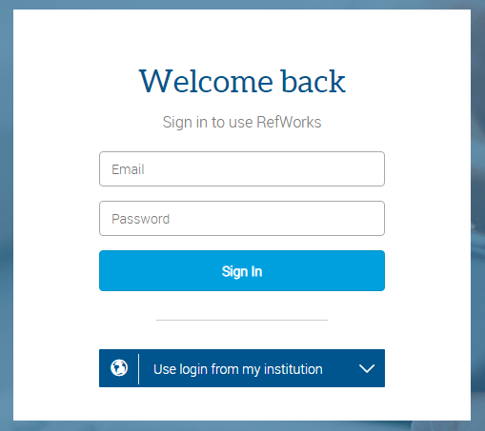
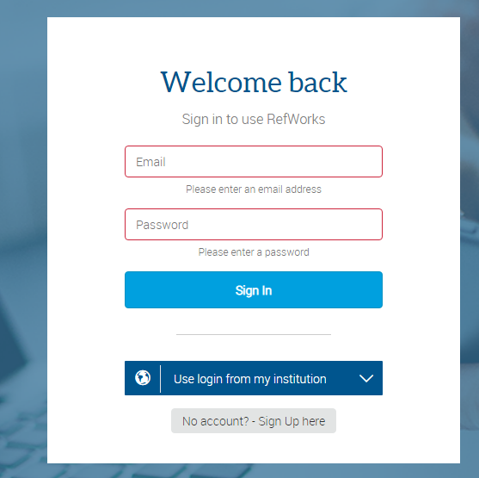
RefWorks
Web-based with one login
Step 1; Creating an account
Click Sign in – Ignore ‘login from my institution’
Click ‘No account? Sign up here’ and create an account using an email and password.

Slide 18
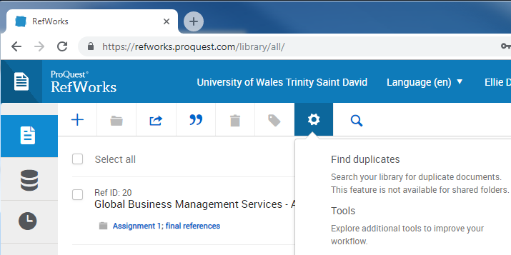
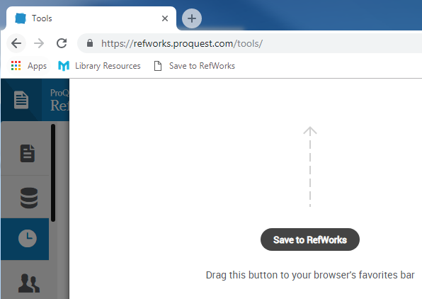
Installing the bookmark tool
The bookmark tool enables you to save anything you look at online to your reference list
Step 2; Installing the tool
Ensure that your Bookmark Bar is visible
Login into Refworks and click on ‘Tools’
Click ‘install Save to RefWorks’ and drag the button into the Bookmark bar

Slide 19
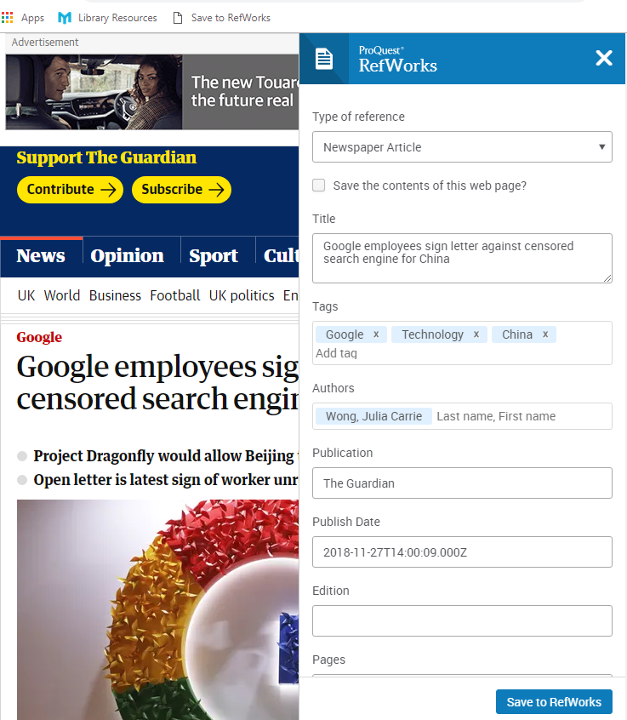
Using RefWorks
Go onto a database or website
Click on ‘Save to RefWorks’
This tool scrapes the webpage for the information and formats your reference, but as always, you must check the reference

