Slide 1


An Appraisal of a Guest Service Experience
Marin Bocai – 1815474 Simona Elena Pavalache -1816300
Petru Butnaru - 1818186 Larisa Mirabela Olteanu – 1816341
Lecturer Name: Dale Clarke | Module: Hospitality and Guest Service Management – M4X01915

Slide 2

The Sector within the Hospitality and
Tourism Industry:
The hospitality industry within the UK considered as one of the biggest engine for growth in the economy as because it able to get the attention of government, customers and employees in the business. The various sectors are covered under the hospitality industry such as travel and tourism, food and beverage, lodging, recreation, entertainment, transportation, meeting and events etc. (Kapiki, 2012).
2017
2018
2019
3.6%
GDP
Gross Domestic Product
(Hospitality & Tourism, 2019)

Slide 3
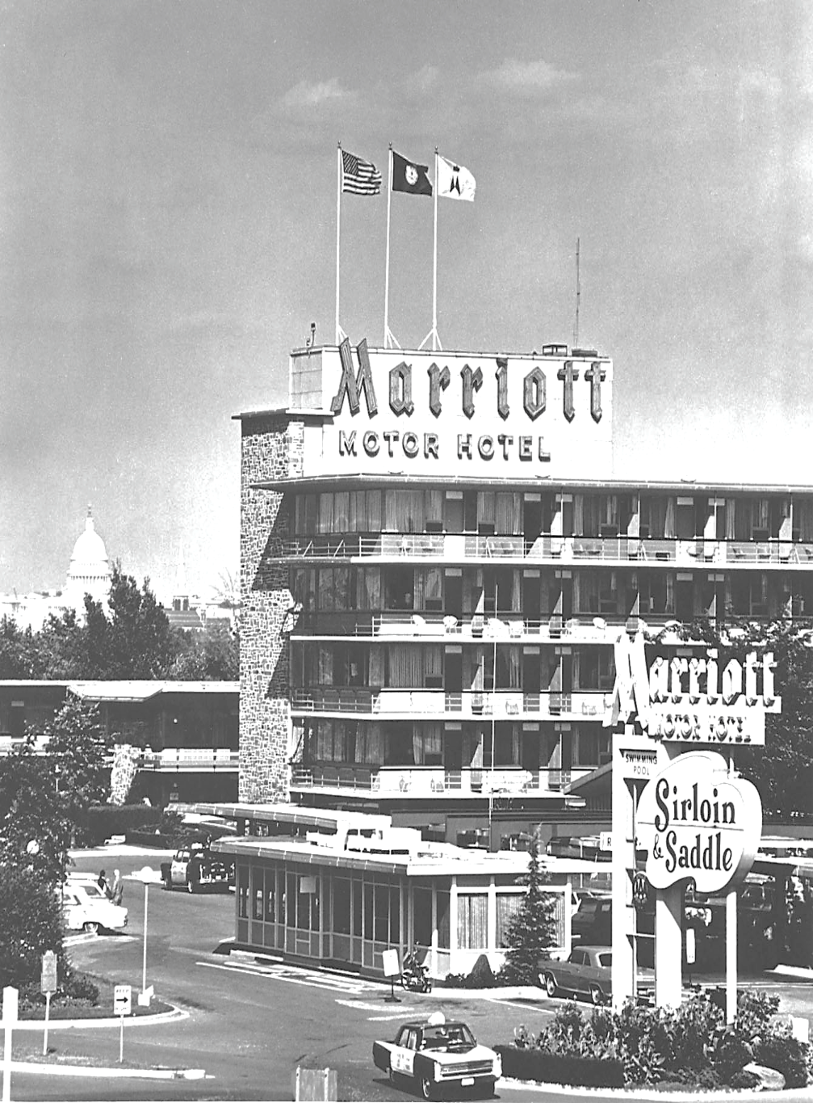
An Appraisal of a Guest Service Experience
As the chosen organization for this report is Marriott which is operating their business activities under the hospitality sector. This company is formed by J. Willard Marriott in 1927 which headquarters is situated in Bethesda, Maryland and U.S. This firm is listed as the third largest hotel chain in the world. Marriott has almost 30 brands and 7003 hotels in 131 countries This business organization is well-known for offering a range of quality services to its guests as per the latest technologies and current market segments(Kim, Stonesifer and Han, 2012).

Slide 4

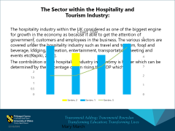
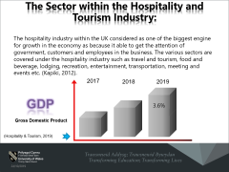
Products/Services Offered
Marriott is categorized under the most prestigious and famous brand due to offering several luxurious products and services to its customers, mainly concern for providing higher satisfaction to their guests so that the higher brand value and recognition can be gained in the limited period of time. The accumulation of the organizational service depends on the three characteristics which are customers participation, accessibility of services and interaction with service organization(Ryan,2015).
USP (Unique Selling Point)
The USP of Marriott is global market leadership in which they give their focus on covering a big market share by use its dominance in order to compete their competitors in the marketplace. The core strength of Marriott is that it has good returns on capital expenditure as they are successful at execution of new project. Along with this company can expand in other nation because they have strong free cash flow. In global market firm has high brand recognition due to which huge profit is maximized. Company with hold skilled and capable employees with their effective tactics which aid them to achieve set goals and objectives (Lampinen, 2016).

Slide 5

Strategies for Appraising Guest Service Experience
In order to sustain the business position, Marriott hotel give their major focus on espousing the effective strategies which enables them to attain the higher customer satisfaction and retain their interest and attention for a long span of time. For operating all the functions smoothly they are adopting that marketing strategies which are more suitable as per the culture and custom of the nation. They usually work on the basis on this approach which is “one size fits all” in which they are operating various marketing transactions wherever it is placed. For better understanding this concept there are define various points which will describe about all those strategies that are adopting by the manager of the Marriott to give their guests best experience:
Customization strategy: This strategy also helps Marriott hotel in providing various products and services as per the customers demand or expectations so that needs of their guests can be satisfied and the profitability of the business can be increased(Lashley, 2015).
Pricing strategy: The pricing strategy of Marriott hotel comprises the strategy of selling the right product to the right customer at right time so that the satisfaction of the customers can be raised. Along with this, Marriott also consider the competitive pricing strategy sometime which enable them to set the price of their services as per the situation and competitor’s strategies (Kim, Knutson and Vogt, 2014).
Distribution strategy: In order to provide the higher experience to their customers Marriott is adopting the both direct and indirect distribution channels. All these strategies provide the benefit to the manager as lowering the costs and cover a big market share with higher satisfaction of customers (Nunkoo, Gursoy and Ramkissoon, 2013).
Personalisation marketing: It is another most effective strategy for the business to attract a range of customers in the company services and to enhance their customers experience.

Slide 6
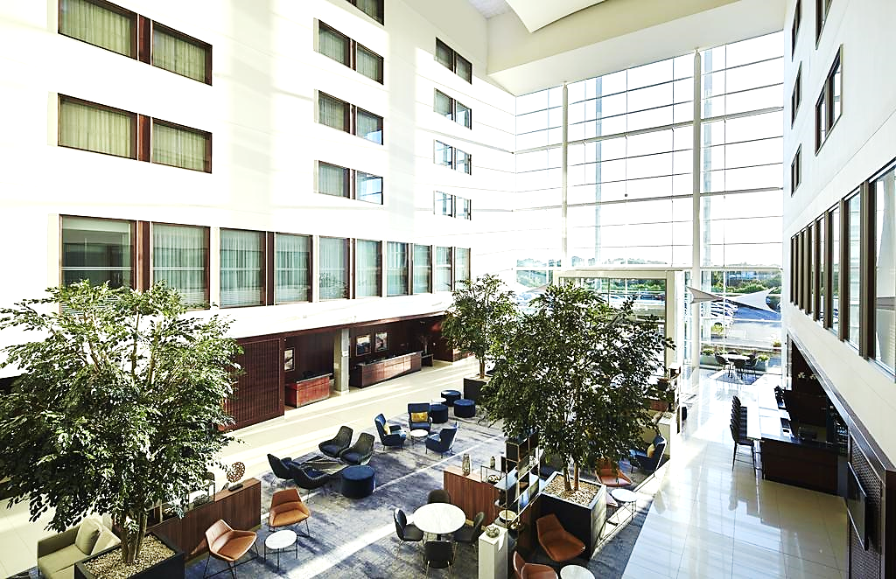
Service Setting
Service setting refers to the environment and ambience of a hotel in which the business organisation is operating their business activities and offering the services. Service setting refers to the environment and ambience of a hotel in which the business organisation is operating their business activities and offering the services. As the Marriott is conducting their activities at global level so it is necessary for them to create an effective culture and ambience in their hotel as this will help them to retain their customers for a longer period. Also, service setting refers to the way of render the services to the customers such as how they are serving food to their customers, how effectively they are organising parties or other formal events to their customers as these reflects the culture and ethics of the organisation which they following while rendering the services. In the Marriott hotel, all the employees are highly skilled and trained which demonstrate the excellent services to the customers(Chan and Hsu, 2016).
Service Quality
Marriott is listed under one of the most famous brands which provide premier and luxury facilities to their customers in order to attain the higher customer satisfaction. The effectiveness of their services can be seen by their rooms, the cleanliness of their property, quality of the amenities like food, exercise rooms, gym facility and pool. Due to render the quality services to their customers the organisation can attain the leadership position in the marketplace (Stierand and Zizka, 2015).

Slide 7
Service Delivery by Marriott
In Marriott hotel, the manager give their major focus on maintaining the service delivery. For this, they have divided it service delivery process into two parts which is front and back service. The front service includes the reception and restaurant service as these both are visible to the customer. In this aspect, food they are adopting the TQM approach. That is mainly concerned with quality of the food at restaurant which enables them to deliver the best quality of food to the customers in order to create the positive image of the hotel. Other, in the back services include cleaning services, security facility and other which are not represented but essential to taking care of those facilities in order to enhance the customers service experience. All these help the Marriott in getting the higher success and growth in their business along with the higher profitability (Lashley, 2015).

Slide 8


Guest Service Experience
Consumers experience is a perception and related feelings caused by the one-off and cumulative effect of interaction with the supplier of goods and services. In the present case experience of three consumers who had enjoyed their stay in the Marriott hotel is mentioned. This experience will be based on the services that are provided by hotel.

Slide 9
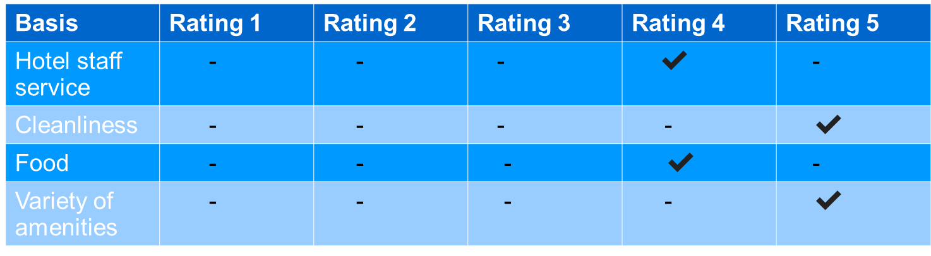
Consumer 1
As per this consumer hotel staff was quite friendly and efficient in performing all the services that are assigned to them. Only delay in service for few minutes was a small issue. Food offered by Marriott was delicious in taste, but variety was not as per consumers requirement. Variety of amenities such as play area, pool, conference room, spa and gym all are available in the hotel (Rauch and et. al., 2016).

Slide 10
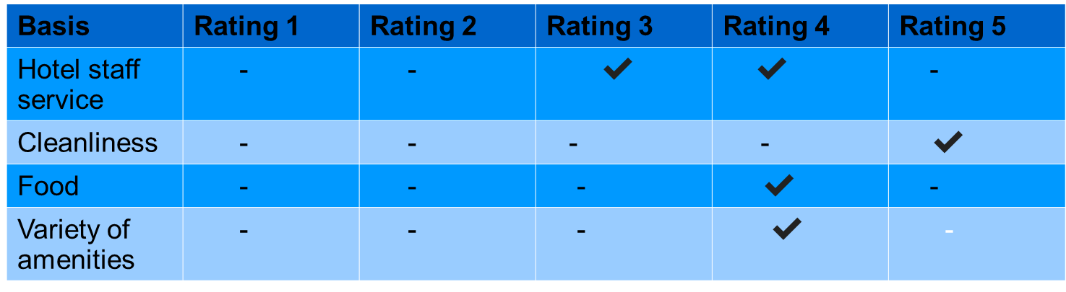
Consumer 2
Consumer two while staying with Marriott was not satisfied with the hotel staff service as one that day hotel staff was ineffective to entertain them in the mid night with some specific drinks that was ordered. Cleanliness was rated full as all the hotel was finely cleaned and hygiene is maintained. Food was rated good as taste was nice and as per consumers preference.

Slide 11
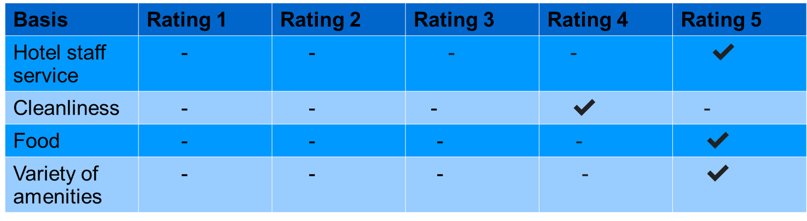
Consumer 3
Hotel staff services rated by this consumer was with the highest ratting as he find hotel staff very friendly and all the services provided was on time and in best manner. All the facilities was luxury and quality of services are worth the value paid for the stay in Marriott(Chen and Law, 2016).

Slide 12
Conclusion
As per the preceding study, it can be concluded that hospitality industry have a huge role in growth of the economy. The scope of this industry is very high as it is diverse in nature as they are not only providing the food and accommodation facility, but they are also rendering the various facilities like gymnasium, night clubs, internet, conference, sauna, parking and many others. . The organisations which are indulging in hospitality industry like Marriott are concerning for adopting the effective strategies for their business operations which enables them to deliver the higher customer experience to their guests and attain higher recognition and growth in the marketplace.

Slide 13

Findings
Marriott hotel it has found that they are operating their all operations or functions with great efficiency. But in order to getting more recognition and success in the business the manager must consider some efficacious plans in their functions as it will enables them to provide higher customer experience which will open paths of the success and recondition in the marketplace. They should focus on increasing the food variety so that customers can order as per their choices and needs. Also, they give their main concern to organise live shows in their hotel so that customers can feel their stay more convenient and enjoyable. For enhancing the guests experience in their hotel they should also focus on appointing more experienced employees in their organisation which can also deliver the basic essential during their working hour either it be a day or a night shift.

Slide 14
References
Books & Journal
Chan, E. S. and Hsu, C. H., 2016. Environmental management research in hospitality. International Journal of Contemporary Hospitality Management. 28(5). pp.886-923.
Chen, Y. F. and Law, R., 2016. A review of research on electronic word-of-mouth in hospitality and tourism management. International Journal of Hospitality & Tourism Administration. 17(4). pp.347-372.
Kapiki, S., 2012. Quality management in tourism and hospitality: An exploratory study among tourism stakeholders. International Journal of Economic Practices and Theories. 2(2).
Kim, M., Knutson, B. J. and Vogt, C. A., 2014. Post trip behavioural differences between first-time and repeat guests: A two-phase study in a hospitality setting. Journal of Hospitality Marketing & Management. 23(7). pp.722-745.
Kim, W. G., Stonesifer, H. W. and Han, J. S., 2012. Accommodating the needs of disabled hotel guests: Implications for guests and management. International Journal of Hospitality Management. 31(4). pp.1311-1317.
Lampinen, A., 2016. Hosting together via Couchsurfing: Privacy management in the context of network hospitality. International Journal of Communication. 10. p.20.
Lashley, C., 2015. Hospitality and hospitableness. Research in Hospitality Management. 5(1). pp.1-7.
Lashley, C., 2015. Hospitality studies: escaping the tyranny?. Quality Assurance in Education. 23(4). pp.364-377.
Nunkoo, R., Gursoy, D. and Ramkissoon, H., 2013. Developments in hospitality marketing and management: Social network analysis and research themes. Journal of Hospitality Marketing & Management. 22(3). pp.269-288.
Rauch, E. and et. al., 2016. Lean Hospitality-Application of Lean Management methods in the hotel sector. Procedia CIRP. 41. pp.614-619.
Ryan, C., 2015. Trends in hospitality management research: a personal reflection. International Journal of Contemporary Hospitality Management. 27(3). pp.340-361.
Stierand, M. and Zizka, L., 2015. Reflecting on hospitality management education through a practice lens. Quality Assurance in Education. 23(4). pp.353-363.
Online
Hospitality & Tourism. 2019. [Online]. Available through:<http://www.investinuk.net/industry/hospitality-tourism/hospitality-tourism>.

