Slide 1

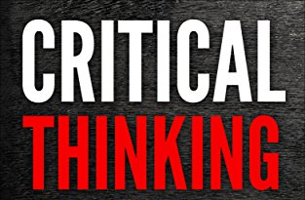



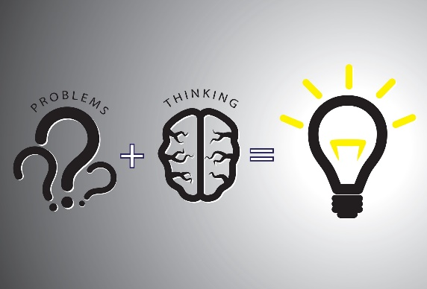
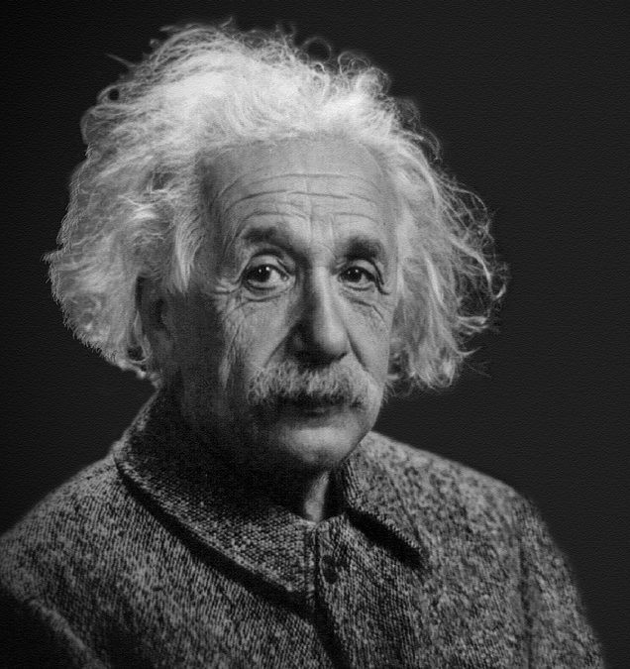



Think
About
Thinking
Think
Decide
“Education is not the learning of facts but the training of the mind to think”.
-Albert Einstein
Reasoning
Problem
solving
Evaluating
Analyzing
Decision making
https://www.peardeck.com/pear-deck-blog/back-to-school-chart-your-course
https://medium.com/@Iqra.rahman/problem-solving-better-way-to-think-creatively-217bd28d1024
https://www.copyblogger.com/critical-thinking/
https://www.copyblogger.com/critical-thinking/
https://ieltsforfree.com/analysing-ielts-task-2-writing-questions/
https://www.papermasters.com/teaching-critical-thinking-skills.html

Slide 2
Reference list:
https://www.copyblogger.com/critical-thinking/
https://successtoro.com/best-books-on-critical-thinking/
https://firefighternow.com/downloads/mechanical-reasoning-video-course/
https://www.privateschoolreview.com/blog/evaluating-and-choosing-a-private-school
https://medium.com/@Iqra.rahman/problem-solving-better-way-to-think-creatively-217bd28d1024
https://www.translatemedia.com/translation-blog/how-language-affects-decision-making/
http://kairo.9terrains.co/analyse-writing/
https://me.me/i/how-about-a-nice-big-cup-of-critical-thinking-research-20396544
https://www.blackenterprise.com/albert-einstein-went-hbcu/

