Slide 1
Events and Festivals in Context
Historical origins of events

Slide 2
Development of festivals and events
F&E now a global industry, but much earlier beginnings
As a benchmark for our lives (births, deaths, anniversaries)
Coming-of-age, rites of passage
Lunar cycles, seasonal changes
Role of culture and mythology
Notes:
18th birthday /21st - whats the difference these days? Apart from age!
Seasonal – spring festivals; harvest
May fair; halloween – in Spain 1 Nov is the day of the dead – people visit graveyards and ‘celebrate’ their ancestors

Slide 3
Developments of festivals and events
Chinese New Year
Ancient Egypt, Greece, Rome
Festus – Latin meaning “Feast-Like”
Mediaeval carnivals in Europe
Religion – Saint’s Days, holy days
Stonehenge; Celts & ‘folk memory’ eg Atlantis / the great flood
Notes:
18th birthday /21st - what’s the difference these days? Apart from age!
Seasonal – spring festivals; harvest
May fair; halloween – in Spain 1 Nov is the day of the dead – people visit graveyards and ‘celebrate’ their ancestors

Slide 4
Origins of Festivals and events
What is clear is that the origins of F&E have some common anthropological features in society:
Culture
Heritage
Music
Arts
Sport
Traditionalism

Slide 5
Task
What is anthropology? How could it link to events?
Consider an event you know of or have attended. How does it represent those anthropological features
Notes:
Anthropology is the scientific study of humanity, concerned with human behavior, human biology, and societies, in both the present and past, including past human species. Social anthropology studies patterns of behaviour and cultural anthropology studies cultural meaning, including norms and values. Linguistic anthropology studies how language influences social life. Biological or physical anthropology studies the biological development of humans. Visual anthropology, which is usually considered to be a part of social anthropology, can mean both ethnographic film (where photography, film, and new media are used for study) as well as the study of "visuals", including art, visual images, cinema etc. Oxford Bibliographies describes visual anthropology as "the anthropological study of the visual and the visual study of the anthropological".

Slide 6
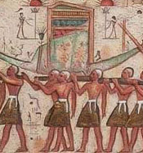
Ancient origins
Ancient Egypt : evidence from over 5000 years ago (3000 b.c.)
a wealth of festivals and events!
http://panhistoria.com/www/AncientEgyptianVirtualTemple/calendar1.html

Slide 7
Ancient Egyptian Festivals
Centered on procession by land and river
Celebrated on particular days or series of days in the official year.
The official year (365 days) was just short of the solar year, 365 1/4 days); as a result, the official year gradually moved back, with the official 'winter' months and their festivals falling into the summer.
There seems to be no attempt to move the festivals, even those relating to other events in the solar year such as flood, or the low-river sowing season.
The evidence for festivals is uneven; there are more inscriptions recording funerary and royal festivals, and far more evidence from Thebes than from the rest of Egypt. One of the most important sources is the hieroglyphic inscription recording a great festival list in the temple for Ramesses III at Medinet Habu.
Notes:
Opening of the Year
Thoth festival
First of the Year
Wag festival
Sokar festival
Great Festival
Flame festival
Procession of Min
Sadj festival
Coptic Christmas: 7th January 2021
Eid Al Ghetas: January
Sun Festival: February and October
Sham Al Naseem: 3rd May 2021
Ramadan: 13th April – 13th May 2021
Sphinx Festival: Yet to be announced
Eid Al Fitr: 13th May – 15th May 2021
Eid Al Adha: 20th July – 23rd July 2021
Islamic New Year: 9th August – 10th August 2021
Wafaa Al Nil: August
Mawlid An Nabi: 19th October 2021
Leylet En Nuktah: Yet To Be Announced
Ramadan, Islam’s holy month of fasting, has been observed and celebrated by Muslims around the world for more than 14 centuries. In the seventh century, Prophet Muhammad stated that Islam is built upon five pillars and that fasting in Ramadan was one of them.

Slide 8


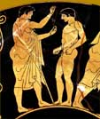
The Ancient Greeks
Festivals were an important part of life in ancient Greece, and were a central part of worshipping the gods. They usually included a procession and a sacrifice.
They included various competitions, in music, poetry, drama and also athletics.
One festival in Athens, held to honour Dionysos, involved a competition between playwrights. This led to the creation of some of the best-known plays from ancient Greece, written by people such as Sophokles, Euripides and Aristophanes.
Olympics – celebrating the Zeus

Slide 9
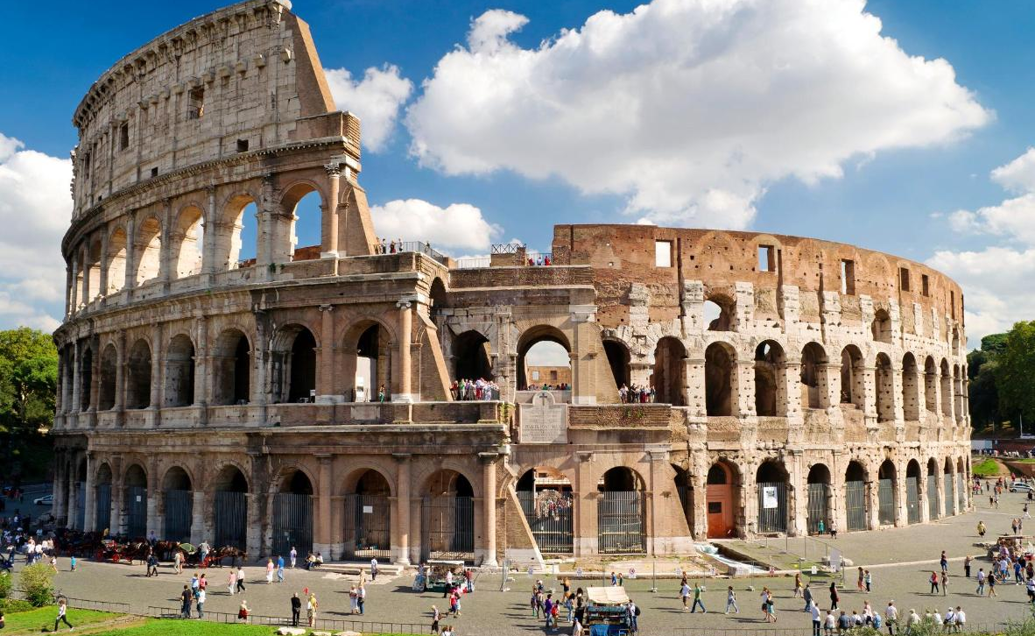
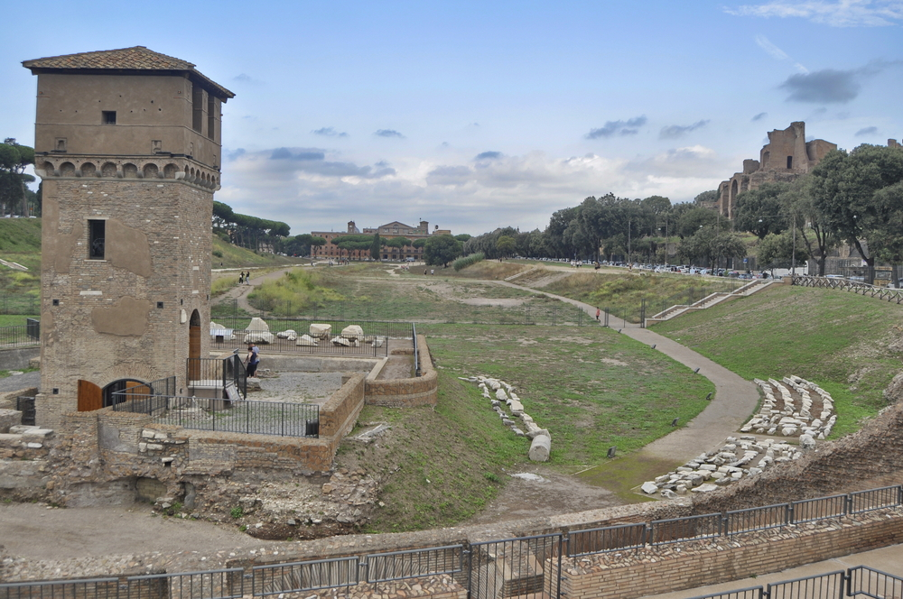
Roman origins
Roman ‘feriae’ were holidays (holy days) where work normally stopped
Public (state funded) or private events
Games (ludi), such as the Ludi Apollinares, were not technically feriae, but the days on which they were celebrated were dies festi,
From mid-1st century AD, more evidence of spectacles and games (circenses) held in the venue called a ‘circus’
Notes:
Chariot Racing in the Circus Maximus
The circus was a specific arena, shaped like a bullet, for the staging of chariot races, the largest of these was the Circus Maximus in Rome. Circus Maximus means “Biggest Circus.” It was an enormous structure, standing four stories in height, half a Roman mile down each side, with a central large spine up the center of the racing arena where the chariots raced around. It could seat about 200,000 people, making it the largest sporting arena ever erected anywhere at that point in human history.

Slide 10
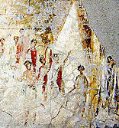
Roman men thought to be participating in the Compitalia festival, in a wall painting from Pompeii

Slide 11
Task
Do you recognise any of the traits in these historical special events?
Can you name any events which may have developed from these formats?
Notes:
How many days in a year?
Why do we have leap years?
How did the months get their names?
Gregorian calendar etc
etc

Slide 12
‘Modern’ Developments
Industrial revolution
Introduction of Leisure time
Manchester United and industrialisation

Slide 13
A Victorian Christmas?
At the beginning of the 19th century Christmas was hardly celebrated.
Many businesses did not even consider it a holiday.
However by the end of the century it had become the biggest annual celebration and took on the form that we recognise today.
The transformation happened quickly, and came from all sectors of society.
Notes:
Decorations
Christmas tree
Crackers
Mince pies
Turkey
Carol singing
Christmas Cards
Charles Dickens

Slide 14
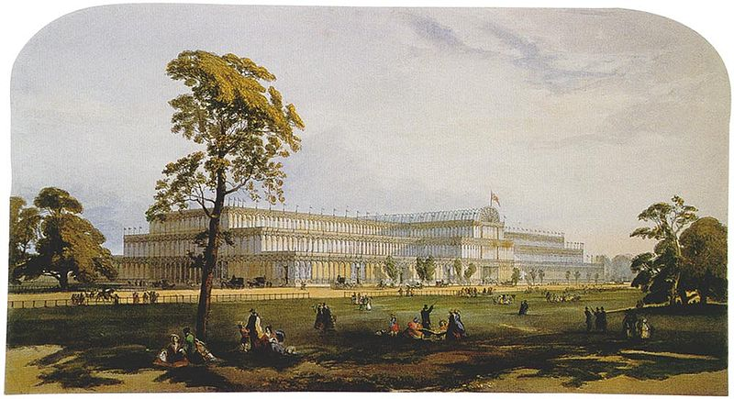
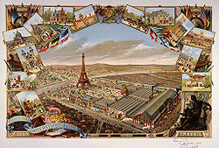
19th Century:
World’s Fairs
1851 London
1889 Paris

Slide 15
World’s Fair 1851
1851 Crystal Palace, London.
The first World Expo was held in the iconic Crystal Palace to showcase the inventions of the Industrial Revolution.
Purpose built venue for an event where countries could showcase their achievements. A celebration of modernity and innovation.
World's fairs have continued, now referred to as World Expo.
For 170 years, World Expos have provided a platform to showcase the greatest innovations that have shaped the world we live in today. Expo 2020 will continue that tradition with the latest technology from around the globe.
World Expos’ history | Expo 2020 Dubai

Slide 16
Paris
1855 - Exposition Universelle des produits de l’agriculture, de l’industrie et des beaux-arts
This World Expo introduced the world to innovations including the lawn mower, Moore's washing machine, Singer's sewing machine, the speaking doll, and one of the first vehicles running on oil.
Exposition Universelle de 1867
This was the first World Expo to feature national pavilions. They provided a space in which countries could display their culture, their history and their innovations.

Slide 17
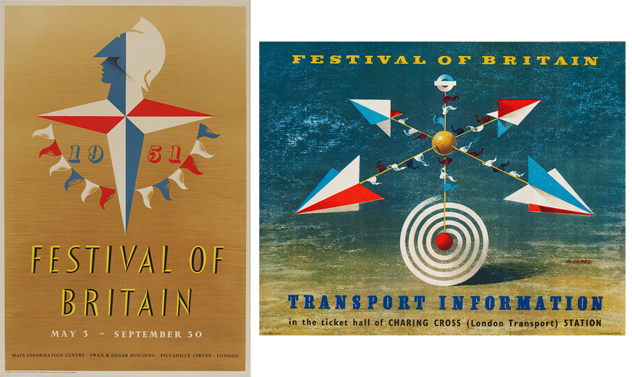
1951 Festival of Britain
Organised by the government to give Britons a feeling of recovery in the aftermath of war.
The Festival of Britain was intended as a 'tonic for the nation', a spectacular cultural event to raise the spirits of a country still in the grasp of austerity and rationing, and undergoing severe social and economic reform.
Held in the summer of 1951, it provided light-relief to 8.5 million people who visited the main Festival site on London's South Bank, and the events held in cities and towns across the country.
Importantly, it also acted as a catalyst for a new design aesthetic, launching the career of noted British designers working in the fields of textiles, furniture and graphic design.
Notes:
The Guide Book to the Festival described its legacy in these words: "It will leave behind not just a record of what we have thought of ourselves in the year 1951 but, in a fair community founded where once there was a slum, in an avenue of trees or in some work of art, a reminder of what we have done to write this single, adventurous year into our national and local history

Slide 18
Post industrialisation
Case study of Birmingham
1970s Decline in manufacturing industries resulted in job losses and 20% unemployment
Reinvention of the city included the construction of a major exhibition centre (The NEC) opened in 1976
It is one of the largest exhibition centres in the world with in excess of 4 million visitors every year.
Notes:
The City Council responded to the legacy of the 1960s by developing a visionary approach to reinventing the city. The first stage of this was the construction of a major exhibition centre, located close to the airport on city owned land. The National Exhibition Centre (NEC) opened in 1976 and has provided many new jobs, contributed significantly to the region’s GDP and has hosted a wide range of important international events and exhibitions. It is one of the largest exhibition centres in the world with in excess of 4 million visitors every year.

Slide 19
Proliferation of Music Festivals
Throughout history, music has played an important role at these mass cultural gatherings. For example: The Pythian Games of ancient Greece, dating as far back at the 6th century B.C., featured competitions of musical ability in addition for the physical feats for which they are primarily remembered.
Celtic and Gaelic cultures held cultural fairs from as far back as the year 1000, named Mods in Scotland and Feis in Ireland, of which dance competitions were major aspects.
Start of modern day Music festivals –
  1957 – Bob Dylan Newport Folk Festival, USA
  1969 - Woodstock
  1970, - the Isle of Wight Festival took place and attracted 700,000 people
  1970 - The first-ever Glastonbury festival happened on it only ran for one day. It was initially called the Pilton Pop, Blues, and Folk Festival and approximately, 1,500 people were in attendance.
Present day …..
  7000 Major outdoor events
  British music events attended by 27.7 billion people
• Largest UK music festivals 2019 | Statista
Notes:
A (Brief) 1,000 Year History of Music Festivals | Everfest

Slide 20
Wednesday Workshop
Festivals Britannia (BBC Documentary 2010) ENG - Bing video
https://www.theguardian.com/music/2010/dec/11/bbc4-festivals-britannia-documentary
Watch the BBC4 Festivals Britannia documentary and
Read the write up on the documentary. What has led to the proliferation of festivals we have today?

Slide 21
Summary
Festivals and events often have (sometimes forgotten) historical origins
Importance of societal factors: culture; religion; society ( n.b. anthropology)
Events and festivals as catalysts for regeneration

