Slide 1
Community Care and Management of Longer-term Conditions
Semester 1 2021/22
UK National Guideline for Nutrition
Dr Aishat Bakre

Slide 2
UK National Guideline for Nutrition
Week

Slide 3
Learning outcomes
Upon successful completion of this module, student should be able to:
Demonstrate a thorough understanding and knowledge of the various approaches to social epidemiology interventions and ways for monitoring epidemiological information of a population during the life course.
Apply knowledge on the link between social environment and health for the development of needs assessments, considering the social determinants of health and impact of social factors on individual and public health.
Communicate analysis and evaluation of outcomes of epidemiological studies and how these outcomes relate to social and cultural contexts, public health interventions and policies.
Demonstrate knowledge and understanding of the various forms of health inequalities in the UK and globally, and critically compare and evaluate public health policies and interventions.

Slide 4
Module Summary
The module aims overall to introduce students to the various approaches to interventions and ways for monitoring public health information related to health inequalities, social determinants of health, socio-economic and demographic characteristics of a population.
To familiarise students with the core concepts of social epidemiology and public health development and to acquire the skills necessary to describe and interpret epidemiological information.

Slide 5
Aims of the Session
To understand
The term nutrition
The UK national guidelines for nutrition
The eat well guide

Slide 6

What is Nutrition?
Notes:
https://www.nhs.uk/common-health-questions/food-and-diet/what-should-my-daily-intake-of-calories-be/

Slide 7
Nutrition
….the processes of ingestion, digestion and absorption of food.
It also involve the metabolism of food nutrients.
Nutrition plays an important role in maintaining health and wellbeing.
Diet can be defined as what we habitually eat and drink,
which is best considered a lifestyle.
Notes:
https://www.hwb.com.au/why-is-nutrition-important/

Slide 8
Nutrition
Nutrition is the biochemical and physiological process by which an organism uses food to support its life.
It includes ingestion, absorption, assimilation, biosynthesis, catabolism and excretion.
The science that studies the physiological process of nutrition is called nutritional science.
Appropriate nutrition is a vital modifiable lifestyle factor that benefits the promotion of good health among the populace and can help to combat life-threatening diseases
Notes:
https://www.hwb.com.au/why-is-nutrition-important/

Slide 9
Nutrition
Nutrition means getting the food and nourishment that you need for health and growth.
In scientific terms, nutrition is the supply of food that we need as an organism to feed our cells and keep them alive.
Without nutrition, we grow weak, sick and at the very worst can even die.
We miss developmental milestones and cannot put our bodies through the daily mental and physical tasks that we need them to do.
We are not able to grow and may also be unable to reproduce.
Notes:
https://www.hwb.com.au/why-is-nutrition-important/

Slide 10
Activity
Working independently, research the term digestion, ingestion and metabolism
Feedback your findings to the whole class

Slide 11
What is Eatwell Guide?

Slide 12
Eatwell Guide
The Eatwell Guide is based on the 5 food groups and shows how much of what we need to consume from each food group.
Public Health England encourages organisations and individuals to use the Eatwell Guide to make sure everyone receives consistent messages about the balance of foods in a healthy diet.
(Public Health England, 2016)

Slide 13
Eatwell Guide
The Eatwell Guide (below) is a pictorial representation of government healthy eating advice showing the proportions in which different types of foods are needed to have a well-balanced and healthy diet.
The proportions shown are representative of your food consumption over the period of a day or even a week, not necessarily each meal time.

Slide 14
Eatwell Guide
The Eatwell Guide makes healthy eating easier to understand by giving a visual representation of the types of foods and drinks we should consume and in what proportions to have a healthy, balanced diet.

Slide 15
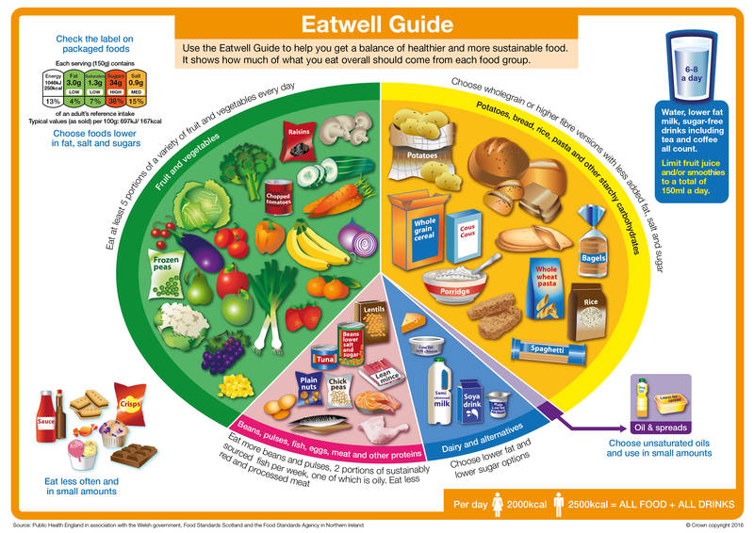
Eatwell Guide
Notes:
https://www.food.gov.uk/business-guidance/the-eatwell-guide-and-resources

Slide 16
Activity 1
Watch the video below then discuss and
https://youtu.be/CSOtIfh82Ns
Feedback your findings to the whole class

Slide 17
Activity 2
Watch the video below then discuss and
https://www.youtube.com/watch?v=8aWqZd9RScQ
Feedback your findings to the whole class
Notes:
Your guide to the Eatwell Guide! - YouTube

Slide 18
Activity
Working in groups, research the term calorie intake and
Feedback your findings to the whole class

Slide 19
What are calories?

Slide 20
Calories
Calories are a measure of how much energy food or drink contains. The amount of energy you need will depend on:
Your age – for example, growing children and teenagers may need more energy
Your lifestyle – for example, how active you are
Your size – your height and weight can affect how quickly you use energy
(NHS.UK, 2021)
Notes:
https://www.nhs.uk/common-health-questions/food-and-diet/what-should-my-daily-intake-of-calories-be/
the power and ability to be physically and mentally active:

Slide 21
Calories
Other factors can also affect how much energy you burn. For example:
Some hormones (chemicals produced by the body) – such as thyroid hormones
Some medicines – such as glucocorticoids, a type of steroid used to treat inflammation
Being unwell
(NHS.UK, 2021)

Slide 22
Activity
Working in groups, research the average daily energy requirement for a man and a woman
Feedback your findings to the whole class

Slide 23
What are the UK nutritional guidelines based on?

Slide 24
Daily energy requirements
Everyone need different amounts of energy (or calories) from food to attain a healthy weight.
The amount we need depends on a number of factors, including how active you are.
Therefore, every time we eat more than our body needs, we put on weight.
The average daily energy requirement for a man is about 10.5 MJ (2,500 kcal); and 8.4MJ (2,000 kcal) for a woman.
Notes:
https://www.gov.uk/government/publications/the-eatwell-guide

Slide 25
Daily energy requirements
An ideal daily intake of calories varies depending on age, metabolism and levels of physical activity, among other things.
By convention
Breakfast should provide about 1.7 MJ/400kcal of your energy
Lunch about 2.5 MJ/600kcal
Evening meal about 2.5 MJ/600kcal
Remaining 1.7 MJ/ 400kcal for all the snacks and drinks consumed between meals
(NHS.UK, 2021)
Notes:
https://www.nhs.uk/common-health-questions/food-and-diet/what-should-my-daily-intake-of-calories-be/
The unit of energy is the kilojoule (kJ) or megajoule (1 MJ = 1,000 kJ) 4.18 kilojoules are equal to 1 kilocalorie

Slide 26
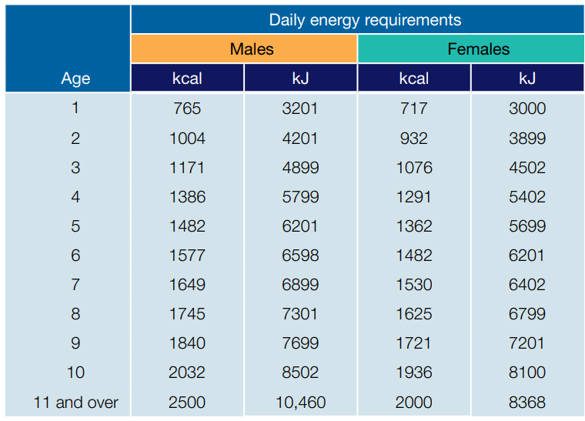

Slide 27
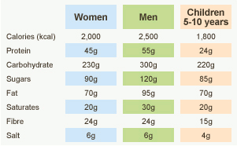
Guided Daily Allowance
However, depending on how much you exercise, you will need to consume more as your body needs more energy.

Slide 28
Activity 5
Working in groups, check the link below to learn more about calorie intake of 7-10 years children and
https://www.nhs.uk/common-health-questions/childrens-health/how-many-calories-does-a-child-of-7-10-need/
Feedback your findings to the whole class
Notes:
what is the recommended dietary intake for children in UK

Slide 29
Activity 6
Working in groups, check the link below to learn more about calorie intake of teenagers and
https://www.nhs.uk/common-health-questions/childrens-health/how-many-calories-do-teenagers-need/
Feedback your findings to the whole class

Slide 30
Cutting down on sugar
Regularly consuming foods and drinks high in sugar increases your risk of obesity and tooth decay.
Ideally, no more than 5% of the energy we consume should come from free sugars*.
Currently, children and adults across the UK are consuming 2-3 times that amount.
(Public Health England, 2018)

Slide 31
Cutting down on sugar
Age Recommended maximum free sugars intake Sugar cubes
4-6 years No more than 19g/day 5 cubes
7-10 years No more than 24g/day 6 cubes
11+ years/adults No more than 30g/day 7 cubes
(Public Health England, 2018)

Slide 32
Cutting down on sugar
Many packaged foods and drinks contain surprisingly high amounts of free sugars* including some breakfast cereals, yoghurts and fruit juice drinks.
Use the food label to help you choose foods lower in sugar.
Swap sugary breakfast cereals for plain cereals such as plain porridge, wholewheat biscuit cereals, shredded wholewheat or no added sugar muesli.
Cereal bars often contain high levels of free sugars* too, so remember to check the label.
Swap flavoured or corner-style yoghurts for low fat, lower sugar yoghurts, adding fresh fruit for variety
(Public Health England, 2018)

Slide 33
Activity
Working in groups, research the term “free sugar” and
Feedback your findings to the whole class

Slide 34
Free sugars
Free sugars - Any sugar added to food or drink products by the manufacturer, cook or consumer including those naturally found in honey, syrups and unsweetened fruit juice.
(Public Health England, 2018)

Slide 35
Activity
Working in groups,
Research why Obesity is a problem in the UK
What are the short and long term effect of Obesity?
Research three campaigns needed to help people with a nutrition problems
Feedback your findings to the whole class

Slide 36
Activity
Watch the video and make notes then discuss
https://www.youtube.com/watch?v=Pp6MX1ZksZo
Feedback your findings to the whole class
Notes:
Understanding Food Labels - YouTube

Slide 37
Further Reading
The Eatwell Guide and all supporting information are available from: https://www.gov.uk/government/publications/the-eatwell-guide
NHS (2021) www.nhs.uk/change4life/Pages/ change-for-life.aspx
World Health Organisation. Diet, nutrition and the prevention of chronic diseases. 2003. Available from: http://whqlibdoc.who.int/trs/WHO_TRS_916.pd

