Slide 1
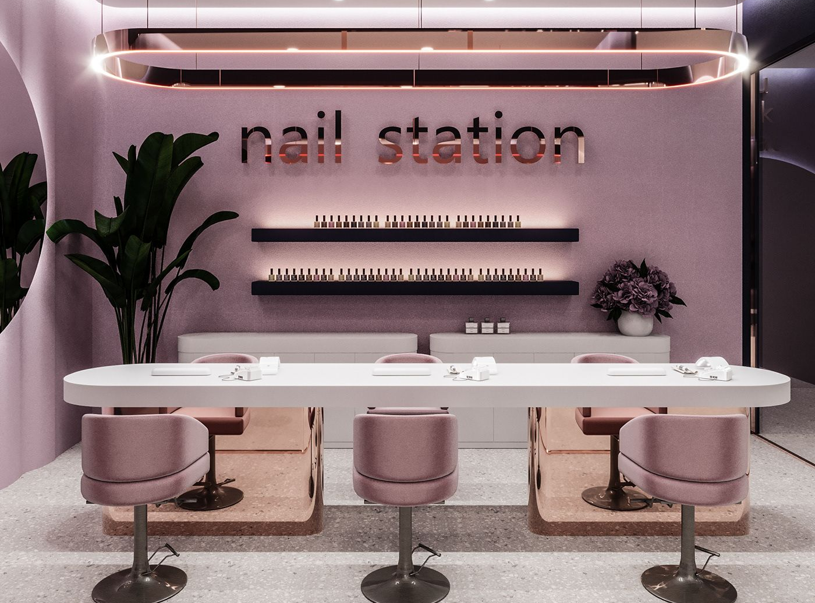
BlancaNails Salon
A Sustainable Nail Care Business
Monica Tamara Antonache

Slide 2
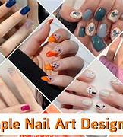
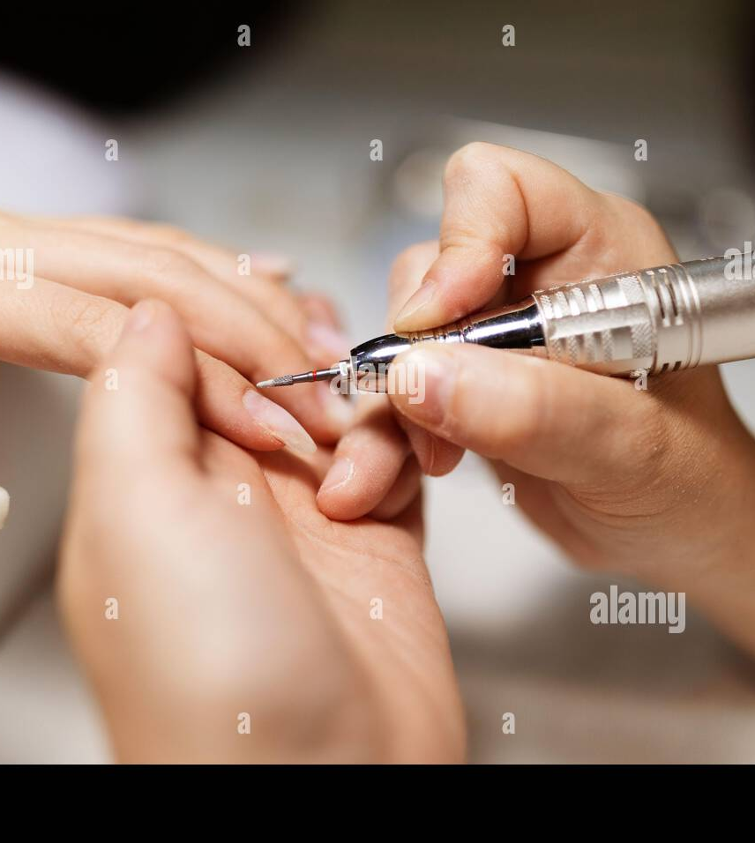
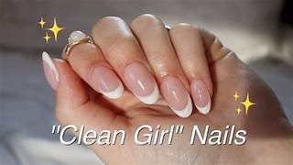
Business Overview
Sustainable nail salon offering:
Manicures & pedicures
BIAB & gel nails
Nail art
Target market:
Ages 16–45
Eco-conscious consumers
Unique Selling Point:
Non-toxic, cruelty-free products
Premium service + sustainability

Slide 3
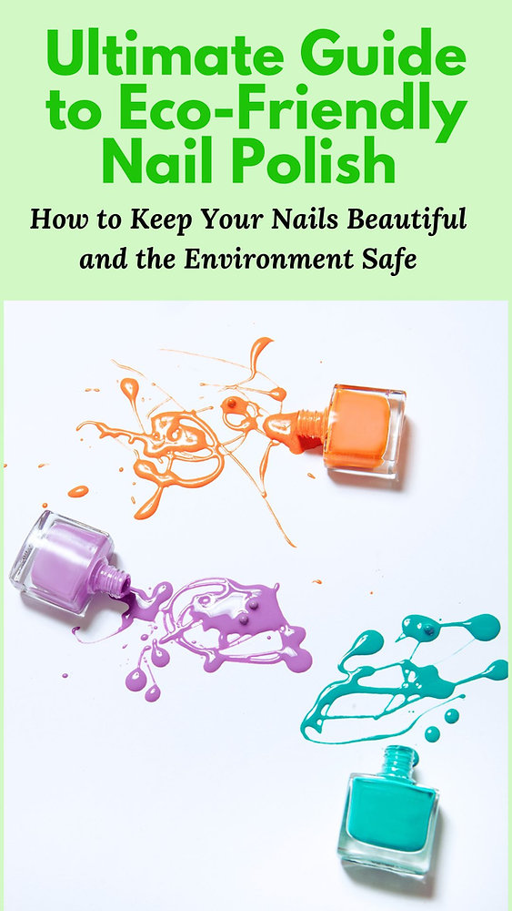
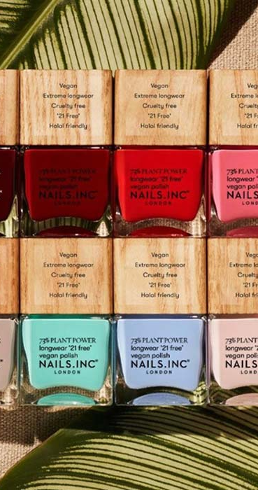
Sustainability Features
Environmental:
Reduced chemical use
Recycling & waste reduction
Energy-efficient equipment
Social:
Safe working conditions
Staff training & fair pay
Economic:
Repeat customers
Premium pricing model

Slide 4
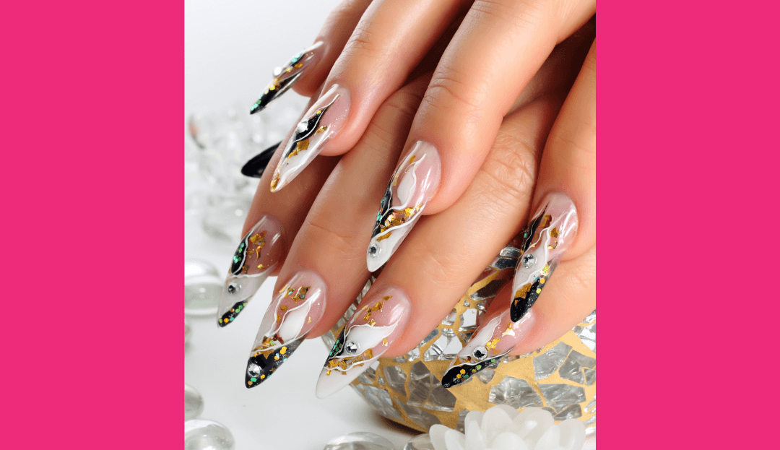

Market & Marketing Strategy
Growing demand for:
Clean beauty
Ethical services
Marketing strategy:
Social media (Instagram, TikTok)
Local partnerships
Loyalty schemes
Strong brand image = customer loyalty

Slide 5


Why BlancaNails Will Be Successful
Recurring demand for nail services
Clear sustainable differentiation
Strong customer loyalty potential
Profitable Year 1 forecast
Scalable business model

Slide 6
References
Nogueira, E., Gomes, S., & Lopes, J. M. (2023). Triple Bottom Line, sustainability, and economic development: What binds them together? A bibliometric approach. Sustainability, 15(8), 6706.
Sharabati, A. A. A., Ali, A. A. A., Allahham, M. I., Hussein, A. A., Alheet, A. F., & Mohammad, A. S. (2024). The impact of digital marketing on the performance of SMEs: An analytical study considering modern digital transformations. Sustainability, 16(19), 8667.
https://gb.hostadvice.com/blog/how-to-start-a-business/start-a-nail-salon/
https://atouchofbusiness.com/startup-ideas/nail-salon/
https://www.business.hsbc.uk/en-gb/insights/starting-a-business/how-to-write-business-plan
https://gitnux.org/nail-industry-statistics/
https://dojobusiness.com/blogs/news/nail-salon-industry-statistics
https://www.grandviewresearch.com/industry-analysis/nail-salon-market-report
https://wifitalents.com/nail-salon-industry-statistics/

