Slide 1
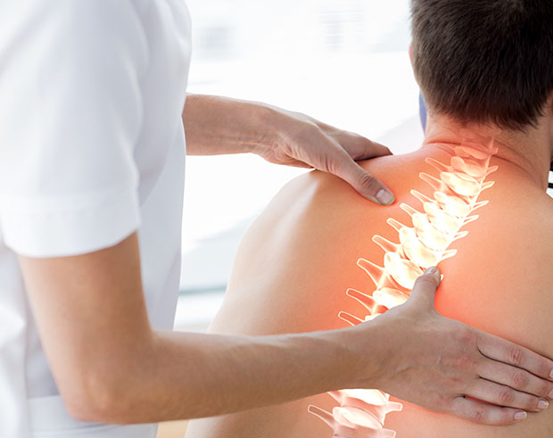
Manual therapy

Slide 2
What is manual therapy?
Passive skilled movement.
Applied to target anatomical structures or systems.
Joint – articular structures.
Muscle and connective tissue - manual stress to these tissues.
Neurovascular - neurovascular bundles.
Also includes diagnostic process, education, and advise.

Slide 3
What is it used for?
Increase management for musculoskeletal pain.
Causes movement in tissues.
Causes structuaral changes.
Reduction in inflammatory.
Decreased spinal pain sensitivity.

Slide 4
Maitlands
One of the most common approaches.
Can be used on both peripheral or spinal joints.
Movements or oscillations are applied to the affected areas.
Grades are used to reduce pain and increase range of motion and stiffness.
Mobilization restores the spinning, gliding and rolling motions.

Slide 5
Gradings
Applied on joints to remove stiffness and improve efficiency of movements.
Grade-I - mobilization is applied with small movements with low resistance.
Useful in treating conditions causing pain.
Grade-II - wider amplitude of movement.
Also used for pain.
Use of grade I and II are used when resistance is applied before the limit of pain.
Grade-III - larger to and fro movements.
Grade IV - movement pushed past end point.

Slide 6
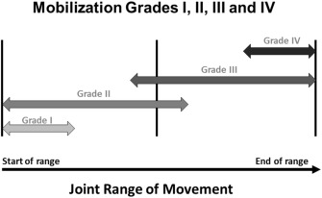

Slide 7
Direction of movements
Lateral Glide - pushing movement laterally
Anterior to posterior (AP) - front to back
Posterior to anterior (PA) - back to front
Longitudinal Caudad – downwards
Longitudinal Cephalad – upwards
Joint Distraction – moving joints away
Medial Glide – pushing movement medially

Slide 8
Contraindications
Neurological impingement.
Some contraindications of Maitlands include:
Early stage of healing (fracture, torn ligament).
Osteoporosis.
Inflammatory condition affecting joint (reumatoid artheritis).
Severe inflammation or infection.

Slide 9
Studies on Maitlands
Done for two days a week for eight weeks.
Study by Shabbir, Maryam, et al. (2021).
30 participants with chronic neck pain into 2 groups.
Maitland mobilization group (study group).
Conventional physiotherapy (placebo group).
Study group – treated by manual therapist.
PA mobilization using Grade I & II on C1-C2.
Lateral PA glide using Grade-III & IV on C3-C6.

Slide 10
Studies on Maitlands
Flexors, extensors, side flexors and rotators.
Placebo group - conventional physiotherapy.
Active exercises-10 repetitions in all direction.
isometrics 5-10 seconds.
brief but maximum contraction.

Slide 11
Studies on Maitlands
Maitland mobilization and manipulation - valuable in improving outcomes.
Results:
Maitland therapy - reduced pain and increased range of motion.
both groups showed decreased in pain over time.
Maitland group - neuro physiological, sympathetic and psychological effects of mobilization.
mechanical and neuro physiological mechanisms - improved range of motion.
Mechanical effects - permanent and temporary changes in length of connective tissues.

Slide 12
Studies on Maitlands
In favour to Maitland mobilisation technique.
Effective in reducing pain.
Improving the ranges of cervical spine.
Statistical difference between the groups.

Slide 13
Is Maitlands effective?
In large favour towards Maitlands.
Shabbir, Maryam, et al. (2021) study.
Positive outcome of Maitlands mobilisations.
Reduced pain and increased range of motion.

Slide 14
Is Maitlands effective?
Incorporate other options in treatment (soft tissue).
Good light for Maitlands.
Shows Maitlands as an effective treatment.
valuable for specific areas for certain needs.
Reduction in pain and increased range.
Only used within joints.
Other treatments for other areas.

Slide 15
References
Bishop, Mark D, et al. “What Effect Can Manual Therapy Have on a Patient’s Pain Experience?” Pain Management, vol. 5, no. 6, Nov. 2015, pp. 455–464, www.ncbi.nlm.nih.gov/pmc/articles/PMC4976880/, https://doi.org/10.2217/pmt.15.39.
Celenay, Seyda Toprak, et al. “Cervical and Scapulothoracic Stabilization Exercises with and without Connective Tissue Massage for Chronic Mechanical Neck Pain: A Prospective, Randomised Controlled Trial.” Manual Therapy, vol. 21, Feb. 2016, pp. 144–150, https://doi.org/10.1016/j.math.2015.07.003.
Hassan, Furqan, et al. “Effects of Oscillatory Mobilization as Compared to Sustained Stretch Mobilization in the Management of Cervical Radiculopathy: A Randomized Controlled Trial.” Journal of Back and Musculoskeletal Rehabilitation, vol. 33, no. 1, 13 Jan. 2020, pp. 153–158, https://doi.org/10.3233/bmr-170914.
Lee, Keun-Su, and Joon-Hee Lee. “Effect of Maitland Mobilization in Cervical and Thoracic Spine and Therapeutic Exercise on Functional Impairment in Individuals with Chronic Neck Pain.” Journal of Physical Therapy Science, vol. 29, no. 3, 2017, pp. 531–535, www.ncbi.nlm.nih.gov/pmc/articles/PMC5361027/, https://doi.org/10.1589/jpts.29.531.
Paterson, Charlotte, and Paul Dieppe. “Characteristic and Incidental (Placebo) Effects in Complex Interventions such as Acupuncture.” BMJ, vol. 330, no. 7501, 19 May 2005, pp. 1202–1205, https://doi.org/10.1136/bmj.330.7501.1202.
Qamar, MuhammadMustafa, et al. “Comparison of Efficacy of Mulligan’s Mobilization with Movement with Maitland Mobilization along with Conventional Therapy in the Patients with Knee Osteoarthritis: A Randomized Clinical Trial.” Libyan International Medical University Journal, vol. 3, no. 1, 2018, p. 26, https://doi.org/10.4103/liuj.liuj_12_18.
Shabbir, Maryam, et al. “Clinical Outcomes of Maitland Mobilization in Patients with Myofascial Chronic Neck Pain: A Randomized Controlled Trial.” Pakistan Journal of Medical Sciences, vol. 37, no. 4, 22 Apr. 2021, www.ncbi.nlm.nih.gov/pmc/articles/PMC8281150/, https://doi.org/10.12669/pjms.37.4.4220.

