Slide 1

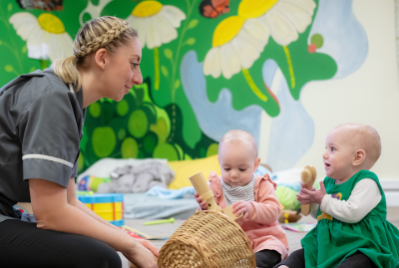
Understanding Early Childhood Development: Supporting Amira through Attachment Theory
Student Name: Mariyam Rubah
Student ID: 2321256
Module Code: LCHS4010
Assignment Title: Individual Presentation
Lecturer Name: Neale Haddon
Submission Date: 13 Oct 2025
Notes:
Hello everyone, My presentation is focused on Amira’s case a 3-year old girl who is reluctant playing with other children, has limited communication and feel anxious when apart.

Slide 2
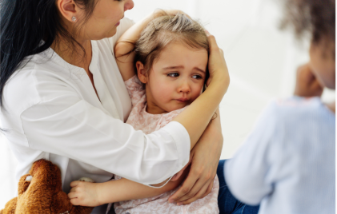
Introduction
Case study of Amira a 3 year-old.
Signs include reluctant in playing with other children, limited communication and feeling anxious when apart.
For her case, Bowlby's Attachment Theory is more relevant because it consider both the nature (biology) and nurture (environment).
Notes:
Amira is showing common signs of early separation anxiety and social problems.. Among the given theories in assignment brief I have found Bowlby's Attachment Theory is more relevant to understand Amira's behavior and make plans to support her development in the nursery.

Slide 3
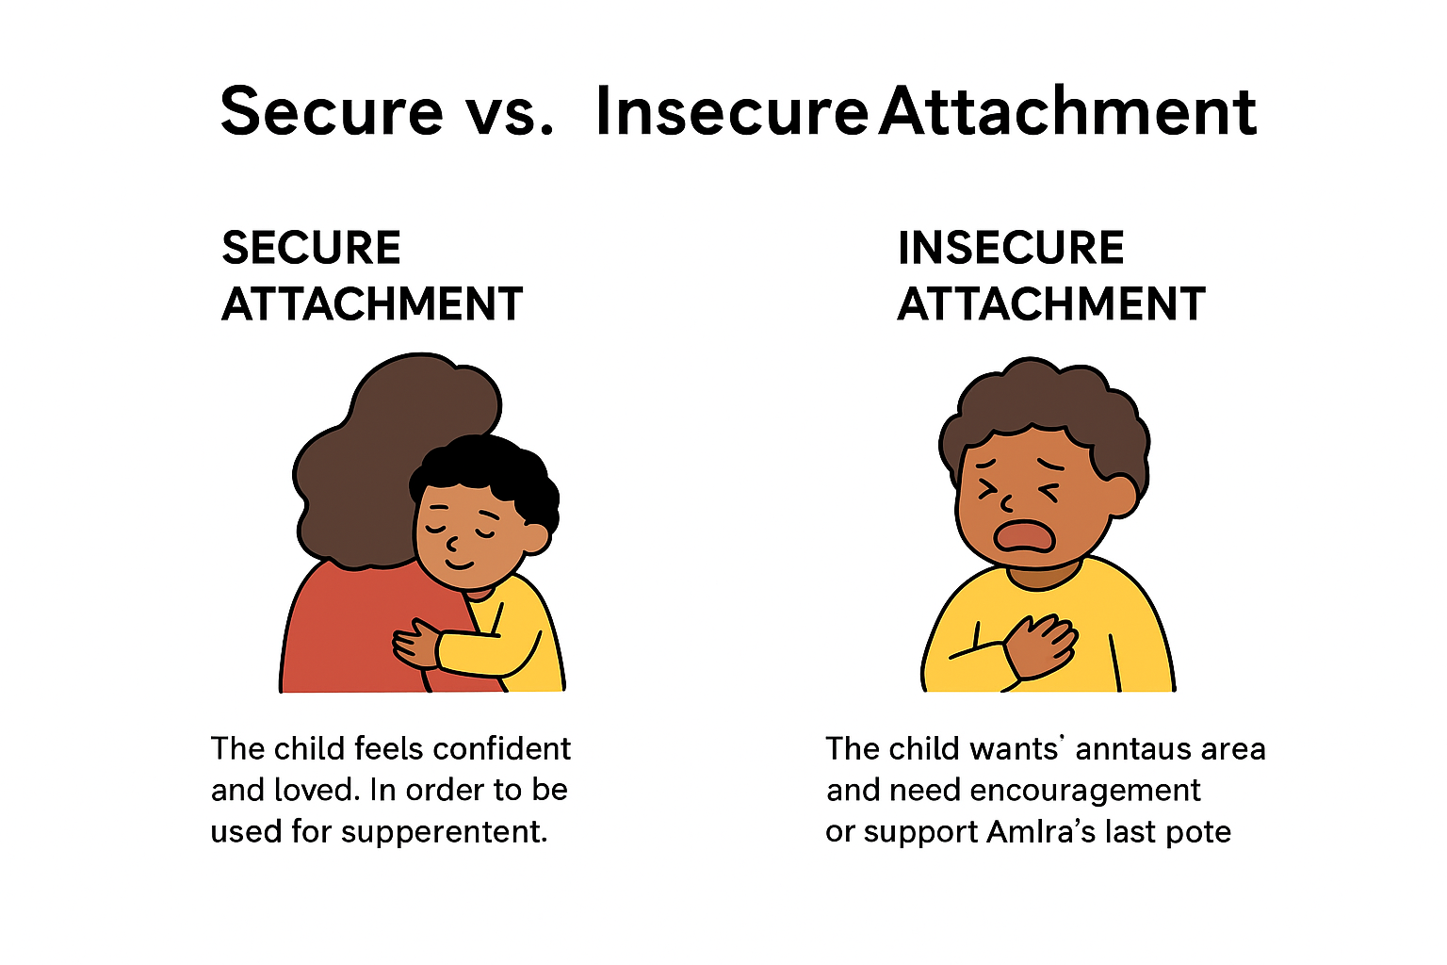
Overview of Bowlby’s Attachment Theory
According to John Bowlby (1969), connection is a survival strategy and a biological requirement.
Emotional stability and cognitive and social growth are two benefits of secure connection.
Pertinent to the early years as separation issues are typical between the ages of two and three.
Notes:
According to Bowlby’s theory, being attached to others is really important for survival. At Amira's age, having a stable connection is important for building good relationships and confidence.

Slide 4
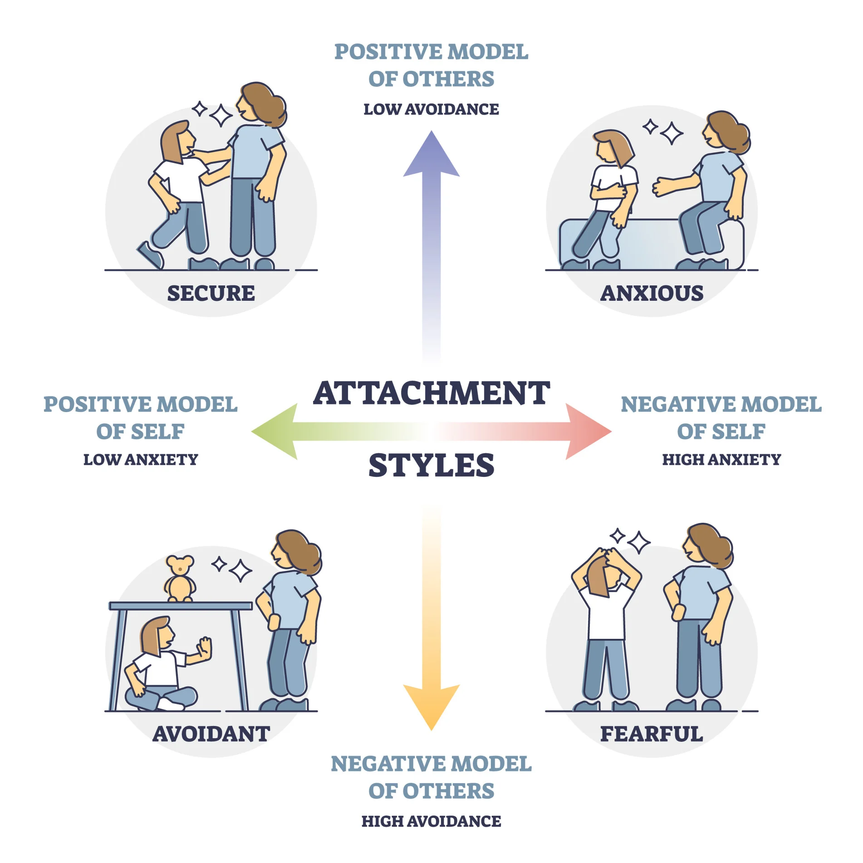
Major Concepts
Important period for attachment (0–5 years) (NHS, 2025).
Attachment styles: secure vs. insecure as shown in a picture
Internal Working Model: early ideas about relationships
The idea of maternal deprivation (Ainsworth et al., 1978)
Notes:
Bowlby focused on how important the early years are for forming close connections, different kinds of attachment styles, and how these early relationships affect our future ones.

Slide 5
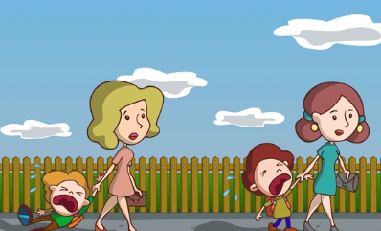
Implementation to Amira’s Case
Fear of caretakers leaving => potential unstable attachment.
Insufficient verbal communication may be a sign of stress or a lack of social confidence.
Group play struggles lead to a lack of social and emotional stability.
Take into account both environmental (home routines, caregiver-child interactions) and biological (temperament, brain development) aspects (Bretherton, 1992; Opie et al., 2021).
Notes:
Amira might feel nervous and have trouble playing in groups because she doesn't feel secure in her relationships. Her behavior is shaped by her natural personality and the stability of her environment.

Slide 6

Practical Strategies (Interventions)
Developing trust in the nursery needs a reliable caregiver staff (Cassidy and Shaver, 2016).
Strategies for gradual parting (phased settling-in).
Apply play therapy and get involved in Small-group interactions.
Implement practices which involves story telling, singing, modeling in order to encourage language development in children.
Get involve parents in regular meetings and discuss child’s progress.
STEP 3
STEP 2
Notes:
Finding a dependable keyworker for Amira, slowly starting to separate her from her main caregiver, and helping her use language through play and stories are all practical strategies. It will also help to work closely with her family.

Slide 7


Assessing Attachment Theory
Strengths: Clearly explains Amira's behavior, including her fear of being away from people and her trouble with socializing. strong research on early childhood education and development.
Weaknesses: The mother is seen as the most important person to connect with. ignores the differences in how cultures are connected. The Vygotsky (1978) theory may explain this better because according to him children engage with more experienced people to acquire and develop language thinking and social skills.
Notes:
Amira's anxiousness can be well explained by attachment theory, but her speech difficulties and cultural background cannot be well explained by it. In contrast, Vygotsky (1978) suggested that children engage with more experienced people—like peers or adults—in their social and cultural surroundings to acquire and develop language, thinking, and social skills.

Slide 8

Conclusion
Amira's feelings and social issues can be explained by attachment theory.
Support programs that help create secure attachments are likely to be helpful.
Her development is shaped by both nurture (carer interactions) and nature (natural personality).
Notes:
Bowlby's hypothesis, in summary, helps us understand Amira's needs. Although both nature and nurture play a role in her growth, at this point, her surroundings and connections will have the most influence.

Slide 9
Any Questions
I would be happy to Answer

Slide 10
References
Ainsworth, M. D., Blehar, M. C., Waters, E., and Wall, S. (1978) Patterns of attachment: A Psychological study of the strange situation. Hillsdale, NJ: Erlbaum.
Bowlby, J. (1969) Attachment and Loss, Vol. 1: Attachment. Attachment and Loss. New York: Basic Books.
Bretherton, I. (1992) ‘The Origins of Attachment Theory: John Bowlby and Mary Ainsworth’, Developmental Psychology, 28, 759-775.
Cassidy, J. and Shaver, P. R. (eds.) (2016) Handbook of attachment theory, research, and clinical applications, Third edition. New York: Guilford Publications.
Opie, J. E., McIntosh, J. E., Esler, T. B., et al. (2021) ‘Early childhood attachment stability and change: a meta-analysis’, Attachment & human development, 23(6), 897–930.
VYGOTSKY, L. S. (1978) Mind in Society: Development of Higher Psychological Processes (M. Cole, V. Jolm-Steiner, S. Scribner, & E. Souberman, Eds.). MA: Harvard University Press.
NHS (2025). Child developmental milestones. Available at: https://cambspborochildrenshealth.nhs.uk/child-development-and-growing-up/milestones/ (Accessed 2 October 2025).

Slide 11
THANK YOU
SLIDE

