Slide 1
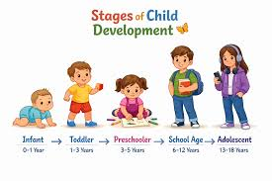
Understanding Early Childhood Development: Application of Erikson's Psychosocial Theory
Module:
Psychology in Health and Social Care
(LCHS4010)
name: Aisma Bibi
(2225758)
Lecture: Alice Clayton

Slide 2
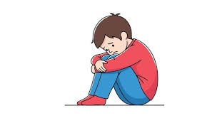
Scenario and Context
Understanding Isaac's Development Through Erikson's Theory
Role: Trainee Early Years Support Worker contributing to a multi-agency early help plan.
Child Profile: Isaac, aged 4, has experienced maternal post-natal depression, disrupted childcare, and limited social support.
Key Concerns: Separation distress, social withdrawal, language delay, and difficulty joining group activities.
Chosen Theory: Erikson's Psychosocial Theory: focusing on confidence, independence, and social development (Kroger, 2022).
Presentation Aim: To apply Erikson's theory to understand Isaac's needs and develop evidence-based support strategies (Masten, 2021; Syed and McLean, 2023).
Stock, 2020

Slide 3
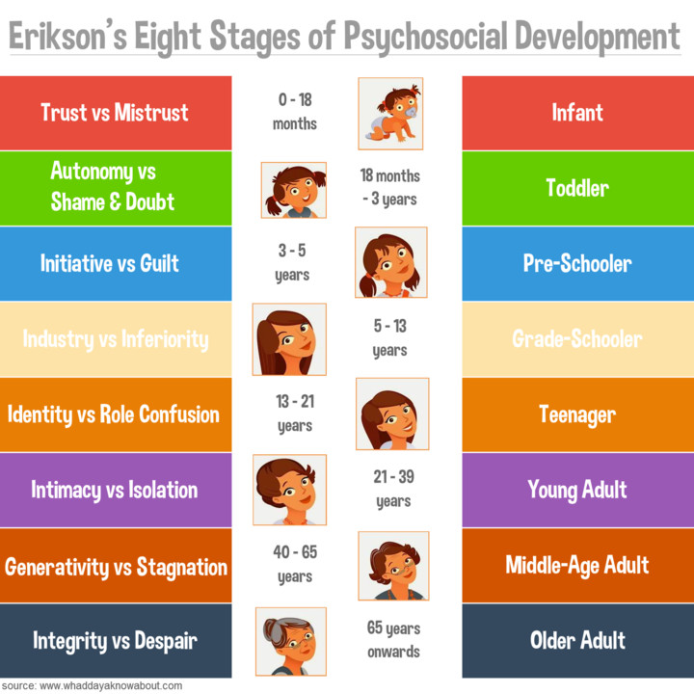
Introduction to Erikson's Psychosocial Theory
Introduction to Erikson's Psychosocial Theory
Developed by Erikson, who proposed that development occurs through a series of psychosocial stages (Kroger, 2022).
Each stage involves a developmental challenge that influences future wellbeing and behavior.
Isaac is in the Initiative vs Guilt stage (3–6 years), where children develop confidence, independence, and a sense of purpose (Newman and Newman, 2021).
Key Concepts
Psychosocial Development
Initiative
Guilt
Purpose
Social Relationships
Developmental Assumptions
Development is shaped by social experiences and relationships.
Successful resolution of each stage promotes healthy development and wellbeing (Syed and McLean, 2023).
(Div, 2015)

Slide 4
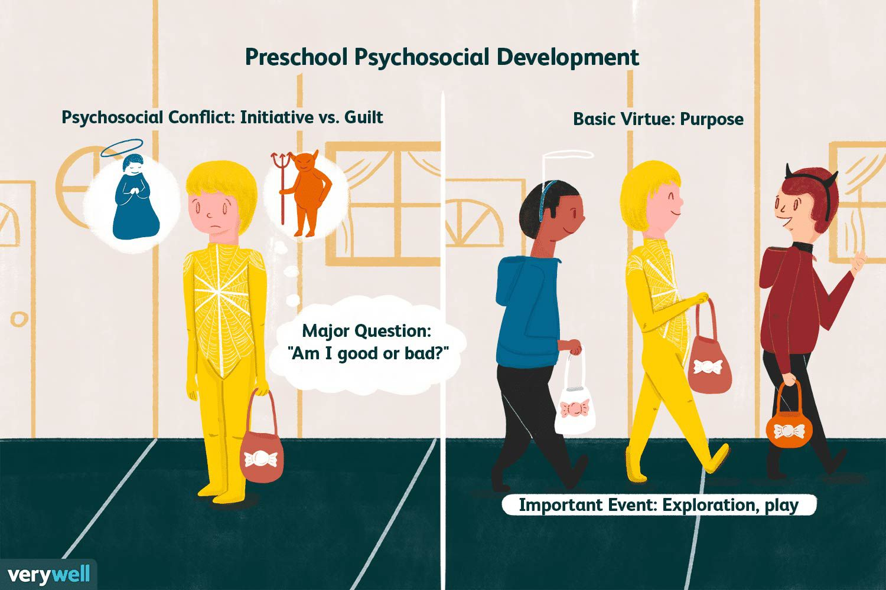
How Erikson's Theory Works and Why It Is Relevant to Isaac
Initiative vs Guilt (3–6 Years)
Children develop confidence by exploring, playing, and interacting with others (Newman and Newman, 2021).
Positive encouragement helps children develop initiative, independence, and a sense of purpose.
Repeated difficulties or lack of support may lead to guilt, self-doubt, and reduced confidence (Kroger, 2022).
Why It Is Relevant to Isaac
His social withdrawal may indicate reduced confidence in initiating interactions.
Separation distress may limit independence and exploration.
Language delay may affect participation in play and communication with peers.
Difficulty joining group activities may hinder the development of initiative and social competence (Syed and McLean, 2023).
Developmental Implications
Without appropriate support, Isaac may develop low self-esteem, reduced participation, and poor social confidence.
(Cherry, 2026)

Slide 5
Applying Erikson's Theory to Isaac's Experiences
Isaac's Experience | Erikson's Concept | Possible Impact on Development
Maternal post-natal depression | Support and encouragement | Reduced confidence and emotional security (Masten, 2021)
Disrupted childcare | Stability in relationships | Difficulty developing trust and independence (Bornstein, 2022)
Social withdrawal | Initiative vs Guilt | Reduced participation in play and social activities (Kroger, 2022)
Separation distress | Developing independence | Reluctance to explore without reassurance (Newman and Newman, 2021)
Language delay | Social competence | Lower confidence when communicating with others (Syed and McLean, 2023)
Clingy behaviour | Initiative development | Reduced autonomy and self-confidence (Dunkel and Harbke, 2023)

Slide 6
Erikson-Informed Multi-Agency Support Plan
Need Identified | Strategy and Professional Involved | Link to Erikson's Theory
Separation distress | Key worker approach (Early Years Practitioner) | Consistent support builds confidence and security needed for initiative (Newman and Newman, 2021).
Social withdrawal | Small-group play activities (Nursery Staff) | Encourages social participation and initiative through positive peer experiences (Kroger, 2022).
Language delay | Storytelling and language-rich activities (SALT and Nursery Staff) | Supports confidence in communication and social interaction (Denham, 2022).
Low confidence | Praise and positive reinforcement (All Practitioners) | Promotes a sense of purpose and achievement rather than guilt (Syed and McLean, 2023).
Emotional regulation | Feelings discussions and emotion coaching (Family Support Worker) | Helps children manage emotions and develop psychosocial wellbeing (Masten, 2021).
Parent support | Parenting support and positive modelling (Health Visitor) | Strengthens supportive relationships that encourage independence (Bornstein, 2022).
Complex needs | Multi-agency reviews (SALT, Health Visitor, Early Help Team) | Provides consistent support across settings to promote healthy development (Sameroff, 2023).

Slide 7
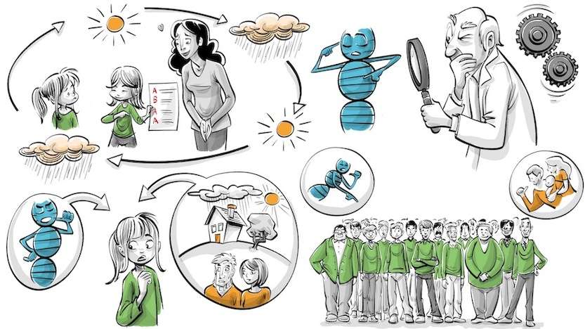
Nature and Nurture Influences
Nature (Biological Factors) | Nurture (Environmental Factors)
Temperament may influence how Isaac responds to stress, change, and new situations (Shonkoff, 2021). | Maternal post-natal depression may affect emotional support and confidence building (Masten, 2021).
Early brain development influences emotional regulation, communication, and social behavior (Center on the Developing Child, 2022). | Disrupted childcare arrangements may reduce stability and opportunities to build positive relationships (Bornstein, 2022).
Some children are naturally more sensitive and require additional reassurance during transitions (Sameroff, 2023). | Relocation and limited social support may reduce opportunities for social interaction and play (Denham, 2022).
Combined Influence
Erikson believed that children's psychosocial development is shaped by both individual characteristics and social experiences.
Isaac's confidence, independence, and social participation are influenced by the interaction between his biological traits and environmental experiences.
(Koblin, 2022)

Slide 8
Critical Evaluation of Erikson's Theory
Strengths
Explains how early social experiences influence confidence, independence, and emotional wellbeing (Kroger, 2022).
Highly relevant to Isaac's difficulties with social participation, confidence, and separation from his mother (Masten, 2021).
Provides practical guidance for early years practitioners to promote initiative through positive experiences and encouragement (Newman and Newman, 2021).
Limitations
Development may not occur in fixed stages as Erikson suggested (Syed and McLean, 2023).
Limited focus on attachment relationships, which may also influence Isaac's behaviour (Bornstein, 2022).
Does not fully explain language development and communication difficulties (Denham, 2022).
Alternative Theory: Bowlby's Attachment Theory
Bowlby's theory may better explain Isaac's separation anxiety and clingy behaviour through the importance of early attachment relationships (Ahnert, 2022).
Erikson, however, provides a broader understanding of confidence, initiative, and social participation.
Cultural and Contextual Considerations
Expectations of independence and social participation vary across cultures and family backgrounds.
Practitioners in London's diverse communities should adapt support to meet individual family values and circumstances (Sameroff, 2023).

Slide 9
Conclusion
Erikson's Psychosocial Theory provides a valuable framework for understanding Isaac's emotional, social, and developmental needs.
His experiences of disrupted childcare, maternal mental health difficulties, and limited social support may affect his confidence, independence, and participation.
Theory-informed, multi-agency interventions can help Isaac develop initiative, resilience, and positive social relationships.
With consistent support and encouragement, Isaac can achieve positive psychosocial and developmental outcomes.

Slide 10
REFERENCES
Ahnert, L. (2022) Child care and family relationships in early childhood development. Cham: Springer.
Bornstein, M.H. (2022) ‘Cultural approaches to parenting and child development’, Current Opinion in Psychology, 43, pp. 8–13.
Denham, S.A. (2022) ‘Social and emotional learning in early childhood: Foundations for positive adjustment’, Early Education and Development, 33(5), pp. 713–728.
Dunkel, C.S. and Harbke, C.R. (2023) ‘Erikson’s lifespan theory and contemporary developmental psychology’, Journal of Adult Development, 30(2), pp. 95–104.
Kroger, J. (2022) Identity development through adulthood: An Eriksonian perspective. 4th edn. Oxford: Oxford University Press.
Masten, A.S. (2021) Ordinary magic: Resilience in development. New York: Guilford Press.
Newman, B.M. and Newman, P.R. (2021) Theories of human development. 3rd edn. New York: Routledge.
Sameroff, A. (2023) The transactional model of development: How children and contexts shape each other. Washington, DC: American Psychological Association.
Shonkoff, J.P. (2021) ‘Building a new bio developmental framework to guide the future of early childhood policy’, Child Development, 92(1), pp. 1–18.
Syed, M. and McLean, K.C. (eds.) (2023) The Oxford handbook of identity development. Oxford: Oxford University Press.

