Slide 1
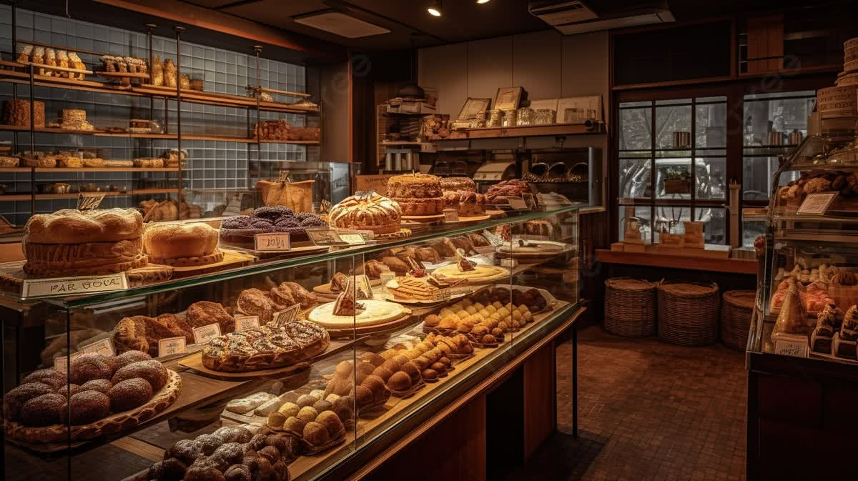
Student Name: Irfan Sabir
Student ID: 2507088
Lecturer’s Name: Bohdan Kovalov
Module Code: LCLM 4004
Module Name: Problem Solving and Decision-Making
Component 1: Basil’s Bakery PowerPoint presentation

Slide 2
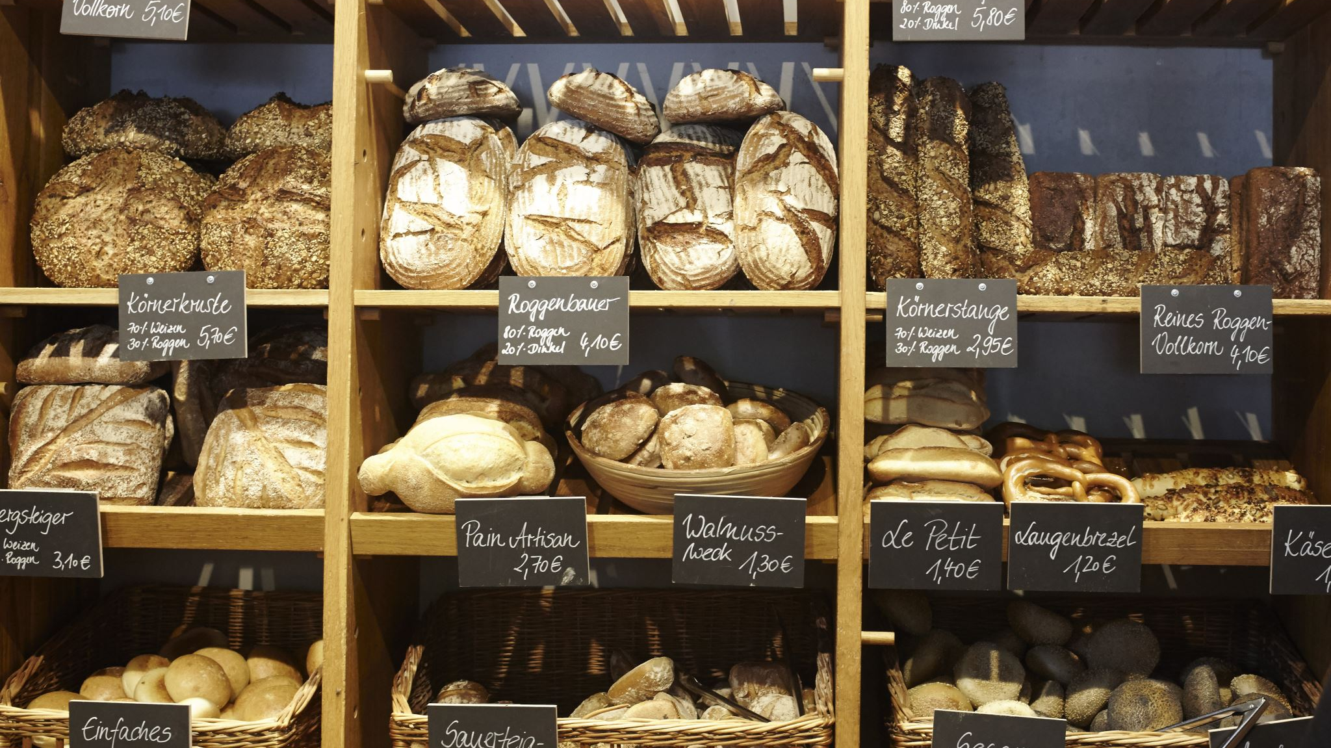




Introduction and Case Study Overview
Small independent bakery in a retail park in Coventry
Established in 2015
Produces cakes, pastries and bread using organic ingredients
Previously experienced year-on-year sales growth
Sales fell significantly during COVID-19 restrictions in 2020
Sales improved afterwards but remained around 25% below 2019 levels between 2023–2025
PESTEL Analysis – Critique, explanation and application to Basil’s Bakery
Cause-and-Effect Analysis – Critique, explanation and application using a Fishbone Diagram
Key Findings – Summary of the main issues affecting sales and business growth

Slide 3

Background of Basil’s Bakery
Business background
Small independent bakery located in a retail park in Coventry
Established in 2015
Produces cakes, pastries and bread using organic ingredients
Experienced year-on-year sales growth before 2020
Change in business performance
Sales fell significantly during the COVID-19 restrictions
Sales improved after restrictions were lifted
However, sales remained around 25% below 2019 levels between 2023–2025
Changing business environment
The retail park has become less busy
Several neighboring businesses have closed
More office workers now work from home
Some loyal customers have lost their local jobs
Current business pressures
Operating costs have increased
Organic ingredient prices are unpredictable
Customers have requested greater convenience, such as delivery and pre-ordering

Slide 4


Insight into the Problems
Main Problem: Stagnation in Sales
Sales remain around 25% below 2019 levels
The bakery has not returned to its previous level of sales growth
External Problems — Limited Control
Reduced footfall in the retail park
Closure of neighbouring businesses
Changes in local employment
Increase in home/hybrid working
Changes in customer spending patterns
Unpredictable cost of organic ingredients
Internal Problems — Greater Control
Limited ability to process pre-orders
No current delivery service
Heavy dependence on physical customer visits
Increased operating expenses a

Slide 5
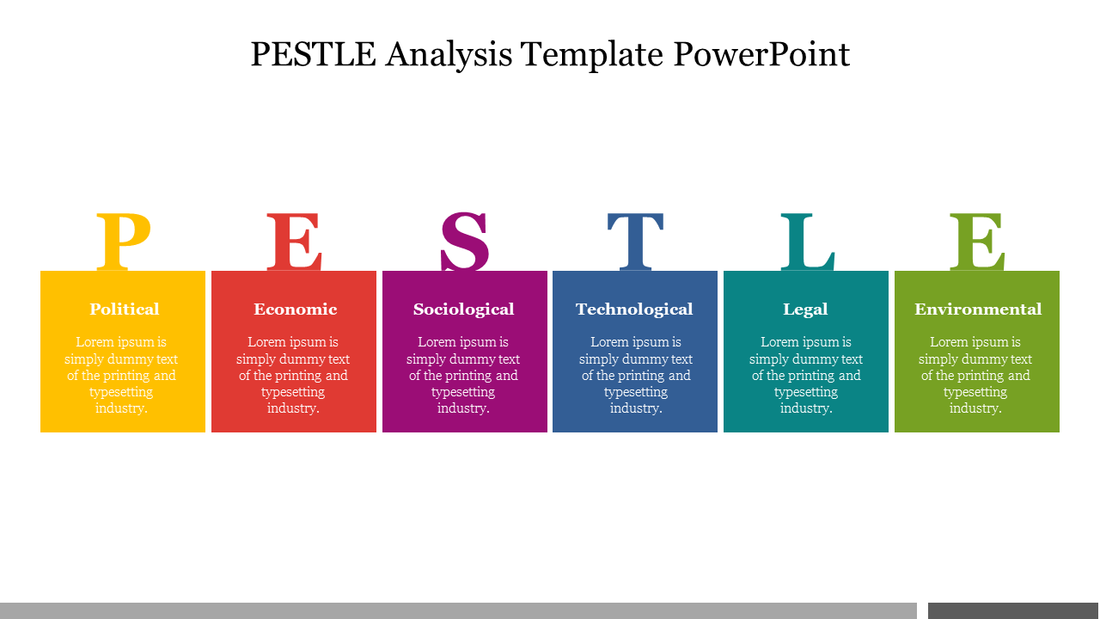
Critique of PESTEL
PESTEL is a strategic framework used to analyse the external macro-environment of a business
Examines six factors:
Political
Economic
Social
Technological
Environmental
Legal
Helps businesses understand external factors that may influence their performance and decisions (Whittington et al., 2023)
Why and where is it used?
Used in strategic planning and business analysis
Helps organizations understand changes in their wider environment
Can be applied to different businesses, industries and markets
Benefits:
Provides a structured approach to analyzing external factors
Helps identify potential opportunities and threats
Supports strategic decision-making
Encourages businesses to consider factors beyond their immediate operations (Whittington et al., 2023)
Limitations / Criticisms:
Can oversimplify complex external issues
Does not show how different factors interact with each other
External conditions can change quickly, making analysis outdated
Does not directly tell a business which action to take
Should therefore be used alongside other business analysis tools

Slide 6
political
Government policies, taxation and business rates can influence Basil’s operating costs and profitability.
Economic
social
Changing working patterns are reducing customer footfall. 28% of working adults in Great Britain hybrid worked between January and March 2025, which supports the case study’s concern about fewer office workers visiting the retail park. (ONS, 2025) (Office for National Statistics)
technology
Environment
Legal
Higher rent, utilities, insurance and business rates are increasing overheads. Unpredictable organic ingredient costs also make budgeting difficult.
basil currently has limited digital ordering options. Customers asking for pre-orders and delivery indicates that technology and digital services are becoming relevant to the bakery's customer experience.
As a food business, Basil must comply with food safety and legal requirements. UK guidance confirms that food businesses must register with their local authority, including businesses that prepare, sell or distribute food. (Food Standards Agency, 2026) (GOV.UK)
basil's commitment to organic ingredients supports environmental values, but organic produce can be more vulnerable to crop failure, contributing to unpredictable stock costs.
PESTEL analysis helps managers systematically examine external political, economic, social, technological, environmental and legal factors that may affect an organisation and support strategic decision-making.(sproull,2018

Slide 7
Critique of Cause-and-Effect
.
.
What is the Cause-and-Effect Model?
A structured problem-solving tool used to identify possible causes of a specific problem.
Also known as a Fishbone Diagram or Ishikawa Diagram.
It shows the relationship between a problem and the different factors that may contribute to it (Kumah and Forkuo-Minka, 2023).
Benefits
Provides a clear and visual way to organise possible causes.
Encourages systematic thinking about a problem.
Helps identify multiple contributing factors.
Supports discussion and further investigation of the problem.
Why and Where is it Used?
Used to investigate problems and identify their possible root causes.
Commonly used in quality management, business and organisational problem-solving.
It helps users examine a problem from different categories rather than focusing on one possible cause
Limitations / Criticisms
It identifies possible causes but does not prove which cause is responsible.
The diagram can become complicated when too many causes are in01cluded.
Findings can depend on the knowledge and judgement of the people creating the diagram.
It does not provide solutions by itself and may need to be combined with other analysis methods.
Cause-and-effect analysis helps managers identify the possible causes of a problem; however, its effectiveness depends on the accuracy of the information collected, as identifying possible causes does not necessarily prove that they are the actual causes (Proctor, 2014,p.111).

Slide 8

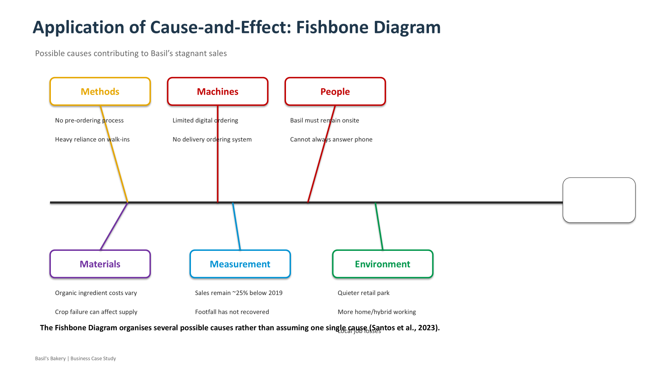
Stagnant Sales25% below 2019 levels

Slide 9
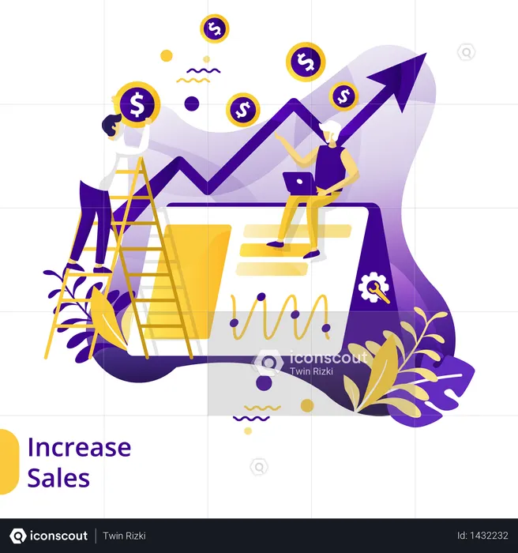
Key Findings
Sales stagnation: Sales remain around 25% below 2019 levels.
External pressures: A quieter retail park, increased home/hybrid working and changes in local employment have reduced customer footfall.
Business pressures: Higher operating costs and unpredictable organic ingredient costs are putting pressure on the bakery.
Internal limitations: Lack of pre-ordering and delivery options, together with limited ability to answer the phone, may affect customer convenience.
Overall finding: Basil’s stagnant sales are caused by a combination of internal and external factors, rather than one single problem.

Slide 10
Reference list
Food Standards Agency (FSA) (2026) Food business registration. Available at: https://www.gov.uk/guidance/food-business-registration
(Accessed: 6 October 2026).
Kumah, A. and Forkuo-Minka, A. O. (2023) ‘Advancing staff safety: assessment of quality improvement interventions in reducing needlestick injuries among staff at Nyaho Medical Centre’, Global Journal on Quality and Safety in Healthcare, 6(2), pp. 55–61. doi: 10.36401/JQSH-22-16.
Office for National Statistics (ONS) (2025) Who has access to hybrid working in Great Britain? Available at: https://www.ons.gov.uk/employmentandlabourmarket/peopleinwork/employmentandemployeetypes/articles/whohasaccesstohybridworkingreatbritain/2025-06-11
(Accessed: 6 October 2026).
Proctor, T. (2014) Creative problem solving for managers: developing skills for decision making and innovation. 4th edn. London: Routledge.
Santos, G., Sá, J. C., Félix, M. J., Carvalho, F. and Lopes, M. P. (2023) ‘Determining which of the classic seven quality tools are in the quality practitioner’s RCA tool kit’, Cogent Business & Management, 10(1), p. 2199516. doi: 10.1080/23311916.2023.2199516.
Sproull, B. (2018) The Problem-Solving, Problem-Prevention, and Decision-Making Guide: Organized and Systematic Roadmaps for Managers. New York: Productivity Press.
Whittington, R., Regnér, P., Angwin, D., Johnson, G. and Scholes, K. (2023) Exploring Strategy: Text and Cases. 13th edn. Harlow: Pearson.`

