Slide 1
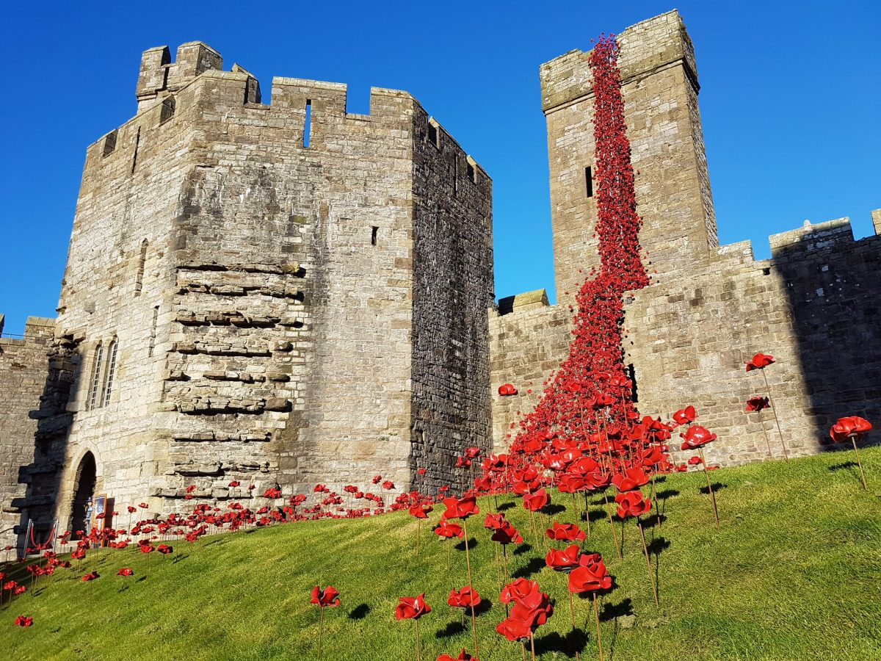
Event Design and Delivery
Week nine
The Business and Marketing Environment for events

Slide 2
Last week
Event bidding
Elements of a feasibility study
Creating and evaluating the concept
Designing the ‘experience’

Slide 3
Session Outcomes
Identifying an audience
Demand/motivation for events (consumer and organiser) how has this changed?
Matching the consumer to the event experience
Internal and external analysis

Slide 4
Reminder –
Attendee Motivations
We need to understand why people attend or participate in events and how this information can support decision making for promotional activity and consumer satisfaction

Slide 5
The Importance of Understanding Attendee Motivation
The range of motives impacts upon event attendance
Facilitates decision making regarding effective event promotion and programming of activities
Meet expectations resulting in customer satisfaction
Relevance to marketing other activities and products

Slide 6
Event Motives
Examples of Social Motives - Social interaction with others - Creation of community spirit - Status or recognition of achievement - Philanthropy or charitable contributions | Examples of Organisational Motives - The need to make sales - The need to have organisational presence - Status or recognition - Sponsorship or community support
Examples of Physiological Motives - Relaxation or recognition with others - Exercise or physical challenge - To eat, drink or be entertained | Examples of Personal Motives - Seeking new experiences - Learning and education - Creativity and exploration - Fulfilment of ambitions
Adapted from McDonnell et al (1999) cited in Shone & Parry (2011, p.27)

Slide 7
Determinants for participation in an event (the ‘buying process’)
Whether your friends might go (cultural, personal or other reference groups)
What decision making time is available, or what lead time is there before you have to buy a ticket?
Whether the price is a major concern (‘price sensitivity’ – high cost, low cost, total package and value for money)
Whether the event will be good enough – the perceived quality of the event
Access factors e.g. local, regional, national, international; do people in your area go to this type of event? How easy is it to get to? What are the opening times?

Slide 8
Determinants for participation in an event (the ‘buying process’) cont…
One off or repeat sales opportunities – is this annual, biannual, occasional? Will the event happen again, or is this the only opportunity to go?
Familiarity – people’s knowledge and awareness: have they been to one before, or something similar?
Propensity to join in community activities (high, low)
Inclination to join in the activity due to personal interest, education, entertainment, relaxation, status, etc.
Considerations of personal enjoyment, arousal or other satisfaction from the event
Shone & Parry (2011, p.150)

Slide 9
Task
Based on this, would you attend Christmas street food Friday at Unit Nineteen on 7th December?
Why?/Why not? What effects your decision-making?

Slide 10
Consumer decision-making process for events
Needs
Physical
Esteem of others
Self-actualisation
Adapted from Getz (1997) cited in Raj (2009, p.95)
Motives
Seeking and escaping
Personal / interpersonal
Expectations of Benefits
Past experience
Word of mouth
Communications
Alternatives
Stay at home
Other leisure choices
Other events
Constraints
Time and money
Knowledge
Social factors
Other barriers
Decision to Attend

Slide 11

Theories of Event Motives
The needs achievement hierarchy (Maslow)
‘Push’ and ‘pull’ motives
Intrinsic motives for leisure
Axelsen and Arcodia (2004) cited in Bowdin et al (2006, p.195)

Slide 12
Task
Research – identify a creative event you are interested in/work on you assignment event idea
What is the event? What is its aim and objectives
Who is it for?
How is it designed to ‘match’ the audience, creating ‘experiences’ but maximising opportunity – turning idea to innovation and entrepreneurship
Yeoman – does the event tap in to one of Yeoman’s 10 trends?
Has the event included elements of ‘creative consumption’.

Slide 13
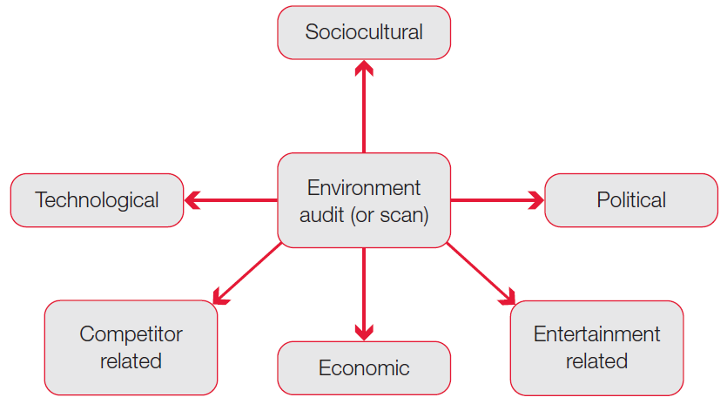
Analysing event environments
Figure 9.4 Components of the environment analysis

Slide 14
Task
For your assignment idea, use the previous model to conduct an external analysis
Now conduct an internal analysis (SWOT) to identify key issues for the event and the destination (marketing, operational/resources, financial
See http://www.swansea.gov.uk/dmp

Slide 15
Marketing Planning for Events
Applying the marketing concept to festivals and special events
Understand how event consumers can be segmented into markets
Understand the consumer decision process for festivals and events
Apply the principles of services marketing in creating marketing strategies and tactics for events and festivals

Slide 16
What is marketing?
Marketing is concerned with satisfying consumer needs and wants by exchanging goods, services or ideas for something of value
Event marketing is the process by which event managers and marketers gain an understanding of their potential consumers’ characteristics and needs in order to produce, price, promote and distribute an event experience that meets those needs, and the objectives of the event

Slide 17
Why have a Marketing Plan?
Relates to feasibility and ultimate success of the event
Knowledge of target market: demographics, age group, past events experience
  Who will come?!
Consideration of competing events
Unique selling proposition (USP)

Slide 18
An event marketing plan?
Plan the event ‘service–product’ experience, including its programming and packaging
Develop event pricing strategies or other entry options for special events
Create strategies for place/distribution, physical setting and event processes that respond to consumer needs
Apply the knowledge generated into an effective and efficient marketing plan

Slide 19
Marketing – not just publicity
Marketing principles and techniques provide a framework for decision making
Sponsoring bodies need reassurance that their sponsorship is linking their brand with their target markets
All levels of government require a demonstration of marketing expertise before committing funding
Events must compete against other leisure activities

Slide 20
More marketing theories
Events as ‘service experiences’
The delivery and consumption of an event are inseparable
Because of the immediacy of service consumption, event experiences can have variations in quality each time it is held
Events are intangible
Events have credence qualities – characteristics that consumers aren’t able to understand or evaluate
The event experience is perishable

Slide 21
Positioning the event
Existing reputation or image
Charisma of director
Focus on event programming
Focus on performers
Emphasis on location or facilities
Event users
Price or quality
Purpose or application
Event category

Slide 22
Packaging the event
Strategies to package different types of entertainment, food and beverage, and merchandise as a single market offer (a service bundle)
Strategies to package the event with accommodation, transport and other attractions in the vicinity

Slide 23
People and partnerships
Sense of sharing a common vision pervades the team of staff, volunteers and sponsors behind successful events
Principles of relationship marketing and management may be applied with a range of event or festival stakeholders
The people element in marketing events extends to building relationships with the residents where an event is staged

Slide 24
Pricing
Event managers should account for two cost categories when setting the price strategy for the event:
  Fixed costs (those that do not vary with volume of visitors, i.e. venue rental, power costs)
  Variable costs (those that do vary with volume of visitors, i.e. catering costs, staffing costs)

Slide 25
Market Selection
Questions to be asked:
  What is the existing and potential demand for your event?
  How many people do you expect?
  What types of people are most likely to be interested/attracted?
  What are their needs/motives?
  What are the expected spending patterns? (packages, admission, merchandise)

Slide 26
Market Selection (Cont.)
Analyse the needs of the target market to establish your event ‘product’
  (design/experience/delivery)
Research any competitive events that could satisfy similar needs
  Helps devising/refining USP
Predict how many will attend and at what time they are likely to attend
Consider profile of customers and what they might be willing to pay

Slide 27

Segmentation
Market segmentation is the process of identifying your target market. Some factors to consider:
Geographic - location
Demographic – population and population trends
Psychographic – life style, values, opinions personality characteristics, interests
Behavioural - brand loyalty, volume usage and price sensitivity

Slide 28
Reading to support your work…
Borland, J. and MacDonald, R. (2003) Demand for Sport Oxford Review of Economic Policy, Volume 19, Number 4, pp. 478-502
Bouchet, P., Bodet, G., Bernache-Assollant., I Kada, F., (2011) Segmenting sport spectators: Construction and preliminary validation of the Sporting Event Experience Search Sport Management Review, Volume 14, Issue 1, pp. 42 - 53

Slide 29
The pitch!
https://www.youtube.com/watch?v=Lb0Yz_5ZYzI
Tips for the 30 second pitch
https://www.youtube.com/watch?v=Njh3rKoGKBo
TEDx Presentation (30 mins)

Slide 30
Cont.
Bowdin, G., Allen, J., O’Toole, W., Harris, R. and McDonnell, I. (2011) Events Management Elsevier, Oxford – Chapter Eleven
Raj, R., Walters, P., Rashid, T (2009) ‘Events Management: An Integrated and Practical Approach’ London, Sage – Chapter Seven
Shone, A, and Parry, B (2011) Successful Event Management, a Practical Handbook London, Thomson - Chapter Eight

